Slide 1
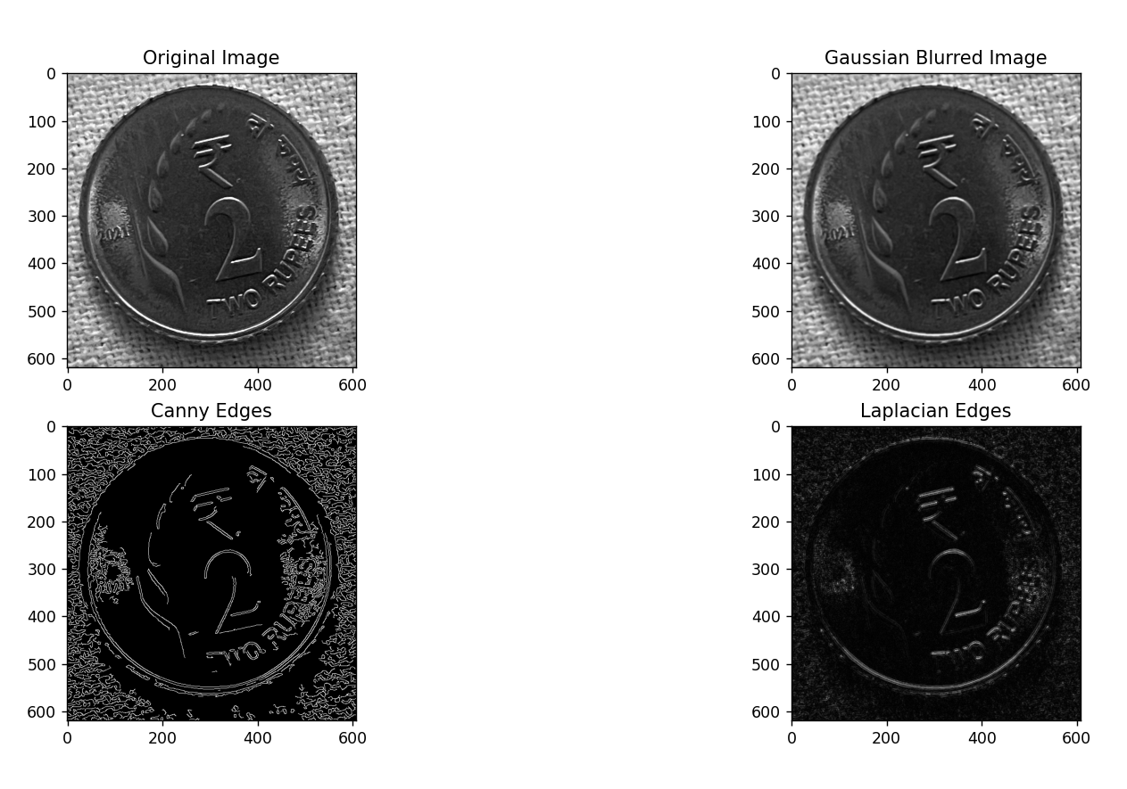
COMPUTER VISION ASSIGNMENT – 1 FACULTY: Dr. Tilottama Goswami EDGE DETECTION Gaussian Operators: Canny, Laplacian
Group no : 8
IT-B
K. Prasanna Reddy (1602-20-737-093)
K. Praneeth (1602-20-737-092)

