Slide 1
CIVICASSIST
Local Government Scheme Assistant using Private RAG & SLM/LLM Inference
A zero-cloud API, offline-capable welfare scheme discovery and eligibility matching platform
Team Members
Anish M – 2303917720521015
Moulesh G S – 2303917720521087
Prasanna T – 2303917720521107
Yogesh T – 2303917720521177

Slide 2
CIVICASSIST · LOCAL GOVERNMENT SCHEME ASSISTANT
Executive Summary & Core Value Proposition
The Problem
• Millions of citizens miss welfare benefits due to fragmented scheme portals.
• Complex jargon and unstructured eligibility guidelines.
• Privacy concerns with uploading sensitive demographic data to cloud LLMs.
• Expensive cloud API costs for civic tech deployments.
CivicAssist Solution
• Local-first RAG architecture built with FAISS and SentenceTransformers.
• Zero cloud dependency — powered by local Ollama models (Phi-3, Gemma, Llama 3.2).
• Interactive Streamlit citizen profile interface.
• Hybrid execution: SLM, LLM, or Retrieval-Only fallback.
Key Highlights
• Complete Data Privacy: No citizen data leaves the device.
• Low Resource Footprint: Runs efficiently on CPU-only machines (4GB+ RAM).
• Factual Grounding: Direct citations to official government source URLs.
• Model Comparison Engine: Real-time evaluation of local models.

Slide 3
CIVICASSIST · LOCAL GOVERNMENT SCHEME ASSISTANT
Problem Analysis & Existing Solution Gap
Challenges in Citizen Welfare Access
1. Information Fragmentation:
Central and State schemes are scattered across hundreds of official websites.
2. Complex Eligibility Rule Matching:
Determining eligibility involves multi-variate constraints (Income, Category, Age, Land holding, State).
3. Hallucination Risk in Public AI:
Generic LLMs frequently hallucinate fake schemes or invalid deadlines.
4. Digital Divide & Infrastructure Limits:
Rural centers need low-cost offline systems without recurring API bills.
Comparative Gap Analysis
• Government Portals (e.g. MyScheme): Static search filter; lack conversational understanding and synthesis.
• Commercial Cloud LLMs (ChatGPT / Claude): Require high-bandwidth internet, paid API keys, and expose user privacy.
• Generic RAG Pipelines: Lack specialized eligibility calculation engines alongside semantic vector search.
-> CivicAssist bridges this gap by combining FAISS vector search, structured eligibility rules, and local SLM inference.

Slide 4
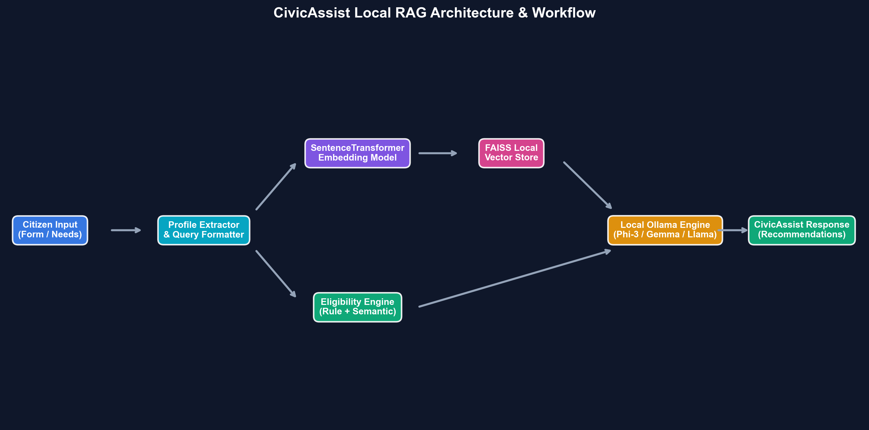
CIVICASSIST · LOCAL GOVERNMENT SCHEME ASSISTANT
System Architecture & Processing Workflow

Slide 5
CIVICASSIST · LOCAL GOVERNMENT SCHEME ASSISTANT
Government Schemes Knowledge Base
Core Scheme Corpus
• PM-KISAN: Direct income support for eligible farmer families.
• Pradhan Mantri Awas Yojana (PMAY): Housing assistance for EWS/LIG households.
• Ayushman Bharat PM-JAY: Cashless health insurance up to ₹5 Lakh/family.
• National Social Assistance Programme (NSAP): Pension for seniors, widows, & disabled.
• Minority & Merit Scholarships: Education fee support.
• Women & Child Development Welfare: Nutrition & family welfare.
Knowledge Vectorization
• Embedding Model: sentence-transformers/all-MiniLM-L6-v2 (384 dimensions).
• Vector Store: Local FAISS IndexFlatL2 for instant L2 distance search.
• Metadata Schema: Stores scheme name, description, eligibility criteria, benefits, category, state, and official source URLs.
• Auto-Indexing: Instant vector store generation on first startup.

Slide 6
CIVICASSIST · LOCAL GOVERNMENT SCHEME ASSISTANT
Rule-Based & Semantic Eligibility Matching Engine
Multi-Factor Eligibility Scoring
Formula: Match Score = (Σ Field Scores / Total Factors) * 100
Weighted Factors:
• Need Category Match (Healthcare, Housing, Agriculture): 100 points
• Social Category Match (General, SC, ST, OBC, Minority): 100 points
• Geographic Alignment (State / All India): 90 points
• Income Qualification Check: +20 bonus points
• Senior Citizen Age Check (>=60 years): +20 bonus points
Dual-Stage Recommendation
Stage 1: Semantic Retrieval (FAISS)
Retrieves Top-K candidate schemes matching the semantic context of citizen needs.
Stage 2: Eligibility Filtering
Ranks candidates by profile likelihood match (0 - 100%).
Threshold >= 55% marks schemes as Recommended.
Result: Eliminates hallucinations by passing ONLY verified matches to the LLM.

Slide 7
CIVICASSIST · LOCAL GOVERNMENT SCHEME ASSISTANT
Model Architecture Strategy: SLM vs LLM Trade-offs
Small Language Models (SLM)
Models: Phi-3 Mini (3.8B), Gemma 2B
Advantages:
• RAM Footprint: < 4-8 GB
• High Speed: ~1.4 - 1.8s response latency
• CPU Friendly: Runs smooth on standard laptops
Trade-off: Concise phrasing, simple synthesis.
Large Language Models (LLM)
Models: Llama 3.2 (3B/8B), Qwen 2.5
Advantages:
• Superior Reasoning: Explains multi-step criteria
• Richer Language: Dynamic citizen advice
Trade-off: Requires 8-16 GB RAM, ~3.6s latency.
Retrieval Only (Fallback)
Models: Zero LLM (Pure FAISS + Rule Engine)
Advantages:
• Ultra-Fast: < 0.15s response
• 100% Deterministic: Zero hallucination risk
• Minimal Hardware: Runs on 4GB RAM CPU
Trade-off: Displays exact scheme cards without conversational synthesis.

Slide 8
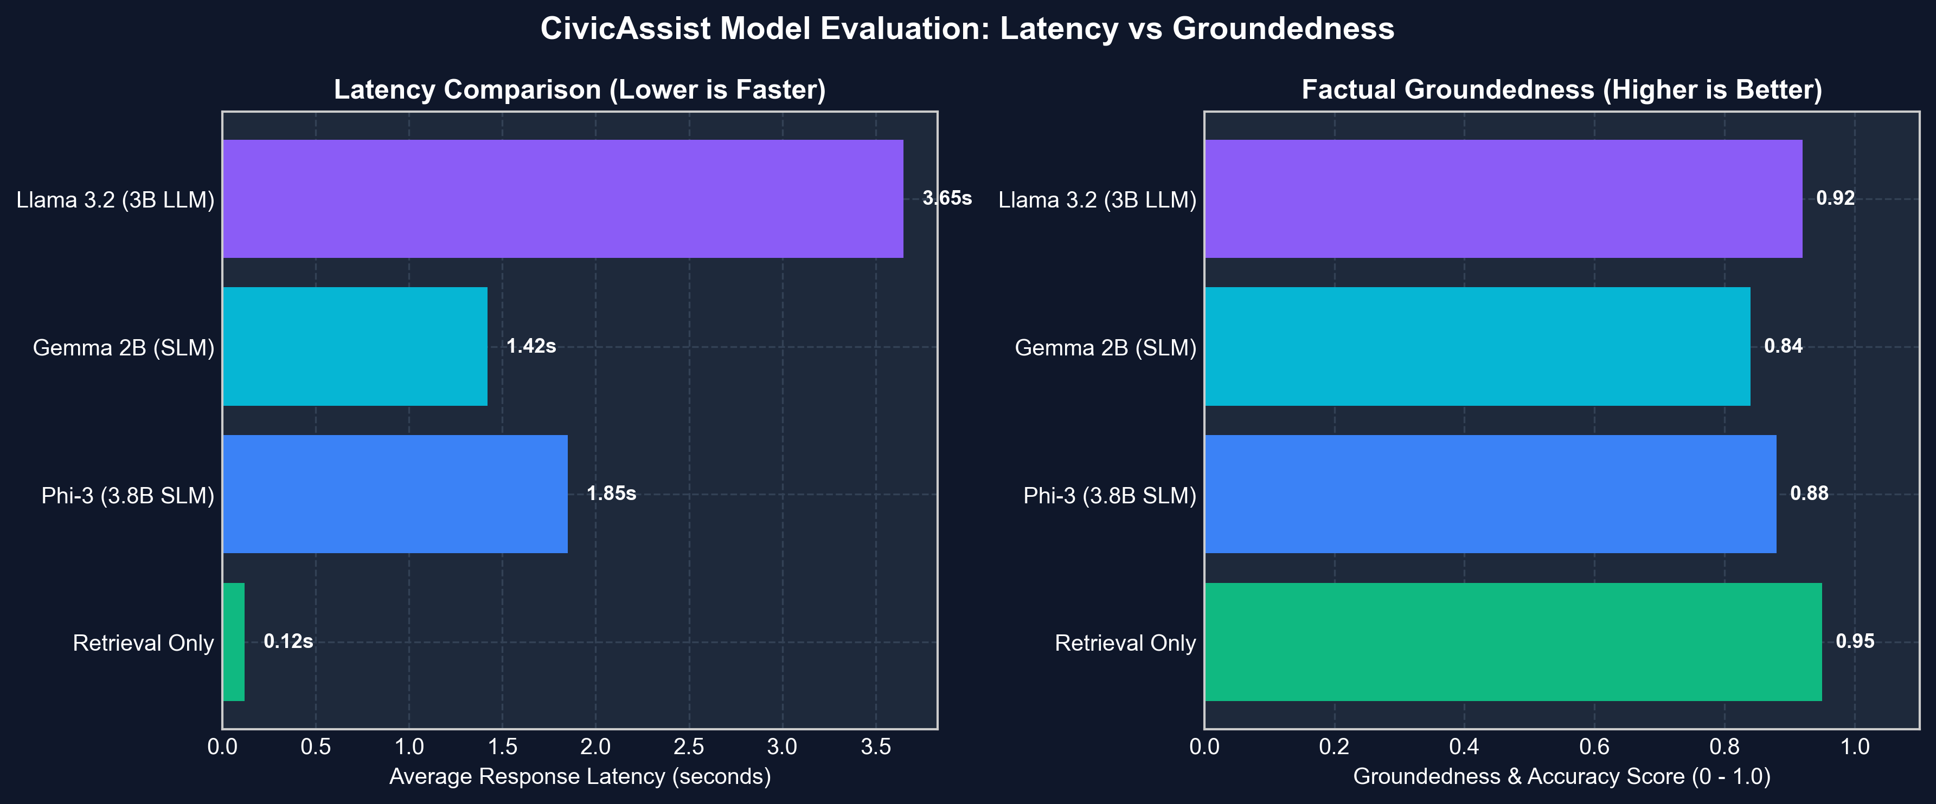
CIVICASSIST · LOCAL GOVERNMENT SCHEME ASSISTANT
Experimental Evaluation & Performance Metrics

Slide 9
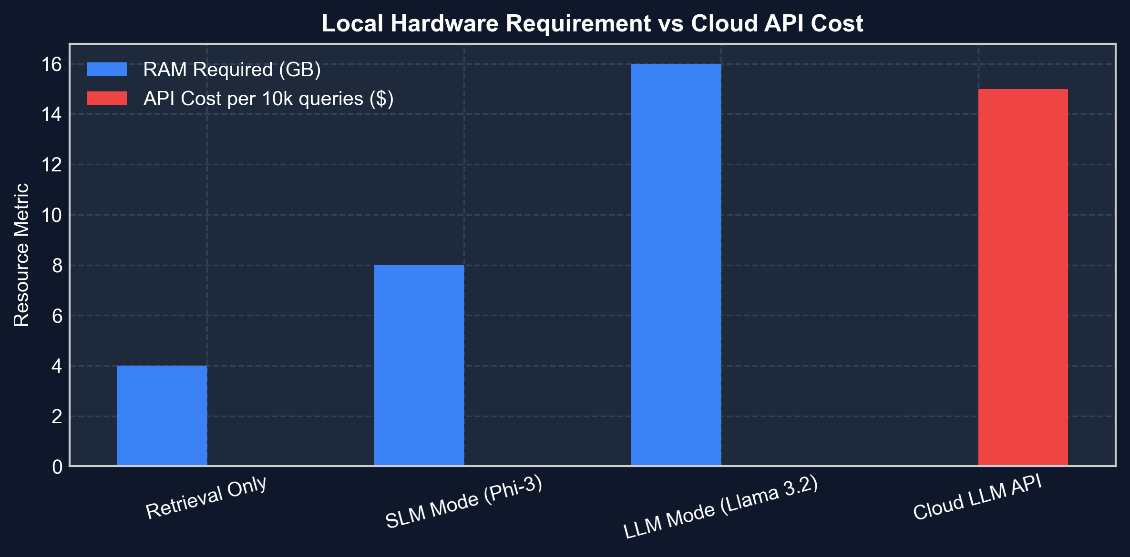
CIVICASSIST · LOCAL GOVERNMENT SCHEME ASSISTANT
Deployment Feasibility & Cost Matrix
Deployment Insights
• Zero Recurring Expenses: Eliminates per-token API charges of commercial models ($15+ per 10k queries).
• Local Hardware Viability: Demonstrated success running on standard consumer hardware (Intel i5/i7, 8-16GB RAM, CPU-only).
• Scalability: Can be packaged as a single desktop installer or local server for rural digital centers (Kiosks/Common Service Centers).

Slide 10
CIVICASSIST · LOCAL GOVERNMENT SCHEME ASSISTANT
Prototype Demonstration & Test Scenarios
TC1: Small Farmer
Profile:
• Age: 42 | Income: ₹15,000/mo
• Occupation: Farmer | State: Karnataka
• Need: Agriculture & Income
Output Match:
• PM-KISAN (95% Match)
• PM-JAY Health Insurance (78% Match)
TC2: Senior Citizen
Profile:
• Age: 67 | Income: ₹8,000/mo
• Occupation: Retired | Need: Pension
Output Match:
• National Social Assistance Programme (NSAP) (92% Match)
• Ayushman Bharat (85% Match)
TC3: Minority Student
Profile:
• Age: 19 | Category: Minority
• Occupation: Student | Need: Education
Output Match:
• Scholarship for Minorities (94% Match)
• Official portal citation provided.

Slide 11
CIVICASSIST · LOCAL GOVERNMENT SCHEME ASSISTANT
Team Division of Responsibilities
Lead Engineer & Research
Moulesh G S & Anish M
Responsibilities:
• Architecture & RAG Pipeline Design
• FAISS Vector Store Integration
• System Validation & Benchmarking
• Documentation & Report Writing
Model & Inference Optimization
Prasanna T
Responsibilities:
• Ollama API Integration & Tag Resolving
• SLM vs LLM Performance Testing
• Memory & Fallback Handling
• Latency Profiling
Frontend & UX Design
Yogesh T
Responsibilities:
• Streamlit UI Layout & Forms
• Citizen Profile Schema
• Scheme Card Components & Source Links
• Error Notifications

Slide 12
CIVICASSIST · LOCAL GOVERNMENT SCHEME ASSISTANT
Conclusion & Future Work Roadmap
Key Findings & Conclusion
1. Local RAG Is Fully Feasible:
Demonstrated accurate government scheme matching without any paid API dependencies.
2. Hybrid SLM/LLM Model Validated:
SLMs (Phi-3) provide the optimal balance of low latency and good summary quality for citizen guidance.
3. Zero Privacy Risk:
Citizen personal data remains strictly local on the client machine.
Future Enhancements
• Live Scheme Scraping: Automated scraping of myscheme.gov.in with active/expired status tracking.
• Multi-Lingual Interface: Voice and text support in Hindi, Kannada, and regional languages.
• Document Requirement Verification: Automated checklist generator for required application documents.
• Offline Mobile App Packaging: Converting system to run on Android via embedded ONNX models.

