Slide 1
GIT

Slide 2
Course Objective
To understand Git version control system and its commands.

Slide 3


Slide 4
Gamification
Objective:
To make the participants familiarize with Git through activity.

Slide 5

Session Plan
About Git
Version Control Systems
Distributed VCS (GIT)
Local Git areas
Git workflow
Creating Git Repo
Git commands
Git commit
Undo changes on file
Viewing history and diffs
Branching
Rebase
Interaction with Remote Repo
Stashing commits

Slide 6

About Git
Created by Linus Torvalds,
creator of Linux, in 2005
– Came out of Linux development community
– Designed to do version control on Linux kernel
• Goals of Git:
– Speed
– Support for non-linear development
(thousands of parallel branches)
– Fully distributed
(Committing code does not require access to a central server)
– Able to handle large projects efficiently
(speed and data size) (13,5 million lines of code)

Slide 7
References
https://www.atlassian.com/git/tutorials
The standard one: http://git-scm.com
Free on-line book: http://git-scm.com/book
Git tutorial: http://schacon.github.com/git/gittutorial.html
From StackExchange: http://stackoverflow.com/questions/315911/git-for-beginners-the-definitive-practical-guide#323764
From github- https://help.github.com/
At command line: (where verb = config, add, commit, etc.)
– git help verb

Slide 8
Version Control Systems
Version control (or revision control, or source control) is all about managing multiple versions of documents, programs, web sites, etc.
Almost all “real” projects use some kind of version control
Essential for team projects, but also very useful for individual projects
Some well-known version control systems are CVS, Subversion, Mercurial, and Git
CVS and Subversion use a “central” repository; users “check out” files, work on them, and “check them in”
Mercurial and Git treat all repositories as equal
Distributed systems like Mercurial and Git are newer and are gradually replacing centralized systems like CVS and Subversion

Slide 9
Why Version Control?
For working by yourself:
Gives you a “time machine” for going back to earlier versions
Gives you great support for different versions (standalone, web app, etc.) of the same basic project
For working with others:
Greatly simplifies concurrent work, merging changes

Slide 10
Centralized VCS
In Subversion, CVS, Perforce, etc. A central server repository (repo) holds the "official copy" of the code – the server maintains the sole version history of the repo
You make "checkouts" of it to your local copy
– you make local modifications
– your changes are not versioned
When you're done, you "check in" back to the server
– your check-in increments the repo's version

Slide 11


Traditional Centralized VC model (CVS, Subversion)
Central Repository
Checkouts & Updates
Commits & Adds

Slide 12
Distributed VCS (Git)
In git, mercurial, etc., you don't "checkout" from a central repo
– you "clone" it and "pull" changes from it
Your local repo is a complete copy of everything on the remote server
- yours is "just as good" as theirs
Many operations are local:
- check in/out from local repo
- commit changes to local repo
- local repo keeps version history
When you’re ready, you can “push” changes back to server.

Slide 13

Distributed version control system (git)
Local
Local
Remote repository
Local
Local
Pulls & Clones
Pushes
Commits & Adds
Notes:
Everything is a branch
Every clone is always a backup
Committing is fast
Working offline also can work

Slide 14
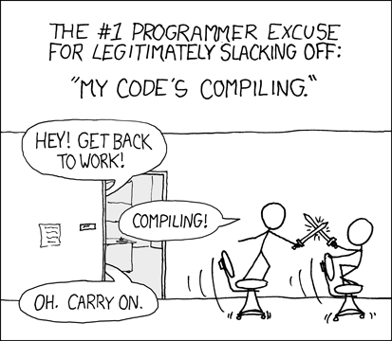
Advantages
Changing branches can be done offline
Other revisions of a file can be obtained
Changes can be commited offline
Merging and Diff can be done offline
”Repo server is down”
Server’s dead

Slide 15
Local Git areas
In your local copy on git,
files can be:
– In your local repo
(committed)
– Checked out and modified,
but not yet committed
(working copy)
– Or, in-between, in a "staging" area
- Staged files are ready to be committed.
- A commit saves a snapshot of all staged state.
Unmodified/modified Staged Committed
Files Files Files

Slide 16
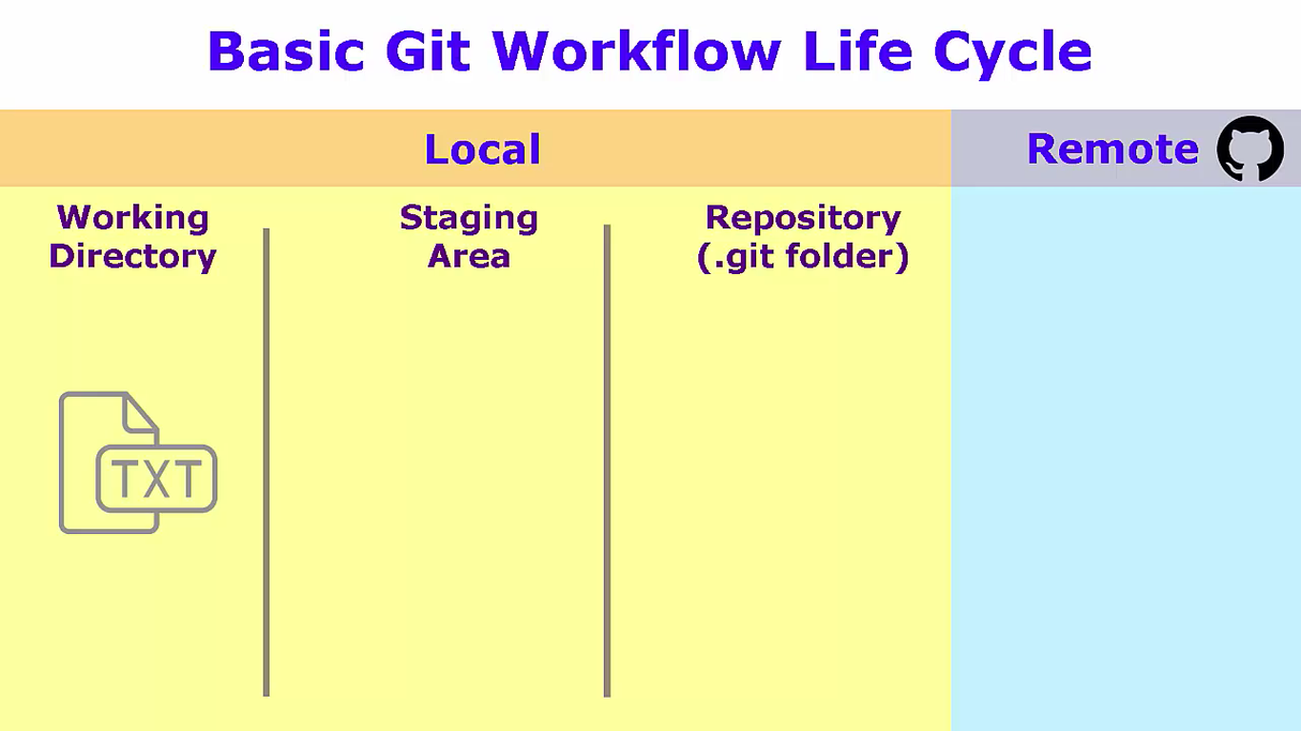
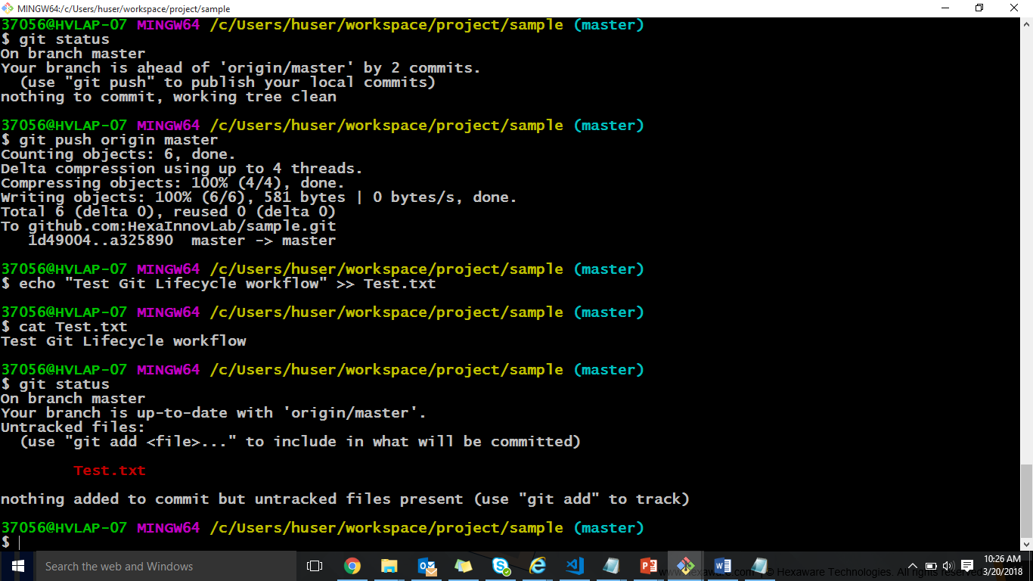
Basic Git Workflow Life Cycle
Modify files in your working directory.

Slide 17
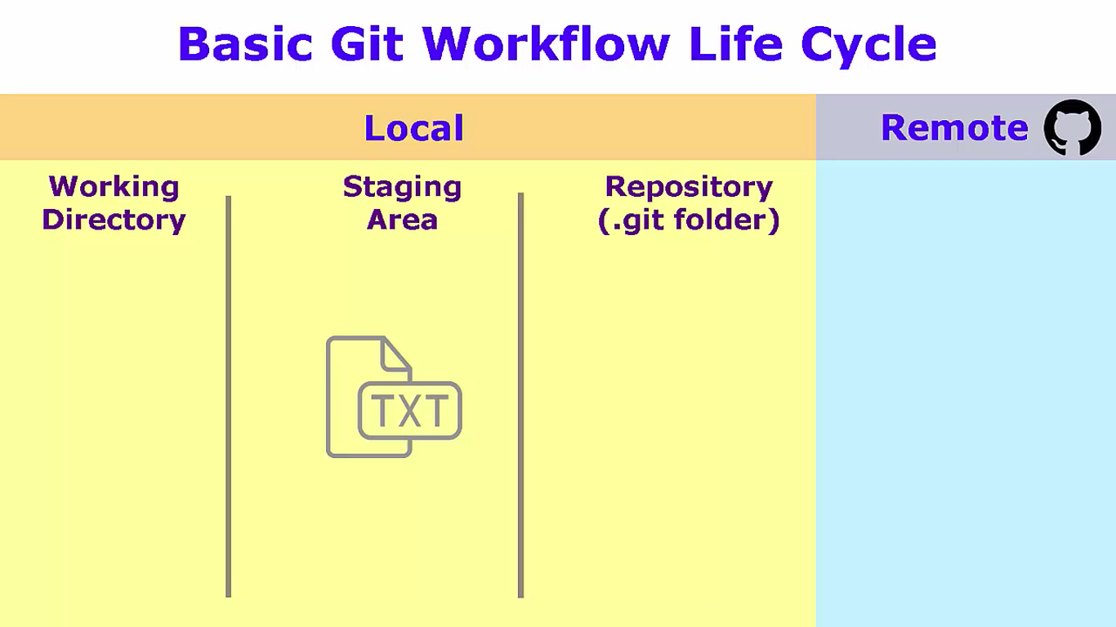
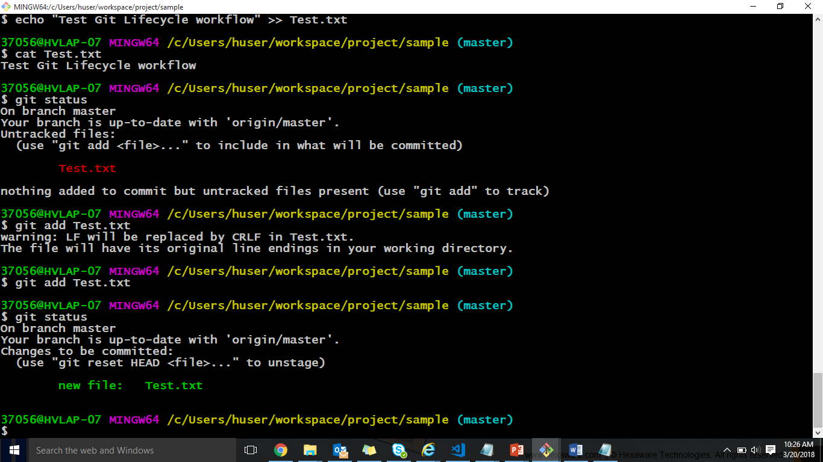
Basic Git Workflow Life Cycle (Cont..)
Stage files, adding snapshots of them to your staging area.

Slide 18
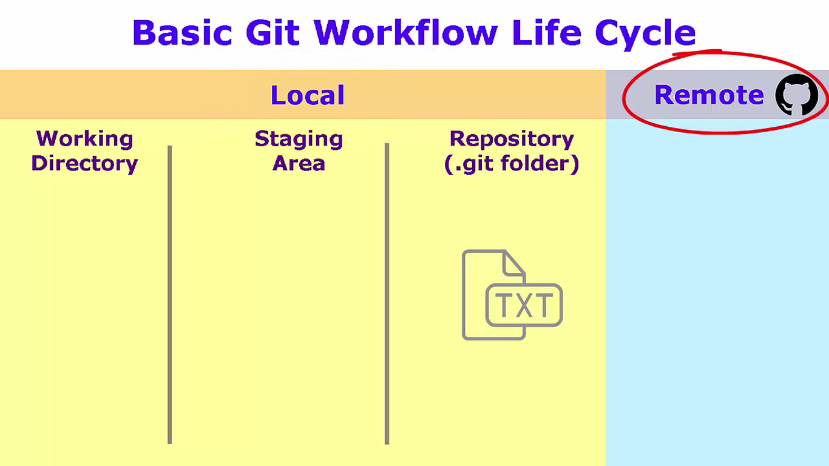
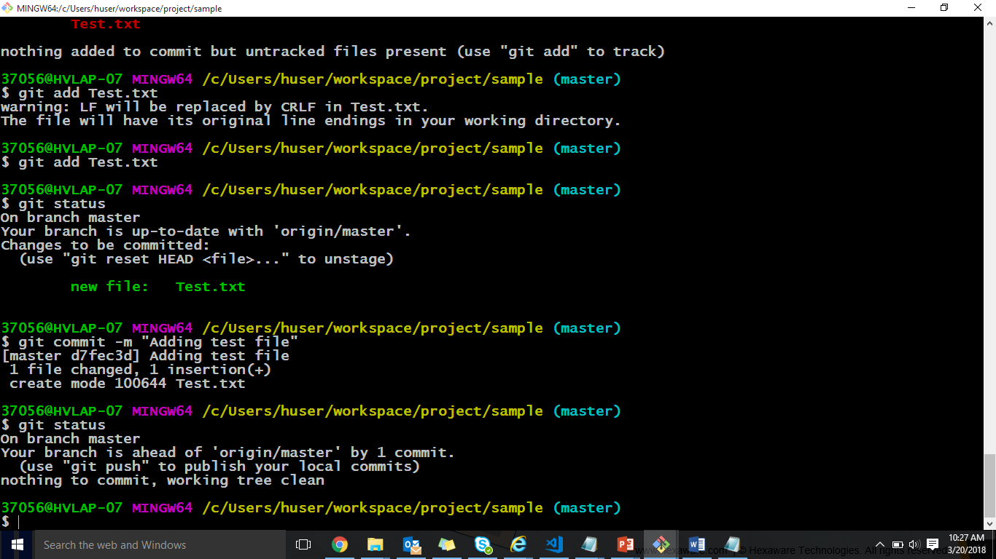
Basic Git Workflow Life Cycle (Cont..)
Commit, which takes the files in the staging area and stores that snapshot permanently to your Git directory.

Slide 19
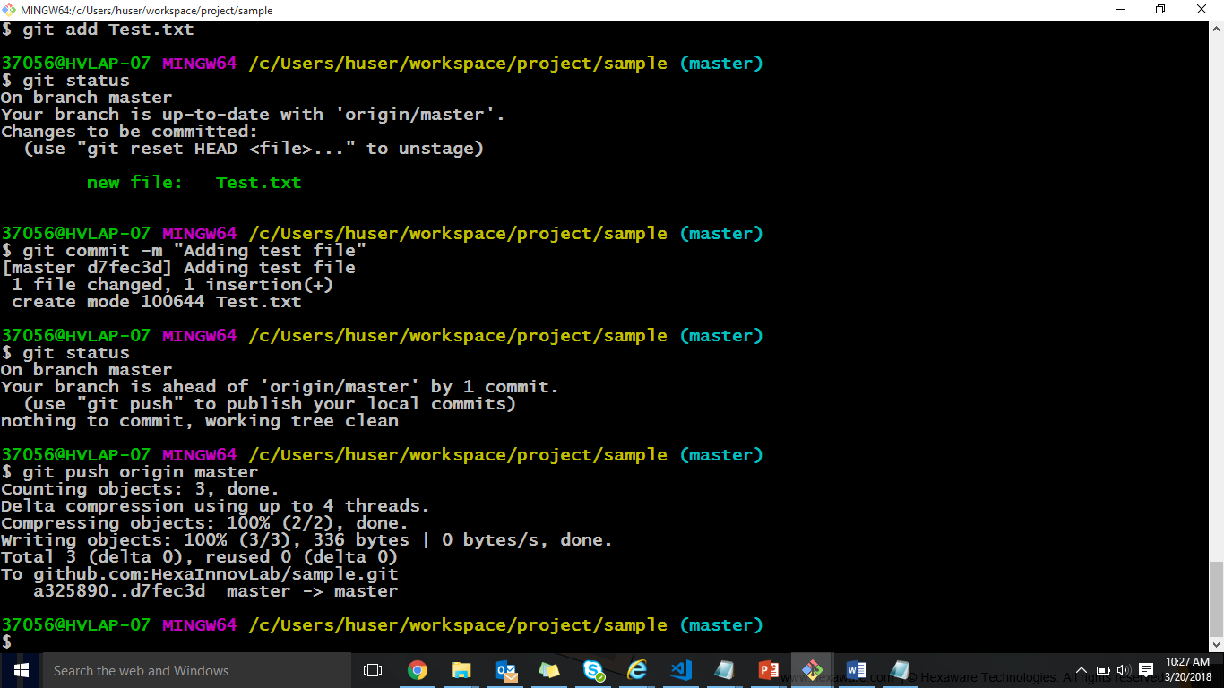
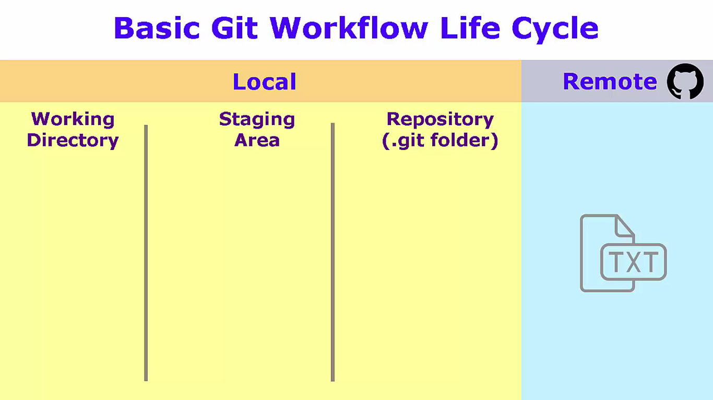
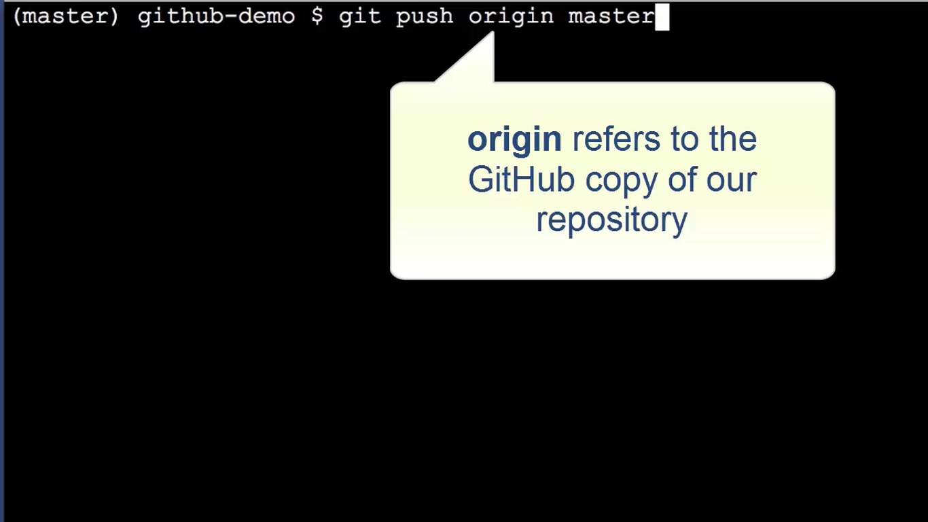
Basic Git Workflow Life Cycle (Cont..)
Push your local changes to the remote repo.

Slide 20
Initial GIT Configuration
Set the name and email for Git to use when you commit:
– git config --global user.name "Bugs Bunny”
– git config --global user.email bugs@gmail.com
– You can call git config –list to verify these are set.

Slide 21
Creating a GIT Repo
Two common scenarios: (only do one of these)
To create a new local Git repo in your current directory:
To clone a remote repo to your current directory:
git init
• This will create a .git directory in your
current directory.
• Then you can commit files in that
directory into the repo.
– git add filename
– git commit –m "commit message“
git clone url localDirectoryName
• This will create the given local directory, containing a working copy of the files from the repo, and a .git directory
(used to hold the staging area and your actual local repo)

Slide 22
GIT Commands
command | description
git clone url [dir] | copy a Git repository so you can add to it
git add file | adds file contents to the staging area
git commit | records a snapshot of the staging area
git diff | shows diff of what is staged and what is modified but unstaged
git help [command] | get help info about a particular command
git pull | fetch from a remote repo and try to merge into the current branch
git push | push your new branches and data to a remote repository
git fetch | imports commits from a remote repository into your local repo.
git revert | is for undoing shared public changes
git reset | Is for undoing local private changes.

Slide 23
GIT Commit
Used to capture a snapshot of the project’s currently staged changes.
git commit
- Commit the staged snapshot.
[This will launch a text editor prompting you for a commit message. After you’ve entered a message, save the file and close the editor to create the actual commit.]
git commit –a
- Commit a snapshot of all changes in the working directory
git commit –m “commit message”
- A shortcut command that immediately creates a commit with a passed commit
message.

Slide 24
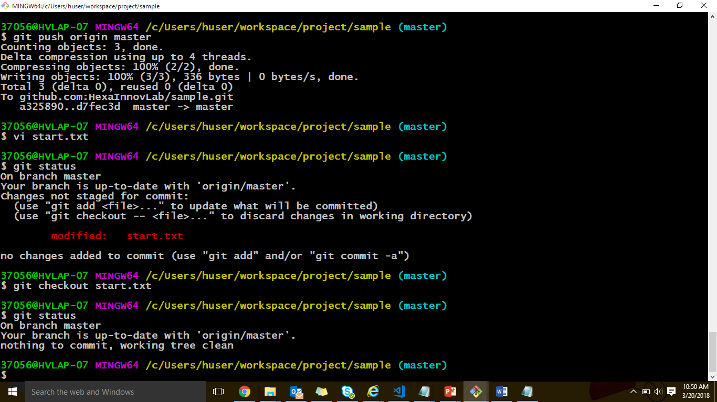
Undo changes on a file
• To undo changes on a file before you have committed it:
– All these commands are acting on your local version of repo.
– git checkout -- filename
(undoes your changes)

Slide 25
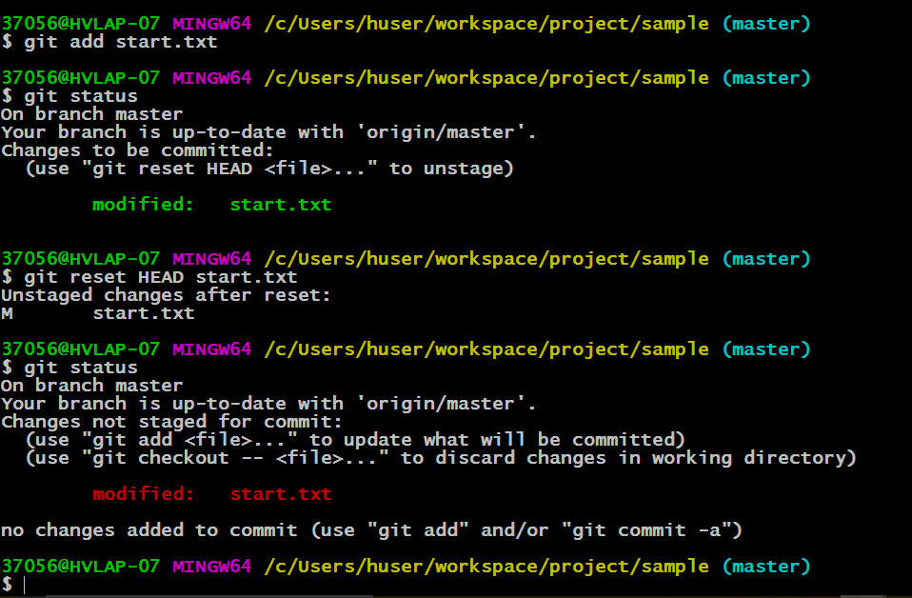
Undo changes on a file (cont.)
- git reset HEAD – filename
(unstages the file)

Slide 26
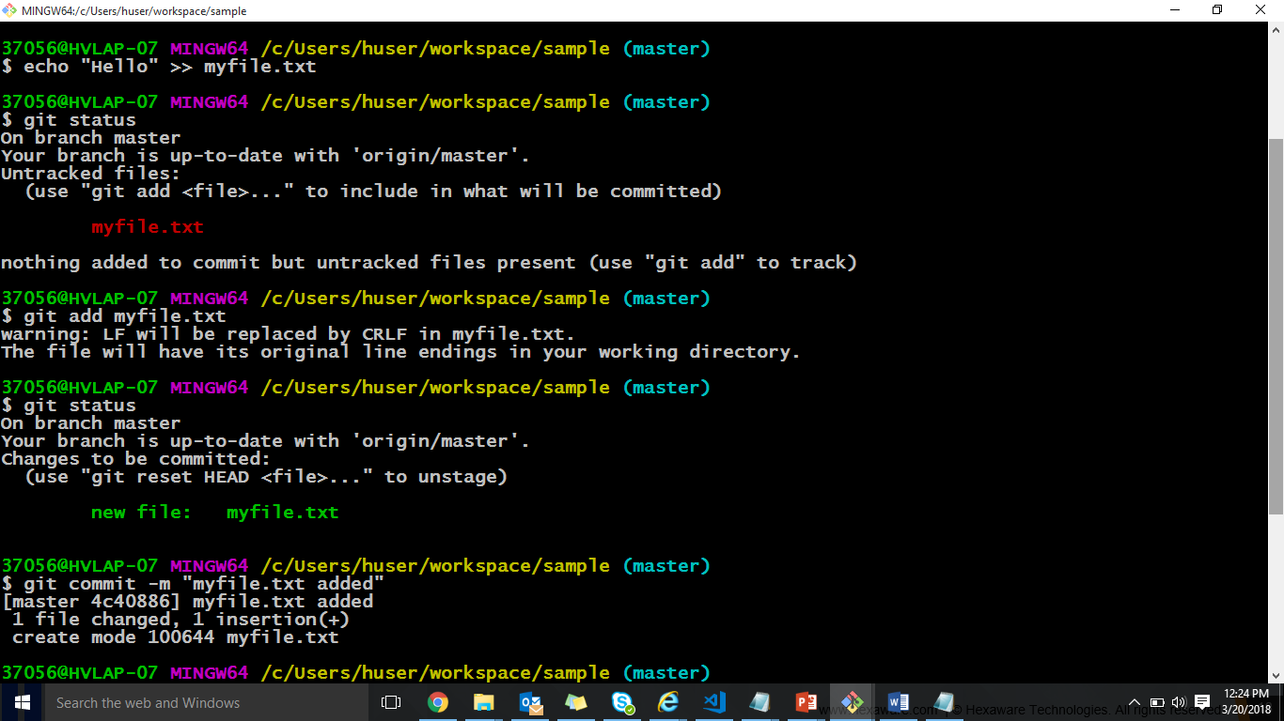
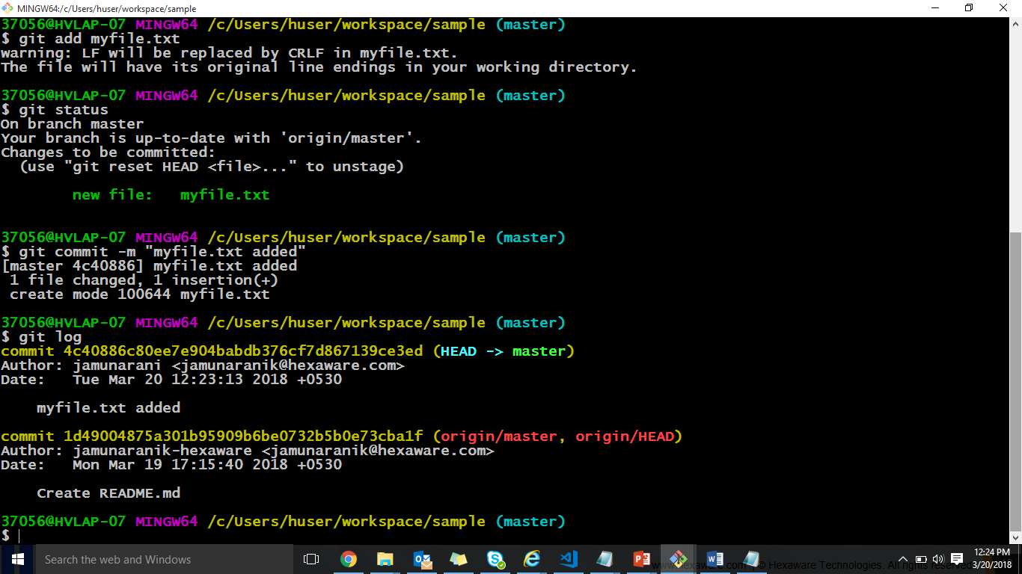
Viewing History and diffs
•
Git log:
Used to see the history of commits.

Slide 27
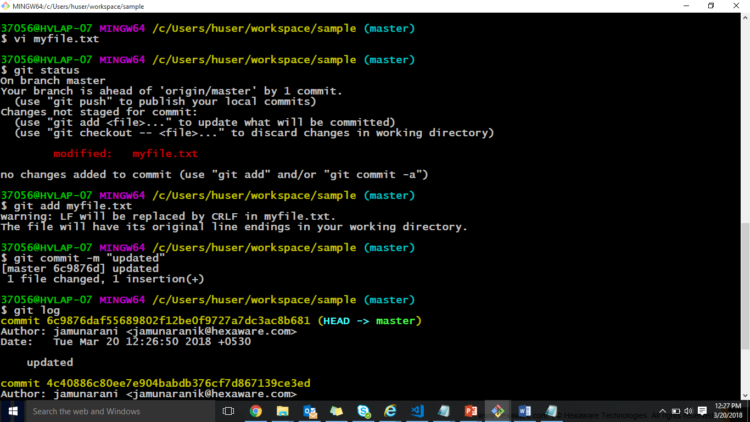
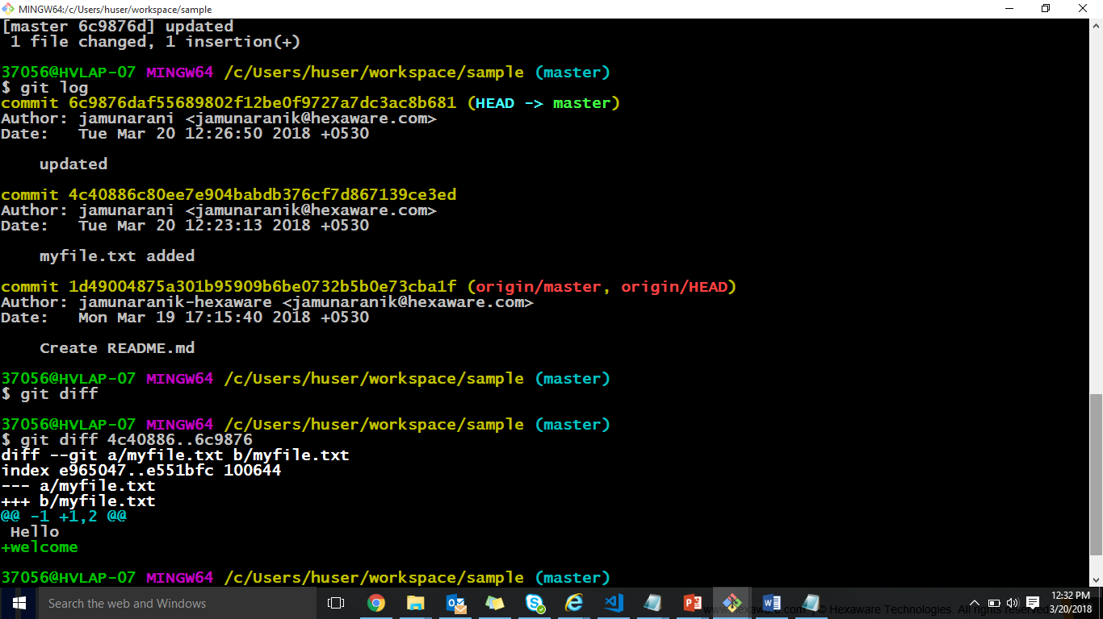
Viewing History and diffs (Cont..)

Slide 28
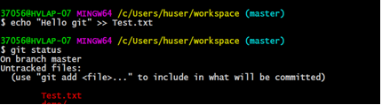
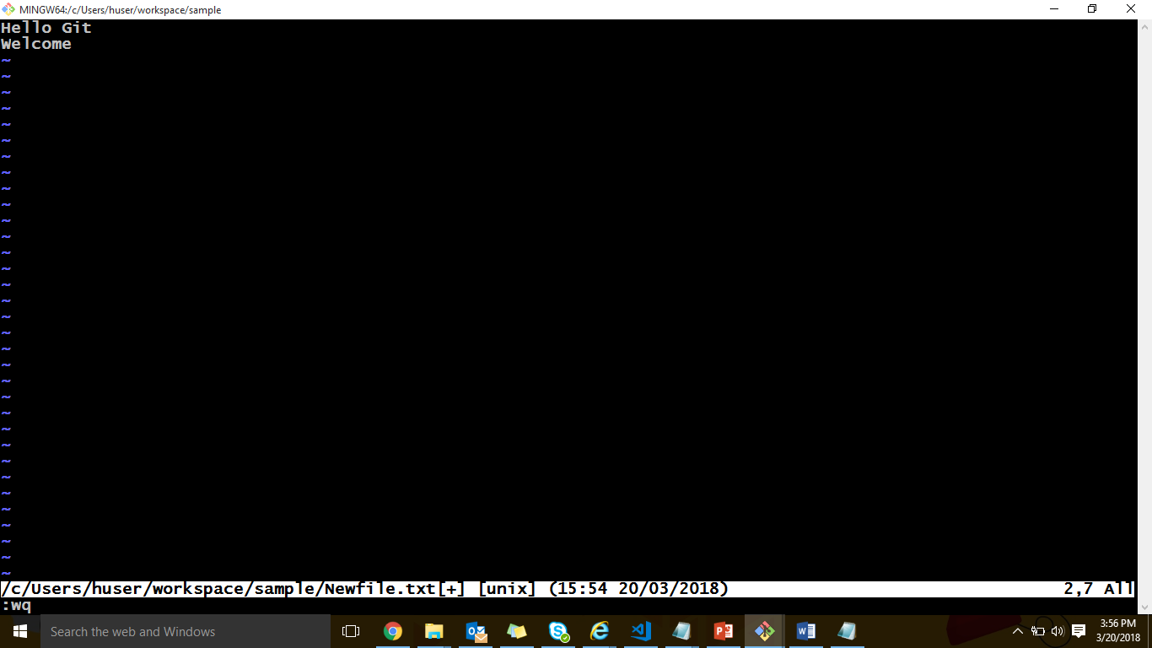
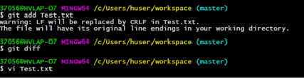
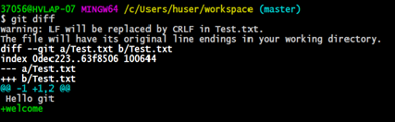
Viewing History and diffs cont..
To see what is modified but unstaged:
– git diff

Slide 29
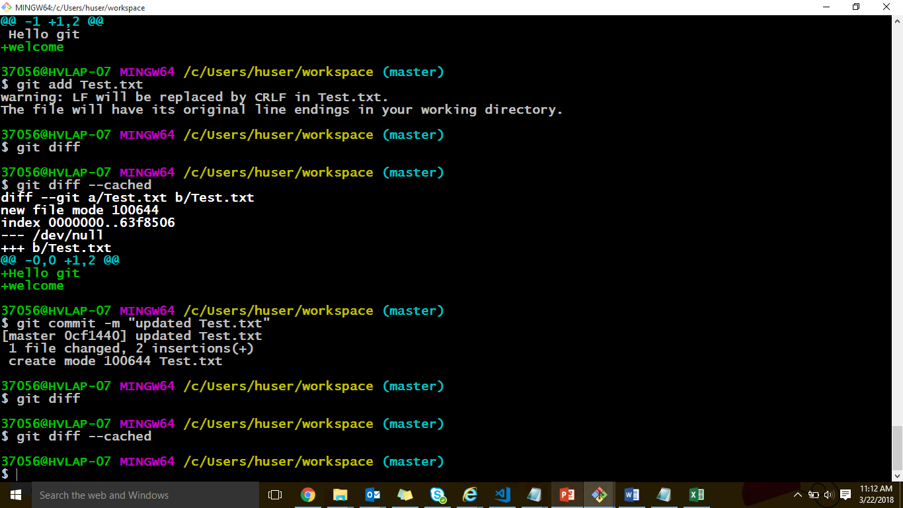
Viewing History and diffs cont..
To see a list of staged changes:
– git diff --cached

Slide 30
Branching
Git uses branching heavily to switch between multiple tasks.
• To create a new local branch:
– git branch name
• To list all local branches: (* = current branch)
– git branch
• To switch to a given local branch:
– git checkout branchname
Creates and checkouts to a branch called <name>
- git checkout -b <name>

Slide 31
Merge Conflicts
Merge conflicts may occur if competing changes are made to the same line of a file or when a file is deleted that another person is attempting to edit.
The conflicting file will contain <<< and >>> sections to
indicate where Git was unable to resolve a conflict:
Find all such sections, and edit them to the proper state
(whichever of the two versions is newer / better / more correct).

Slide 32
Merge Conflicts
For Example:
- If one person wrote "open an issue" in the base or HEAD branch
And another person wrote "ask your question in the compare branch
Decide if you want to
Keep only your branch's changes,
or other branch's changes,
or make a brand new change, which may incorporate changes from both branches.
Deletes the conflict marker <<<<<<< , ======= , >>>>>>> and make the changes.
If you have questions, Please
<<<<<<< HEAD
Open an issue
=======
Ask your question
>>>>>>> branch-a
Conflict Marker
Divides your changes from the changes in the other branch.

Slide 33
Rebase
Changes the "starting point" of a branch
Can be used in feature branches when the "development branch" changes drastically and it affects the feature branches
Usage: $ git rebase <branch> sets the starting point of the current branch to <branch>

Slide 34
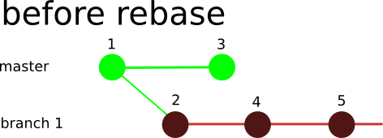
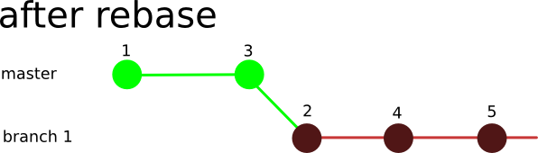

Slide 35
Interaction w/ remote repo
Push your local changes to the remote repo.
Pull from remote repo to get most recent changes.
– (fix conflicts if necessary, add/commit them to your local repo)
To fetch the most recent updates from the remote repo into
your local repo, and put them into your working directory:
– git pull origin master
To put your changes from your local repo in the remote repo:
– git push origin master

Slide 36
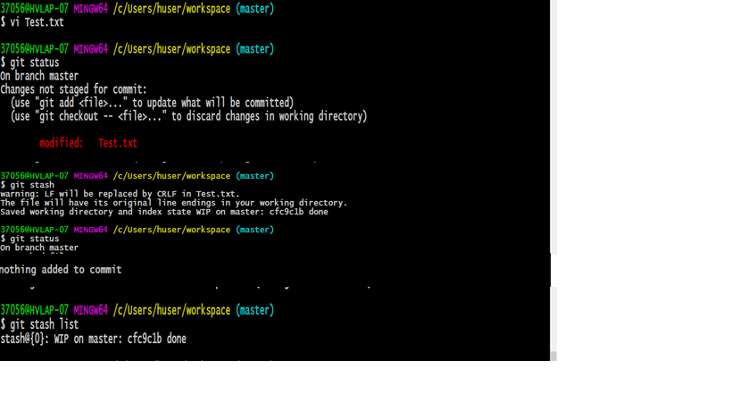
Stashing commits
Stashing commits can be useful when you have made some changes in your working directory, but want to return to a ”clean working directory”
Like when you need to do a quick fix on something entirely else, but your hacking is not complete
Usage
Stashing your commits since last pull
$ git stash
Listing all stashed changes
$ git stash list
Recovering changes from stash
$ git stash pop/apply
Cleaning up your stash
$ git stash drop

Slide 37
Best practices for code collaboration
When to commit?
Source of major arguments (big changes vs small change)
Never put broken code on the master branch (test first!)
Try not to break things (don't do two weeks worth of work in one commit)
Always use a clear, concise commit message
Put more details in lines below, but always make the first line short
Describe the why; the what is clear in the change log
When making giant changes, consider branches (we'll talk about these in a few slides)
Oh, and make sure your name and email are right

Slide 38

The Task:
Create the branch called greeting and check it out.
Edit the greeting.txt to contain your favorite greeting.
Add greeting.txt files to the staging area
Commit
Switch back to the master branch
Create a file README.md with information about this repository
Add the README.md file to staging area and make the commit
Diff the branches
Merge the greeting branch into master

Slide 39


Slide 40
Question 1:
Which of these terms best describes GIT?
a) Issue Tracking
b) Integerated Development Environment
c) Web-Based Repository Hosting Service
d) Distributed Version Control System
Ans : Distributed Version Control System

Slide 41
Question 2:
Which of these Git clients commands creates a copy of the repository and a working directory in the client’s workspace?
Import
Clone
Checkout
Merge
Ans: Clone

Slide 42

Question 3:
Now, Imagine that you have a local repository, but other team members have pushed changes into the remote repository. What GIT operation would use to download those changes into your working copy?
Export
Commit
Checkout
Pull
Ans: Pull

Slide 43
Question 4:
In Git which error would you get if you try to push master-branch changes to a remote repository and someone else pushed changes to that same branch while you were making your changes?
Rejected
404
500
Access denied
Ans : Rejected

Slide 44
Question 5:
If you want to make radical changes to your team’s project and don’t want to impact the rest of the team, you should implement your changes in …
The root
a tag
a branch
The trunk
Ans : a branch

