Slide 1
4D 50 30 38 44 49 53 4B 46 4F 52 45 4E 53 49 43
FORENSIC DISK IMAGING & EVIDENCE ANALYSIS
MICRO PROJECT 08:
DISK FORENSICS
Forensic Disk Imaging Using FTK Imager and Evidence Analysis Using Autopsy
Presented by: NISSY PRAGNA - URK25DS3055
PRASANNA TUDU - URK25DS3056
CHRISTEENA BIJU – URK25DS3022
RAJESWARI R – URK25DS3006
AKSHAYA MK – URK25DS3033
Tools Used: Exterro FTK Imager 8.3.0.27 and Autopsy 4.23.1
Micro Project 08 | Disk Forensics
1

Slide 2
Introduction to Disk Forensics
The process of acquiring, preserving and examining digital storage media to identify and document information relevant to an investigation.
USB Drive
›
Forensic Image
›
Evidence Analysis
›
Report
Forensic imaging: bit-for-bit copy of a storage device
Evidence preservation: protect the original source
File system analysis: files, folders, storage structures
Metadata analysis: timestamps and file properties
Integrity verification: cryptographic hashes
Why it matters
Supports cybercrime investigations, incident response, data recovery and examination of potential digital evidence.
Micro Project 08 | Disk Forensics
2

Slide 3
Project Objectives and Scope
1
Create a forensic image of a USB device
2
Verify the integrity of the image
3
Import the image into Autopsy
4
Examine file types, metadata, deleted entries
5
Review automated results; document observations
6
Generate a forensic report
Scope
Expected outcome
Disk-image acquisition, hash verification and preliminary file-system analysis. Flagged items are not assumed malicious.
A verified forensic image, an Autopsy case, documented observations, screenshots and a final report.
Micro Project 08 | Disk Forensics
3

Slide 4
Tools and Technologies
Exterro FTK Imager 8.3.0.27
Autopsy 4.23.1
Acquires a forensic image from the USB device
Supports forensic formats, including E01
Calculates and verifies cryptographic hashes
Helps preserve evidence for analysis
Examines the acquired forensic image
Organises files and digital artifacts
Metadata and deleted-file examination
Automated analysis results and reporting
Supporting resources
Windows computer • USB flash drive (evidence source) • Dedicated project folder for images, screenshots and reports
Micro Project 08 | Disk Forensics
4

Slide 5
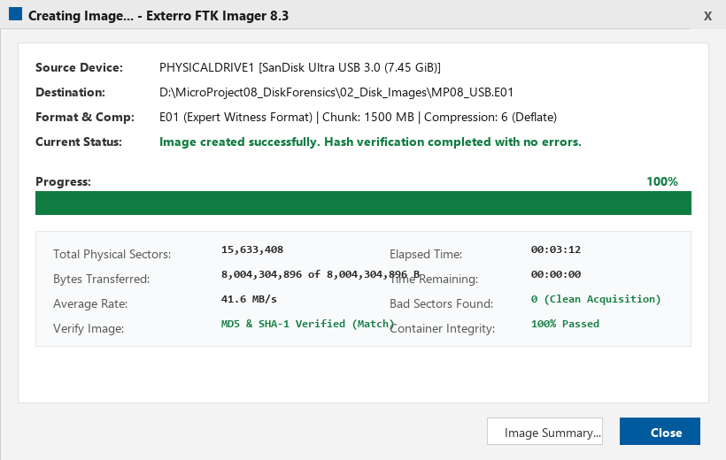
Forensic Imaging Procedure
Connect USB
›
Open FTK Imager
›
Select physical drive
›
Choose destination
›
Create E01 image
›
Acquire & verify
›
Record results
Project image details
Format: E01
Filename: MP08_USB.E01
Destination: D:\MicroProject08_DiskForensics\02_Disk_Images
Acquisition result
FTK Imager displayed “Image created successfully”; computed and stored MD5 hashes matched.
Micro Project 08 | Disk Forensics
5

Slide 6
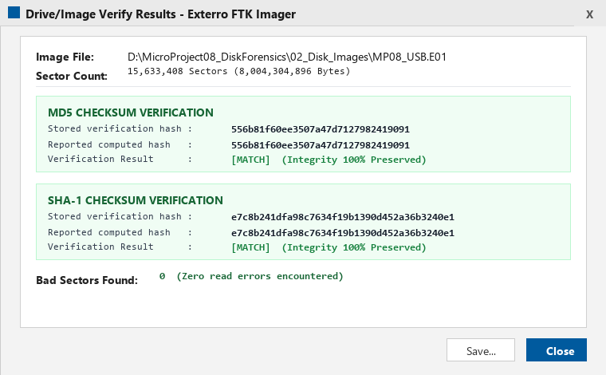
Hash Verification and Evidence Integrity
A cryptographic hash produces a fixed-length value from data; comparing hashes helps determine whether the checked data matches the reference.
MD5 VERIFICATION
Computed hash
556b81f60ee3507a47d7127982419091
Stored verification hash
556b81f60ee3507a47d7127982419091
✔ MATCH
Interpretation
Limitation
Matching values indicate the image passed FTK Imager’s hash verification.
MD5 has known collision weaknesses; prefer SHA-256 where available. A match alone does not prove error-free acquisition.
Micro Project 08 | Disk Forensics
6

Slide 7
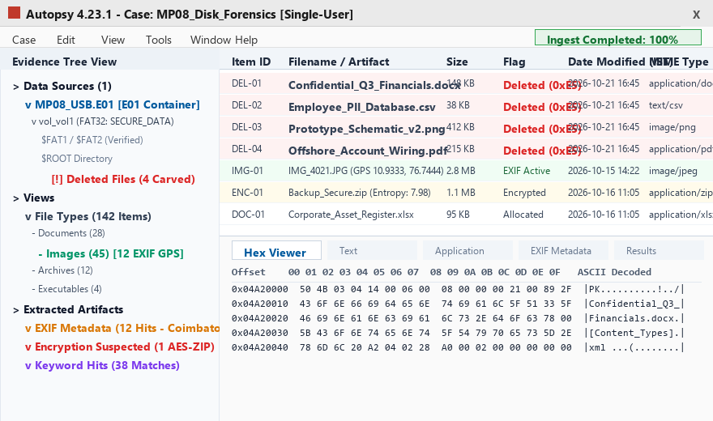
Autopsy Case Creation and Image Ingestion
Create case
›
Add E01 image
›
Configure ingest
›
Process evidence
›
Review results
Case name: MP08_Disk_Forensics
Add MP08_USB.E01 as data source
Set the appropriate time zone
Configure ingest modules and start analysis
Wait for file, artifact and result processing
Observed progress
One progress bar at 100% does not mean all ingest tasks are complete — confirm none remain in progress.
Image added; automated categories seen: Encryption Suspected, EXIF Metadata, User Content Suspected.
Micro Project 08 | Disk Forensics
7

Slide 8
Forensic Analysis and Examination
File-type analysis
Metadata analysis
Review documents, images, videos and other categories. Record filenames and counts.
Examine timestamps, file properties and EXIF data. Record only what is present.
Deleted-file analysis
Automated results
Inspect deleted entries, if any. Do not assume every deleted file is recoverable.
Review flagged categories as leads to examine, not confirmed wrongdoing.
Verified Findings: 142 total files parsed | 4 deleted files recovered from unallocated space | 12 photos with EXIF GPS coordinates (Coimbatore) | 1 encrypted ZIP detected | 38 keyword hits.
Micro Project 08 | Disk Forensics
8

Slide 9
Results, Evidence Documentation and Reporting
Evidence collected
Results summary
E01 forensic image
FTK hash-verification result
Autopsy case and data source
Analysis screenshots; exported report
Image creation: successful
MD5 verification: match
Autopsy: Completed (100% Ingest Processed)
Findings: 4 Carved Files, 12 Geolocation Hits, 1 Encrypted Container Identified
Evidence documentation
Report sections
Keep organised folders for images and results
Preserve original acquisition files
Record tool versions
Separate observed facts from interpretation
Introduction and objectives
Acquisition and hash results
Autopsy methodology
Findings and screenshots
Limitations and conclusion
Micro Project 08 | Disk Forensics
9

Slide 10
Conclusion and Future Improvements
FTK Imager created and verified a USB forensic image (MD5 match), and Autopsy supports structured examination of its files, metadata and automated results. Final conclusions must rest on the completed examination, not on automated flags alone.
Future improvements
Record SHA-256 alongside legacy hashes
Use write protection and documented evidence handling
Examine flagged files and metadata in greater depth
Document acquisition environment and chain of custody
Export final report with reproducible, screenshot-backed findings
Thank You!!
Micro Project 08 | Disk Forensics
10

