Slide 1
Good Afternoon Everyone
Today My Topic Is :
Abbrevation And Acronyms Related To Computer & Networking

Slide 2
SMTP -
Simple Mail Transfer Protocol
FTP -
File Transfer Protocol
SSL -
Secure Socket Layer
TCP -
Transmission Control Protocol
UDP -
User Datagram Protocol
SSH -
Secure Shell

Slide 3
TLD -
Top Level Domain
TLS -
Transport Layer Security
SHA -
Secure Hash Algorithm
VoIP -
Voice over Internet Protocol
WPA
WPA -
Wireless Protected Access
GSM -
Global System for Mobile

Slide 4
CDN -
Content Delivery Network
OSINT -
Open Source Inteligent
RAT -
Remote Administration Tool
Dos -
Deniel Of Service
CSRF -
Cross Site Request Foregery
TI -
Threat Intelligence

Slide 5
What is HTTP?
HTTP stands for Hypertext Transfer Protocol, and it is a protocol—or a prescribed order and syntax for presenting information—used for transferring data over a network. Most information that is sent over the Internet, including website content and API calls, uses the HTTP protocol.

Slide 6
What Is HTTPS ?
HTTPS stands for Hypertext Transfer Protocol Secure (also referred to as HTTP over TLS or HTTP over SSL). HTTPS uses TLS (or SSL) to encrypt HTTP requests and responses, so instead of the plaintext, an attacker would see a series of seemingly random characters.

Slide 7
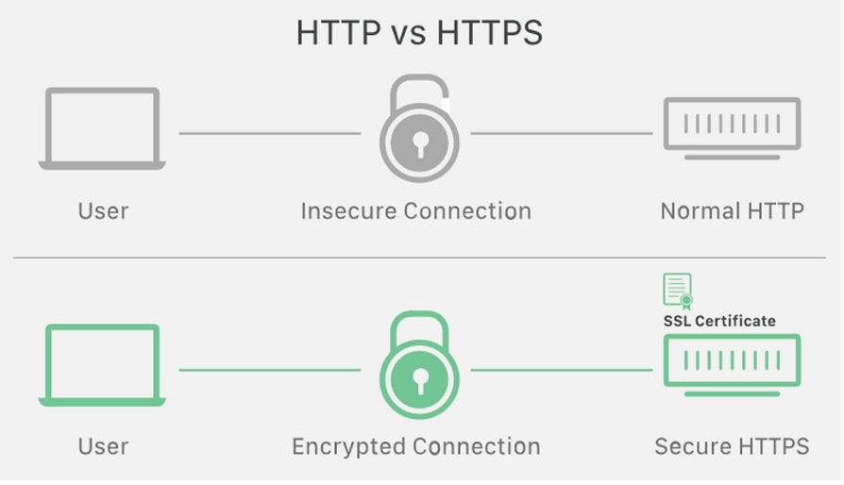

Slide 8
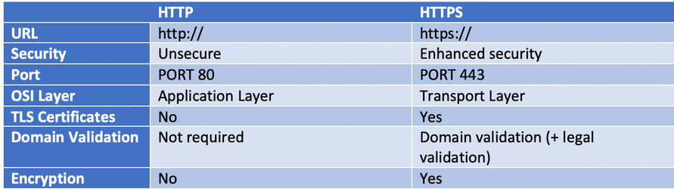
Difference Between HTTP & HTTPS

Slide 9
What Is Port Number ?
A port number is a way to identify a specific process to which an internet or other network message is to be forwarded when it arrives at a server. All network-connected devices come equipped with standardized ports that have an assigned number. These numbers are reserved for certain protocols and their associated function. Hypertext Transfer Protocol (HTTP) messages, for example, always go to port 80

Slide 10
There Are More Than 65,535 port number’s are Alvailable to use
Port Number : 0 – 1023 --> These are resticted port number’s
Port Number : 1024 – 49,151 --> These Port Number’s are freely available to use
Port Number : 49,152 – 65,535 These Port Number’s Are Owned By the Top MNC’s For Their Company Use

Slide 11
Ports 20 and 21. FTP is used to transfer files between a client and a server.
Port 22. Secure Shell is one of several tunneling protocols used to build secure network connections.
Port 25. Simple Mail Transfer Protocol (SMTP) is commonly used for email.
Port 53. Domain name system (DNS) is a critical process that matches human-readable domain names to machine-readable IP addresses on the modern internet. It helps users load websites and applications without typing in a long list of IP addresses.
Instead of typing : www.google.com --> You can type 172.217.13.78
Port 80. HTTP is the protocol that enables the World Wide Web.
Port 123. Network Time Protocol helps computer clocks sync with each other. It's a vital process in encryption

