Slide 1
EC2 Linux Instance

Slide 2
Agenda for session
EC2 instance definition.
Creating and Launching EC2 Linux Instance
Static website Hosting on EC2 Linux instance
Adding volume to EC2 instance
Interview Questions.

Slide 3
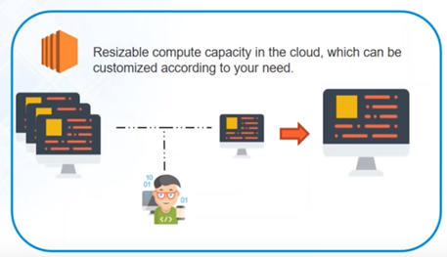
EC2(Elastic compute cloud)
This managed service is called Elastic Compute Cloud
It is mainly used for provisioning a virtual machine along with CPU, RAM, storage, network etc.

Slide 4
Steps to create EC2 Linux instance
Choose AMI
Choose Instance Type
Configure Instance
Add Storage
Add Tags
Configure Security groups
Creating key pair.
Launch Instance

Slide 5
Deploying static website on EC2 instance.

Slide 6
Creating and attach volume to EC2 instance

Slide 7
Interview questions on EC2

Slide 8
Q. How is stopping and terminating an instance different from each other?
Stopping and Starting an instance: When an instance is stopped, the instance performs a normal shutdown and then transitions to a stopped state. All of its Amazon EBS volumes remain attached, and you can start the instance again at a later time. You are not charged for additional instance hours while the instance is in a stopped state.
Terminating an instance: When an instance is terminated, the instance performs a normal shutdown, then the attached Amazon EBS volumes are deleted unless the volume’s deleteOnTermination attribute is set to false. The instance itself is also deleted, and you can’t start the instance again at a later time.

Slide 9
Q. What are the various AMI design options?
Ans. Fully Baked AMI, JeOS (just enough operating system) AMI and Hybrid AMI.

Slide 10
Q. What are the best practices for Security in Amazon EC2?
There are several best practices to secure Amazon EC2. A few of them are given below:
Use AWS Identity and Access Management (IAM) to control access to your AWS resources.
Restrict access by only allowing trusted hosts or networks to access ports on your instance.
Review the rules in your security groups regularly, and ensure that you apply the principle of least
Privilege – only open up permissions that you require.
Disable password-based logins for instances launched from your AMI. Passwords can be found or cracked, and are a security risk.

Slide 11
Q. You have an EC2 Security Group with several running EC2 instances. You changed the Security Group rules to allow inbound traffic on a new port and protocol, and then launched several new instances in the same Security Group. The new rules apply:
Immediately to all instances in the security group.
Immediately to the new instances only.
Immediately to the new instances, but old instances must be stopped and restarted before the new rules apply.
To all instances, but it may take several minutes for old instances to see the changes.
Answer A. Immediately to all instances in the security group.
Any rule specified in an EC2 Security Group applies immediately to all the instances, irrespective of when they are launched before or after adding a rule.

Slide 12
Q. What are the features of the Amazon EC2 service?
Amazon EC2 provides the following features:
Virtual computing environment (known as instances)
Pre-configured templates for your instances (known as Amazon Machine Images – AMIs)
Amazon Machine Images (AMIs) is a complete package that you need for your server (including the operating system and additional software)
Amazon EC2 provides various configurations of CPU, memory, storage and networking capacity for your instances (known as instance type)
Secure login information for your instances using key pairs (AWS stores the public key and you can store the private key in a secure place)
Storage volumes of temporary data is deleted when you stop or terminate your instance (known as instance store volumes)
Amazon EC2 provides persistent storage volumes (using Amazon Elastic Block Store – EBS)
A firewall that enables you to specify the protocols, ports, and source IP ranges that can reach your instances using security groups
Static IP addresses for dynamic cloud computing (known as Elastic IP address)
Amazon EC2 provides metadata (known as tags)

Slide 13
Please subscribe to My Channel

