Slide 1
EC2 Windows Instance

Slide 2
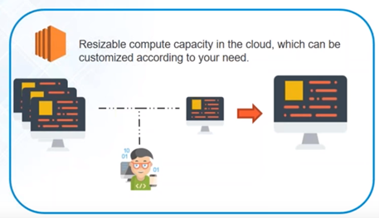
EC2(Elastic compute cloud)
This managed service is called Elastic Compute Cloud
It is mainly used for provisioning a virtual machine along with CPU, RAM, storage, network etc.
5/5/2017
Prepared by Mohan Rao

Slide 3
Steps to create EC2 instance
Choose AMI
Choose Instance Type
Configure Instance
Add Storage
Add Tags
Configure Security groups
Creating key pair.
Launch Instance

Slide 4
Please subscribe to My Channel

