Slide 1
AWS (Amazon Web Services)

Slide 2
Agenda for the session
Problems in Local centers
Features of Cloud?
What is Cloud?
Different CSP(Cloud Service Providers)
How to select Cloud Service Provider?
What is AWS?
Different types of Cloud Models
Different Types Of Cloud Services
AWS Regions
Availability Zones & Data Centers
Edge locations.
Opportunities in AWS Cloud Market?
AWS Certifications

Slide 3
Local Data Center Vs Cloud

Slide 4
Local Data Center Vs Cloud
Local Data Center
Cloud
Buy a stack of Servers
(This setup is too expensive)
Pay rent and use servers,
no more buying expensive
servers. No long-term
commitments & up front
capital needed. Pay-by-use.

Slide 5
Elasticity / scaling
Local Data Center
Cloud
Since the traffic is varying most of the time either servers will be in ideal state or overloaded
CSP will provide the required number of servers it may Scale up or down depending on usage.

Slide 6
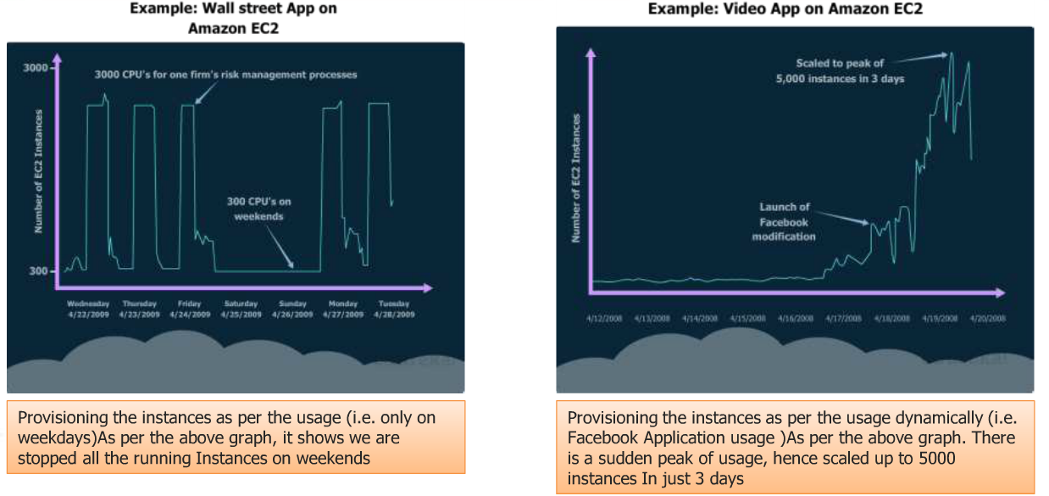
On-demand and scalability

Slide 7
Monitoring and Maintenance
Local Data Center
Cloud
Need resources to monitor and we need to bear the maintenance cost
Cloud service provider will manage the servers, hence no worries about the underlying infrastructure.

Slide 8
On-Demand Resources provisioning.
Local Data Center
Cloud
Difficult to provide the required capacity whenever we need.
Ask for what you need, when you need it & when to stop.

Slide 9
Availability(24 X 7)
Local Data Center
Cloud
Difficult to maintain as we have limited no. of instances.
CSP will replace the unhealthy servers in minutes.

Slide 10
Efficiency of Experts.
Local Data Center
Cloud
Difficult to maintain
Utilize the skills, knowledge and resources of experts

Slide 11


Time Consuming
Local Data Center
Cloud

Slide 12
Measurability
Local Data Center
Cloud
Difficult to measure all usage details.
Every unit of usage (i.e. managed service) is measurable.

Slide 13
What is Cloud computing?
It is the use of remote servers on the internet to store, manage and process data rather than a local server

Slide 14
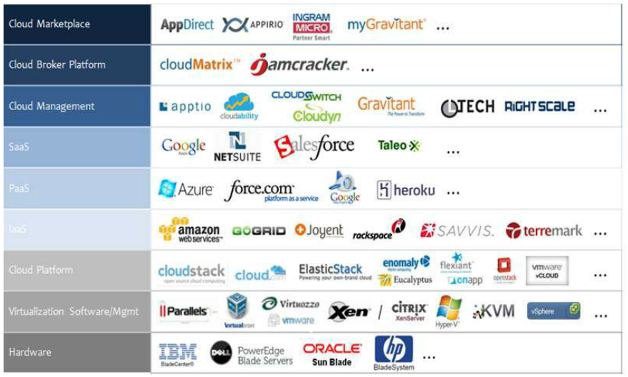
Different CSP(Cloud Service Providers)

Slide 15
How to select Cloud Service Provider?

Slide 16
How to select Cloud provider?
How long they are there in the business?
Ans: AWS started their business in 2006 , since then they are continuing in Cloud business with exponential growth.

Slide 17
What are the companies using the cloud services?

Slide 18
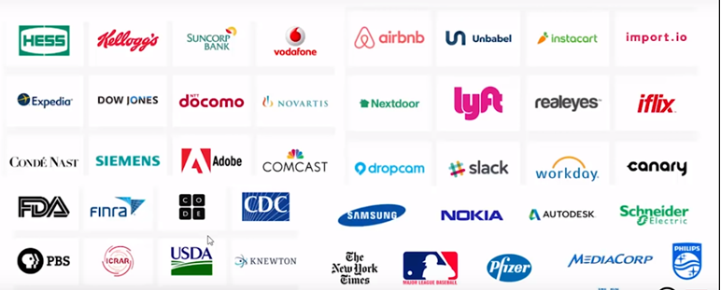
AWS partners

Slide 19
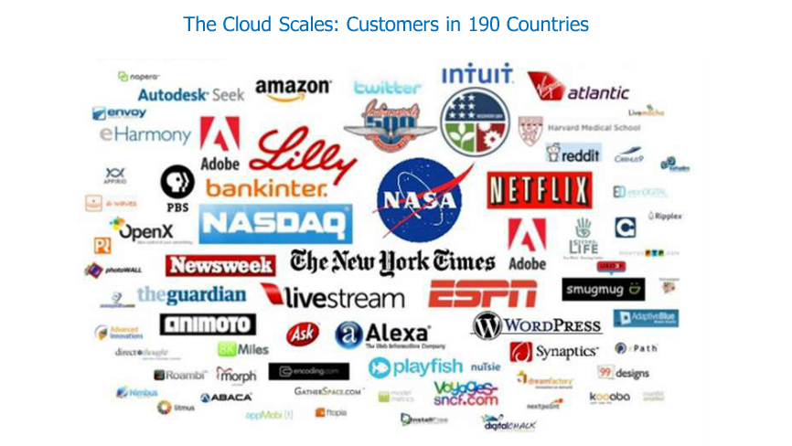
Who is using AWS?

Slide 20
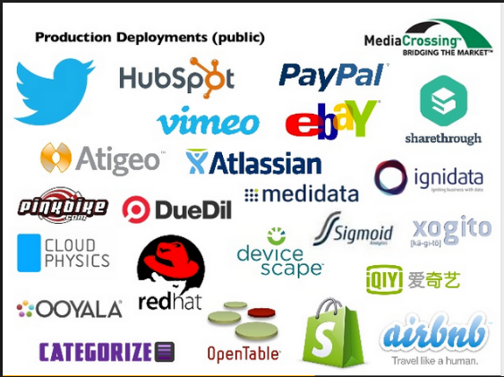
Who is using AWS?

Slide 21
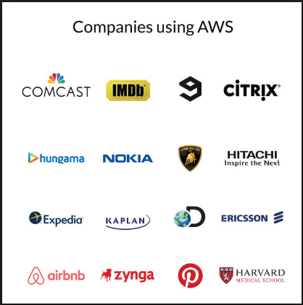
Who is using AWS?

Slide 22
How to select Cloud provider?
Ratings/Reviews given by trusted websites?
Ans: indeed.com is giving 1st rating for AWS since 7 years, it is Leader in Cloud market.

Slide 23
How to select Cloud provider?(Cont..)
Capacity?
Ans : 6X times of all Cloud services provides.

Slide 24
How to select Cloud provider?(cont…)
What is their market share?

Slide 25
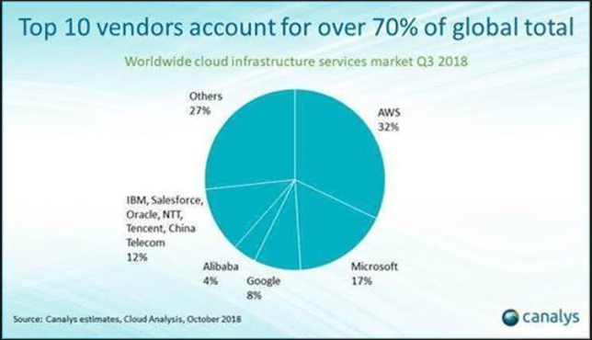
AWS Market share is 32%

Slide 26
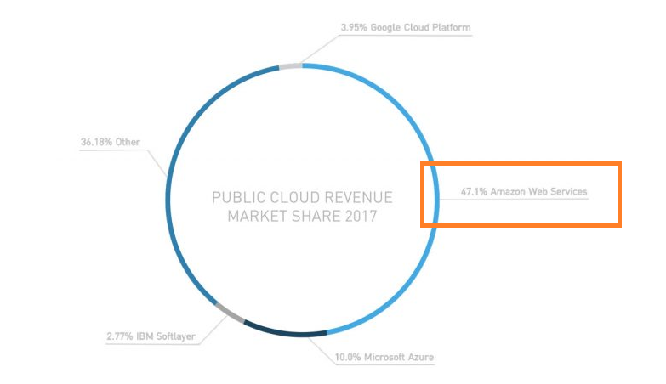
AWS public Cloud Market share
Notes:
https://www.skyhighnetworks.com/cloud-security-blog/microsoft-azure-closes-iaas-adoption-gap-with-amazon-aws/

Slide 27
How to select Cloud provider?(Cont..)
Flexibility in pricing?
There 4 types of pricing Models.
Dedicated instances
Reserved instances
On-Demand instances
Spot instances

Slide 28
How to select Cloud provider?(Cont..)
How many regions they are covering?
Ans : 25 Regions (21 for public , 2 for US govt. and 1 for China govt. and 1 for local region)
In how many countries they have business?
Ans: ~200 Countries.
Notes:
https://aws.amazon.com/about-aws/global-infrastructure/

Slide 29
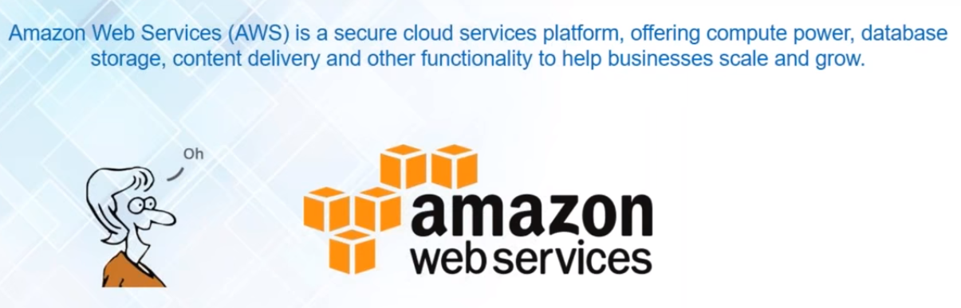
What is AWS?

Slide 30
Different types of Cloud Models

Slide 31
Different types of Cloud Models
Public Cloud
Private Cloud
Hybrid cloud

Slide 32
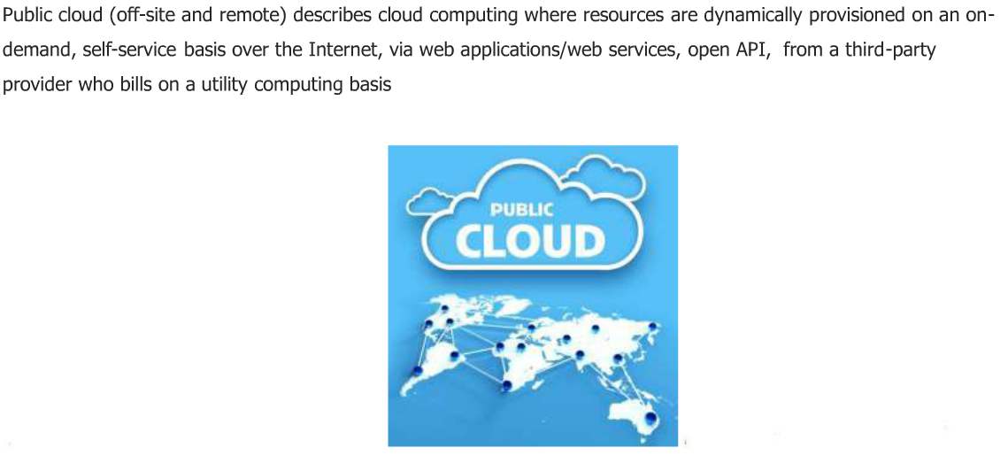
Public Cloud

Slide 33
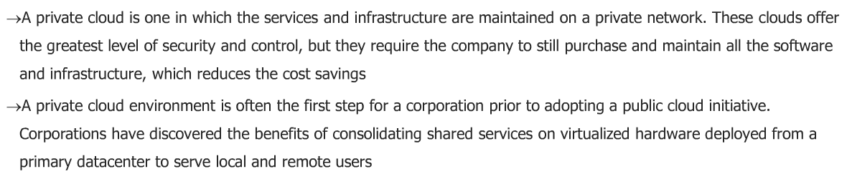
Private Cloud

Slide 34
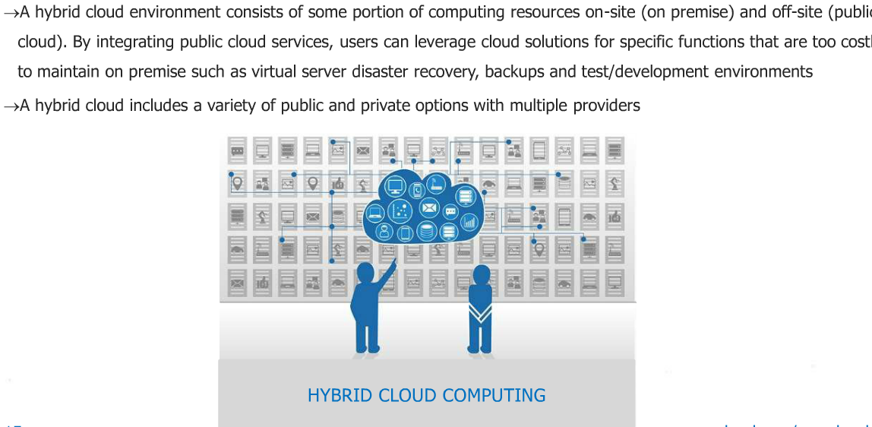
Hybrid Cloud

Slide 35
Choose Public Cloud under below situations.
Dev, test and DR environments.
For collaboration projects.
SaaS (Software as a service) applications from a vendor who has a well-implemented security strategy.
When we need incremental capacity (the ability to add computer capacity for peak times)

Slide 36
When do we choose privat & Hybrid Cloud?
When business needs security and data privacy issues.
When business needs to access on premise data and your applications.
When company is large enough to run a next generation cloud data center efficiently and effectively on its own.

Slide 37
Public Vs Private Vs Hybrid
parameter | public | private | Hybrid
Cost | Very Low | High | Medium
Elasticity | Very High | Medium | High
Security | Faithful | Very High | High
Availability | Very High | High | High
On-demand | Very High | High | High
Maintenance | Easiest | Easy | Easier

Slide 38
Different Types Of Cloud Services

Slide 39
Different Types of Cloud Services
IaaS (infrastructure as a service)
PaaS (Platform as a Service)
SaaS (Software as a Service)

Slide 40
Local data center vs IAAS vs PAAS vs SAAS
Blue : CSP responsibility && Orange :your own responsibility.
Local data center
IaaS
PaaS
SaaS
Application
Application
Application
Application
Data
Data
Data
Data
MIddleware
Middleware
Middleware
Middleware
OS
OS
OS
OS
Virtualization
Virtualization
Virtualization
Virtualization
Server
Server
Server
Server
Storage
Storage
Storage
Storage
Network
Network
Network
Network

Slide 41
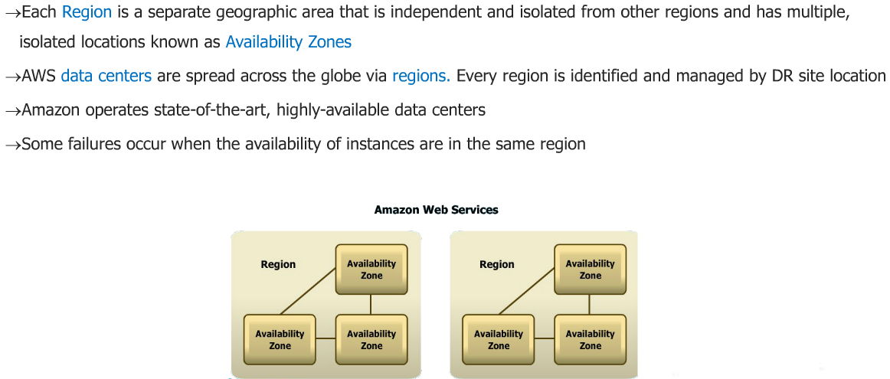

AWS Region
Notes:
Each Region is a separate geographic area that is independent and isolated from other regions and has multiple isolated locations known as Availability zones.

Slide 42
AWS Regions
Code | Name
us-east-1 | US East (N. Virginia)
us-east-2 | US East (Ohio)
us-west-1 | US West (N. California)
us-west-2 | US West (Oregon)
ca-central-1 | Canada (Central)
eu-central-1 | EU (Frankfurt)
eu-west-1 | EU (Ireland)
eu-west-2 | EU (London)

Slide 43
AWS Regions (Cont..)
Code | Name
eu-west-3 | EU (Paris)
ap-northeast-1 | Asia Pacific (Tokyo)
ap-northeast-2 | Asia Pacific (Seoul)
ap-northeast-3 | Asia Pacific (Osaka-Local)
ap-southeast-1 | Asia Pacific (Singapore)
ap-southeast-2 | Asia Pacific (Sydney)
ap-south-1 | Asia Pacific (Mumbai)
sa-east-1 | South America (São Paulo)
eu-north-1 | EU (Stockholm)

Slide 44
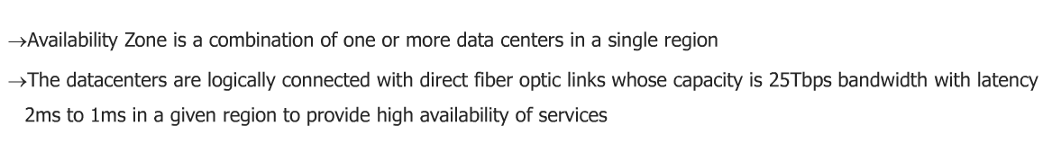
Availability Zone
Notes:
Availability Zone is a combination of one or more data centers in a single region.

Slide 45
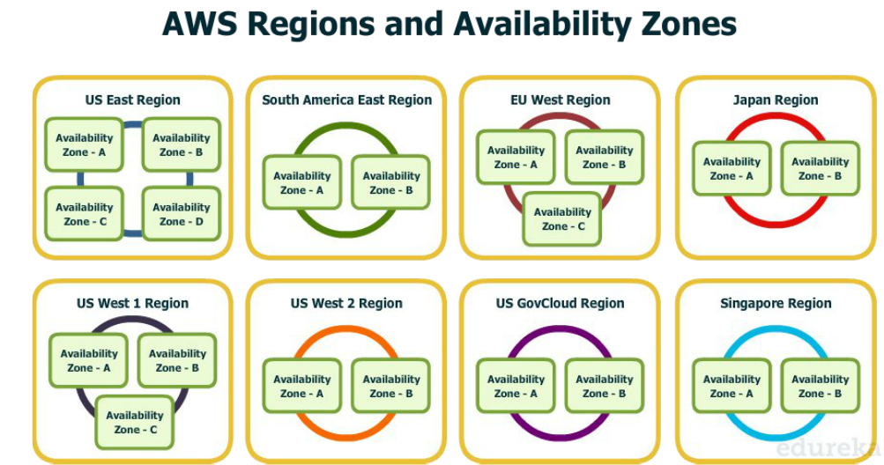
AWS Availability zone

Slide 46
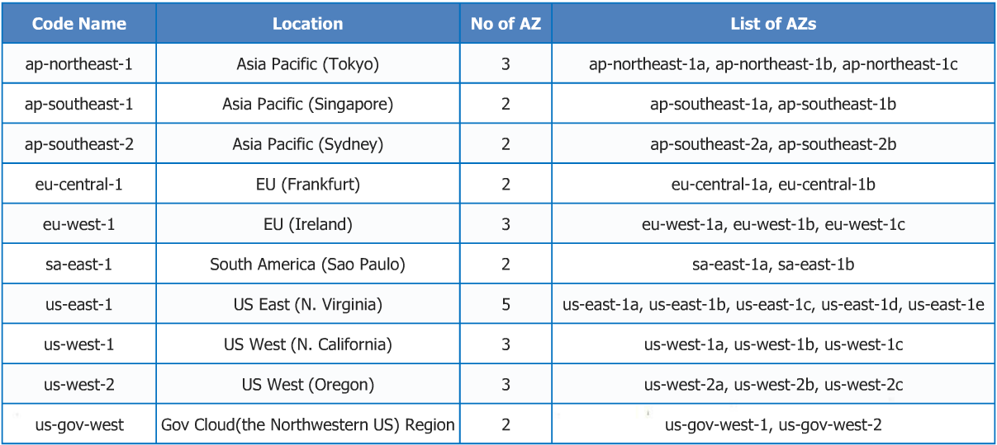
AWS Availability zone

Slide 47
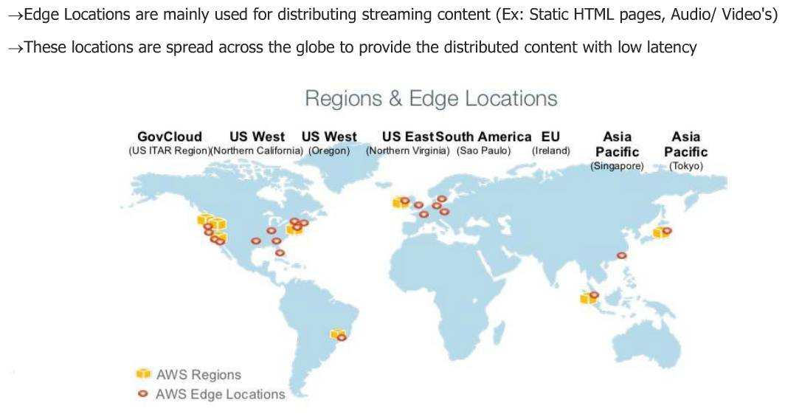
AWS Edge location
Notes:
Edge locations are mainly used for distributing streaming content (Static html, Audio and video etc.)
These locations are spread across the globe to provide the distributed content with low latency.

Slide 48
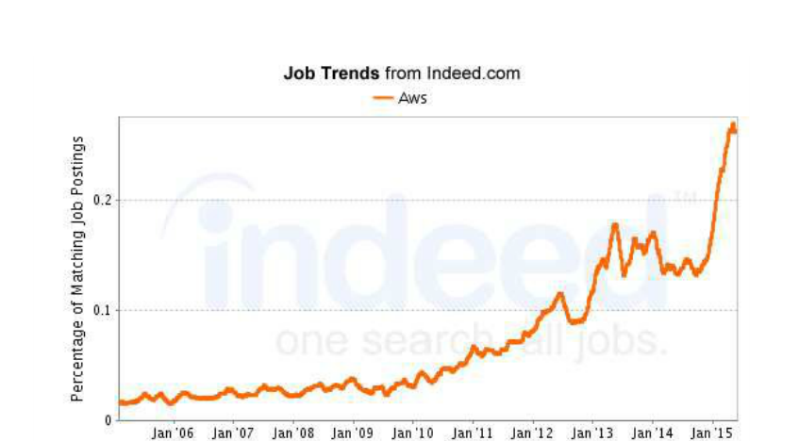
Opportunities in AWS Cloud / Market?

Slide 49
AWS Certifications

Slide 50
