Slide 1
Introduction
Purpose of Database Systems
View of Data
Database Languages
Relational Databases
Database Design
Data Storage and Querying
Transaction Management
Database Architecture
Overall Structure
History of Database Systems

Slide 2
Database Management System (DBMS)
DBMS contains information about a particular enterprise
  Collection of interrelated data
  Set of programs to access the data
  An environment that is both convenient and efficient to use
Database Applications:
  Banking: all transactions
  Airlines: reservations, schedules
  Universities: registration, grades
  Sales: customers, products, purchases
  Online retailers: order tracking, customized recommendations
  Manufacturing: production, inventory, orders, supply chain
  Human resources: employee records, salaries, tax deductions
Databases touch all aspects of our lives

Slide 3
Purpose of Database Systems
In the early days, database applications were built directly on top of file systems
Drawbacks of using file systems to store data:
  Data redundancy and inconsistency
    Multiple file formats, duplication of information in different files
  Difficulty in accessing data
    Need to write a new program to carry out each new task
  Data isolation — multiple files and formats
  Integrity problems

Slide 4
Purpose of Database Systems (Cont.)
Drawbacks of using file systems (cont.)
  Atomicity of updates
  Concurrent access by multiple users
    Concurrent accessed needed for performance
    Uncontrolled concurrent accesses can lead to inconsistencies
  Security problems
    Hard to provide user access to some, but not all, data (access to the whole file!)
Database systems offer solutions to all the above problems

Slide 5
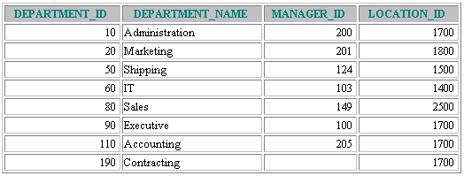
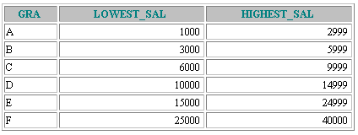


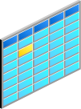
Data Storage on Different Media
Electronic spreadsheet
Database
Filing cabinet
Notes:
Storing Information
Every organization has some information needs. A library keeps a list of members, books, due dates, and fines. A company needs to save information about employees, departments, and salaries. These pieces of information are called data.
Organizations can store data on various media and in different formats, such as a hard-copy document in a filing cabinet or data stored in electronic spreadsheets or in databases.
A database is an organized collection of information.
To manage databases, you need a database management system (DBMS). A DBMS is a program that stores, retrieves, and modifies data in databases on request. There are four main types of databases: hierarchical, network, relational, and (most recently) object relational.

Slide 6
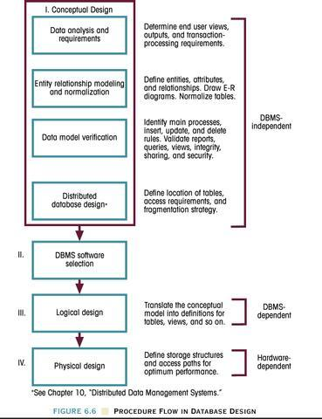
The Database Life Cycle: Conceptual Design

Slide 7
Data Models
A collection of tools for describing
  Data
  Data relationships
  Data semantics
  Data constraints
Relational model
Entity-Relationship data model (mainly for database design process)

Slide 8

Data Models
Model of
system
in client’s
mind
Entity model of
client’s model
Table model
of entity model
Oracle
server
Tables on disk
Notes:
Data Models
Models are a cornerstone of design. Engineers build a model of a car to work out any details before putting it into production. In the same manner, system designers develop models to explore ideas and improve the understanding of database design.
Purpose of Models
Models help communicate the concepts that are in people’s minds. They can be used to do the following:
Communicate
Categorize
Describe
Specify
Investigate
Evolve
Analyze
Imitate
The objective is to produce a model that fits a multitude of these uses, can be understood by an end user, and contains sufficient detail for a developer to build a database system.

Slide 9
Schemas
Similar to types and variables in programming languages
Schema – the logical structure of the database
  Example: The database consists of information about a set of customers and accounts (and the relationship between them)
  Analogous to type information of a variable in a program
  Physical schema: database design at the physical level ~ indexes, data dictionaries
  Logical schema: database design at the logical level ~ record structure, constraints.

Slide 10
Instances
Instance – the actual content of the database at a particular point in time
  Analogous to the value of a variable
Physical Data Independence
– the ability to modify the physical schema without changing the logical schema
  Applications depend on the logical schema
  In general, the interfaces between the various levels and components should be well defined so that changes in some parts do not seriously influence others.

Slide 11
Transaction Properties
ACID
Atomicity: A transaction is an atomic unit of processing; it should either be performed in its entirety or not performed at all.
Consistency preservation: A transaction should be consistency preserving, meaning that if it is completely executed from beginning to end without interference from other transactions, it should take the database from one consistent state to another.
Isolation: A transaction should appear as though it is being executed in isolation from other transactions, even though many transactions are executing concurrently. That is, the execution of a transaction should not be interfered with by any other transactions executing concurrently.
Durability or permanency: The changes applied to the database by a committed transaction must persist in the database. These changes must not be lost because of any failure. The durability property is the responsibility of the recovery subsystem of the DBMS.

Slide 12
Database Design
The process of designing the general structure of the database:
Logical Design – Deciding on the database schema. Database design requires that we find a “good” collection of relation schemas.
  Business decision – What attributes should we record in the database?
  Computer Science decision – What relation schemas should we have and how should the attributes be distributed among the various relation schemas?
Physical Design – Deciding on the physical layout of the database

Slide 13
Relational Database Properties
A relational database:
  Can be accessed and modified by executing structured query language (SQL) statements
  Contains a collection of tables with no physical pointers
  Uses a set of operators
Notes:
Properties of a Relational Database
In a relational database, you do not specify the access route to the tables, and you do not need to know how the data is arranged physically.
To access the database, you execute a structured query language (SQL) statement, which is the American National Standards Institute (ANSI) standard language for operating relational databases. The language contains a large set of operators for partitioning and combining relations. The database can be modified by using the SQL statements.

Slide 14
Entity Relationship Diagram (ERD)
A database can be modeled as:
  a collection of entities,
  relationship among entities.
Database systems are often modeled using an Entity Relationship (ER) diagram as the "blueprint" from which the actual data is stored — the output of the design phase

Slide 15
Entity Relationship Diagram (ERD)
ER model allows us to sketch database designs
ERD is a graphical tool for modeling data.
ERD is widely used in database design
ERD is a graphical representation of the logical structure of a database
ERD is a model that identifies the concepts or entities that exist in a system and the relationships between those entities

Slide 16
Entity Relationship Diagram (ERD)
A database can be modeled as:
  a collection of entities,
  relationship among entities.
Database systems are often modeled using an Entity Relationship (ER) diagram as the "blueprint" from which the actual data is stored — the output of the design phase

Slide 17
Purposes of ERD
An ERD serves several purposes
The database analyst/designer gains a better understanding of the information to be contained in the database through the process of constructing the ERD.
The ERD serves as a documentation tool.
Finally, the ERD is used to communicate the logical structure of the database to users.
In particular, the ERD effectively communicates the logic of the database to users.

Slide 18
Components of an ERD
An ERD typically consists of four different graphical components:
1.Entity
  2. Relationship
  3. Cardinality
  4. Attribute

Slide 19
Classification of Relationship
Optional Relationship
  An Employee may or may not be assigned to a Department
  A Patient may or may not be assigned to a Bed
Mandatory Relationship
  Every Course must be taught by at least one Teacher
  Every mother have at least a Child

Slide 20
Cardinality Constraints
Express the number of entities to which another entity can be associated via a relationship set.
Cardinality Constraints - the number of instances of one entity that can or must be associated with each instance of another entity.
Minimum Cardinality
  If zero, then optional
  If one or more, then mandatory
Maximum Cardinality
  The maximum number

Slide 21
Cardinality Constraints (Contd.)
  One to one
    A Manager Head one Department and vice versa
  One to many ( or many to one)
    An Employee Works in one Department or One Department has many Employees
  Many to many
    A Teacher Teaches many Students and A student is taught by many Teachers

Slide 22
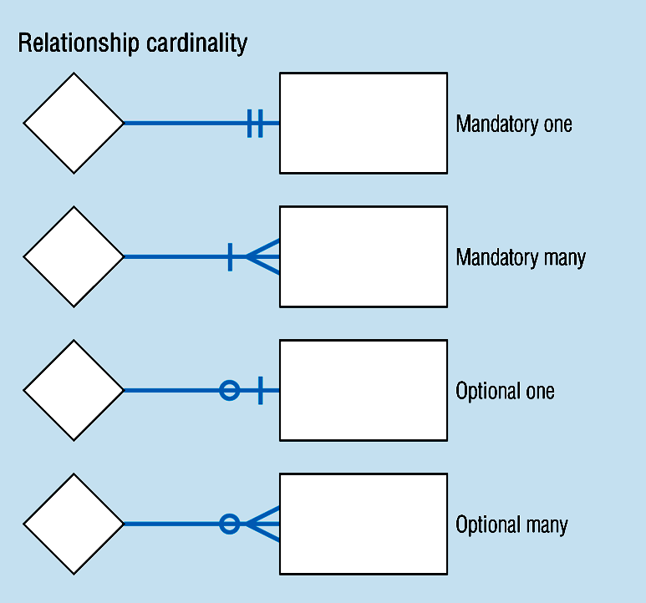
Cardinality Constraints (Contd.)

Slide 23
Cardinality Constraints Example
In our model, we wish to indicate that each school may enroll many students, or may not enroll any students at all.
We also wish to indicate that each student attends exactly one school. The following diagram indicates this optionality and cardinality:

Slide 24
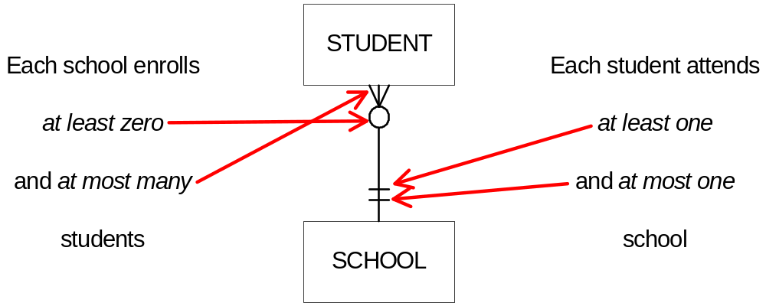
Cardinality Constraints Example (Contd.)

Slide 25
General Steps to create an ERD
Identify the entity
Identify the entity's attributes
Identify the Primary Keys
Identify the relation between entities
Identify the Cardinality constraint
Draw the ERD
Check the ERD

Slide 26
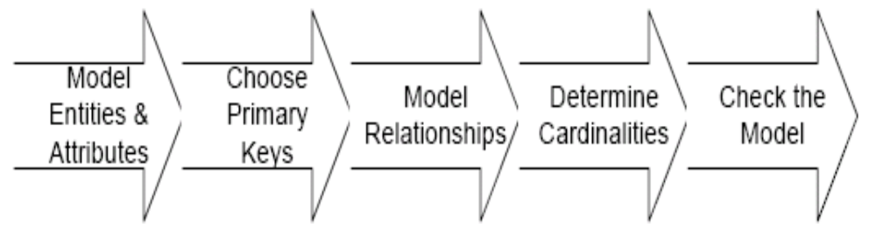
Steps in building an ERD

Slide 27
Developing an ERD
The process has ten steps:
  1. Identify Entities
  2. Find Relationships
  3. Draw Rough ERD
  4. Fill in Cardinality
  5. Define Primary Keys
  6. Draw Key-Based ERD
  7. Identify Attributes
  8. Map Attributes
  9. Draw fully attributed ERD
  10. Check Results

Slide 28
A Simple Example
A company has several departments. Each department has a supervisor and at least one employee. Employees must be assigned to at least one, but possibly more departments. At least one employee is assigned to a project, but an employee may be on vacation and not assigned to any projects. The important data fields are the names of the departments, projects, supervisors and employees, as well as the supervisor and employee number and a unique project number.

Slide 29
Identify entities
One approach to this is to work through the information and highlight those words which you think correspond to entities.
A company has several departments. Each department has a supervisor and at least one employee. Employees must be assigned to at least one, but possibly more departments. At least one employee is assigned to a project, but an employee may be on vacation and not assigned to any projects. The important data fields are the names of the departments, projects, supervisors and employees, as well as the supervisor and employee number and a unique project number.
A true entity should have more than one instance

Slide 30
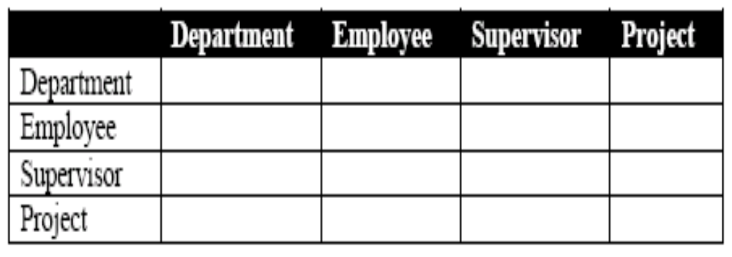
Find Relationships
Aim is to identify the associations, the connections between pairs of entities.
A simple approach to do this is using a relationship matrix (table) that has rows and columns for each of the identified entities.

Slide 31
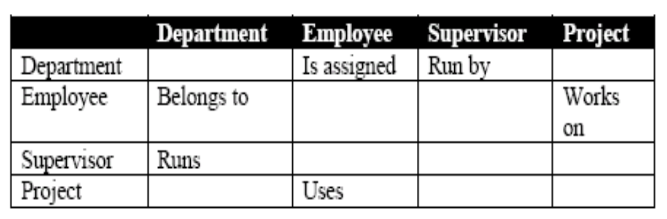
Find Relationships (Contd.)
Go through each cell and decide whether or not there is an association.
For example, the first cell on the second row is used to indicate if there is a relationship between the entity "Employee" and the entity "Department".

Slide 32
Identified Relationships
Names placed in the cells are meant to capture/describe the relationships. So you can use them like this
A Department is assigned an employee
A Department is run by a supervisor
An employee belongs to a department
An employee works on a project
A supervisor runs a department
A project uses an employee

Slide 33
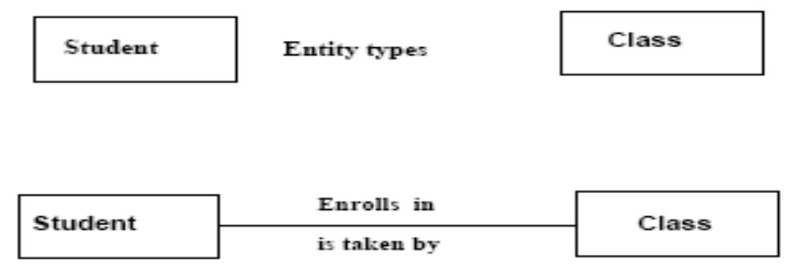
Draw Rough ERD
Draw a diagram and:
Place all the entities in rectangles
Use diamonds and lines to represent the relationships between entities.

Slide 34


Drawing Rough ERD (Contd.)

Slide 35
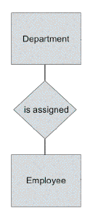
Drawing Rough ERD (Contd.)

Slide 36
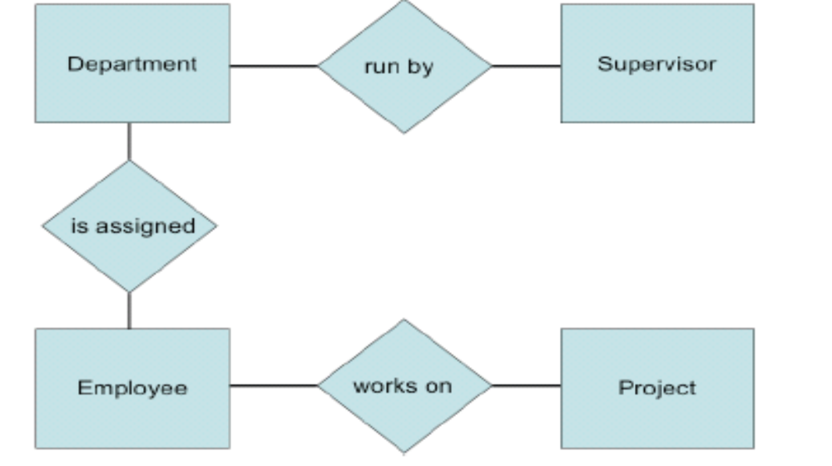
Drawing Rough ERD (Contd.)

Slide 37
Fill in Cardinality
Supervisor
  Each department has one supervisor.
Department
  Each supervisor has one department.
  Each employee can belong to one or more departments
Employee
  Each department must have one or more employees
  Each project must have one or more employees
Project
  Each employee can have 0 or more projects.

Slide 38
Fill in Cardinality (Contd.)
The cardinality of a relationship can only have the following values
  One and only one
  One or more
  Zero or more
  Zero or one

Slide 39
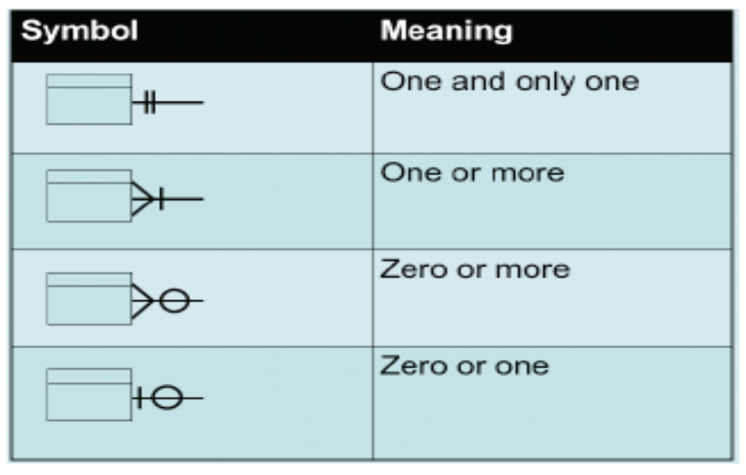
Cardinality Notation

Slide 40
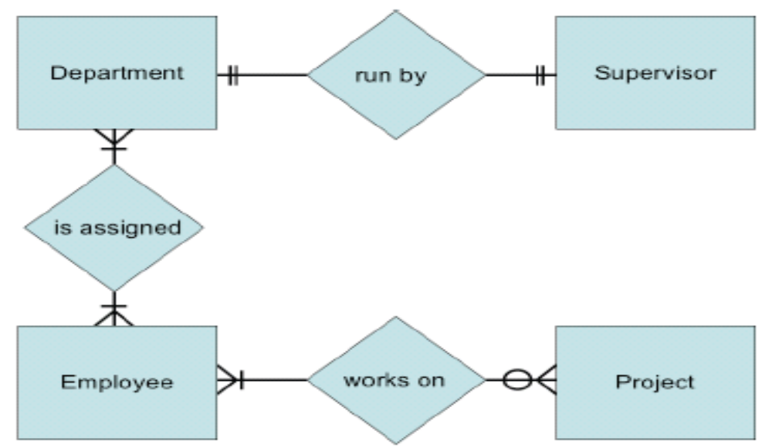
ERD with cardinality

Slide 41
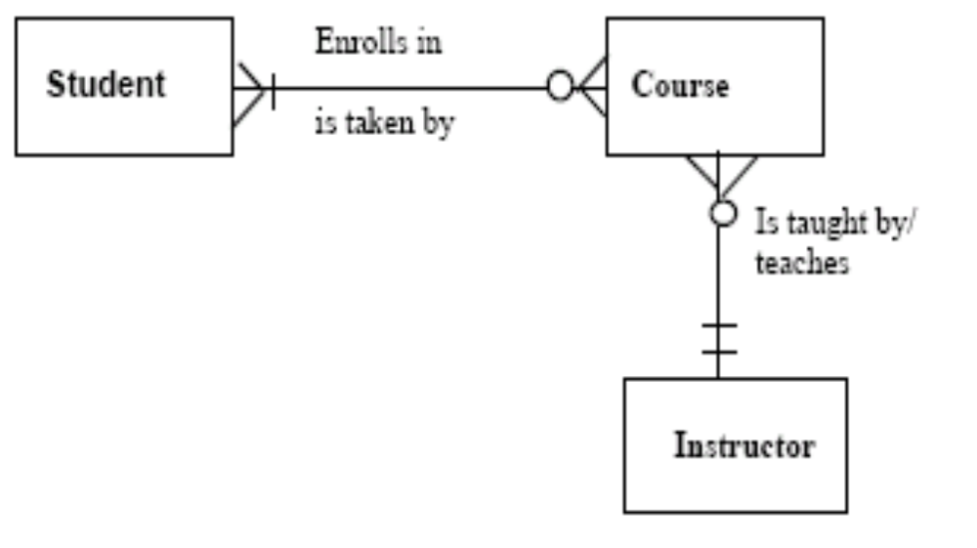
ERD for Course Enrollment

Slide 42
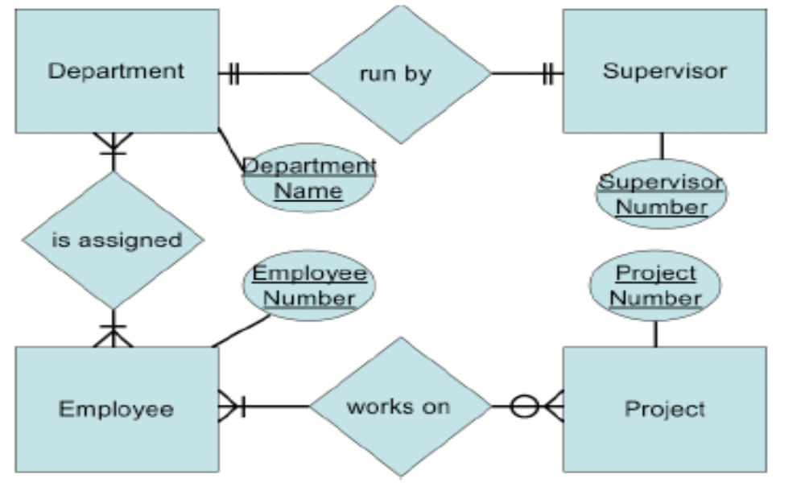
Rough ERD Plus Primary Keys

Slide 43
Map Attributes
For each attribute we need to match it with exactly one entity. Often it seems like an attribute should go with more than one entity (e.g. Name). In this case you need to add a modifier to the attribute name to make it unique (e.g. Customer Name, Employee Name, etc.) or determine which entity an attribute "best' describes.
If you have attributes left over without corresponding entities, you may have missed an entity and its corresponding relationships. Identify these missed entities and add them to the relationship matrix now.

Slide 44
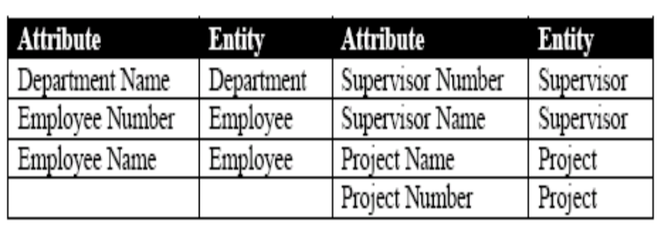
Map Attributes (Contd.)

Slide 45
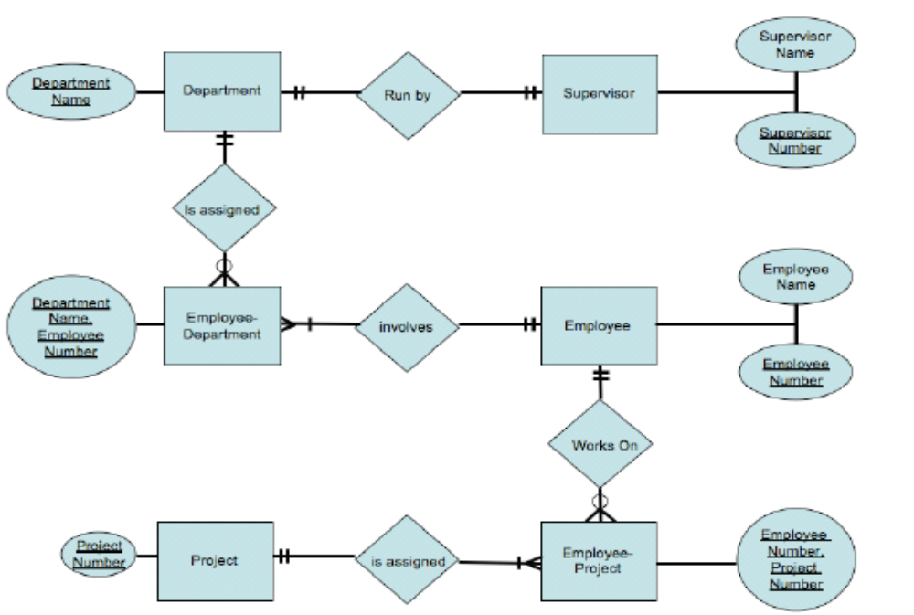
Draw Fully Attributed ERD

Slide 46
Check ERD Results
Look at your diagram from the point of view of a system owner or user. Is everything clear?
Check through the Cardinality pairs.
Also, look over the list of attributes associated with each entity to see if anything has been omitted.

