Slide 1
Relational Database
Dr. E.F.Codd proposed the relational model for database system in 1970.
It is the basis for the relational database management system (RDBMS)

Slide 2
Relational Database Model
  Uses tables to organize data
  Each table corresponds to an entity
  Each row represents the instance of that entity
  Tables can be related each other
      Relation=Table
      Tuple=Row
      Attribute=Column

Slide 3
RDBMS
Fundamental Features
  ACID
  Referential Integrity
  Transactions
  Unicode
Other objects are supported
  Data Domain
  Cursor
  Trigger
  Function
  Procedure
Database Capabilites
  Union
  Inner joins
  Outer joins
  Inner selects
  Merge
  Blobs

Slide 4
Relational Model
Three key terms are used extensively in relational models
  Relation
    relation is a table with columns and rows
  Attributes
    The named columns of the relation are called attributes
  Domains
    set of values the attributes are allowed to take

Slide 5
Transaction Properties
ACID
Atomicity: A transaction is an atomic unit of processing; it should either be performed in its entirety or not performed at all.
Consistency preservation: A transaction should be consistency preserving, meaning that if it is completely executed from beginning to end without interference from other transactions, it should take the database from one consistent state to another.
Isolation: A transaction should appear as though it is being executed in isolation from other transactions, even though many transactions are executing concurrently. That is, the execution of a transaction should not be interfered with by any other transactions executing concurrently.
Durability or permanency: The changes applied to the database by a committed transaction must persist in the database. These changes must not be lost because of any failure. The durability property is the responsibility of the recovery subsystem of the DBMS.

Slide 6
Relational Database Properties
A relational database:
  Can be accessed and modified by executing structured query language (SQL) statements
  Contains a collection of tables with no physical pointers
  Uses a set of operators
Notes:
Properties of a Relational Database
In a relational database, you do not specify the access route to the tables, and you do not need to know how the data is arranged physically.
To access the database, you execute a structured query language (SQL) statement, which is the American National Standards Institute (ANSI) standard language for operating relational databases. The language contains a large set of operators for partitioning and combining relations. The database can be modified by using the SQL statements.

Slide 7





Oracle’s Relational Database Management System
Oracle
server
User tables
Data
dictionary
Notes:
Oracle’s Relational Database Management System
Oracle provides a flexible RDBMS called Oracle Database 10g. Using its features, you can store and manage data with all the advantages of a relational structure plus PL/SQL, an engine that provides you with the ability to store and execute program units. Oracle Database 10g also supports Java and XML. The Oracle server offers the options of retrieving data based on optimization techniques. It includes security features that control how a database is accessed and used. Other features include consistency and protection of data through locking mechanisms.
The Oracle10g release provides an open, comprehensive, and integrated approach to information management. An Oracle server consists of an Oracle database and an Oracle server instance. Every time a database is started, a system global area (SGA) is allocated and Oracle background processes are started. The SGA is an area of memory that is used for database information shared by the database users. The combination of the background processes and memory buffers is called an Oracle instance.

Slide 8
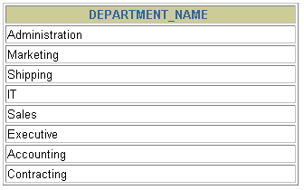
Communicating with an RDBMS Using SQL
SQL statement is entered.
Statement is sent to Oracle server.
SELECT department_name
FROM departments;
Oracle
server
Notes:
Structured Query Language
Using SQL, you can communicate with the Oracle server. SQL has the following advantages:
Efficient
Easy to learn and use
Functionally complete (With SQL, you can define, retrieve, and manipulate data in the tables.)

Slide 9
SQL
SQL: widely used non-procedural language
  Example: Find the name of the customer with customer-id 192-83-7465
  select customer.customer_name
  from customer
  where customer.customer_id = ‘192-83-7465’
Application programs generally access databases through one of
  Language extensions to allow embedded SQL
  Application program interface (e.g., ODBC/JDBC) which allow SQL queries to be sent to a database

Slide 10
Data Manipulation Language (DML)
Language for accessing and manipulating the data organized by the appropriate data model
  DML also known as query language:
    Insert, edit, delete, and of course query.
SQL is the most widely used query language

Slide 11
Data Definition Language (DDL)
Specification notation for defining the database schema
  Example: create table clubMember (
  name char(30),
  fee_balance integer)
DDL compiler generates a set of tables stored in a data dictionary
Data dictionary contains metadata (i.e., data about data)
  Database schema
  Data storage and definition language
    Specifies the storage structure and access methods used
  Integrity constraints

Slide 12
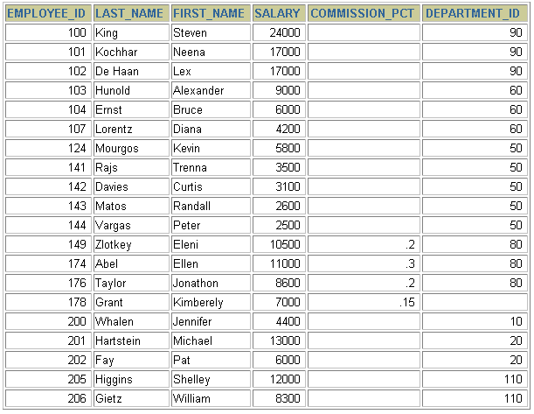
Relational Database Terminology
3
4
2
5
6
1
Notes:
Terminology Used in a Relational Database
A relational database can contain one or many tables. A table is the basic storage structure of an RDBMS. A table holds all the data necessary about something in the real world, such as employees, invoices, or customers.
The slide shows the contents of the EMPLOYEES table or relation. The numbers indicate the following:
1. A single row (or tuple) representing all data required for a particular employee. Each row in a table should be identified by a primary key, which permits no duplicate rows. The order of rows is insignificant; specify the row order when the data is retrieved.
2. A column or attribute containing the employee number. The employee number identifies a unique employee in the EMPLOYEES table. In this example, the employee number column is designated as the primary key. A primary key must contain a value, and the value must be unique.
3. A column that is not a key value. A column represents one kind of data in a table; in this example, the data is the salaries of all the employees. Column order is insignificant when storing data; specify the column order when the data is retrieved.

Slide 13
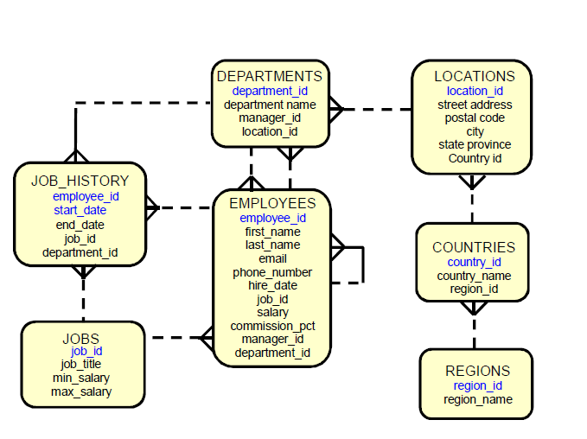
HR Schema
Notes:
Terminology Used in a Relational Database
A relational database can contain one or many tables. A table is the basic storage structure of an RDBMS. A table holds all the data necessary about something in the real world, such as employees, invoices, or customers.
The slide shows the contents of the EMPLOYEES table or relation. The numbers indicate the following:
1. A single row (or tuple) representing all data required for a particular employee. Each row in a table should be identified by a primary key, which permits no duplicate rows. The order of rows is insignificant; specify the row order when the data is retrieved.
2. A column or attribute containing the employee number. The employee number identifies a unique employee in the EMPLOYEES table. In this example, the employee number column is designated as the primary key. A primary key must contain a value, and the value must be unique.
3. A column that is not a key value. A column represents one kind of data in a table; in this example, the data is the salaries of all the employees. Column order is insignificant when storing data; specify the column order when the data is retrieved.

Slide 14
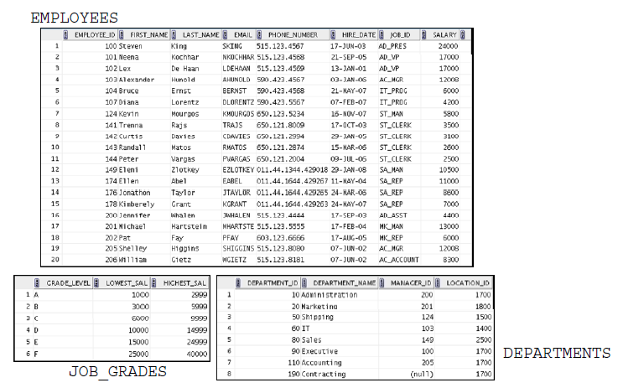
Converting HR Schema ERD to Tables
Notes:
Terminology Used in a Relational Database
A relational database can contain one or many tables. A table is the basic storage structure of an RDBMS. A table holds all the data necessary about something in the real world, such as employees, invoices, or customers.
The slide shows the contents of the EMPLOYEES table or relation. The numbers indicate the following:
1. A single row (or tuple) representing all data required for a particular employee. Each row in a table should be identified by a primary key, which permits no duplicate rows. The order of rows is insignificant; specify the row order when the data is retrieved.
2. A column or attribute containing the employee number. The employee number identifies a unique employee in the EMPLOYEES table. In this example, the employee number column is designated as the primary key. A primary key must contain a value, and the value must be unique.
3. A column that is not a key value. A column represents one kind of data in a table; in this example, the data is the salaries of all the employees. Column order is insignificant when storing data; specify the column order when the data is retrieved.

Slide 15
Database Normalization
The process by which we efficiently organize data to achieve these goals:
Eliminating redundancy
Ensuring data is stored in the correct table
Eliminating need for restructuring database when data is added.
Five levels of normal form
In order to achieve one level of normal form, each previous level must be met.
Third normal form is sufficient for most typical database applications.
Notes:
Terminology Used in a Relational Database
A relational database can contain one or many tables. A table is the basic storage structure of an RDBMS. A table holds all the data necessary about something in the real world, such as employees, invoices, or customers.
The slide shows the contents of the EMPLOYEES table or relation. The numbers indicate the following:
1. A single row (or tuple) representing all data required for a particular employee. Each row in a table should be identified by a primary key, which permits no duplicate rows. The order of rows is insignificant; specify the row order when the data is retrieved.
2. A column or attribute containing the employee number. The employee number identifies a unique employee in the EMPLOYEES table. In this example, the employee number column is designated as the primary key. A primary key must contain a value, and the value must be unique.
3. A column that is not a key value. A column represents one kind of data in a table; in this example, the data is the salaries of all the employees. Column order is insignificant when storing data; specify the column order when the data is retrieved.

Slide 16
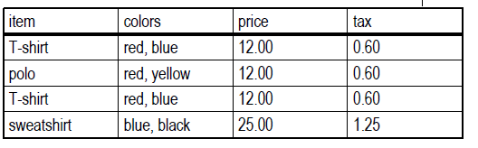
First Normal Form (1NF)
There are no repeating or duplicate fields.
Each cell contains only a single value.
Each record is unique.
Identified by primary key
Example
Table is not in first normal form because:
Multiple items in color field
Duplicate records / no primary key
Notes:
Terminology Used in a Relational Database
A relational database can contain one or many tables. A table is the basic storage structure of an RDBMS. A table holds all the data necessary about something in the real world, such as employees, invoices, or customers.
The slide shows the contents of the EMPLOYEES table or relation. The numbers indicate the following:
1. A single row (or tuple) representing all data required for a particular employee. Each row in a table should be identified by a primary key, which permits no duplicate rows. The order of rows is insignificant; specify the row order when the data is retrieved.
2. A column or attribute containing the employee number. The employee number identifies a unique employee in the EMPLOYEES table. In this example, the employee number column is designated as the primary key. A primary key must contain a value, and the value must be unique.
3. A column that is not a key value. A column represents one kind of data in a table; in this example, the data is the salaries of all the employees. Column order is insignificant when storing data; specify the column order when the data is retrieved.

Slide 17
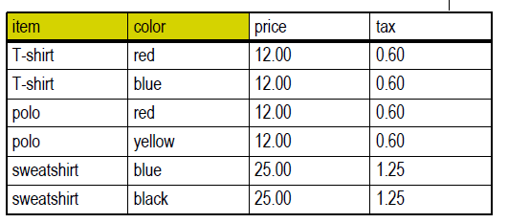
First Normal Form (1NF)
Example
Table is in First Normal Form
Notes:
Terminology Used in a Relational Database
A relational database can contain one or many tables. A table is the basic storage structure of an RDBMS. A table holds all the data necessary about something in the real world, such as employees, invoices, or customers.
The slide shows the contents of the EMPLOYEES table or relation. The numbers indicate the following:
1. A single row (or tuple) representing all data required for a particular employee. Each row in a table should be identified by a primary key, which permits no duplicate rows. The order of rows is insignificant; specify the row order when the data is retrieved.
2. A column or attribute containing the employee number. The employee number identifies a unique employee in the EMPLOYEES table. In this example, the employee number column is designated as the primary key. A primary key must contain a value, and the value must be unique.
3. A column that is not a key value. A column represents one kind of data in a table; in this example, the data is the salaries of all the employees. Column order is insignificant when storing data; specify the column order when the data is retrieved.

Slide 18
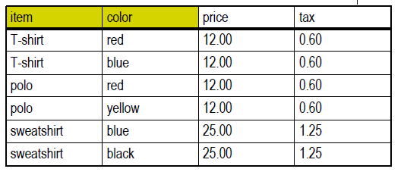
Second Normal Form (2NF)
All non-key fields depend on all components of the primary key.
Guaranteed when primary key is a single field.
Example
Table is not in second normal form because:
price and tax depend on item, but not color
Notes:
Terminology Used in a Relational Database
A relational database can contain one or many tables. A table is the basic storage structure of an RDBMS. A table holds all the data necessary about something in the real world, such as employees, invoices, or customers.
The slide shows the contents of the EMPLOYEES table or relation. The numbers indicate the following:
1. A single row (or tuple) representing all data required for a particular employee. Each row in a table should be identified by a primary key, which permits no duplicate rows. The order of rows is insignificant; specify the row order when the data is retrieved.
2. A column or attribute containing the employee number. The employee number identifies a unique employee in the EMPLOYEES table. In this example, the employee number column is designated as the primary key. A primary key must contain a value, and the value must be unique.
3. A column that is not a key value. A column represents one kind of data in a table; in this example, the data is the salaries of all the employees. Column order is insignificant when storing data; specify the column order when the data is retrieved.

Slide 19
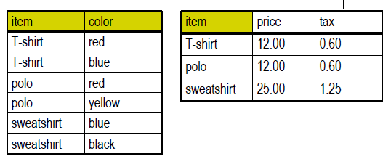
Second Normal Form (2NF)
Example
Tables are now in second normal form.
Notes:
Terminology Used in a Relational Database
A relational database can contain one or many tables. A table is the basic storage structure of an RDBMS. A table holds all the data necessary about something in the real world, such as employees, invoices, or customers.
The slide shows the contents of the EMPLOYEES table or relation. The numbers indicate the following:
1. A single row (or tuple) representing all data required for a particular employee. Each row in a table should be identified by a primary key, which permits no duplicate rows. The order of rows is insignificant; specify the row order when the data is retrieved.
2. A column or attribute containing the employee number. The employee number identifies a unique employee in the EMPLOYEES table. In this example, the employee number column is designated as the primary key. A primary key must contain a value, and the value must be unique.
3. A column that is not a key value. A column represents one kind of data in a table; in this example, the data is the salaries of all the employees. Column order is insignificant when storing data; specify the column order when the data is retrieved.

Slide 20
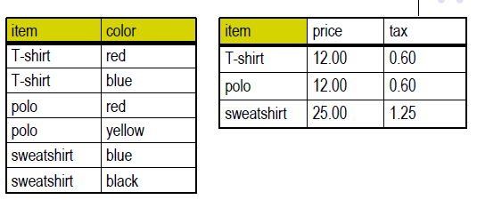
Third Normal Form (3NF)
No non-key field depends upon another.
All non-key fields depend only on the primary key.
Example
Tables are not in third normal form because:
tax depends on price, not item
Notes:
Terminology Used in a Relational Database
A relational database can contain one or many tables. A table is the basic storage structure of an RDBMS. A table holds all the data necessary about something in the real world, such as employees, invoices, or customers.
The slide shows the contents of the EMPLOYEES table or relation. The numbers indicate the following:
1. A single row (or tuple) representing all data required for a particular employee. Each row in a table should be identified by a primary key, which permits no duplicate rows. The order of rows is insignificant; specify the row order when the data is retrieved.
2. A column or attribute containing the employee number. The employee number identifies a unique employee in the EMPLOYEES table. In this example, the employee number column is designated as the primary key. A primary key must contain a value, and the value must be unique.
3. A column that is not a key value. A column represents one kind of data in a table; in this example, the data is the salaries of all the employees. Column order is insignificant when storing data; specify the column order when the data is retrieved.

Slide 21
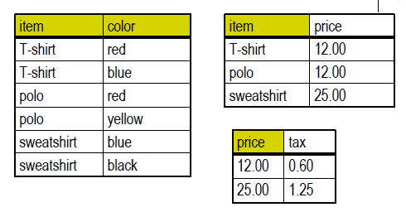
Third Normal Form (3NF)
Example
Tables are now in third normal form.
Notes:
Terminology Used in a Relational Database
A relational database can contain one or many tables. A table is the basic storage structure of an RDBMS. A table holds all the data necessary about something in the real world, such as employees, invoices, or customers.
The slide shows the contents of the EMPLOYEES table or relation. The numbers indicate the following:
1. A single row (or tuple) representing all data required for a particular employee. Each row in a table should be identified by a primary key, which permits no duplicate rows. The order of rows is insignificant; specify the row order when the data is retrieved.
2. A column or attribute containing the employee number. The employee number identifies a unique employee in the EMPLOYEES table. In this example, the employee number column is designated as the primary key. A primary key must contain a value, and the value must be unique.
3. A column that is not a key value. A column represents one kind of data in a table; in this example, the data is the salaries of all the employees. Column order is insignificant when storing data; specify the column order when the data is retrieved.

Slide 22
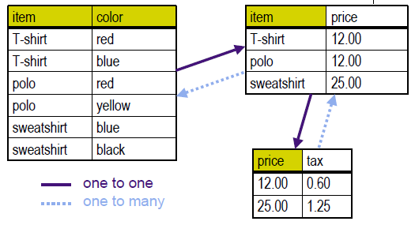
Relationships
Boyce-Codd Normal Form (BCNF)
A relation is in BCNF if and only if every determinant is a candidate key.
Example
Notes:
Terminology Used in a Relational Database
A relational database can contain one or many tables. A table is the basic storage structure of an RDBMS. A table holds all the data necessary about something in the real world, such as employees, invoices, or customers.
The slide shows the contents of the EMPLOYEES table or relation. The numbers indicate the following:
1. A single row (or tuple) representing all data required for a particular employee. Each row in a table should be identified by a primary key, which permits no duplicate rows. The order of rows is insignificant; specify the row order when the data is retrieved.
2. A column or attribute containing the employee number. The employee number identifies a unique employee in the EMPLOYEES table. In this example, the employee number column is designated as the primary key. A primary key must contain a value, and the value must be unique.
3. A column that is not a key value. A column represents one kind of data in a table; in this example, the data is the salaries of all the employees. Column order is insignificant when storing data; specify the column order when the data is retrieved.

Slide 23
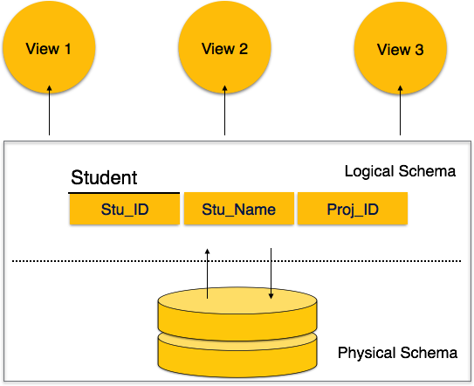
Security
Different Levels of security
Database Views
Users Roles, Privileges
Constraints
Database Views
Notes:
Terminology Used in a Relational Database
A relational database can contain one or many tables. A table is the basic storage structure of an RDBMS. A table holds all the data necessary about something in the real world, such as employees, invoices, or customers.
The slide shows the contents of the EMPLOYEES table or relation. The numbers indicate the following:
1. A single row (or tuple) representing all data required for a particular employee. Each row in a table should be identified by a primary key, which permits no duplicate rows. The order of rows is insignificant; specify the row order when the data is retrieved.
2. A column or attribute containing the employee number. The employee number identifies a unique employee in the EMPLOYEES table. In this example, the employee number column is designated as the primary key. A primary key must contain a value, and the value must be unique.
3. A column that is not a key value. A column represents one kind of data in a table; in this example, the data is the salaries of all the employees. Column order is insignificant when storing data; specify the column order when the data is retrieved.

Slide 24
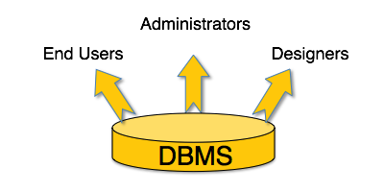
Security
Different Levels of security
Database Views
Users Roles, Privileges
Constraints
Users
Notes:
Terminology Used in a Relational Database
A relational database can contain one or many tables. A table is the basic storage structure of an RDBMS. A table holds all the data necessary about something in the real world, such as employees, invoices, or customers.
The slide shows the contents of the EMPLOYEES table or relation. The numbers indicate the following:
1. A single row (or tuple) representing all data required for a particular employee. Each row in a table should be identified by a primary key, which permits no duplicate rows. The order of rows is insignificant; specify the row order when the data is retrieved.
2. A column or attribute containing the employee number. The employee number identifies a unique employee in the EMPLOYEES table. In this example, the employee number column is designated as the primary key. A primary key must contain a value, and the value must be unique.
3. A column that is not a key value. A column represents one kind of data in a table; in this example, the data is the salaries of all the employees. Column order is insignificant when storing data; specify the column order when the data is retrieved.

Slide 25
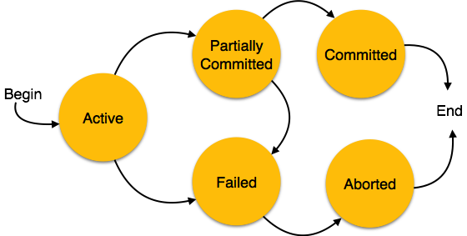
Transaction Processing
States of Transactions
Active
Partially Committed .
Failed
Aborted
  Re-start the transaction
  Kill the transaction
Committed
Notes:
Terminology Used in a Relational Database
A relational database can contain one or many tables. A table is the basic storage structure of an RDBMS. A table holds all the data necessary about something in the real world, such as employees, invoices, or customers.
The slide shows the contents of the EMPLOYEES table or relation. The numbers indicate the following:
1. A single row (or tuple) representing all data required for a particular employee. Each row in a table should be identified by a primary key, which permits no duplicate rows. The order of rows is insignificant; specify the row order when the data is retrieved.
2. A column or attribute containing the employee number. The employee number identifies a unique employee in the EMPLOYEES table. In this example, the employee number column is designated as the primary key. A primary key must contain a value, and the value must be unique.
3. A column that is not a key value. A column represents one kind of data in a table; in this example, the data is the salaries of all the employees. Column order is insignificant when storing data; specify the column order when the data is retrieved.

Slide 26
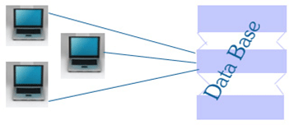
Distributed Databases and Client-Server Computing
Two-Tier Architecture
Three – Tier Architecture
N tier Architecture
Two-Tier Architecture
The two-tier architecture is like client server application. The direct communication takes place between client and server. There is no intermediate between client and server.
Notes:
Terminology Used in a Relational Database
A relational database can contain one or many tables. A table is the basic storage structure of an RDBMS. A table holds all the data necessary about something in the real world, such as employees, invoices, or customers.
The slide shows the contents of the EMPLOYEES table or relation. The numbers indicate the following:
1. A single row (or tuple) representing all data required for a particular employee. Each row in a table should be identified by a primary key, which permits no duplicate rows. The order of rows is insignificant; specify the row order when the data is retrieved.
2. A column or attribute containing the employee number. The employee number identifies a unique employee in the EMPLOYEES table. In this example, the employee number column is designated as the primary key. A primary key must contain a value, and the value must be unique.
3. A column that is not a key value. A column represents one kind of data in a table; in this example, the data is the salaries of all the employees. Column order is insignificant when storing data; specify the column order when the data is retrieved.

Slide 27

Two-Tier Architecture
Two-Tier Architecture
The two tiers of two-tier architecture is
Database (Data tier)
Client Application (Client tier)
Notes:
Terminology Used in a Relational Database
A relational database can contain one or many tables. A table is the basic storage structure of an RDBMS. A table holds all the data necessary about something in the real world, such as employees, invoices, or customers.
The slide shows the contents of the EMPLOYEES table or relation. The numbers indicate the following:
1. A single row (or tuple) representing all data required for a particular employee. Each row in a table should be identified by a primary key, which permits no duplicate rows. The order of rows is insignificant; specify the row order when the data is retrieved.
2. A column or attribute containing the employee number. The employee number identifies a unique employee in the EMPLOYEES table. In this example, the employee number column is designated as the primary key. A primary key must contain a value, and the value must be unique.
3. A column that is not a key value. A column represents one kind of data in a table; in this example, the data is the salaries of all the employees. Column order is insignificant when storing data; specify the column order when the data is retrieved.

Slide 28
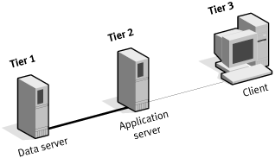
Three-Tier Architecture
Three tier architecture having three layers. They are
Client layer
Business layer
Data layer
Client: Here we design the form using textbox, label etc.
Application Server / Bussiness Layer: It is the intermediate layer which has the functions for client layer and it is used to make communication faster between client and data layer. It provides the business processes logic and the data access.
Data Server: it has the database.
Notes:
Terminology Used in a Relational Database
A relational database can contain one or many tables. A table is the basic storage structure of an RDBMS. A table holds all the data necessary about something in the real world, such as employees, invoices, or customers.
The slide shows the contents of the EMPLOYEES table or relation. The numbers indicate the following:
1. A single row (or tuple) representing all data required for a particular employee. Each row in a table should be identified by a primary key, which permits no duplicate rows. The order of rows is insignificant; specify the row order when the data is retrieved.
2. A column or attribute containing the employee number. The employee number identifies a unique employee in the EMPLOYEES table. In this example, the employee number column is designated as the primary key. A primary key must contain a value, and the value must be unique.
3. A column that is not a key value. A column represents one kind of data in a table; in this example, the data is the salaries of all the employees. Column order is insignificant when storing data; specify the column order when the data is retrieved.

Slide 29
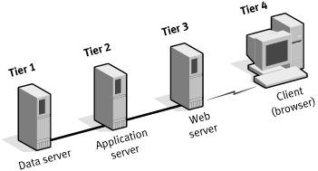
N-Tier Architecture
Partitioning the application logic among various hosts can also create an N-tiered system.
As applications become Web-oriented, Web server front ends can be used to offload the networking required to service user requests, providing more scalability and introducing points of functional optimization.
In this architecture, the client sends HTTP requests for content and presents the responses
provided by the
application system.
On receiving requests,
the Web server either
returns the content
directly or passes
it on to a specific
application server
Notes:
Terminology Used in a Relational Database
A relational database can contain one or many tables. A table is the basic storage structure of an RDBMS. A table holds all the data necessary about something in the real world, such as employees, invoices, or customers.
The slide shows the contents of the EMPLOYEES table or relation. The numbers indicate the following:
1. A single row (or tuple) representing all data required for a particular employee. Each row in a table should be identified by a primary key, which permits no duplicate rows. The order of rows is insignificant; specify the row order when the data is retrieved.
2. A column or attribute containing the employee number. The employee number identifies a unique employee in the EMPLOYEES table. In this example, the employee number column is designated as the primary key. A primary key must contain a value, and the value must be unique.
3. A column that is not a key value. A column represents one kind of data in a table; in this example, the data is the salaries of all the employees. Column order is insignificant when storing data; specify the column order when the data is retrieved.

Slide 30
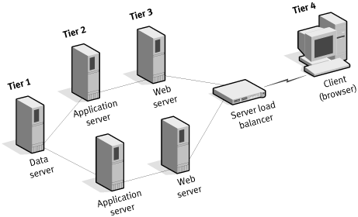
N-Tier Architecture
with Server Load Balancing
Notes:
Terminology Used in a Relational Database
A relational database can contain one or many tables. A table is the basic storage structure of an RDBMS. A table holds all the data necessary about something in the real world, such as employees, invoices, or customers.
The slide shows the contents of the EMPLOYEES table or relation. The numbers indicate the following:
1. A single row (or tuple) representing all data required for a particular employee. Each row in a table should be identified by a primary key, which permits no duplicate rows. The order of rows is insignificant; specify the row order when the data is retrieved.
2. A column or attribute containing the employee number. The employee number identifies a unique employee in the EMPLOYEES table. In this example, the employee number column is designated as the primary key. A primary key must contain a value, and the value must be unique.
3. A column that is not a key value. A column represents one kind of data in a table; in this example, the data is the salaries of all the employees. Column order is insignificant when storing data; specify the column order when the data is retrieved.

Slide 31
Codd’s Rules
Dr Edgar F. Codd, after his extensive research on the Relational Model of database systems, came up with twelve rules of his own, which according to him, a database must obey in order to be regarded as a true relational database.
Rule 1: Information Rule.
Rule 2: Guaranteed Access Rule
Rule 3: Systematic Treatment of NULL Values
Rule 4: Active Online Catalog
Rule 5: Comprehensive Data Sub-Language Rule
Rule 6: View Updating Rule
Rule 7: High-Level Insert, Update, and Delete Rule
Rule 8: Physical Data Independence
Rule 9: Logical Data Independence
Rule 10: Integrity Independence
Rule 11: Distribution Independence
Rule 12: Non-Subversion Rule
Notes:
Terminology Used in a Relational Database
A relational database can contain one or many tables. A table is the basic storage structure of an RDBMS. A table holds all the data necessary about something in the real world, such as employees, invoices, or customers.
The slide shows the contents of the EMPLOYEES table or relation. The numbers indicate the following:
1. A single row (or tuple) representing all data required for a particular employee. Each row in a table should be identified by a primary key, which permits no duplicate rows. The order of rows is insignificant; specify the row order when the data is retrieved.
2. A column or attribute containing the employee number. The employee number identifies a unique employee in the EMPLOYEES table. In this example, the employee number column is designated as the primary key. A primary key must contain a value, and the value must be unique.
3. A column that is not a key value. A column represents one kind of data in a table; in this example, the data is the salaries of all the employees. Column order is insignificant when storing data; specify the column order when the data is retrieved.

Slide 32
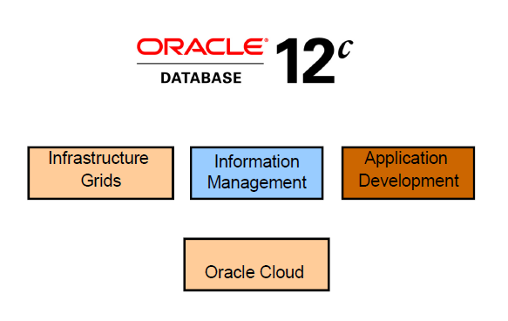
Oracle 12c
Notes:
Terminology Used in a Relational Database
A relational database can contain one or many tables. A table is the basic storage structure of an RDBMS. A table holds all the data necessary about something in the real world, such as employees, invoices, or customers.
The slide shows the contents of the EMPLOYEES table or relation. The numbers indicate the following:
1. A single row (or tuple) representing all data required for a particular employee. Each row in a table should be identified by a primary key, which permits no duplicate rows. The order of rows is insignificant; specify the row order when the data is retrieved.
2. A column or attribute containing the employee number. The employee number identifies a unique employee in the EMPLOYEES table. In this example, the employee number column is designated as the primary key. A primary key must contain a value, and the value must be unique.
3. A column that is not a key value. A column represents one kind of data in a table; in this example, the data is the salaries of all the employees. Column order is insignificant when storing data; specify the column order when the data is retrieved.

Slide 33
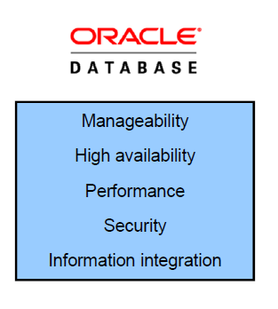
Oracle 12c
Notes:
Terminology Used in a Relational Database
A relational database can contain one or many tables. A table is the basic storage structure of an RDBMS. A table holds all the data necessary about something in the real world, such as employees, invoices, or customers.
The slide shows the contents of the EMPLOYEES table or relation. The numbers indicate the following:
1. A single row (or tuple) representing all data required for a particular employee. Each row in a table should be identified by a primary key, which permits no duplicate rows. The order of rows is insignificant; specify the row order when the data is retrieved.
2. A column or attribute containing the employee number. The employee number identifies a unique employee in the EMPLOYEES table. In this example, the employee number column is designated as the primary key. A primary key must contain a value, and the value must be unique.
3. A column that is not a key value. A column represents one kind of data in a table; in this example, the data is the salaries of all the employees. Column order is insignificant when storing data; specify the column order when the data is retrieved.

Slide 34
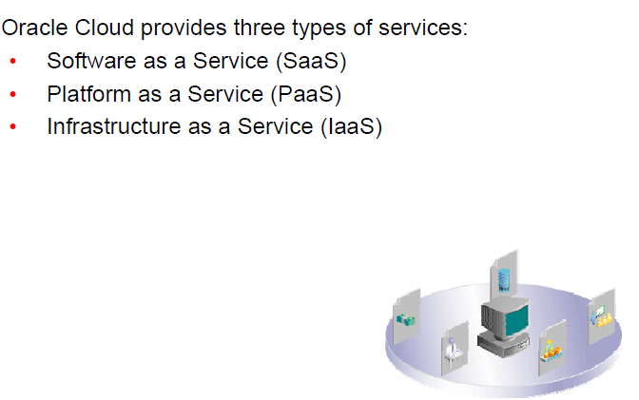
Oracle Cloud Services
Notes:
Terminology Used in a Relational Database
A relational database can contain one or many tables. A table is the basic storage structure of an RDBMS. A table holds all the data necessary about something in the real world, such as employees, invoices, or customers.
The slide shows the contents of the EMPLOYEES table or relation. The numbers indicate the following:
1. A single row (or tuple) representing all data required for a particular employee. Each row in a table should be identified by a primary key, which permits no duplicate rows. The order of rows is insignificant; specify the row order when the data is retrieved.
2. A column or attribute containing the employee number. The employee number identifies a unique employee in the EMPLOYEES table. In this example, the employee number column is designated as the primary key. A primary key must contain a value, and the value must be unique.
3. A column that is not a key value. A column represents one kind of data in a table; in this example, the data is the salaries of all the employees. Column order is insignificant when storing data; specify the column order when the data is retrieved.

Slide 35
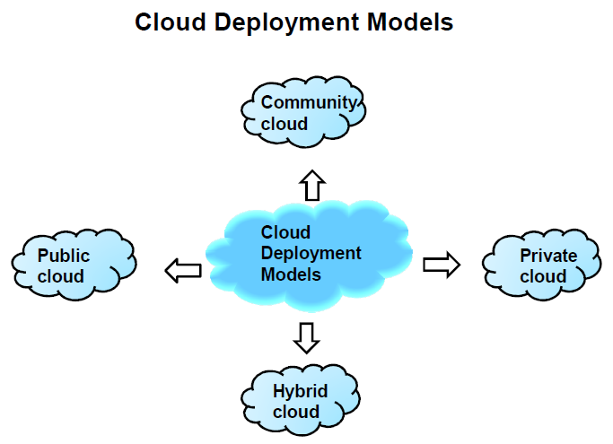
Oracle Cloud Services
Notes:
Terminology Used in a Relational Database
A relational database can contain one or many tables. A table is the basic storage structure of an RDBMS. A table holds all the data necessary about something in the real world, such as employees, invoices, or customers.
The slide shows the contents of the EMPLOYEES table or relation. The numbers indicate the following:
1. A single row (or tuple) representing all data required for a particular employee. Each row in a table should be identified by a primary key, which permits no duplicate rows. The order of rows is insignificant; specify the row order when the data is retrieved.
2. A column or attribute containing the employee number. The employee number identifies a unique employee in the EMPLOYEES table. In this example, the employee number column is designated as the primary key. A primary key must contain a value, and the value must be unique.
3. A column that is not a key value. A column represents one kind of data in a table; in this example, the data is the salaries of all the employees. Column order is insignificant when storing data; specify the column order when the data is retrieved.

