Slide 1
Report: Modeling Canadian CO2 Emissions in Cars
Capstone Project
Prasan Ratnayake (Zone 24x7)
Data Science Engineer

Slide 2
Introduction
The transportation sector stands as a significant contributor to Canada's carbon footprint, with vehicles accounting for a substantial portion of CO2 emissions. Understanding and mitigating these emissions have become critical in the pursuit of sustainable environmental practices.
The dataset utilized in this study encapsulates a comprehensive official record of CO2 emissions data sourced from a myriad of cars, encompassing various makes, models, and characteristics. Spanning 7385 records and 12 columns, this dataset offers a rich repository of information crucial for assessing and predicting CO2 emissions within the Canadian automotive landscape
The relevance of this analysis transcends the confines of a mere predictive modeling exercise. At its core, this study seeks to address the pressing need for a deeper understanding of the factors influencing CO2 emissions in cars. By leveraging machine learning techniques and extensive data analysis, we aim to unravel patterns, correlations, and predictive insights that can significantly impact policymaking, environmental initiatives, and consumer awareness.

Slide 3
Data
The dataset comprises 7385 records and 12 columns, providing essential insights into CO2 emissions factors for different cars. Abbreviations used in the dataset to describe features are detailed in the Data Description sheet, enhancing the understanding of the data.
Url :Dataset
Data Columns
Key columns such as 'Make', 'Model', 'Vehicle Class', 'Engine Size (L)', 'Cylinders', 'Transmission', 'Fuel Type', and fuel consumption metrics ('Fuel Consumption City', 'Highway', and 'Combined') form the backbone of this dataset, contributing vital information about CO2 emissions.

Slide 4
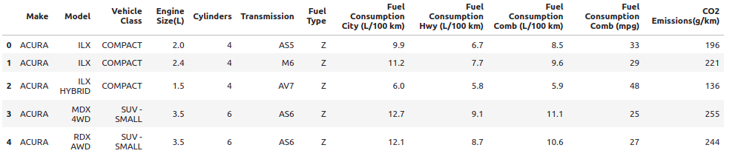
Data

Slide 5
Methodology
Data Preprocessing
Design ML Solution
Train Model
Hyperparameter Tuning
Evaluate Model Performance on Train Test

Slide 6
Methodology
Data Preprocessing
Before model development, a rigorous data preprocessing phase was executed. This phase involved meticulous cleaning, handling missing values, categorical variable encoding, and feature scaling. The objective was to ensure the dataset's readiness for subsequent modeling tasks.
Model Development and Hyperparameter Tuning
A variety of machine learning techniques were employed to predict CO2 emissions effectively. Through systematic experimentation, hyperparameter tuning, and cross-validation, the best-performing model was identified.
Best Model and Accuracy
The XGBoost algorithm emerged as the most accurate model, achieving an impressive R-squared score of 99.07%. Notably, the Random Forest model closely followed with a score of 98.89%. Other models, such as Support Vector Machines and Linear Regression, also contributed valuable insights.

Slide 7
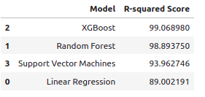
Results

Slide 8
Discussion
Understanding CO2 Emissions Patterns
The analysis of CO2 emissions in Canadian cars uncovered intricate patterns and relationships among various vehicle features and emission levels. By exploring factors such as engine specifications, fuel types, and consumption metrics, we gained valuable insights into the dynamics influencing emissions. Notably, features like engine size, cylinder count, and fuel consumption emerged as significant contributors to CO2 emissions, corroborating existing knowledge in the automotive domain.
Impact of Machine Learning Techniques
The application of diverse machine learning algorithms unveiled promising avenues for predicting CO2 emissions. Among these, XGBoost and Random Forest models demonstrated exceptional accuracy, surpassing traditional linear models and providing deeper insights into the nonlinear relationships within the dataset. The high accuracy achieved by these models underscores their potential as robust predictive tools for assessing and managing CO2 emissions in cars.

Slide 9
Discussion
Significance for Policy and Sustainability Initiatives
The findings from this analysis hold immense implications for policymakers, environmentalists, and industry stakeholders. Accurate predictive models enable informed decision-making regarding emission regulations, fuel efficiency standards, and incentivizing eco-friendly vehicle designs. Additionally, understanding emission patterns can aid consumers in making environmentally conscious choices when purchasing vehicles, fostering a shift towards greener transportation practices.
Limitations and Future Directions
While our analysis provided significant insights, several limitations warrant consideration. The dataset's completeness and representativeness may influence model performance, and the inclusion of additional data sources could enhance predictive accuracy. Furthermore, exploring temporal trends and integrating real-time emissions data could bolster the models' predictive capabilities in a dynamic automotive landscape.

Slide 10
Discussion
Conclusion and Recommendations
In conclusion, the modeling of CO2 emissions in Canadian cars represents a crucial step towards understanding, predicting, and mitigating environmental impacts. The insights gained from this analysis not only contribute to the academic discourse but also offer actionable insights for policymakers and industry stakeholders. Moving forward, continuous refinement of models and data collection methodologies stands imperative for developing robust, adaptive models capable of addressing evolving emission challenges.

Slide 11
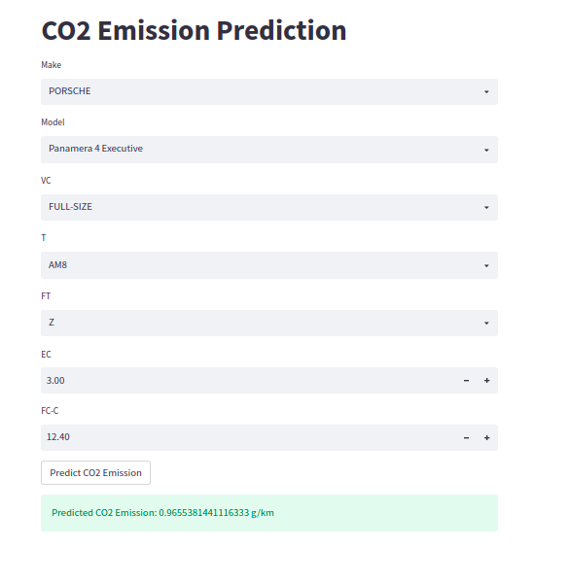
Final Application
Input Parameters:
Make: Dropdown menu to select the car manufacturer (e.g., PORSCHE, BMW, etc.).
Model: Dropdown menu to select the car model (e.g., Panamera 4 Executive, M6 CABRIOLET, etc.).
Vehicle Class (VC): Dropdown menu to specify the vehicle class (e.g., FULL-SIZE, SUBCOMPACT, etc.).
Transmission (T): Dropdown menu for the car's transmission type (e.g., AM8, AM7, etc.).
Fuel Type (FT): Dropdown menu for the fuel type (e.g., Z, X, etc.).
Engine Size (EC): Numeric input field to enter the engine size (in liters).
Fuel Consumption City (FC-C): Numeric input field for the fuel consumption in the city (in L/100 km).

Slide 12
Final Application
Prediction:
Upon entering these parameters and clicking the 'Predict CO2 Emission' button, the application processes the inputs using a pre-trained XGBoost model.
The predicted CO2 emissions in grams per kilometer (g/km) are displayed as the output.
Functionality:
The application encodes categorical inputs using label encoders to fit the model's requirements.
It handles both categorical and numerical inputs, transforming categorical inputs while keeping numerical ones unchanged.
Errors, such as attempting to convert non-numeric values to floats, are being addressed to ensure smooth user experience.

Slide 13
Final Application
Usage:
Users can experiment with different car attributes by selecting from available options or inputting numerical values.
The prediction output allows users to understand the estimated CO2 emissions based on the selected car specifications.
Technologies Used:
Streamlit for the web-based app interface.
Pandas for data manipulation and handling.
XGBoost model for CO2 emission prediction.

