Slide 1


An Autonomous Institute
Affiliated to VTU, Belagavi,
Approved by AICTE, New Delhi,
Recognized by UGC with 2(f) & 12(B)
Accredited by NBA & NAAC
TOPIC: Anti Theft Protection of Vehicle by GSM and
GPS and Accident detection.
Team Members:-
Prasant Kumar Pradhan 1MJ19CS118
Pritipragyna Jena 1MJ19CS120
Hugar Veerendra 1MJ20CS410
Pradeep Kumar T N 1MJ20CS411
Guide:- Asst. Prof. Nikitha G S
Approved by AICTE |Affiliated to VTU | Recognized by UGC with 2(f) & 12(B) status |Accredited by NBA and NAAC

Slide 2
Abstract
An efficient automotive security system is implemented for anti-theft and accident detection, using an embedded system consisting of a Global Positioning System (GPS) and a Global System for Mobile Communication (GSM) Module. The system in the event of theft will send predefined message to the owner of vehicle. The user (if he feels his vehicle is getting stolen) can start tracking the position of targeted vehicle on Google maps on a dedicated vehicle. Using GPS locator, the target’s current location is determined and sent. Since the main medium of communication is internet (system to user and vice versa), the term IOT or ‘Internet of Things’ is implemented here. The aspect of the project is the accident detection. The process is same as in theft detection, i.e., when accident does take place, the accelerometer’s readings will trigger the system to start sending coordinates of the accident site to the law enforcement authorities and hospitals, in response to which emergency action can be taken by them immediately.
Approved by AICTE |Affiliated to VTU | Recognized by UGC with 2(f) & 12(B) status |Accredited by NBA and NAAC

Slide 3
Problem Statement
Development of an efficient security system for anti-theft and accident detection, using an embedded system consisting of a global positioning system (GPS) , a Wi-Fi module and message sending technology using GSM.
Approved by AICTE |Affiliated to VTU | Recognized by UGC with 2(f) & 12(B) status |Accredited by NBA and NAAC

Slide 4
Introduction
The project titled “Anti-Theft Protection of Vehicle by GSM and GPS and Accident Detection” is a model for an anti-theft and accident detection for four-wheeler. As the theft of the vehicles are increasing nowadays it’s becoming difficult to locate the stolen vehicle.As, many accidents are also happening and people are dying on the roads, many times their families won't get to know for a long time that their family members have met with the accident.
In order to overcome these 2 problems, the solution is to opt a device which gives the location of the vehicle and notifies when accident occurs. By using this device, we will be able to track the live location of the vehicle and detect when an accident occurs.
Hence the implementation is simple, and the cost is less so that people can easily afford to install this device in their cars, which will in turn benefit them in the future in case something occurs.
Approved by AICTE |Affiliated to VTU | Recognized by UGC with 2(f) & 12(B) status |Accredited by NBA and NAAC

Slide 5
Literature Survey
Sl. No | Authors | Inference | Year of Publication
1 | M.Veeraiah, B.Nandini, P. Koteswara Rao, M. Jaswanth, M. Jyotsna | Used the finger print module where placing finger in this module can be started by the authorized person only, which provides more security. They have placed Accident Detection module as well. | 2022
2 | Anjan T L, Nikhil Satish, Abhinandan Kumar, Abhinav Narayan, Kiran S M | Used a password to access the vehicle, if the password is correctly entered then the circuit is build to engine ignition system. If not, ignition of the vehicle will not light-up and the vehicle shall not start. | 2018
3 | Adnan Shamim, Eurusha Pious, Muhammad Adil | proposed a system in which when you insert the key it redirects to your Android Application. The mobile application is in the main control of the system and can specify the commands after then. | 2018
4 | Akinwole Bukola | Has designed a antitheft system with authentication unit which is used for verifying the users of the vehicle by matching the captured fingerprints with the predefined fingerprints in the database. | 2020
Approved by AICTE |Affiliated to VTU | Recognized by UGC with 2(f) & 12(B) status |Accredited by NBA and NAAC

Slide 6
Literature Survey
Sl. No | Authors | Inference | Year of Publication
5 | M. Bandyopadhyay, N. Mandal, S. Chattopadhyay, B. Roy | Implemented an embedded system, GPS And GSM Technology. It is an multi-processor operation technique. This module only provides anti-theft system in automobiles and it’s very flexible. | 2017
6 | Dr. G. Uday Kiran Bhargava, B. Ravi Kumar, A. Karna Rao | Proposed system which can monitor the vehicle, prevent as well as get location during the accident and prevent accident when vehicles come in close contact to each other via the sensor. | 2022
7 | Harsha P. Pawar, Snehal A. Chavan, Sayali S. Chavan, Tejasvi S. Yadav | Proposed system which will so location of vehicle on mobile. Owner can get accidental details and location if the vehicle is being used by any other person. The owner can lock the vehicle by himself as well. | 2015
8 | M. Benedict Tephila, G. Gokul, K. Imthyas Ahamed, R. Indiran | Used IoT Device with Raspberry-Pi along with ultrasonic and Vibration sensor. They equipped camera for facial recognition system as a part of system feature. | 2022
Approved by AICTE |Affiliated to VTU | Recognized by UGC with 2(f) & 12(B) status |Accredited by NBA and NAAC

Slide 7
Literature Survey
Sl. No | Authors | Inference | Year of Publication
9 | Gundepu Reddy Anuroopa, Vuyyala Lingaswamy | System which will monitor and prevent the vehicle from getting into road accidents. They have used embedded systems and ARDUINO microcontroller. It can track as well as position a vehicle. | 2021
10 | Mohammed Shafeeq K. K., Maqbool Thoufeeq T. | Designed a facial recognition anti-theft system. Which has stored database of multiple facial copies. It uses Machine Learning Pre-processing algorithm for storing and recognizing the facial system. | 2018
11 | S. J. Karale, Sweety Awchat, Piyush Rewatkar, Shantanu Mankar, Harshal Khapekar, Tejas Atram | Arduino based anti-theft detection system. It used ARM 7 microcontroller. This mainly focused in caching the criminals who would steal your vehicle and extra layer of hands for traffic police when parked incorrectly. | 2019
12 | S. Gnanapriya, M. Sowmiya, S. Priyadarshini, R. Ramya Priya, R. Saranya | Has three main components, the android application, the hardware system and the ATS web application for the anti-theft protection of the vehicles. | 2022
Approved by AICTE |Affiliated to VTU | Recognized by UGC with 2(f) & 12(B) status |Accredited by NBA and NAAC

Slide 8
Literature Survey
Sl. No | Authors | Inference | Year of Publication
13 | Dhanya N. M | Used haversine formula for calculation of vehicle travel. She used GPS Module and then calculated the distance. Then she compared the Path and Alerted user as an indication of tracking the vehicle. Then she predicted the location using GPS module. | 2018
14 | N Bharath Kumar, N Akash, H Aravindan | Arduino based Anti-theft System via SMS control. The vehicle stops moving through the SMS Command. The vehicle can be identified by tapping the Accelerometer, GPS and SMS Sensors. | 2018
15 | Ogunrinola O. B, Olalere N. A, Nwosu E. U, Adebari F. A. | Invented an shock sensor module which will give shock during an theft scenario to the person stealing the vehicle can get an low voltage non-life threatening shock. It will also send the SMS to the owner if someone else is driving the vehicle and shall also send a report called as Accident Report. The communication was well established on networks like MTN and AIRTEL. | 2018
Approved by AICTE |Affiliated to VTU | Recognized by UGC with 2(f) & 12(B) status |Accredited by NBA and NAAC

Slide 9
Abstract
An efficient automotive security system is implemented for anti-theft and accident detection, using an embedded system consisting of a Global Positioning System (GPS) and a Global System for Mobile Communication (GSM) Module. The system in the event of theft will send predefined message to the owner of vehicle. The user (if he feels his vehicle is getting stolen) can start tracking the position of targeted vehicle on Google maps on a dedicated vehicle. Using GPS locator, the target’s current location is determined and sent, along with various parameters received by vehicle’s data port. Since the main medium of communication is internet (system to user and vice versa), the term IOT or ‘Internet of Things’ is implemented here.
The aspect of the project is the accident detection. The process is same as in theft detection, i.e., when accident does take place, the accelerometer’s readings will trigger the system to start sending coordinates of the accident site to the law enforcement authorities and hospitals, in response to which emergency action can be taken by them immediately.
Approved by AICTE |Affiliated to VTU | Recognized by UGC with 2(f) & 12(B) status |Accredited by NBA and NAAC

Slide 10
Methodology
EXSISTING SYSTEM
In many previous research works, Global positioning system (GPS) and GSM modules were separately used as global navigation satellite system. This system is generally used to locate the vehicles if stolen. The location information is sent in the form of a message containing latitude and longitude and speed information of the vehicle can also be sent to the owner of the vehicle. The utilization of ARM 7 microcontroller, GSM and GPS module together with an accelerometer and temperature sensor are used to track the vehicle’s location. Some of the other works used GPS-GSM framework to track vehicles using Google Earth application and to view the current area and status of the vehicles that are being stolen.
DEMERITS OF EXSISTING SYSTEM
The proposed system deals with the accident alerting and detection.
It is common scenario that people die unnoticed during accidents, especially during night time.
Communication is possible only through telephone calls.
In present scenario, we see many case where people die on road due to unnoticed road accidents.
This becomes a usual case at nights.
There is no such system to inform the rescue forces when the driver is seriously injured.
Approved by AICTE |Affiliated to VTU | Recognized by UGC with 2(f) & 12(B) status |Accredited by NBA and NAAC

Slide 11
Methodology
PROPOSED SYSTEM
In this project, we present an anti-theft-control system for automobiles that tries to stop a vehicle from being stolen. This proposed system makes use of an embedded chip with an inductive- proximity sensor. If a wrong key is entered into the keypad, the proximity sensor senses the key and sends the message to the owners mobile stating that the vehicle is being accessed.
Subsequently the control system present in the car prompts the person entering the key to enter the correct password.
At present, the rate of crime is increasing rapidly because it is a kind of evidence from the fact that thefts became a matter of routine. Particularly these vehicles may incur huge losses on the part of the amount invested in these vehicles. To overcome this problem, there are numerous technologies are available in the market such as GPS, GSM and GPRS systems. In the present day, most of the vehicles are designed with GSM-based vehicle theft control systems, which protects from thefts even if they are parked in the parking area.
For a better understanding of this concept of the vehicle theft control system, the projects that are based on GPS and GSM security systems are discussed below.
These GSM and GPS tracking systems for cars project significantly reduce the time, manpower and operates without interference of humanoid. In the modern world, there are various new technologies like GPS, GSM, RFID, Biometric Recognition. Mobile communication has been integrated into vehicles for security purposes. In these projects GPS technology is used to find the exact location of the vehicle and GSM is used to send the message to the owner of the vehicle. At once if the vehicle seems to be theft, the owner just has to send an SMS to that vehicle, that means a vehicle will be stopped all the doors will be closed then the theft will be locked in the car.
Approved by AICTE |Affiliated to VTU | Recognized by UGC with 2(f) & 12(B) status |Accredited by NBA and NAAC

Slide 12
Methodology
PROPOSED SYSTEM
This GSM based vehicle theft control system retrieves the exact location of a vehicle in terms of its longitude and latitude. This data is fed to the microcontroller, that is interfaced with a GSM
modem. The microcontroller retrieves the exact location details from the GPS and sends an SMS to the concerned authority over GSM modem on periodical intervals which are set by the user.
An LCD is connected to the microcontroller for crossing the data received before being sent over GSM. This project will be very useful for people to keep track of their vehicles. Further, this project can be developed by arranging to stop the ignition of the vehicle by the owner remotely by sending an SMS in theft situations. The main objective of this project is to send an auto-generated SMS to the owner of the vehicle about any unauthorized entry. An advantage of this project is that the owner of the vehicle can also send back the SMS, which will deactivate the ignition of the vehicle.
As the crime rate is increasing day by day, vehicle theft control system is essential for every vehicle. In this project, if an unauthorized person tries to steal the vehicle, the microcontroller gets an interrupt through a switch mechanism which is connected to the system. Then, immediately it commands the GSM modem to send an SMS.
Therefore, the owner of the vehicle from anywhere can deactivate the engine of the vehicle. Further, this proposed system can be developed by interfacing a GPS, which will give the exact
location of the vehicle in terms of longitude and latitude. Further, this data can be sent to the vehicle owner through an SMS who can enter these values on google maps to get the vehicle location.
Approved by AICTE |Affiliated to VTU | Recognized by UGC with 2(f) & 12(B) status |Accredited by NBA and NAAC

Slide 13
Methodology
ADVANTAGES PROPOSED SYSTEM
Going further, the details of the vehicle along with their RFID tag numbers can be stored on a centralized database.
Cameras can be implemented in order to record driver’s sight line.
While GPS can also be installed to detect the present location of the vehicle.
Here is the System Architecture of our Project.
Approved by AICTE |Affiliated to VTU | Recognized by UGC with 2(f) & 12(B) status |Accredited by NBA and NAAC

Slide 14
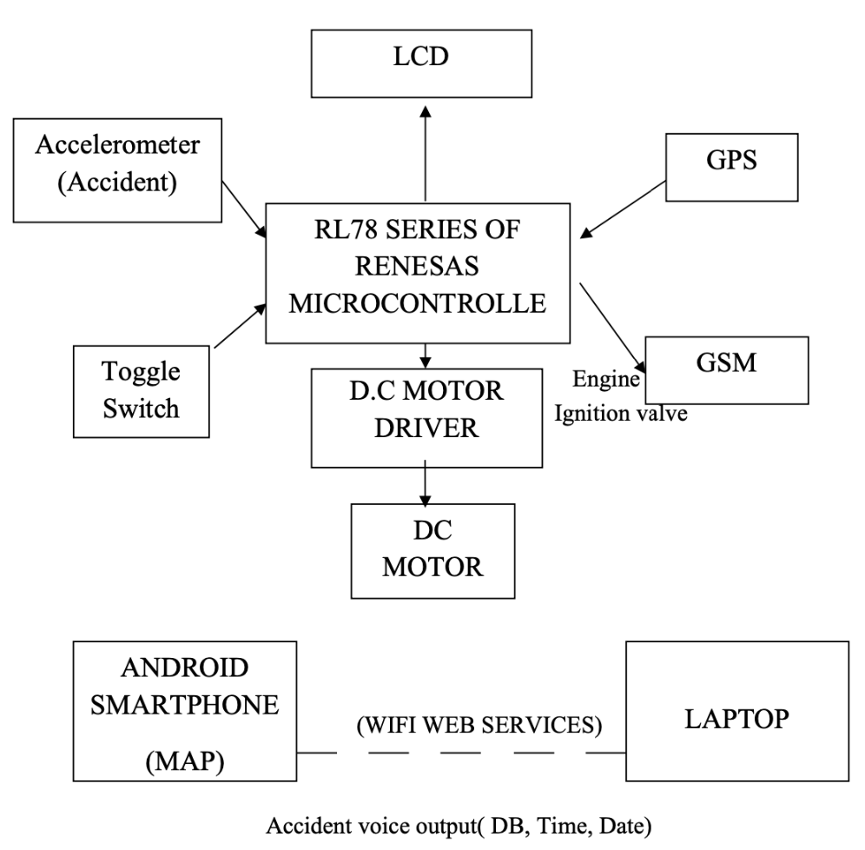
Methodology
System Architecture
Approved by AICTE |Affiliated to VTU | Recognized by UGC with 2(f) & 12(B) status |Accredited by NBA and NAAC

Slide 15
Implementation
Programming Languages
Java : Java is a popular programming language, created in 1995. It is owned by Oracle, and more than 3 billion devices run Java. It is used for:
Mobile applications (specially Android apps)
Desktop applications
Web applications
Web servers and application servers
Games
Database connection and much, much more!
Java works on different platforms (Windows, Mac, Linux, Raspberry Pi, etc.)
It is one of the most popular programming language in the world
It is easy to learn and simple to use
It is open-source and free
It is secure, fast and powerful
It has a huge community support (tens of millions of developers)
Java is an object oriented language which gives a clear structure to programs and allows code to be reused, lowering development costs
As Java is close to C++ and C#, it makes it easy for programmers to switch to Java or vice versa
Approved by AICTE |Affiliated to VTU | Recognized by UGC with 2(f) & 12(B) status |Accredited by NBA and NAAC

Slide 16
Implementation
C: C is a high-level structured oriented programming language, used in general-purpose programming, developed by Dennis Ritchie at AT&T Bell Labs, the USA between 1969 and 1973. In 1988, the American National Standards Institute (ANSI) had formalized the C language. C was invented to write UNIX operating system.
C is a successor of 'Basic Combined Programming Language' (BCPL) called B language. Linux OS, PHP, and MySQL are written in C. C has been written in assembly language.
In the beginning, C was used for developing system applications, e.g :
Database Systems
Language Interpreters
Compilers and Assemblers
Operating Systems
Network Drivers
Word Processors
Approved by AICTE |Affiliated to VTU | Recognized by UGC with 2(f) & 12(B) status |Accredited by NBA and NAAC

Slide 17
Implementation
System Architecture
First if someone tries to start the vehicle other than the owner and DC is on.
The DC motor here resembles a vehicle, if the motor starts rotating then the vehicle is on
else it is off.
So once the vehicle is on, an alert message will be sent to the owner.
The owner can off the engine through vehicle tracker Application or he can track the location of the vehicle through Google Maps which will be present in the message.
So this second message can be used when the vehicle has been stolen and is away from the owners location.
So all the data that is start and stop of the vehicle, date will be stored in the database which will be present in the vehicle tracker application.
Approved by AICTE |Affiliated to VTU | Recognized by UGC with 2(f) & 12(B) status |Accredited by NBA and NAAC

Slide 18
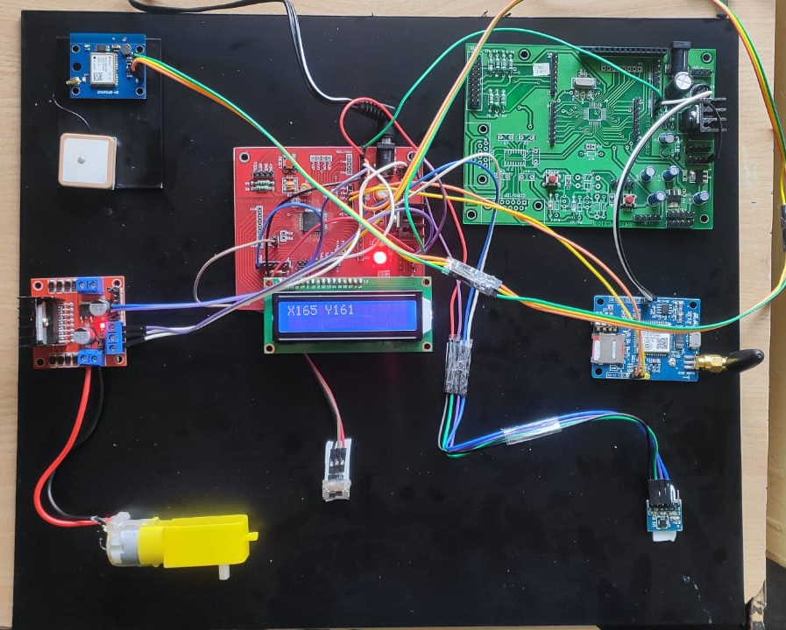
Implementation
Components
Renesas microcontroller is a 16 bit microcontroller belongs to RL78 series .IC R5F100LE is used in this project. This has 64 pins and 16 ports ,p0 and p7 is used for LCD connection.
GPS NEO6M model is connected to UART0 port is utilized to send and receive messages.
GSM is connected to UART1 port to obtain the geo-coordinates from satellites.
DC motor is connected through Driver IC L293 to port p5 of the microcontroller. The D.C motor represents a vehicle, there by demonstrating the starting action or stopping action of the vehicle
Accelerometer sensor ADXL337 model is used to identify the change in the gravitational pull along x-axis, y-axis and provides the variation in the voltage as output.
The toggle switch acts as a vehicle key and is used to demonstrate start or stop the vehicle.
Approved by AICTE |Affiliated to VTU | Recognized by UGC with 2(f) & 12(B) status |Accredited by NBA and NAAC

Slide 19
Implementation
Android Application
Step-1: User can open the app to send SMS for DC motor to on and off the motor. Step-2: In hardware part. If the DC motor is rotating means vehicle is on otherwise it’s off. L293 is the 16 pin IC with eight pins on each side dedicated to the controlling of a motor. GSM is utilized to send SMS, GPS is used for tracking the location of the user along with the coordinates. Step-3: In Android app. If the vehicle is stolen then the user can track the vehicle continuously if user want. Otherwise, user can send SMS like “STOP” through GSM. From android mobile data is sent to the local server (laptop). In the local server data is maintained in the database. These consists of start and stop time of the vehicle, and the date when vehicle was used.
Approved by AICTE |Affiliated to VTU | Recognized by UGC with 2(f) & 12(B) status |Accredited by NBA and NAAC

Slide 20
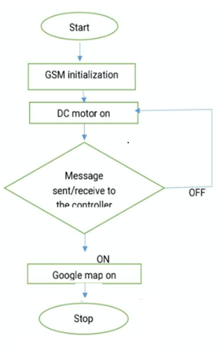
Working
• First, if someone tries to start the vehicle other than the owner and DC is on.
• The DC motor here resembles a vehicle, if the motor starts rotating then the vehicle is on else it is off.
• So once the vehicle is on, an alert message will be sent to the owner.
• The owner can off the engine through vehicle tracker Application or he can track the location of the vehicle through Google Maps which will be present in the message.
• So, this second message can be used when the vehicle has been stolen and is away from the owner’s location.
Approved by AICTE |Affiliated to VTU | Recognized by UGC with 2(f) & 12(B) status |Accredited by NBA and NAAC

Slide 21
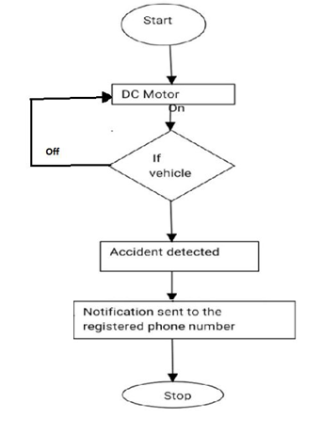
Working
Approved by AICTE |Affiliated to VTU | Recognized by UGC with 2(f) & 12(B) status |Accredited by NBA and NAAC

Slide 22
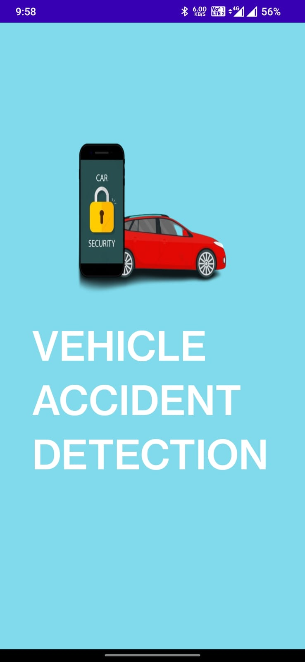

Output
Approved by AICTE |Affiliated to VTU | Recognized by UGC with 2(f) & 12(B) status |Accredited by NBA and NAAC

Slide 23

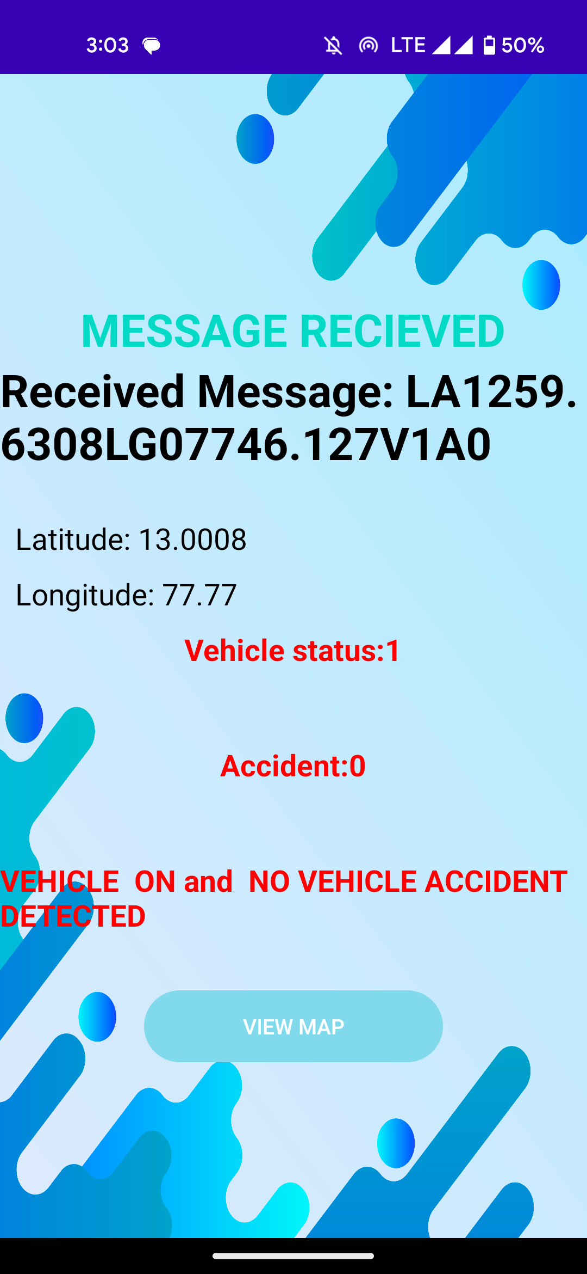
Output
Approved by AICTE |Affiliated to VTU | Recognized by UGC with 2(f) & 12(B) status |Accredited by NBA and NAAC

Slide 24
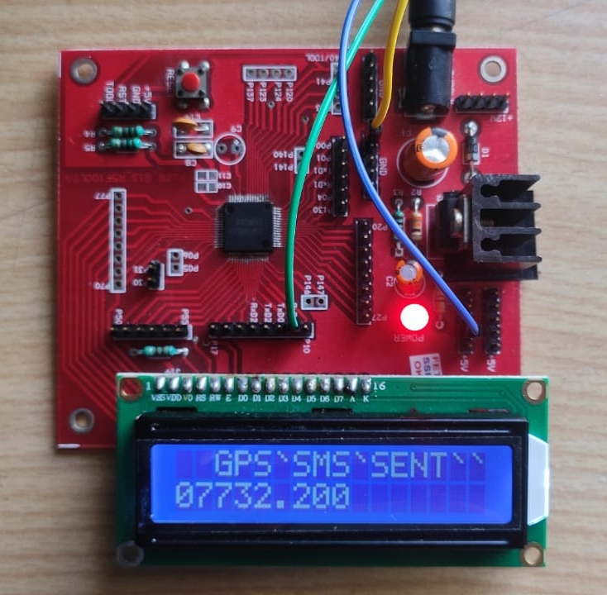
Output
Approved by AICTE |Affiliated to VTU | Recognized by UGC with 2(f) & 12(B) status |Accredited by NBA and NAAC

Slide 25
Conclusion
The project titled “Anti-Theft Protection of Vehicle by GSM and GPS and Accident Detection” is a model for an anti-theft and accident detection for four-wheelers.
As the theft of the vehicles are increasing nowadays it’s becoming difficult to locate the stolen vehicle .
As, many accidents are also happening these days and people are dying on the roads, many times their families won't get to know for a long time that their family members have met with the accident.
In order to overcome these 2 problems, the solution is to opt a device which gives the location of the vehicle and notifies when accident occurs
By using this device, we will be able to track the live location of the vehicle and detect when an accident occurs.
Hence the cost of this will be low, it’s easy to afford, and install.
Approved by AICTE |Affiliated to VTU | Recognized by UGC with 2(f) & 12(B) status |Accredited by NBA and NAAC

Slide 26
References
[1] M.Veeraiah, B.Nandini, P. Koteswara Rao, M. Jaswanth, M. Jyotsna, “Implementation of Vehicle Starting Using Fingerprint Sensor & Accident Detection with Accelerometer, GSM & GPS,” International Journal of Research in Engineering and Science(IJRES), Vishakhapatnam, 22-06-2022
[2] Anjan T L, Nikhil Satish, Abhinandan Kumar, Abhinav Narayan, Kiran S M, “Anti-Theft Security System for Vehicles,” International Research Journal of Engineering and Technology(IRJET), Karnataka, May 2018
[3] Adnan Shamim, Eurusha Pious, Muhammad Adil, “Smart Anti-Theft Vehicular Security and Accident Detection System using GPS and GSM Technology,” University of Swabi Journal(USJ), December 2018
[4] Akinwole Bukola, " Development of an Anti-Theft Vehicle Security System using GPS and GSM Technology with Biometric Authentication," International Journal of Innovative Science and Research Technology, Volume 5, Issue 2, February – 2020
[5] M. Bandyopadhyay, N. Mandal, S. Chattopadhyay, B. Roy, "A Novel GSM and GPS Based Vehicle Security System," AMSE JOURNALS-AMSE IIETA publication-2017-Series: Advances D; Vol. 22; Nov. 15, 2017
[6] Dr. G. Uday Kiran Bhargava, B. Ravi Kumar, A. Karna Rao, "Automatic Vehicle Accident Detection and Rescue System Using GSM and GPS Module," Journal of Critical Review, Vol 9, ISSUE 05, 2022
[7] Harsha P. Pawar, Snehal A. Chavan, Sayali S. Chavan, Tejasvi S. Yadav “GSM and GPS Based Smart Security System for Vehicles”, International Research Journal of Engineering and Technology(IRJET), Maharashtra, March 2015
Approved by AICTE |Affiliated to VTU | Recognized by UGC with 2(f) & 12(B) status |Accredited by NBA and NAAC

Slide 27
References
[8] M. Benedict Tephila, G. Gokul, K. Imthyas Ahamed, R. Indiran “Anti-theft System using IoT” YMER-An International Peer Reviewed Journal, Volume 21, ISSUE 11, Nov - 2022
[9] Gundepu Reddy Anuroopa, Vuyyala Lingaswamy, " GSM & GPM Module Based Automatic Vehicle Accident Detection and Rescue System, " Turkish Journal of Computer and Mathematics Education ,Vol.12 No.02, Hyderabad, (2021)
[10] Mohammed Shafeeq K. K., Maqbool Thoufeeq T., “Android Board Based Intelligent Car Anti-Theft System Through Face Recognition Using GSM and GPS” Journal of Applied Information Science 6 (2), December 2018
[11] S. J. Karale, Sweety Awchat, Piyush Rewatkar, Shantanu Mankar, Harshal Khapekar, Tejas Atram, “Car Anti-Theft System using GPS and GSM Module”, International Journal of Research in Engineering, Science and Management(IJRESM), Volume-2, ISSUE-4, April 2019
[12] S. Gnanapriya, M. Sowmiya, S. Priyadarshini, R. Ramya Priya, R. Saranya, “An IoT Based Anti Theft Detection and Notification System for Two Wheelers”, Social Science Research Network(SSRN), April 2022
[13] Dhanya N. M, “Anti-Theft Vehicle Tracking System Using GPS and Location Prediction”, International Journal on Advanced Science Engineering Information Technology (IJASEIT), Vol. 8, No. 6, 2018
[14] N Bharath Kumar, N Akash, H Aravindan, “Using Arduino Anti-Theft System for Vehicle”, International Journal of Emerging Technologies in Engineering Research (IJETER) Volume 6, Issue 9, September (2018)
Approved by AICTE |Affiliated to VTU | Recognized by UGC with 2(f) & 12(B) status |Accredited by NBA and NAAC

Slide 28
References
[15] Ogunrinola O. B, Olalere N. A, Nwosu E. U, Adebari F. A., “Automobile Accident Reporting and Anti-Theft Stratagem”, Digital Innovations & Contemporary Research in Science, Engineering & Technology, Vol. 6, No. 3, September 2018
[16] Gopu Priyanka, Bala Bhadruni Pranavi, Krishnamsetty Manaswini, A.S.R. Sai Srinivas, A.V. Rajan, “International Journal of Research in Engineering, Science and Management (IJRESM)”, Volume-3, Issue-5, May 2020
[17] K. Lavanya, P. Saketh Reddy, N. Sumanth, P. Prathamesh, N. Aravind, “Accident Prevention, detection and reporting for two-wheeler safety system”, International Research Journal of Modernization in Engineering Technology and Science, Vol. 04, ISSUE-06, June 2022
[18] Chetan Kumar G S, Yogesh HM, “An Approach of Anti-Theft Security System for Vehicles”, International Journal of Multidisciplinary Research in Science, Engineering and Technology (IJMRSET), May 2022
[19] Dhruv Raval, Raj Thakkar, Chirag Prajapati, Rohan Chaudhary, Prof. Mukesh Soni, “Smart Vehicle System”, Technix International Journal for Engineering Research, Volume 6, Issue 1, January 2019
[20] Lalitkumar A. Deshmukh, Ankit A. Singh, Vishal D. Arikar, Seema Biranware, “Vehicle Theft Detection Technique”, International Research Journal of Modernization in Engineering Technology and Science(IRJMETS), Vol. 04, ISSUE 08, August 2022
[21] N. Khadarbasha, A. Yogeshwaran, “Vehicle Anti-Theft Detection and Protection with Air Quality IoT Notification”, Irish Interdisciplinary Journal of Science & Research(IIJSR), Vol. 04, ISSUE 4, Oct-Dec. 2020
Approved by AICTE |Affiliated to VTU | Recognized by UGC with 2(f) & 12(B) status |Accredited by NBA and NAAC

Slide 29
References
[22] P. Aswini, P. Madhuri, O. DivyaSree, Dr. J.Vinoth Kumar, “Vehicle Theft Detection with Remote Engine Locking”, International Journal of Research Publication and Reviews, Vol. 02, ISSUE 3, 2021
[23] Prabha Kant Dwivedi, Pragya Jaiswal, Shobha Nishad, Priya Singh, Sristi Singh, Archana, “Vehicle Theft, Detection and Remote Engine Locking System”, International Research Journal of Modernization in Engineering Technology and Science(IRJMETS), Vol. 02, ISSUE 04, April 2020
[24] Prof. Ujwala Patil, Prof. S.N.Mathad, Mr. Shishir Ramesh Patil, “Vehicle Tracking System using GPS and GSM using Mobile Applications”, International Journal of Innovative Science and Research Technology, Vol. 03, ISSUE – 05, May 2018
[25] T. Shailaja, B. Parameshwari, S. Bahulya, M. Manaswi, S.Chandrabhanu,”Vehicle Tracking and Monitoring System to Enhance the Safety and Security Driving using IoT”, International Journal for Advanced Research In Science & Technology(IJARST), Vol. 10, ISSUE 12, Dec 2020
Approved by AICTE |Affiliated to VTU | Recognized by UGC with 2(f) & 12(B) status |Accredited by NBA and NAAC

