Slide 1

Used Car Price Prediction using Machine Learning
Members:-
Prasanta A/L Sathasivam 17157826
Khor Yi Lun S2018292
Sim Soon Jin S2043577
Sajay Thomas Samuel S2102673

Slide 2




Background
The used car market is a growing business with a projection of 480,000 units of used car to be sold in 2022 (TheStar, 2022)
Buying used cars is commonly an alternative option for the car purchasers if their budgets are insufficient for a new car, due to high cost of new cars (Blanco, 2022), which is almost twice as much compared to a used car.
Notes:
Opportunities & Demand
https://www.thestar.com.my/business/business-news/2022/02/03/used-car-industry-in-for-double-digit-growth
https://www.directlending.com.my/blog/buy-new-used-car-which-one-worth-your-buck-money
Myvi 2021 price RM50k new one to a second hand 2012 myvi at less than RM30k
Insurance New 1,500, old myvi 1002
Insurances are also cheaper, of course maintenance increases

Slide 3

Problem Statement
Purchasing used car has become the need for the people in the recent scenario of short supply of new cars due to the shortage of chips and supply chain issue.
Used car sellers raise the used cars’ price indiscriminately due to high demand of used cars.
It can be tough to determine whether a used car is worth the advertised price while looking at ads online.
An accurate and reliable used car price prediction model is imperative for car buyers and sellers to have a clearer picture to the fair price of the used cars.

Slide 4
Research Objective
RO1: To identify the prominent features that can be used to predict the used car price.
RO2: To develop machine learning models using different algorithms to predict the used car price.
RO3: To evaluate and determine the best machine learning model to predict the used car price.

Slide 5

Literature Review

Slide 6
Types of Algorithms used in Past Studies
Single Machine Learning Algorithm
Ensemble Machine Learning Algorithms
Single Machine Learning Algorithms with Regularization
Support vector machine (SVM) and ANN (Gegic et al., 2019). Dataset collected from web portal autopijaca.ba using web scraper.
K-nearest neighbors (KNN) regressor, linear regression, and decision tree regressor (Gajera et al., 2021)
Linear regression (Asghar et al., 2021). Dataset collected on Kaggle.
Linear regression and decision tree (Gupta, Kumar, Kumar, & Singh, 2021)
Multiple linear regression (Venkatasubbu & Ganesh, 2019), (Monburinon et al., 2018).
Lasso regression (Venkatasubbu & Ganesh, 2019), (Amik, Lanard, Ismat, & Momen, 2021). Datasets collected from 2005 Central Edition of the Kelly Blue Book and portal https://bikroy.com, respectively,
Bagging ensemble algorithm (random forest) (Gegic et al., 2019), (Longani et al., 2021), which dataset collected on Science Direct, (Gajera et al., 2021), (Gupta et al., 2021)
Boosting ensemble algorithm (XGBoost regressor) (Gajera et al., 2021). Dataset collected from previous consumer.
Boosting ensemble algorithm (XGBoost and gradient boosted method) (Longani et al., 2021), (Monburinon et al., 2018)

Slide 7
Methodology

Slide 8
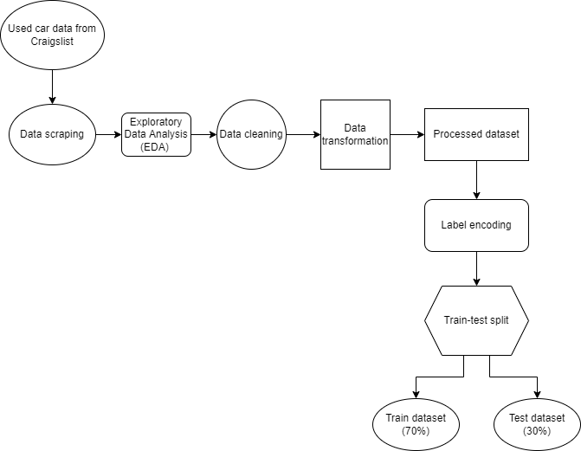
Data Preprocessing flowchart

Slide 9
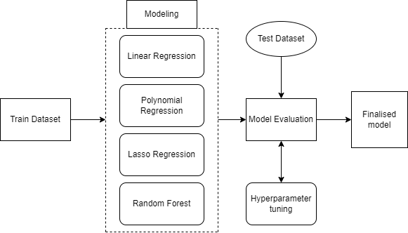
Modeling and model evaluation flowchart

Slide 10

Tools
Data
Python
BeautifulSoup
Selenium
Pandas
NumPy
Matplotlib
Seaborn
Scikit-learn
Date Range | 13/04/2022 – 12/05/2022
Rows | 21455
Columns | 21
Size | 905 KB

Slide 11
Data Preprocessing
Exploratory Data analysis (EDA)
Data cleaning
Data transformation
Better understanding of the data with charts
Detecting outliers using boxplot
Identify the features with the highest listings
Dropped irrelevant columns such as latitude, longitude, and title status
Replaced missing values with ‘unknown’ category
Removed an outlier in SUV car type
Handled extreme values for price and odometer
Handled noise in year column
“2006.” → “2006”
Split ‘year make model’ into 4 separate columns: ‘year’, ‘brand’, ‘model’, and ‘variant’
Notes:
10 features used
fuel
odometer
paint
color
transmission
year
brand
model
variant
price

Slide 12
Hyperparameter Tuning
Name | n_estimators | min_samples_split | min_samples_leaf | max_depth | bootstrap
Value | 30 | 2 | 1 | 30 | True
 | MAE | MSE | RMSE | R²
Before | 8,419.74​ | 9,349,980,784.52​ | 96,695.3​ | -3.973​
After | 7,854.93​ | 562,402,465.8​ | 74,993.62​ | 0.53​
Notes:
10 features used
fuel
odometer
paint
color
transmission
year
brand
model
variant
price

Slide 13
Algorithms & Results
 | MAE | MSE | RMSE
Linear Regression | 11,639.06 | 791,074,506.9 | 28,126.05
Polynomial Regression | 11,933.74 | 838,565,306.72 | 28,957.99
Lasso Regression | 11,640.89 | 791,165,297.88 | 28,127.66
Random Forest Regressor | 7,854.93 | 5,624,042,465.8 | 74,993.62
R² = 0.53 (Random Forest Regressor)
Notes:
10 features used
fuel
odometer
paint
color
transmission
year
brand
model
variant
price

Slide 14
Summary
We identified three variables with the highest importance (Odometer / Fuel / Brand)
Random Forest is the best performing algorithm amongst the ones used
Future Improvements:
Feature Engineer important variables (e.g. condition, vehicleType) and additional data sources (e.g. Carsome, Mudah, Carwow)
Notes:
Variable Importance analysis under Random Forest regressor, howeve
Future suggestion – include features that may have been missing in our dataset
More dataset
Because R Squared may not be the most effective performance metrics
10 features used
fuel
odometer
paint
color
transmission
year
brand
model
variant
price

Slide 15


Thank You
By:
Prasanta A/L Sathasivam 17157826
Khor Yi Lun S2018292
Sim Soon Jin S2043577
Sajay Thomas Samuel S2102673

Slide 16
References
Amik, F. R., Lanard, A., Ismat, A., & Momen, S. (2021). Application of Machine Learning Techniques to Predict the Price of Pre-Owned Cars in Bangladesh. Information, 12(12), 514.
Asghar, M., Mehmood, K., Yasin, S., & Khan, Z. M. (2021). Used Cars Price Prediction using Machine Learning with Optimal Features. Pakistan Journal of Engineering and Technology, 4(2), 113-119.
Blanco, S. (2022). New Car Price Keeps Climbing, with Average Now at Almost $47,100. Retrieved from https://www.caranddriver.com/news/a38748092/new-car-average-sale-prices-47100/
Gegic, E., Isakovic, B., Keco, D., Masetic, Z., & Kevric, J. (2019). Car price prediction using machine learning techniques. TEM Journal, 8(1), 113.
Gajera, P., Gondaliya, A., & Kavathiya, J. (2021). Old Car Price Prediction With Machine Learning. Int. Res. J. Mod. Eng. Technol. Sci, 3, 284-290.
Gupta, P., Kumar, P., Kumar, K., & Singh, N. (2021). Comparative Analysis of Car Sales Using Supervised Algorithms.
Longani, C., Prasad Potharaju, S., & Deore, S. (2021). Price Prediction for Pre-Owned Cars Using Ensemble Machine Learning Techniques. In Recent Trends in Intensive Computing (pp. 178-187): IOS Press.
Monburinon, N., Chertchom, P., Kaewkiriya, T., Rungpheung, S., Buya, S., & Boonpou, P. (2018). Prediction of prices for used car by using regression models. Paper presented at the 2018 5th International Conference on Business and Industrial Research (ICBIR).
Venkatasubbu, P., & Ganesh, M. (2019). Used Cars Price Prediction using Supervised Learning Techniques. Int. J. Eng. Adv. Technol.(IJEAT), 9(1S3).

