Slide 1
Payroll system

Slide 2
Project Meta Data
S. No. | Module Meta Data | Details | Remarks
1. | Author | Prasanta Kumar Padhy
2. | Reviewer
3. | Version Number | 1.0
4. | Release Date | August 2019

Slide 3
Revision History
S. No. | Revision Date | Details | Version no. | Remarks
1
2
3

Slide 4
Project Objectives
To learn and implement the CRT learnings.

Slide 5
Outcome
Scholars will able to understand the life cycle of a project.

Slide 6
Evaluation Criteria in line with the cognitive level
Cognitive Level | Cognitive skill description | Yes/No
1 | Remember | Yes
2 | Understand | Yes
3 | Apply | Yes
4 | Analyze | Yes

Slide 7
Day 1 - Coverage
Day 1
Project documentation
S. No | Key Topics
1 | Abstract.
2 | Software Requirement Specification(SRS).
3 | Various Diagrams.

Slide 8
Discussion time
Why Project and SDLC.
The participants will discuss and understand about project and SDLC.
Duration is 20 Min

Slide 9
Project abstract
Payroll Management System is one of the most important aspects of the business.
Basically it is used to manage the employee’s expenses, various allowances, salary, gross salary, deduction, tax etc. for a particular time period.
Existing System:
In the manual system it is difficult to maintain data and generate different reports according to the request transaction. In the present system it is becoming difficult to issue pay-slip for all the employee every month by manually going through the various records of the organization. i.e. the manger has to go through all the records of the organization in various departments and find out the employee’s department, grade, and no of leaves for that month, his earnings and his deductions along with his pf and all other deduction including his IT and savings. So, it is a time consuming process to perform all these activities for an admin/manager every month.
Hence in order to overcome the difficulties in the existing system of the organization, the system is automated.

Slide 10
Cont..
Proposed System:
The proposed system is designed to automate all the functionalities of the present payroll system of the organization.
Purpose:
Manage employee information efficiently.
Keeps trace of deductions, leave etc.
Generate pay-slip at ease.
Generate all the reports related to employee.
Manage your own security.

Slide 11
Modules and sub-modules
The payroll system is designed with two main modules; they are:
Registration
Reports
Sub-Modules of Registrations Module:
Employee Master
Deductions Master
Department Master
Designation Master
Grade master

Slide 12
Cont..
Sub-Modules of Reports Module:
Employee Report
Grade wise Report
Department wise Report
Designation wise Report
Payroll Report/Pay-slip Report

Slide 13
Hardware requirements
The selection of hardware is very important in the existence and proper working of any software. In the selection of hardware, the size and the capacity requirements are also important.
Pentium processor -------- 233 MHZ or above
RAM Capacity -------- 128MB
Hard Disk -------- 20GB
CD-ROM Drive -------- 32 HZ
KEYBOARD -------- 108 Standard

Slide 14
Software requirements
One of the most difficult tasks is that, the selection of the software, once system requirement is known is determining whether a particular software package fits the requirements. After initial selection further security is needed to determine the desirability of particular software compared with other candidates. This section first summarizes the application requirement question and then suggests more detailed comparisons.
Operating System -------- Windows
Browser -------- IE, Google Chrome
Web/Application Server -------- Apache Tomcat
Database Server ------- Oracle
Database Connectivity -------- JDBC
Other Tools & Technologies -------- Java (JDK), Servlets

Slide 15
Table of contents
1. Introduction
1.1 Purpose
1.2 Scope
1.3 Benefits
1.4 Definitions
1.5 References
1.6 Project Overview
Notes:
Various sections under Topic – Intro.

Slide 16
Cont..
2. Overall Descriptions
2.1 Product Perspective
2.2 Product Functions.
2.2.1 Main Module
2.2.2 Report Module
2.3 User Characteristics
2.3.1 End User
2.3.2 Administrator
2.4 Assumptions And Dependencies.

Slide 17
Cont..
3. Specific Requirements
3.1 External interface requirements
3.1.1 User interface requirement
3.1.2 Hardware interface requirement
3.1.3 Software interface requirements
4. Functional Requirements
4.1 Registrations
4.2 Reports

Slide 18
Cont..
5. Other non functional requirements
5.1 Performance Requirements
5.2 Reliability
5.3 Availability
5.4 Security
6. UML diagrams
6.1 USECASE diagram
6.2 ACTIVITY diagram
6.3 CLASS diagram
6.4 SEQUENCE diagram

Slide 19
1.Introduction
Payroll system is vital in any Human Resource System of an organization. The solution has to manage salary as per rules of the company, income tax calculation and various deductions to be done from the salary including statutory deductions like Income tax and provident fund deductions. It has to generate pay-slip, cheque summary and MIS reports.
It is understood that we are tired of managing thousand of odd papers, pay slip , payroll reports, and salary details and so on. Imagine that we have a payroll processing system which will generate our pay slips and payroll reports within seconds. We can help others automated your payroll system by developing a customized payroll application that suits your specific requirements.

Slide 20
1.1 Purpose
Main aim of developing Employee Payroll Management is to provide an easy way not only to automate all functionalities involved managing leaves and Payroll for the employees of Company, but also to provide full functional reports to management of Company with the details about usage of leave facility.
1.2 Scope:
This system has only few features to work with, but in future we can add many more features.
1.3 Benefits
To improve the efficiency.
Quickly find out information of an employee details.
To provide easy and faster access information.
To provide user friendly environment.
Quickly publish variety of reports using data in the database.

Slide 21
1.4 definitions
Java: Java is a programming language that produces software for multiple platforms. When a programmer writes a Java application, the compiled code (known as bytecode) runs on most operating systems (OS), including Windows, Linux and Mac OS. Java derives much of its syntax from the C and C++ programming languages.
JDBC: Java Database Connectivity (JDBC) is an application program interface (API) packaged with the JavaSE edition that makes it possible to standardize and simplify the process of connecting Java applications to external, relational database management systems (RDBMS).
Servlet: A servlet is a Java programming language class that is used to extend the capabilities of servers that host applications accessed by means of a request-response programming model.
JSP(Java Server Pages): JSP is a server side technology that does all the processing at server. It is used for creating dynamic web applications, using java as programming.
Oracle: An Oracle database is a collection of data treated as a unit. The purpose of a database is to store and retrieve related information. A database server is the key to solving the problems of information management.

Slide 22
1.5 References
SRS format from IEEE website(www.ieee.org/format).
Software Engineering by “Roger Pressman”.
1.6 Project Overview
The following subsections provide the complete overview of the software specifications requirements documentation for the product Payroll System. The entire SRS is documented in view of User and the following sub sections are arranged to give a complete outlook of the software, its perspective, features, system requirements and users know how it is.

Slide 23
2. Overall description
2.1 Product perspective:
The following subsections provide the complete overview of the software specifications requirements documentation for the product Payroll System. The entire SRS is documented in view of User and the following sub sections are arranged to give a complete outlook of the software, its perspective, features, system requirements and users know how it is.
2.2 Product functions
2.2.1 Registration module:
The Registration module mainly concentrates on the recruiting process.
Employee Master : Contains the position or status of employee in departments.
Deductions Master : Contains the information about deductions of a particular month of employees.
Department Master: Deals with various departments information in the organization.

Slide 24
Cont..
Designation Master: Deals with various designations of a particular department.
Grade Master: Deals with various grades in a department of the organization.
2.2.2 Reports module
The reports module is mainly responsible for generating various reports for the organization according to the user request and also generating pay-slip for employees working in the organization.

Slide 25
2.3 User Characteristics
2.3.1 End Users
No specific knowledge or skills are required from the end user.
End user should have basic idea about computer operations and database.
2.3.2 Administrator
Administrator must be having good knowledge of database management system.
Administrator to manage user rights.
If the network connection does not work properly than our system should not work as intended.
Also that is assumed that the product is installed properly at web server.

Slide 26
CONT..
This system will not take care of any virus problem, which might occur either on the client or the server system. Avoiding the use of pirated software and ensuring that floppies and other removable media are scanned for viruses before use could minimize the possibility of viral infection
Recovery of data after a system crash will be possible only if backups are taken at regular intervals.
Manual interfaces cannot be fully avoided. Documented proofs like data entry of employees etc. will have to be verified by the concerned management staff before entering it into the the computerized system.

Slide 27
2.4 Assumptions and Dependencies
2.4.1 Assumptions:
The code should be free with compilation errors/syntax errors.
The product must have an interface which is simple enough to understand.
2.4.2 Dependencies:
All necessary hardware and software are available for implementing and use of the tool.
The proposed system would be designed, developed and implemented based on the software requirements specifications document.
End users should have basic knowledge of computer and we also assure that the users will be given software training documentation and reference material.
The system is not required to save generated reports.
Commercial Database

Slide 28
3. Specific requirements
3.1 External interface requirements
3.1.1 User interfaces
The software provides good graphical interface to the user.
3.1.2 Hardware interfaces
Mouse
Keyboard
Printer
Hard disk
Ram with memory 1 GB or more

Slide 29
3.1.3 Software interfaces
Operating system : Windows Family or any main stream OS
4. Functional requirements
4.1 Registration
This module mainly concentrates on the recruiting process.
4.2 Reports
This module is mainly responsible for generating various reports for the organization according to the user request and also generating pay-slip for employees working in the organization.

Slide 30
5. Other Non-functional requirements
5.1 Performance Requirements
The overall system should be fast and error free.
It should have built in error checking and correction facilities.
The system should be able to handle large amount of data comfortably.
5.2 Reliability
In order to ensure reliability, this system is being designed using software that is established to be stable and easy to use.
5.3 Availability
This system is designed to run 24/7 and be readily available to the user.

Slide 31
Cont..
5.4 Security
The access to the software is given only to valid operators. We need a specific ID and password to get access to the software.
Communication needs to be restricted when the application is validating the user or licence.
Notes:
Ans: C

Slide 32
ER Diagram
dept_desc
Grade code
deptid
addrss
eid
desig
works
Existing dept
grade
department
employee
dob
designation
grade
Grade desc
Pay-slip
deductions
Dept code
E_id
deductions
Grass salary
Notes:
An entity relationship model, also called an entity-relationship (ER) diagram, is a graphical representation of entities and their relationships to each other, typically used in computing in regard to the organization of data within databases or information systems.

Slide 33
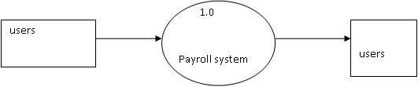
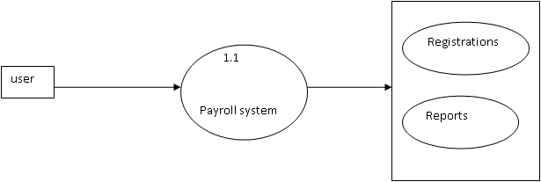
DFD’s
Context level
Notes:
Data flow diagrams are used to graphically represent the flow of data in a business information system.
0-level DFD: It is also known as context diagram.It’s designed to be an abstraction view, showing the system as a single process with its relationship to external entities.
In 1-level DFD, context diagram is decomposed into multiple bubbles/processes.in this level we highlight the main functions of the system and breakdown the high level process of 0-level DFD into subprocesses.
2-level DFD: 2-level DFD goes one step deeper into parts of 1-level DFD.It can be used to plan or record the specific/necessary detail about the system’s functioning.

Slide 34
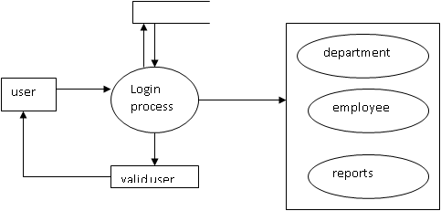
First level DFD

Slide 35
second level DFD
Employee
master
Department
master
login
Payroll system
user
Grade master
Designation master

Slide 36
second level DFD reports
Employee report
Employee
payroll System
Department report
login
Designation report
Grade report
Payroll report

Slide 37
third level DFD for user
Employee master
employee
Department master
deptmaster
user
Deductions master
deductions
Grade master
grade

Slide 38
third level DFD for user
deductions
Deduction process
deductions
employee
Pay-slip generation to employee
Pay-slip

Slide 39
UML Diagrams
Use case diagrams
Notes:
A use case diagram is a dynamic or behavior diagram in UML. Use case diagrams model the functionality of a system using actors and use cases. Use cases are a set of actions, services, and functions that the system needs to perform. In this context, a "system" is something being developed or operated, such as a web site. The "actors" are people or entities operating under defined roles within the system.

Slide 40
UML Diagrams

Slide 41
UML Diagrams

Slide 42
Sequence diagram for registrations
Notes:
A sequence diagram simply depicts interaction between objects in a sequential order i.e. the order in which these interactions take place.

Slide 43
Sequence diagram for reports

Slide 44
Collaboration diagram for registrations
Notes:
A collaboration diagram, also called a communication diagram or interaction diagram, is an illustration of the relationships and interactions among software objects in the Unified Modeling Language (UML).

Slide 45
Collaboration diagram for reports

Slide 46
Class diagram for payroll system
Notes:
In software engineering, a class diagram in the Unified Modeling Language (UML) is a type of static structure diagram that describes the structure of a system by showing the system's classes, their attributes, operations (or methods), and the relationships among objects.

Slide 47
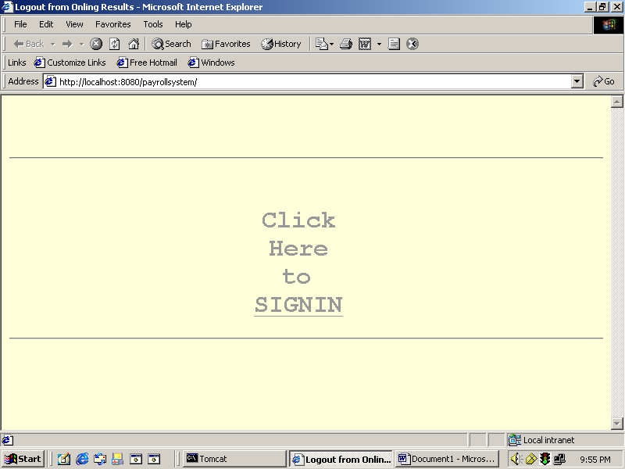
Starting page to payroll system

Slide 48
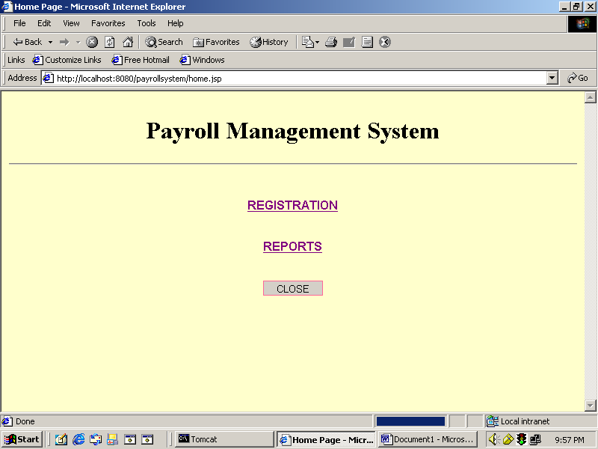
Main page to payroll

Slide 49
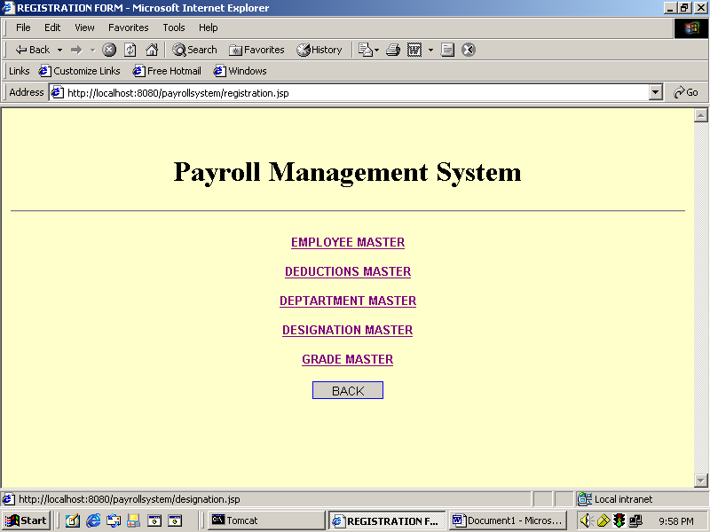
Registrations Module

Slide 50
Registrations Module

Slide 51
BIBLIOGRAPHY
JAVA SERVLETS
- TATA McGraw HILL
- Karl Moss
SOFTWARE ENGINEERING
A Practitioner's Approach
- McGraw-Hill Publications
- Roger S. Pressman.
Oracle-SQL & Pl/Sql Programming
- Evan Byross
[J2EE-Overview] - http://java.sun.com/j2ee/overview.html

Slide 52
BIBLIOGRAPHY
[JS-NET] - http://developer.netscape.com/docs/manuals/communicator/jsref/contents.htm
[J2EE-Home] - http://java.sun.com/j2ee/
[J2EE-Components] -
http://java.sun.com/j2ee/blueprints/platform_technologies/component/index.html
[SUN-Developer] - http://developer.java.sun.com/developer/

Slide 53
summary
A project report on Payroll System
SRS
Functional requirements
Non-Functional requirements.

