Slide 1
Sales Data Analysis using SQL
A Data-Driven Approach to Business Insights
Presented by
[Majji Prasanth Reddy]

Slide 2
Introduction
This project focuses on analyzing sales data using SQL to derive meaningful business insights.
The goal is to improve sales performance by understanding revenue contributions and top-performing products.

Slide 3
Project Objective
- To Calculate total sales revenue
- To Determine sales contribution per channel
- To Identify top-selling products per division
- To Provide insights for business strategy

Slide 4
Data Used
- Sales Transactions: Product sales data including price & quantity
- Customer Channels: Different sales channels (online, retail, etc.)
- Product Information: Details on product categories & divisions

Slide 5
Key SQL Techniques
- Joins: Combining multiple datasets for analysis
- Aggregations: SUM(), COUNT() for revenue calculations
- Window Functions: RANK() to identify top-selling products
- Filtering & Grouping: WHERE and GROUP BY for segmentation

Slide 6
Key Insights: Total Sales & Channel Contribution
- Total revenue calculated as (Gross Price × Sold Quantity)
- Sales contribution per channel calculated as (Channel Sales / Total Sales) * 100%
- Helps identify most profitable sales channels

Slide 7
Key Insights: Top-Selling Products
- Used RANK() to find top 3 products in each division
- Helps focus on high-performing products
- Supports inventory and marketing decisions

Slide 8
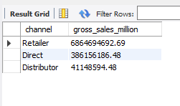
Channel-wise Gross Sales

Slide 9
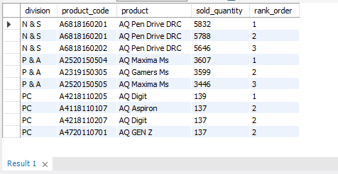
Top Selling Products by Division

Slide 10
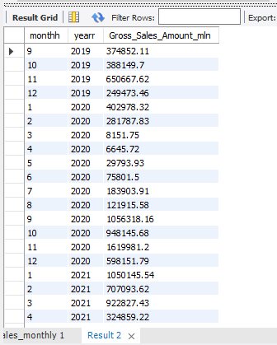
Monthly Sales Trend

Slide 11
Business Impact
- Improved sales strategy by focusing on high-performing channels
- Optimized inventory based on top-selling products
- Enhanced marketing efforts for underperforming categories
- Data-driven decision-making for stakeholders

Slide 12
Conclusion & Next Steps
- This SQL analysis provides actionable insights for sales growth
- Next Steps:
1. Automate reporting with dashboards
2. Expand analysis to seasonal trends
3. Implement predictive sales modeling

Slide 13
Thank You!

