Slide 1


Credit Card Fraud Detection: An Overview
This presentation explores the journey of detecting credit card fraud, covering data preparation, model training, evaluation, and insights for future improvements.
by PRASANTHKUMAR BHUMULA

Slide 2
Dataset: A Foundation for Detection
Transaction Details
Labeling Fraud
The dataset contains anonymized transaction features (V1 to V28), time, and amount, enabling fraud pattern recognition.
Each transaction is labeled as fraudulent (1) or legitimate (0), essential for model training and evaluation.

Slide 3

Data Preprocessing: Preparing for Modeling
Handling Missing Values
Outlier Detection
Outliers, which may indicate fraud, were identified using statistical methods and handled by either removal or treatment to improve model accuracy.
.
Missing values are addressed through techniques like imputation or deletion, ensuring data integrity.
Class Imbalance
We used techniques like oversampling and undersampling to balance the number of fraudulent and legitimate transactions in our dataset. This ensured that our model could effectively learn to identify fraud without being biased toward the majority class.
.

Slide 4
Modeling Approach: Unveiling Patterns
1
Decision Trees
3
Random Forests
Logistic Regression
2
A simple model that predicts the probability of fraud based on feature relationships. Useful for understanding how each feature impacts the likelihood of fraud.
A model that splits data into branches based on feature values. Helps identify key factors contributing to fraudulent transactions in an interpretable manner..
An ensemble of decision trees that improves accuracy and reduces overfitting. Robust against noise, making it effective for fraud detection..
4
Gradient Boosting (XGBoost, LightGBM, CatBoost)
5
Support Vector Machines (SVM)
A classifier that finds the optimal hyperplane to separate fraudulent and legitimate transactions. Effective in high-dimensional spaces and for non-linear separability.
Ensemble methods that sequentially correct errors from previous models. Highly effective in capturing complex patterns for improved fraud detection.

Slide 5





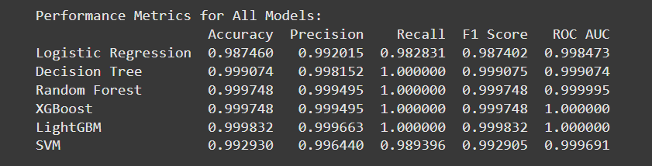
Evaluation Metrics: Assessing Model Performance
Accuracy
Precision
Recall
F1-Score
The proportion of correctly classified transactions.
The proportion of correctly identified fraudulent transactions among all transactions predicted as fraudulent.
The proportion of correctly identified fraudulent transactions among all actual fraudulent transactions.
A harmonic mean of precision and recall, providing a balanced measure of performance.
ROC-AUC
A measure of the model's ability to distinguish between fraudulent and legitimate transactions.

Slide 6
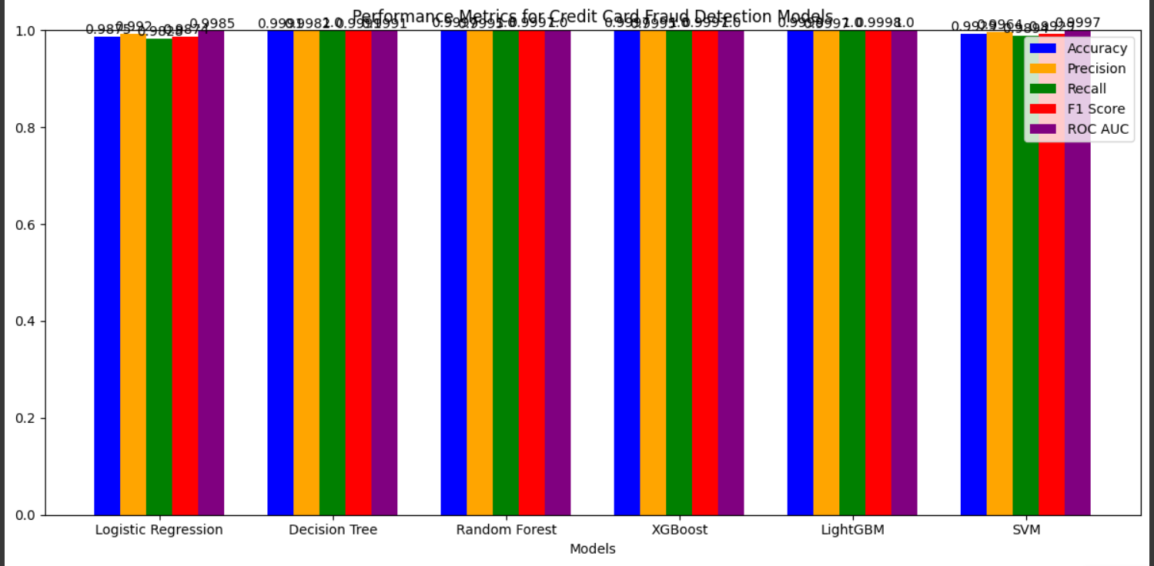
Results: Comparing Model Effectiveness
1
The models are trained and evaluated on the dataset, comparing their performance on different metrics.
2
The model with the best overall performance is selected based on the specific business requirements and risk tolerance.
3
The chosen model serves as the foundation for real-time fraud detection in a production environment.

Slide 7

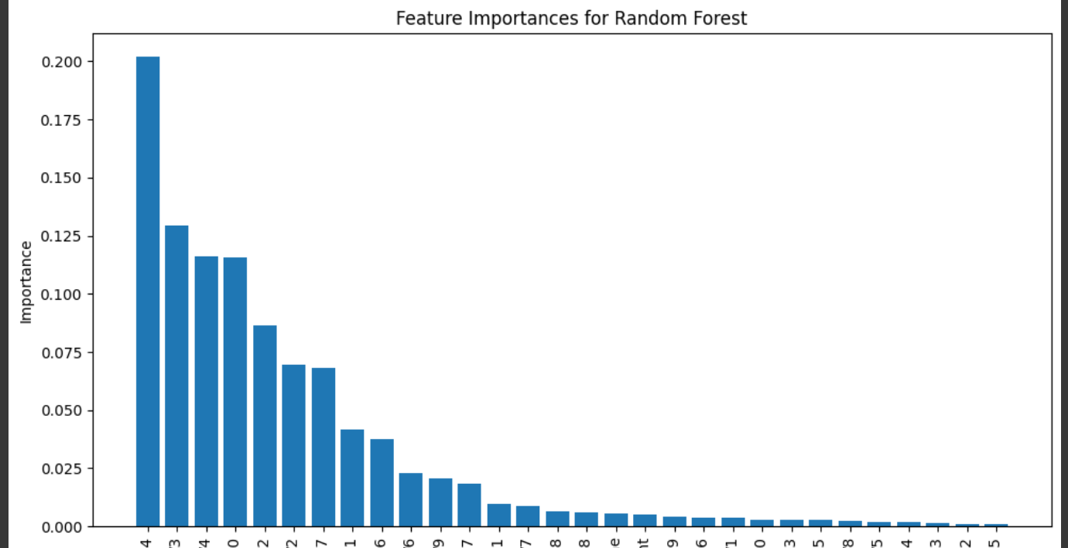


Feature Importance: Understanding Influence
Feature Selection
The most influential features are identified through techniques like feature importance analysis.
Model Optimization
Understanding feature importance helps in refining the model and improving its accuracy.
Risk Assessment
Knowing which features contribute most to fraud detection enables more informed risk assessments.

Slide 8



Challenges: Adapting to Evolving Threats
Evolving Fraud Patterns
1
Fraudsters constantly develop new techniques, making it crucial to adapt models.
Real-Time Detection
2
Promptly identifying fraud in real time is essential to minimize losses.
Data Privacy
3
Protecting sensitive cardholder data while building effective models is paramount.

Slide 9
Future Work: Pushing the Boundaries
Deep Learning Techniques
1
Exploring deep learning models can potentially enhance fraud detection accuracy.
External Data Sources
2
Incorporating external data sources like social media or customer behavior can enrich fraud detection models.
Collaborative Detection
3
Sharing data and best practices among institutions can improve collective fraud detection.

Slide 10

Conclusion: A Path Towards Secure Transactions
1
2
Data-Driven Approach
Continuous Improvement
Leveraging data analysis and machine learning is crucial for effective fraud detection.
Models must be constantly monitored and updated to adapt to evolving fraud patterns.
3
Collaboration is Key
Sharing knowledge and resources among institutions can strengthen the fight against fraud.

