Slide 1
VIRTUALIZATION

Slide 2
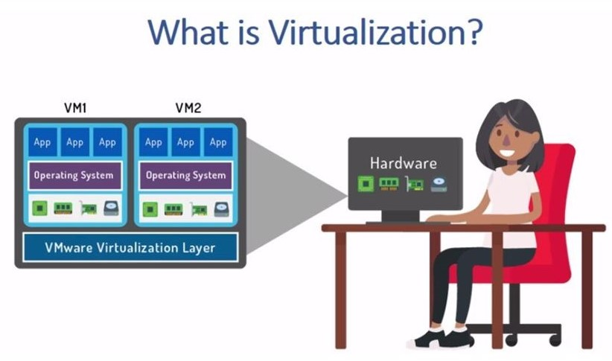
Virtualization is a technology that transforms hardware into software.

Slide 3
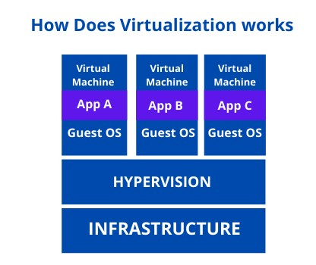
In order to carry out virtualization, the VMM (Virtual Machine Monitor), also called Hypervisor, generates a abstraction layer between the hardware and the operating system of the virtual machine, in such a way that it divides and manages the hardware resources between the number of virtual machines that you wish to use.

Slide 4
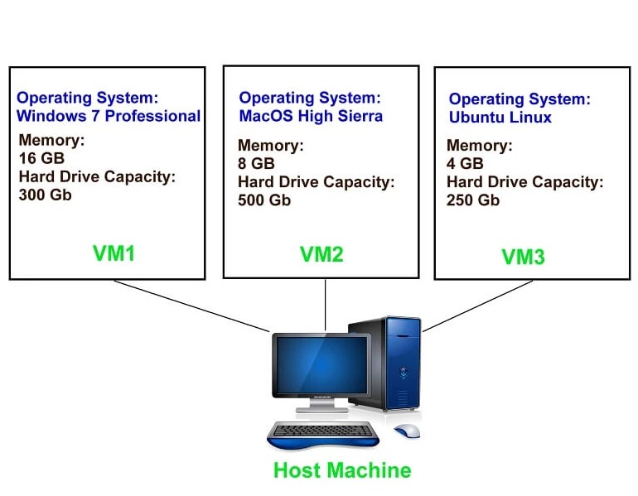
What Is A Virtual Machine ?
From the user perspective, virtual machine is software platform like physical computer that runs operating systems and apps.

Slide 5
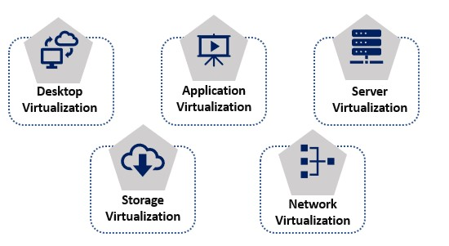
Types Of Virtualization

Slide 6
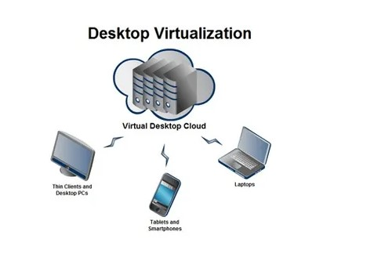
Virtual desktop infrastructure(VDI) is a desktop delivery model which allows client desktop workloads(operating system, application ,user data) to be hosted and executed on servers in the data center.

Slide 7
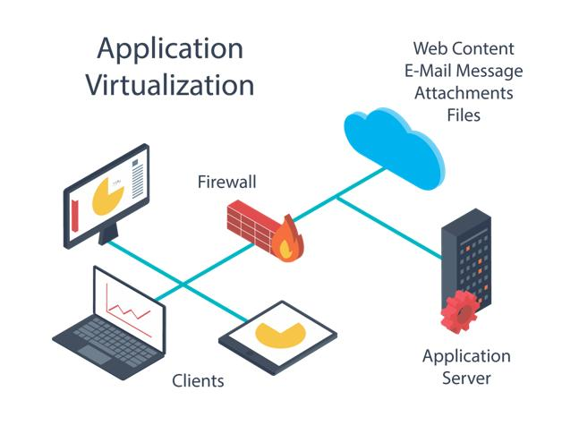
Application virtualization software allows users to access and use an application from a separate computer than the one on which the application is installed.

Slide 8
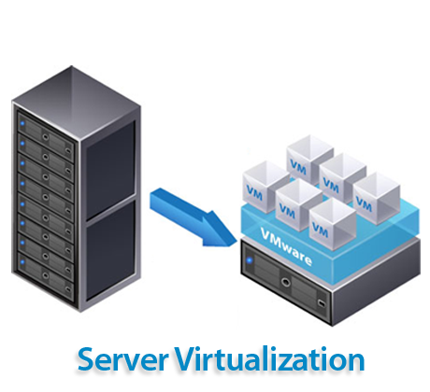
It is common for both companies and service providers. Server virtualization divides these into a series of virtual servers, which offers advantages such as cost savings or the automation of some tasks.

Slide 9
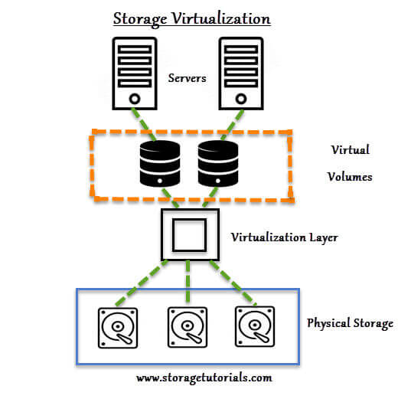
Storage virtualization is the next frontier in storage advances the aims to provide a layer of abstraction to reduce complexity.

Slide 10
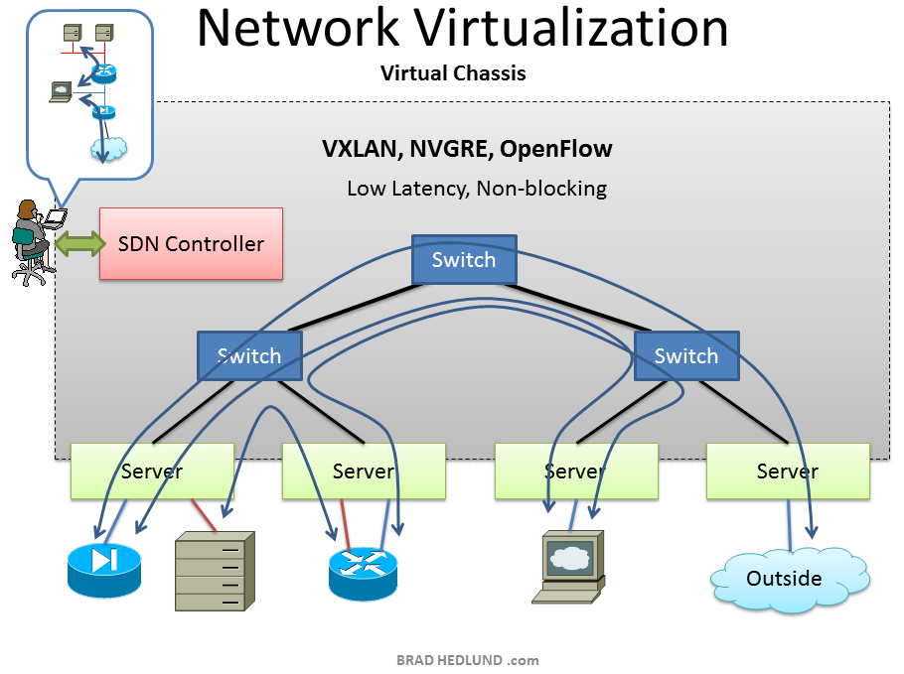
Network Virtualization (NV) refers to abstracting network resources that were traditionally delivered in hardware to software. NV can combine multiple physical networks to one virtual, software-based network, or it can divide one physical network into separate, independent virtual networks.

Slide 11
NESTED VIRTUALIZATION

Slide 12
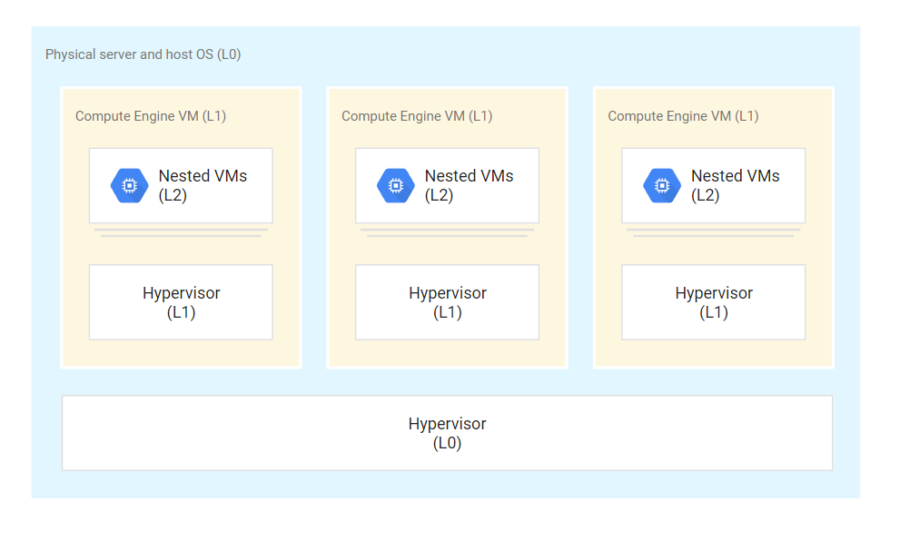
Nested virtualization lets you run virtual machine (VM) instances inside of other VMs so you can create your own virtualization environments.

Slide 13

Windows Defender
Windows Defender is a software application that safeguards a system from malware.
Windows Defender is a software application that safeguards a system from malware.
Released in 2006, Windows Defender was a built-in anti-spyware application included with Windows Vista and Windows 7.
Windows Defender was updated with the release of Windows 8.

Slide 14
Turn on Microsoft Defender Antivirus
Select the Start menu.
In the search bar, type group policy. Then select Edit group policy from the listed results. The Local Group Policy Editor will open.
Select Computer Configuration > Administrative Templates > Windows Components > Microsoft Defender Antivirus.
Scroll to the bottom of the list and select Turn off Microsoft Defender Antivirus.
Select Disabled or Not configured. It might feel counter-intuitive to select these options because the names suggest that you're turning Microsoft Defender Antivirus off. Don't worry, these options ensure that it's turned on.
Select Apply > OK.

Slide 15
THANK YOU

