Slide 1


×
26%
CAGR
Growth Partnership Proposal
India E-Commerce
Growth Rate
One-Year Revenue & Profitability Roadmap
For India's First Subscription-First Marketplace
$325 Billion
By 2030
Prepared by: Digifyce Global Pvt. Ltd.
Presented to: Board of Directors, Gleepick
India Market
Opportunity
Zero
Commission
Model
June 2026 | Confidential
1 / 13

Slide 2
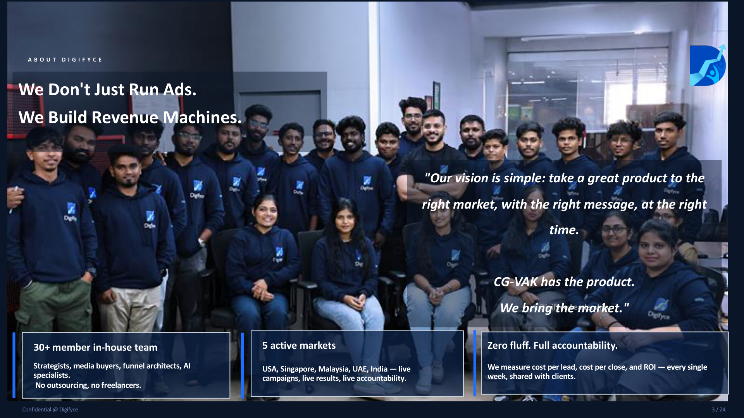

Slide 3
PRICING STRATEGY
Recommended Subscription Pricing Model
TIER | SKU LIMIT | ORDERS / DAY | MONTHLY PRICE | vs. AMAZON FEES
Free | 5 SKUs | 5 / day | ₹0 | Trial — 0% fee vs. 15-40% elsewhere
Starter | Up to 50 SKUs | Up to 30 / day | ₹2,999 / mo | Recovered in ~2 Amazon orders
Growth ★ | Up to 200 SKUs | Up to 100 / day | ₹6,999 / mo | 1 day's Amazon fees for active seller
Pro | Up to 1,000 SKUs | Unlimited | ₹14,999 / mo | Break-even at 30 orders vs. Amazon
Enterprise | Unlimited | Unlimited | ₹24,999+ / mo | Custom SLA & dedicated support
💡 Why Subscription Wins
🔒 Free Tier as Funnel, Not Forever
📈 Growth Tier is the Engine
Amazon/Flipkart charge 15–40% commission per sale. A vendor doing 50 orders/day at ₹500 AOV pays ₹3,750–15,000 daily in commission. Gleepick's ₹6,999/month pays itself back in less than 2 days of saved fees.
5 SKUs / 5 orders per day creates just enough pain to force upgrade. At 10 SKUs / 10 orders (original plan), vendors can run a real business free forever. Tighter limits = 2× faster paid conversion.
At 60% of vendors on Growth/Pro, Gleepick reaches break-even MRR of ₹13–15L by Month 5. The ★ Growth tier at ₹6,999 is the sweet spot — affordable for SMEs, profitable for Gleepick.
3 / 13

Slide 4
FINANCIAL PROJECTIONS
12-Month Revenue & Profitability Trajectory
₹19.5L
₹46L
Month 5
₹2.1Cr
MRR Month 6
MRR Month 12
Break-Even Point
ARR by Year End
Key Milestones
Break-Even
↑ Month 5
M1–M2
100 vendors, 2,500 users
₹4.6–6.1L MRR
M3–M4
170–220 vendors, 9K users
₹8.2–11.5L MRR
M5
250 vendors — BREAK EVEN
₹15.2L MRR
M6
350 vendors, 25K users
₹19.5L MRR
M9
600 vendors, 60K users
₹33L MRR
M12
900 vendors, 1L+ users
₹46L MRR
*Assumes revised pricing model + 3% monthly vendor growth rate + ₹2–3.5L/mo marketing investment
4 / 13

Slide 5
GROWTH TARGETS
App Installs, Vendor Onboarding & Marketing Investment
Cost Per App Install
₹40–80
Meta + Google App Campaigns
Cost Per Vendor Acquired
₹3,000–5,000
Sales + Digital + Events
Monthly Marketing Budget (M1–3)
₹2–2.5L/mo
User acquisition focus
Monthly Marketing Budget (M4–6)
₹2.5–3.5L/mo
Scale + vendor push
Benchmark: Red Taxi achieved app installs at ₹3.74/install in Coimbatore.
Digifyce targets ₹40–70 CPI for Gleepick with hyper-local targeting in Tamil Nadu & Karnataka first.
Monthly Marketing Budget (M7–12)
₹3.5–5L/mo
National expansion
Note:
Vendor numbers are cumulative active paid subscribers.
User numbers are cumulative app installs. Monthly active user rate maintained at 55–65%.
Total 12-Month Marketing Spend
₹35–40L
To reach 1L users + 900 vendors
5 / 13

Slide 6
COST ARCHITECTURE
Fixed Costs, Marketing & AI-First Investment
⚙️ Fixed Operating Costs
📣 Marketing Investment
🧠 AI-First Edge
Team (10 people)
₹6,55,000/mo
Performance Ads (Meta/Google)
₹1,00,000/mo
AI Personalisation Engine
₹20,000/mo
AWS / GCP Infrastructure
₹60,000/mo
Influencer Campaigns
₹50,000/mo
Smart Upsell Algorithm
₹15,000/mo
CDN + Storage
₹15,000/mo
Content Production
₹30,000/mo
Fraud Detection (orders)
₹8,000/mo
Payment Gateway
₹12,000/mo
WhatsApp / Email Automation
₹15,000/mo
Chatbot / WhatsApp Bot
₹12,000/mo
SaaS Tools (CRM, Analytics)
₹20,000/mo
Events & Webinars
₹20,000/mo
Predictive Analytics Dashboard
₹18,000/mo
Legal + Compliance
₹15,000/mo
Agency Retainer (Digifyce)
₹1.75–3.5L/mo
A/B Testing Framework
₹10,000/mo
Office / Co-working
₹30,000/mo
TOTAL MARKETING (M1-3)
₹2,00,000/mo
AI TOTAL MONTHLY
₹83,000/mo
Giveaway Pool (Vendor-funded)
₹25,000/mo
TOTAL MARKETING (M7-12)
₹5,00,000/mo
ROI: Avg AOV uplift
+22–35%
TOTAL FIXED
₹8,50,000/mo
12-MONTH TOTAL
₹35–40L
Cost as % of Revenue (M12)
~2%
Amazon spent $1.3B on ML/AI in 2023 alone. Gleepick doesn't need that — it needs AI that matters: personalisation, upsell triggers, and churn prediction. At ₹83K/month, this is the highest ROI cost line in the entire P&L.
6 / 13

Slide 7
SUMMARY
7 Things The Board Must Know
01
Subscription Model is Correct
02
You Need ₹35–45L in Runway
Commission models kill vendor margin. Gleepick's flat-fee subscription model is the single biggest differentiator in the Indian marketplace landscape today.
At current pricing, you burn ₹5.93L/month at launch. With revised pricing that drops to ₹3.7L/month. Secure this capital before going live.
03
Break-Even Is Month 5, Not Year 2
04
Revised Pricing Saves ₹7L in Capital
With 280 vendors at 60% on paid tiers, MRR crosses ₹15L and covers all fixed + marketing costs. This is achievable, not optimistic.
Moving from ₹4,499 to ₹6,999 on Growth and ₹9,999 to ₹14,999 on Pro immediately adds ₹3.2L/month in MRR from the same vendor base.
05
AI Is Not Optional — It's the Moat
06
Giveaway Model Must Be Vendor-Funded
Personalised rankings, smart upsells, and WhatsApp-first vendor support at ₹83K/month will deliver 22–35% higher AOV and cut churn by 30%.
Build mandatory giveaway contribution (₹500–2,000/month) into paid tiers. Gleepick curates; vendors fund. This makes retention a zero-cost growth engine.
07
First 30 Vendors = Launch Success
Do NOT launch publicly until 30 pre-committed paying vendors are signed. City-first (Coimbatore, Tirupur, Surat) with real order flow before national expansion.
7 / 13

Slide 8
PLAN OF ACTION
Digifyce Marketing POA for Gleepick
å
Q1 (M1–M3)
Q2 (M4–M6)
Q3 (M7–M9)
Q4 (M10–M12)
Foundation & City Launch
Scale & Break-Even
Expansion & Trust
National & Profitability
Pre-launch buzz: 30 paid vendors signed
Expand to 3 cities (Chennai, Bangalore, Kochi)
South India saturation push
Pan-India: Maharashtra, Gujarat, Delhi NCR
Coimbatore / Tirupur hyper-local push
Macro influencers (500K–2M) — 5 creators
Celebrity-level influencer (1 campaign)
Prime Video + OTT brand placements
App launch on Meta + Google
User UGC campaign: #GleepickFinds
Hotstar / YouTube Pre-roll ads
Programmatic + Display re-targeting
Micro-influencers (50K–500K) — 10 creators
Google Performance Max + Shopping
Founder content series — trust building
B2B: Vendor acquisition via trade shows
20 videos + 40 creatives/month
WhatsApp broadcast to 50K+ contacts
CRM automation: Churn prevention flows
AI-driven personalised email & push
Webinars: Vendor onboarding 2×/month
30 videos + 60 creatives/month
Quarterly giveaway mega-event
Gleepick Grand Giveaway (festive season)
Target: 5K app installs, 130 vendors
Target: 25K installs, 350 vendors
Target: 62K installs, 620 vendors
Target: 1L+ installs, 900 vendors
Budget: ₹6–7.5L total
Budget: ₹8–10L total
Budget: ₹10–12L total
Budget: ₹12–15L total
Total 12-Month Budget: ₹35–45 Lakhs | Expected Output: 1L+ App Installs | 900+ Paying Vendors | ₹46L MRR
8 / 13

Slide 9
WHY US
Why Digifyce Is The Right Partner for Gleepick
We Bring Your First 20–30 Vendors
Proven App Install Performance
Digifyce has an active B2B network of 200+ SME brand relationships across Tamil Nadu and South India. We commit to personally onboarding Gleepick's first 20–30 paying vendors with zero additional marketing spend. This alone saves ₹60,000–₹2.4L in acquisition cost.
Our Red Taxi campaign in Coimbatore delivered 63,796 app downloads at ₹3.74 CPI — versus the industry standard of ₹20. For Gleepick, we target sub-₹60 CPI at launch, scaling to 1 Lakh users within 12 months through multi-channel attribution strategy.
Data-Driven, Not Gut-Driven
Consulting + Execution Under One Roof
Every decision — content type, ad channel, influencer tier, vendor messaging — is backed by real performance data. We use heatmaps, Firebase analytics, Meta Pixel, and Google Analytics to optimise weekly, not monthly.
Most agencies either think or do. Digifyce does both. From architecture consulting and strategic hiring frameworks to day-to-day ad management and influencer coordination — you have one accountable partner for all growth levers.
9 / 13

Slide 10
VENDOR STRATEGY
Vendor Onboarding — 4-Phase, Category-First Approach
Phase 1 — Q1
👕 Fashion (Men & Women)
High order frequency, strong repeat purchase, digital-native vendor base. Tamil Nadu fashion & beauty SMEs are underserved by current platforms.
Target: 100 → 130 vendors
👶 Baby Essentials
Foundation Categories
💄 Beauty & Personal Care
₹2–2.5L marketing
Phase 2 — Q2
🏠 Home & Kitchen
Home category surged 40% post-COVID. Tier-2 vendors in furniture & kitchen accessories lack a commission-free platform. Books — strong South India affinity.
Target: 130 → 350 vendors
📚 Books & Stationery
Demand Categories
👟 Shoes & Footwear
₹2.5–3.5L marketing
Phase 3 — Q3
💻 Electronics & Computers
Electronics = high AOV (₹5,000+ average), strong margin for Gleepick. Sports & Fitness growing at 18% CAGR. Pet care is India's fastest growing e-com segment.
Target: 350 → 620 vendors
⚽ Sports & Fitness
High-Value Categories
🐾 Pets & Pet Care
₹3.5–4L marketing
Phase 4 — Q4
🔧 Hardware & Tools
Furniture & Hardware — large AOV, zero commission model most attractive here. Automobile accessories are fragmented, zero-platform category — first-mover advantage.
Target: 620 → 900 vendors
🚗 Automobiles & Accessories
Scale & Niche Categories
🛋️ Furniture
₹4–5L marketing
Category sequencing strategy inspired by Amazon India's 2013–2016 playbook: Electronics & Fashion first, then Hardware & Automotive once trust is established.
10 / 13

Slide 11
VENDOR ACQUISITION
Vendor Marketing Mix & Quarterly Budget Plan
Content & Reach Strategy
Channels & Quarterly Budget
🎥 Founder-led Trust Content
Meta Ads
Google Search
WhatsApp
LinkedIn
CEO/founder videos: why we built Gleepick, vendor success stories — drives authenticity
YouTube
Email
Webinar
Events
📲 Micro-Influencers (10K–500K)
50 creators in Tamil Nadu SME space — Textile, Fashion, Homewear sellers
Quarter | Budget | Vendor Target | Est. Return
Q1 (M1–M3) | ₹6–7.5L | 100 → 130 vendors | ₹8–12L MRR
Q2 (M4–M6) | ₹8–10L | 130 → 350 vendors | ₹15–19.5L MRR
Q3 (M7–M9) | ₹10–12L | 350 → 620 vendors | ₹24–33L MRR
Q4 (M10–M12) | ₹12–15L | 620 → 900 vendors | ₹37–46L MRR
🎓 UGC + Vendor Testimonials
Real vendor revenue stories: 'I saved ₹40,000 in Amazon fees this month'
📺 Webinars & Online Events
2×/month: 'Sell on Gleepick for Free' webinar → qualify → onboard pipeline
💌 WhatsApp + Email Nurture
Monthly deliverables: 20–40 creatives & videos, CRM automation flows, 2 webinars, WhatsApp campaigns targeting 10,000+ SME contacts/month.
CRM sequences: Lead → Trial → Paid conversion funnel (7-touch sequence)
🎯 LinkedIn B2B Targeting
Spider-Web Funnel: Every touch point (webinar → lead → WhatsApp → demo → trial → paid) is tracked via CRM. Digifyce targets 15–20% lead-to-vendor conversion.
Target: SME founders, boutique owners, manufacturer reps in South India
11 / 13

Slide 12
USER ACQUISITION
Consumer App Marketing Mix & Quarterly Budget Plan
High-End Commercial Ads
Channels & Quarterly Budget
Brand-identity-first commercials for YouTube, Hotstar & Instagram Reels. South Indian households — Tamil/Kannada language ads convert 3× better than English-only.
Meta Ads
Google UAC
YouTube
Hotstar
Prime Video
WhatsApp
Email / Push
Snapchat
Influencer Tiers: Micro → Celebrity
Quarter | Budget | User Target | CPI Target
Q1 (M1–M3) | ₹4–5L | 5,000 installs | ₹60–80
Q2 (M4–M6) | ₹5–7L | 25,000 installs | ₹50–65
Q3 (M7–M9) | ₹7–9L | 62,000 installs | ₹45–55
Q4 (M10–M12) | ₹9–12L | 1,00,000 installs | ₹40–50
Micro (50K): 30 creators for authentic reviews. Macro (500K–2M): 8 creators for scale. 1 celebrity anchor per quarter for trust. Total: ₹80K–₹1.5L/month in influencer spends.
Giveaway-Led Engagement
Weekly giveaways create reason to return. App push notification open rates average 7.8% with giveaway-themed copy vs 3.2% standard. Gleepick's giveaway model is its organic retention engine.
Monthly deliverables: 50–60 creatives & videos, heatmap reports, push notification copy, giveaway campaign creatives, influencer briefs & coordination.
Heatmaps & Behaviour Analytics
Hotjar / Clarity heatmaps + Firebase event tracking identify drop-off points in the purchase funnel. Monthly behaviour reports drive content & UX decisions for Gleepick's product team.
🎯 Retention KPI: Active user rate maintained at 55–65% through giveaways, personalised push notifications, and loyalty tier mechanics. Industry benchmark for marketplace apps: 32–40%. Gleepick targets 20% above benchmark.
12 / 13

Slide 13
PROOF POINTS
Case Studies: What Digifyce Has Already Delivered
Red Taxi — App Install Campaign
Suguna Foods — Consumer App Launch
Taxi service, 100Cr+ turnover, Tier-2 India, 1,500 cabs across 5 cities
India's largest chicken brand. Online ordering app for direct consumer delivery.
Challenge: App built for Android & iOS. Direct call bookings performed well but app bookings were far below expectation. Needed scale fast.
Challenge: Zero brand presence on direct-to-consumer digital. App existed but had negligible downloads. Needed cost-efficient scale in South India.
Solution: Facebook App Install Ads + Google UAC + Firebase SDK integration + offer-based creative strategy (₹150 off first 3 rides).
Solution: Hyperlocal audience targeting + recipe-based creative strategy + regional language ads + Google UAC + Meta App Install campaigns.
4.4M
63,796
₹10
35%+
Reach
App Downloads
Cost Per Install
Active User Rate
₹3.74
47%
5 Cities
2.5× ROI
Cost Per Install*
Conv. Rate
Launch Markets
on Ad Spend
*Industry benchmark: ₹20/install. Digifyce delivered at ₹3.74 — 81% below industry standard.
Both campaigns ran from Coimbatore, Tamil Nadu — the same base where Gleepick will launch first.
13 / 13

