Slide 1




THREE GROWTH VERTICALS
Offline Café Expansion
9 outlets → Brand visibility & local positioning
KAAPI STOP
D2C Coffee Brand
× DIGIFYCE
Own-manufactured coffee → South India e-commerce scale
Digital Growth Strategy 2026
Vending Machine B2B
20+ placements → Lead gen & conversion acceleration
Presented by Digifyce · May 2026 · Confidential
Confidential @ Digifyce

Slide 2

ABOUT DIGIFYCE
We Don't Just Run Ads. We Build Revenue Machines.
30+
7
100M+
150+
Team Members
Countries Active
Revenue Generated
Certifications
CERTIFIED PARTNER OF
Google Partner
Meta Business Partner
Amazon Ads Verified
HubSpot Certified
10K+ Campaigns · 500K+ Conversions
20K+ Campaigns · 1M+ Conversions
2K+ Campaigns · 300K+ Conversions
200+ Campaigns · 1000+ Hrs Saved
Proven Results Relevant to Kaapi Stop:
Singapore Real Estate Agent — 8× close rate improvement, 200% drop in cost per lead
Immigas USA — Zero to 1,000+ enquiries/month at 25% closure rate in 90 days
Coimbatore Educational Institution — 705 hot leads, 52% conversion in 3 months
Confidential @ Digifyce

Slide 3

BRAND OVERVIEW
Kaapi Stop — A Great Brand Waiting to Be Discovered
Who They Are
The Problem Statement
9 Outlets
Offline Visibility
Strong offline café presence across Tamil Nadu
9 stores with no centralised digital positioning — each outlet is invisible to nearby audiences searching online
Own Estate
Farm-to-cup coffee — own-manufactured, 3 signature blends
D2C Sales Gap
20+ Vending Machines
Placed in corporate clients across South India
Poor website UX + zero digital marketing = minimal online revenue despite owning a differentiated product
D2C Website
kaapistop.com — functional but underutilised for sales
Vending B2B Stall
Spices & Snacks
Lead conversion stuck at 2% — traditional Meta → Google Sheets → calls cycle with no CRM or nurture system
Diversified product portfolio beyond coffee
Confidential @ Digifyce

Slide 4
01
VENDING MACHINE
B2B LEAD ENGINE
From 2% Conversion → 15%+ · Full Digital-to-CRM Lead Lifecycle
Confidential @ Digifyce

Slide 5

VERTICAL 03 — VENDING MACHINE B2B
Current State vs. Digifyce-Powered State
CURRENT STATE ⚠
DIGIFYCE-POWERED STATE ✓
✕ Meta Lead Gen Ad → Google Sheets capture
Multi-channel lead gen: Meta + Google + LinkedIn
✕ Manual call follow-up (delayed, inconsistent)
Instant WhatsApp auto-response (Interakt/WATI)
✕ No CRM — leads fall through the cracks
GoHighLevel / HubSpot CRM — all leads tracked
✕ No lead scoring — hot and cold treated equally
Lead scoring engine — prioritise hot leads
✕ No nurture sequence — one touch and done
7-day email + WhatsApp nurture sequence
✕ No WhatsApp automation — manual messages
AI chatbot qualifier on landing page
✕ 2% lead-to-close conversion rate
Target: 12–18% lead-to-close conversion rate
✕ Slow expansion — 20 machines in months
Goal: 5 new corporate installations per month
Confidential @ Digifyce

Slide 6




VERTICAL 03 — VENDING MACHINE B2B · LEAD ARCHITECTURE
Full-Funnel B2B Lead Generation & Nurture System
LEAD GENERATION SOURCES
Meta Lead Gen
Google Search
LinkedIn Outreach
Email Outreach
Decision maker targeting
HR Managers, Ops Heads
'coffee vending machine'
'office coffee machine'
Sales Navigator
HR/Facility Manager titles
Cold + warm database
Personalised sequences
↓
QUALIFICATION & NURTURE PIPELINE
1
2
3
4
Lead Captured
WhatsApp Qualifier
Lead Score Assigned
Sales Handoff
All sources auto-captured into CRM
Persona tagged · Source tagged
Instant WA message → qualify need
Company size, timeline, budget
60+ = Hot lead → sales call
<60 = Enter 7-day email + WA drip
SQL → Discovery call booked
Proposal → Installation agreement
Confidential @ Digifyce

Slide 7
VERTICAL 03 — VENDING MACHINE B2B · PERSONA & KEYWORDS
Who Buys Coffee Vending Machines — And Where to Find Them
HR Manager / Admin Head
B2B KEYWORD CLUSTERS
Keyword | Intent | Vol/mo
coffee vending machine | Purchase | 5,400
office coffee machine | Purchase | 3,200
vending machine for office | Purchase | 2,900
coffee machine rent for office | Purchase | 1,900
coffee vending service India | Service | 1,600
automatic coffee machine B2B | B2B | 1,300
coffee machine lease corporate | B2B | 1,100
vending machine manufacturer | Purchase | 2,200
instant coffee machine office | Purchase | 1,800
Target:
IT Companies, Corporates 200+ staff
Pain:
Employee coffee experience, cost vs quality
Hook:
Premium managed service, zero maintenance
Facility / Operations Manager
Target:
Mfg plants, Hospitals, Institutions
Pain:
Bulk coffee logistics are expensive & messy
Hook:
Fixed monthly cost, own estate quality
Business Owner / CEO (SME)
Target:
Offices 20–100 staff
Pain:
Can't afford a dedicated pantry / canteen
Hook:
Professional setup at fraction of canteen cost
Confidential @ Digifyce

Slide 8
ALL VERTICALS — MARKETING AUTOMATION
Lead Scoring & Drip Marketing — The Digifyce System
UNKNOWN VISITOR
LEAD SCORING MODEL
IP tracked → City, State, Pin
Action | Points
Form fill / enquiry submitted | +15
Email opened | +7
Email link clicked | +5
Landing page visit | +5
WhatsApp reply | +10
Webinar attended | +20
Pricing page viewed | +8
Email not opened | –3
SQL Threshold | 60+ pts
↓
LANDING PAGE / AD FORM
Downloads asset or fills enquiry form
↓
ENTERS DRIP
CRM auto-captures · Persona tagged · Score = +15
↓
DAY 1 — WELCOME EMAIL + WA
Opens? YES → +7 pts · NO → -3 pts
↓
DAY 7 — 2ND TOUCHPOINT
Case study / ROI calculator / offer
↓
PAGE REVISIT TRACKED
Returns to landing page → +10 pts · Alert to sales
↓
MARTECH STACK
SCORE 60+ → SQL HANDOFF
Discovery call auto-booked via Calendly
GoHighLevel / HubSpot — CRM Pipeline
ActiveCampaign — Email Drip Sequences
Interakt / WATI — WhatsApp Automation
Hotjar — Heatmaps + Landing Page UX
Tidio AI — Chatbot Lead Qualifier
Confidential @ Digifyce

Slide 9
02
D2C COFFEE
BRAND SCALE
Website · GTM · Meta · Google · Marketplaces · 0 to 7-Figure Revenue
Confidential @ Digifyce

Slide 10
VERTICAL 02 — D2C · MARKET OPPORTUNITY
The D2C Coffee Market — Why Now is the Right Time
₹2,800 Cr
27% CAGR
68M+
₹380–680
India D2C Coffee
market (2024)
Growth rate of
D2C food & bev
Online grocery
shoppers in India
Avg online coffee
purchase value
3 KEY BUYER PERSONAS FOR KAAPI STOP D2C
The Heritage Coffee Lover
The Working Professional
The Gift Buyer
Age:
35–60
Age:
25–40
Age:
28–55
Location:
Pan South India
Location:
Chennai, Bengaluru, Hyderabad
Location:
NRI + Tier 1 India
Pain Point:
Can't find authentic filter coffee quality online
Pain Point:
Premium café quality at home without the price
Pain Point:
Can't find premium South Indian gift hampers
Our Hook:
Estate-to-cup, no compromise on tradition
Our Hook:
Barista-grade at home — 3 distinct roast profiles
Our Hook:
Curated gift boxes — spices + coffee + packaging
Channels:
Facebook · WhatsApp · Amazon
Channels:
Instagram · Google · Blinkit
Channels:
Meta · Amazon · Corporate Gifting
Confidential @ Digifyce

Slide 12
VERTICAL 02 — D2C · 0 TO 7-FIGURE ROADMAP
From Zero Online Revenue to ₹1 Crore+ Monthly — The Roadmap
PHASE 1
PHASE 2
PHASE 3
Foundation
Activation
Scale
Month 1–2
Month 2–4
Month 4–7
› Website rebuild — theme-based, conversion-first, mobile UX
› Meta Ads: Awareness + Sales 5X (South India geo-targeting)
› Performance Max campaigns with ROAS target (4× minimum)
› Product photography & brand story pages
› Google Search: 'buy filter coffee online', 'South Indian coffee gift'
› Blinkit / Zepto / Swiggy Instamart listing for Tier 1 cities
› GTM setup: GA4, Meta Pixel, Google Tag Manager
› Amazon & Flipkart listing optimisation + sponsored ads
› Influencer seeding: 20 micro-influencers per quarter
› 3 persona landing pages (Heritage / Professional / Gift Buyer)
› WhatsApp catalogue + broadcast for repeat buyers
› Loyalty + referral engine: existing buyers bring new buyers
› Value proposition canvas: USP communication per persona
› Email drip: welcome → product education → offer → review ask
› Monthly revenue target: ₹25L → ₹50L → ₹1Cr trajectory
Confidential @ Digifyce

Slide 13



VERTICAL 02 — D2C · CHANNEL STRATEGY
Multi-Channel Customer Acquisition — D2C Coffee
Meta Ads
Google Search
Amazon / Flipkart
Awareness + Lead Gen
Intent Capture
Marketplace Scale
Audience:
South India · 25–55 · Coffee interests
Audience:
High-intent buyers searching to buy
Audience:
Active platform shoppers
Creative:
Short reels, carousel — 3 persona hooks
Creative:
RSA + Display Remarketing
Creative:
A+ content, sponsored listings
KPI:
CPA < ₹100 target
KPI:
ROAS > 5× target
KPI:
40% revenue share
WhatsApp Mktg
Instagram
Email Drip
Retention + Repeat
Brand + Discovery
Nurture + LTV
Audience:
Existing buyers + warm leads
Audience:
25–40 urban South India
Audience:
All purchasers + abandoned carts
Creative:
Catalogue, broadcast, offers
Creative:
Reels, stories, collab posts
Creative:
Welcome → education → review → upsell
KPI:
30% repeat purchase
KPI:
ROAS > 5× target
KPI:
35%+ open rate goal
Confidential @ Digifyce

Slide 14
VERTICAL 02 — D2C · SEARCH INTENT
Google Search — Keyword Universe for D2C Coffee
TRANSACTIONAL KEYWORDS (High Purchase Intent)
Campaign 1 — D2C Sales
SEARCH STRATEGY NOTES
Keyword | Intent | Monthly Vol
buy filter coffee online | Transactional | 8,100
South Indian coffee powder | Transactional | 6,600
best coffee gift box India | Transactional | 3,600
filter coffee decoction buy | Transactional | 2,900
premium filter coffee online | Transactional | 2,400
Coimbatore coffee brand | Brand/Local | 1,900
estate coffee buy India | Transactional | 1,600
coffee vending machine buy | B2B | 5,400
office coffee machine lease | B2B | 3,200
Target transactional intent · South India geo · 3 ad groups by persona · Performance Max
Campaign 2 — Brand
Own brand keywords + competitor conquesting · Discovery ads
Campaign 3 — B2B VM
'Coffee vending machine' + 'office coffee machine' intent cluster → landing page → WhatsApp CRM
Monthly Forecast
Search volume: ~35K total · Expected traffic: 3,500–5,000 clicks · Est. leads: 250–400/mo
Digifyce is a Google Certified Partner with 10,000+ campaigns managed. All keyword clusters will be validated live before spend begins.
Confidential @ Digifyce

Slide 15
03
OFFLINE CAFÉ
BRAND POSITIONING
Concept Shoots · Influencer Strategy · Digital Brand Visibility
Confidential @ Digifyce

Slide 16



VERTICAL 01 — OFFLINE CAFÉ
Brand Positioning & Visibility Strategy — Q3 2025
⚠ Current State: 9 physical stores · Zero centralised digital identity · No concept photography · No influencer touchpoints · Brand invisible online
Brand Identity & Positioning
Concept Shoot & Influencer Collab
Digital Visibility — Hyperlocal
› Centralised brand narrative — 'From Estate to Cup' storytelling
› Quarterly concept photography shoot — cafés, estate, product
› Google Business Profile optimisation for all 9 outlets
› Unified visual language across all 9 outlets
› Micro-influencer partnerships (10K–100K) in Coimbatore, Salem, Chennai
› Hyperlocal Meta ads targeting 5km radius of each store
› Monthly content calendar aligned to regional festivals & seasons
› Nano-influencer café visit campaigns for local outlet visibility
› WhatsApp broadcast lists for loyalty program & offers
› USP communication: Own estate, 3 signature blends, authentic South Indian Kaapi
› Reels & short-form content strategy for Instagram & YouTube Shorts
› SEO: 'best coffee shop in [city]' keyword domination
Confidential @ Digifyce

Slide 17
EXECUTION TIMELINE
90-Day Launch Plan — What Happens Week by Week
Week 1 — Onboarding & Audit
Week 2 — Foundation Build
Week 3 — First Campaigns Live
› Brand audit · Website review · CRM setup begin
› 2 landing pages developed + reviewed
› D2C Meta + Google Search campaigns go live
› Persona finalisation · Keyword research locked
› CRM pipeline configured · Lead scoring rules set
› B2B vending machine Google Search live
› Ad account access · Pixel installation
› WhatsApp automation flows built
› Email welcome sequence activated
Week 4 — Optimise & Expand
Month 2 — Scale Winners
Month 3 — Revenue Review & Next Steps
› Week 3 data review — GYR assessment
› Scale budget on best-performing campaigns
› Month 3 ROI review with CEO
› A/B testing: ad copy + landing page CTA
› Amazon / Flipkart listings live (D2C)
› B2B vending: target 3–5 corporate installations
› LinkedIn outreach begins (Growth & Scale tiers)
› Influencer outreach initiated
› D2C: target ₹8–15L monthly revenue
Confidential @ Digifyce

Slide 18
PROOF OF PERFORMANCE
Live Results from Digifyce — Same Systems, Different Brands
Coimbatore Educational Institution
India's Largest Real Estate Developer
Singapore Real Estate Agent
Lead Gen + Drip Marketing
Full-Funnel Lead Generation
REI Webinar Method
Tools: Facebook · Email · WhatsApp · Drip · Landing Pages
Tools: Facebook · Google · Email · WhatsApp · Drip
Tools: Google · YouTube · Meta · WhatsApp · GoHighLevel CRM
Duration: 3 Months
Duration: 5 Months
Duration: 6 Months
3,87,549
2,987
9,59,540
4,985
8×
200%
Impressions
Total Leads
Impressions
Total Leads
Close Rate Improvement
Drop in CPL
705
52%
1,445
84%
380%
$13K
Hot Leads (60+ score)
Conversion in 3 mo
Hot Leads
Units Sold in 5 mo
Lead Quality Increase
Total Spend — 198 Leads
Confidential @ Digifyce

Slide 19
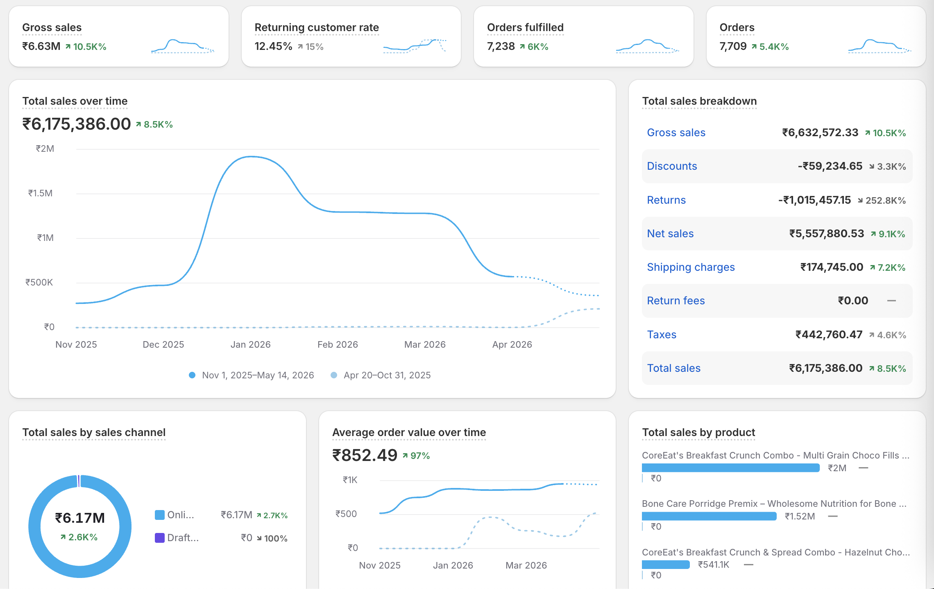
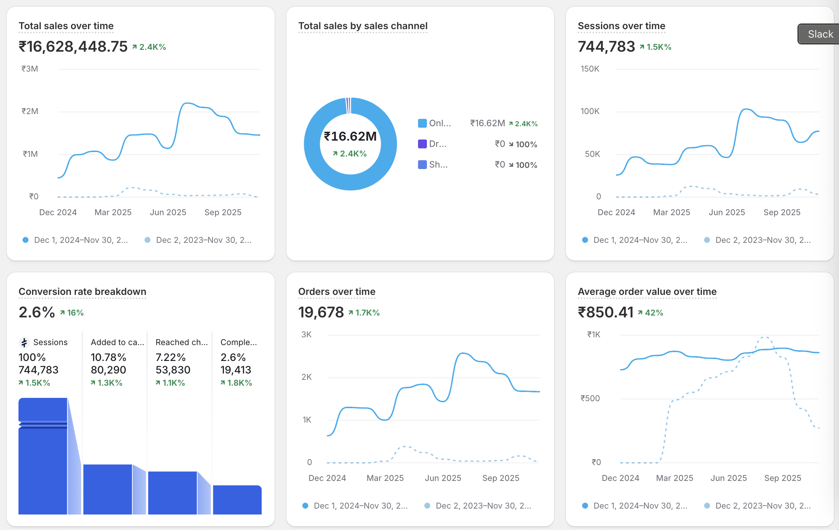
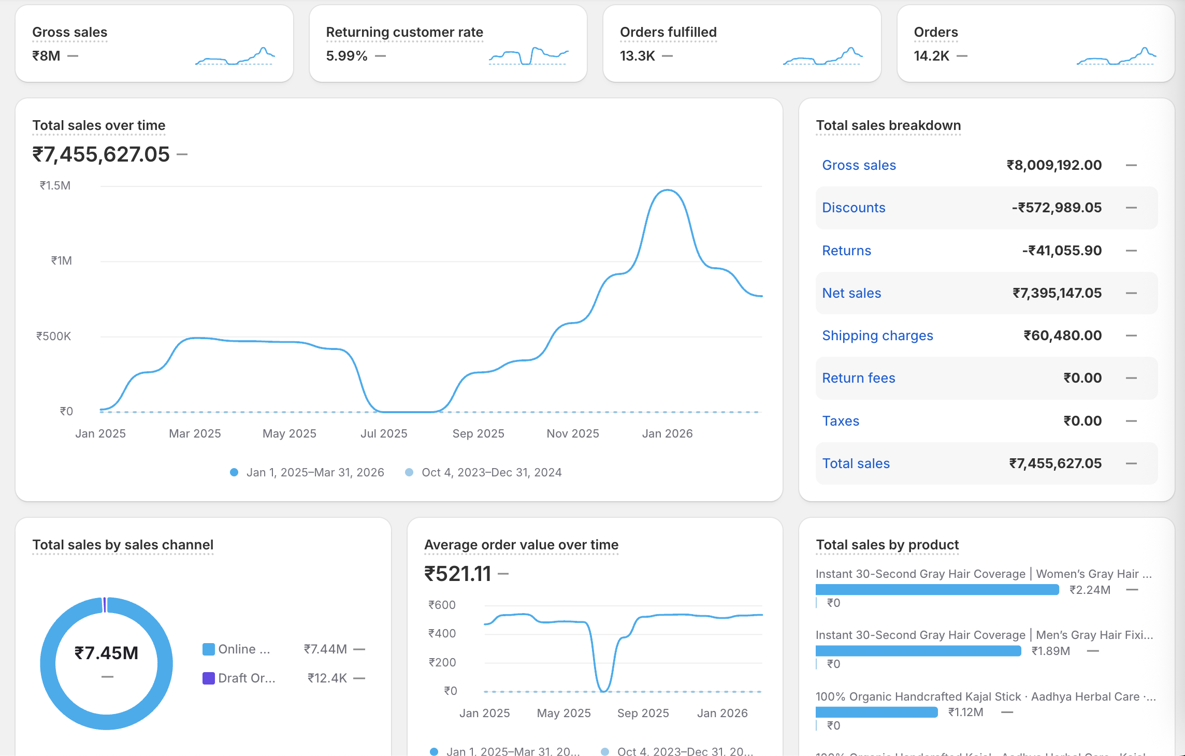
PROOF OF PERFORMANCE
Live Results from Digifyce — Same Systems, Different Brands
FMCG – Ready to Eat
FMCG –Health Supplements
FMCG – Ready to Cook
D2C Sales
D2C & Market Places
D2C & Market Places
Tools: Facebook · Email · WhatsApp · Drip · Google
Tools: Facebook · Google · Email · WhatsApp · Amazon · Flipkart · Drip
Tools: Facebook · Google · Email · WhatsApp · Amazon · Flipkart · Drip
Duration: 6 Months
Duration: 10 Months
Duration: 10 Months
8×
200%
Close Rate Improvement
Drop in CPL
380%
$13K
Lead Quality Increase
Total Spend — 198 Leads
Confidential @ Digifyce

Slide 20

Kaapi Stop has the product.
Digifyce brings the market.
The South India coffee market is growing at 27% CAGR. The B2B vending opportunity is untapped.
Every day without a digital system is a day your competitors fill that gap.
NEXT STEPS — WHAT HAPPENS THIS WEEK
01 Agree on starting vertical and package - we focus, not scatter
02 Onboarding call - share brand assets, ad accounts, and current data
03 First campaign live within 7 days of engagement confirmation
04 Week 3 data review - real numbers, real adjustments
Ready to start? Let's get to work.
www.digifyce.com · ragav@digifyce.com · +91 90259 89708 · Confidential — for Kaapi Stop internal use only

