Slide 1
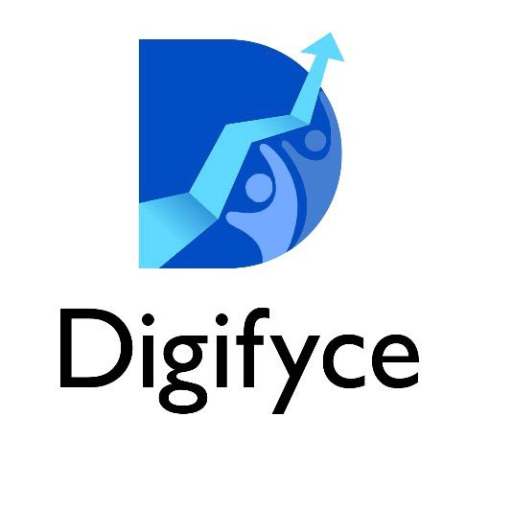
NURTURING ORGANIZATIONS TO THRIVE DIGITALLY
POA & PROPOSAL FOR PADMVATI CONSTRUCTION
#Strategy
#Digital
#MarTech
We Formulate Digital Identities
Confidential @ Digifyce
Notes:
Introduce yourself to get things started.
1

Slide 2



Digifyce, We formulate Digital Identities
OUR APPROACH
TEAM SPECIALIZATIONS
MARKET RESEARCH STUDY
STRATEGICAL APPROACH
CREATIVE
DIRECTORS
MARTECH SPECIALISTS
20+ DIGITAL MARKETERS
150+ CERTIFICATIONS
ROI DRIVEN METHODOLOGY
DATA
DRIVEN DECISIONS
Confidential @ Digifyce

Slide 3















“Our customer retention is our strength”
As we are ROI driven, we help our clients in adding value to their businesses
Confidential @ Digifyce

Slide 4
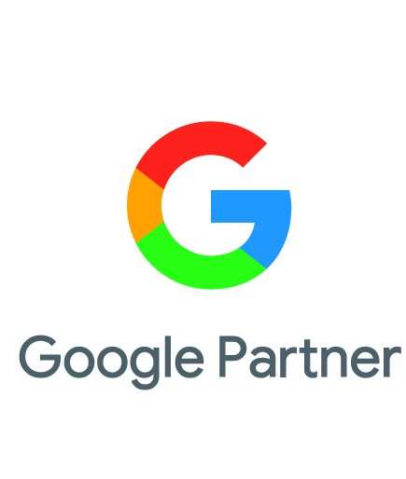
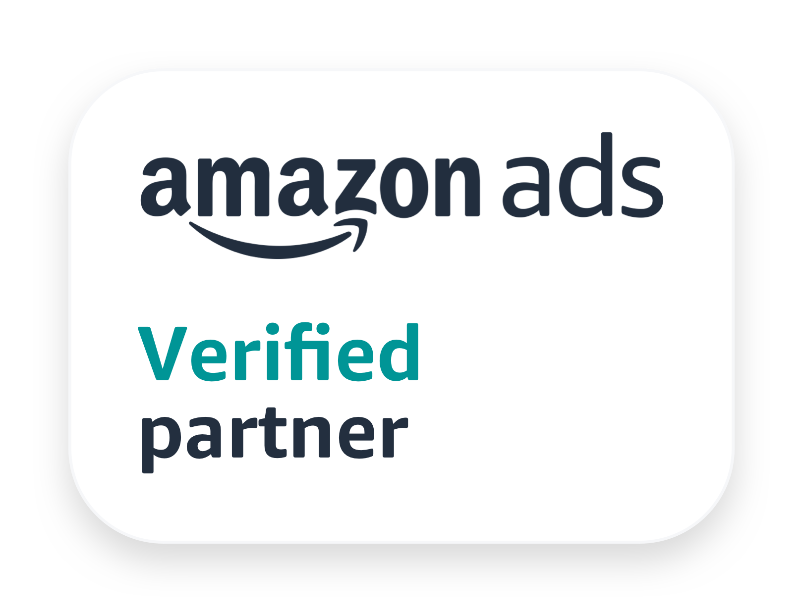


Digifyce, our partnerships
10K+
CAMPAIGNS
500K+
CONVERSIONS
100M+
REVENUE GENERATED
2K+
CAMPAIGNS
300K+
CONVERSIONS
60M+
REVENUE GENERATED
20K+
CAMPAIGNS
1M+
CONVERSIONS
500M+
REVENUE GENERATED
200+
CAMPAIGNS
10K+
CONVERSIONS
1000+HRS
RESOURCE COST SAVED
Confidential @ Digifyce

Slide 5
MARKETING STRATEGY FOR
PADMAVATI CONSTRUCTION
Confidential @ Digifyce

Slide 6
LEADS ACQUISITION STRATEGY FOR CONSTRUCTION - FIRST QUARTER
DIGITAL STRATEGY:
COMPETITION & BUSINESS MODEL
POA & BUDGET STRATEGY
BUILDING THE PERSONAS & TG ANALYSIS
DIGITAL CHANNELS:
SOCIAL MEDIA – BRANDING & LEAD GENERATION
SEARCH ENGINE MARKETING – ORGANIC & PAID
PERSONALIZED MARKETING – WHATSAPP, SMS, PUSH, EMAIL
ADVANCED AUTOMATIONS:
EMAIL MARKETING - SEQUENCES
SEGMENTATIONS, PERSONALISATIONS & AUTOMATIONS
TECH SETUPS – HEAT MAPS, ANALYTICS, TAGS, ETC
LANDING PAGES – EVENT SPECIFIC
DATABASE MARKETING & PERSONAS
BOTS SYSTEMS – CHATBOTS, LINKEDIN BOTS, ETC
Confidential @ Digifyce

Slide 7
SEARCH ENGINE – MARKET STUDY

Slide 8
BUYER PERSONA Development (User, Influencer, Buyer)
Problem Statement: The company wanted to reach the stakeholders with its derived value proposition
Solutions Planned:
Stakeholder matrix: Derived the stakeholder matrix as per the value prop & the personal classification using the primary & secondary research. KPI was engagement.
RESULTS EXPECTED
100K+
Stake holder engagement
 | Persona Segment Rating (on a scale of 0-5) (5 being best)
Capturing key statements | Categorisation | Entrpreneurs, CEOs, Owners | NRI | Other Cities | Total
Value Prop 1 | Your Dream Home | 5 | 2 | 5 | 12
Value Prop 2 | Take a Virtual 360 Tour | 3 | 5 | 5 | 13
Value Prop 3 | Invest in growing region | 5 | 5 | 5 | 15
Engagement
Multi-fold in various channels and re-marketing (Facebook and Instagram)
Enhancing for drip-marketing
Reaching the target group in a sequential manner (eg., day 1, day 10, day 30, etc.,)
Channel selection: The channels were proposed based on the persona presence, the time spent per persona per channel per day, time & day of the publish, etc.,
Content development: Content will be developed based on the key points (e.g., students, family, fashion enthusiasts, etc.). Content will be developed separately for Social, Email, Landing pages, etc.,
Functional & programmatic Marketing: Landing pages will be developed for individual buyer personas to communicate the various pain and gain points. GYR score cards will be prepared with the specific KPI set for each buyer persona.
Tools Used: As required – Ads, Software

Slide 9
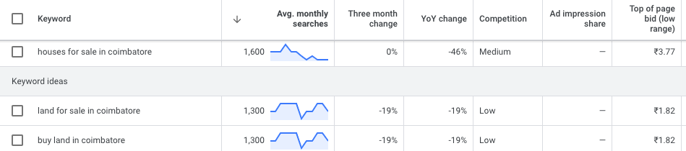
GOOGLE SEARCH ENGINE – MARKET STUDY – CBE MARKET SEARCHES
Topic: Keywords
Asset Type: Search Ads, Demand Gen, YouTube, Display
Channels: Google
Objective: Leads
Audience: People searching based on keywords
Location: Coimbatore
Interests: People searching Villas, Houses for sale
Monthly Forecast
Search Volume: Around 10K
Expected Traffic: 1 to 1.5K
Leads Expected: 100 to 150
Confidential @Digifyce

Slide 10
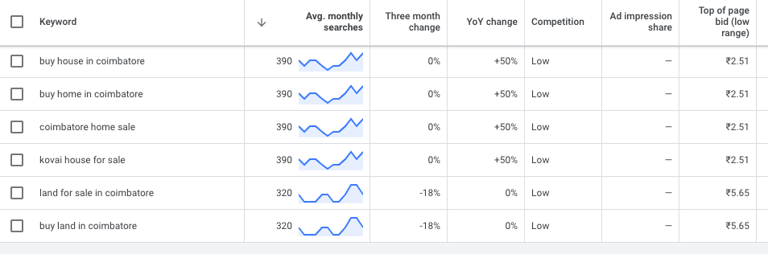

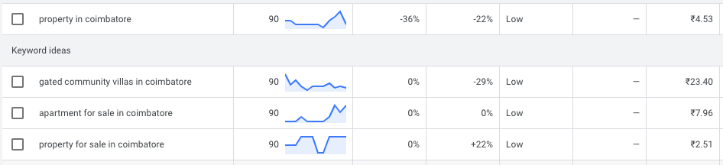
GOOGLE SEARCH ENGINE – MARKET STUDY – NRI MARKET SEARCHES
Topic: Keywords
Asset Type: Search Ads, Demand Gen, YouTube, Display
Channels: Google
Objective: Leads
Audience: People searching based on keywords from other countries
Location: Singapore, Malaysia, USA, UK, Australia, NZ
Interests: People searching Villas, Houses for sale from other countries
Monthly Forecast
Search Volume: Around 2K
Expected Traffic: 200 to 250
Leads Expected: 20 to 35
Confidential @Digifyce

Slide 11
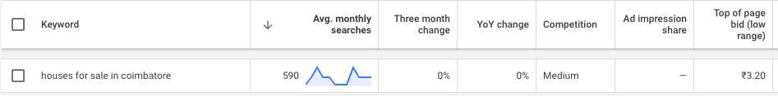
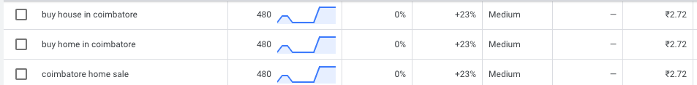
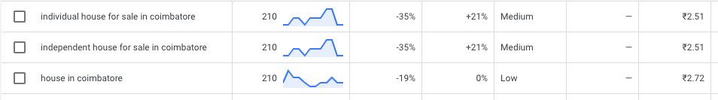
GOOGLE SEARCH ENGINE – MARKET STUDY – T1 CITIES MARKET SEARCHES
Topic: Keywords
Asset Type: Search Ads, Demand Gen, YouTube, Display
Channels: Google
Objective: Leads
Audience: People searching based on keywords from other cities
Location: Chennai, Pune, Mumbai, Delhi, Bengaluru, Hyderabad
Interests: People searching Villas, Houses for sale from other cities
Monthly Forecast
Search Volume: Around 5K
Expected Traffic: 500 to 650
Leads Expected: 50 to 75
Confidential @Digifyce

Slide 12
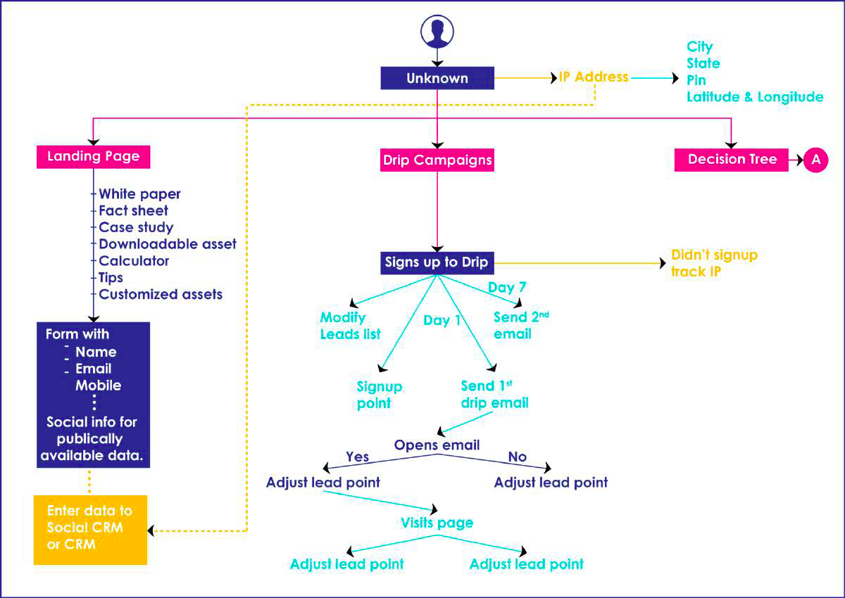
MARKETING AUTOMATIONS – CUSTOMER ACQUISITION & RE-ENGAGEMENT
Marketing Automation:
Based on the user journey and behaviour, segments are created and triggered emails and whatsapp on regular intervals to acquire new customers and retain the existing customers.
Confidential @ Digifyce

Slide 13
CAMPAIGNS, BUDGETS, EXECUTION PLAN & POA

Slide 14
META ADS CAMPAIGN PLAN, BUDGETS & EXPECTED RESULTS
Channel: Meta: FB and Insta
*NOTE: BELOW NUMBERS ARE HIGH LEVEL PLAN, THIS WILL BE CHANGED BASED ON THE SCOPE SELECTED
Meta Ads Plan-2024
Type of Campaign | Campaign Objective | Target Audience | Creative Type | Location
Leads/ Enquiries | Showcase Property Details – Investment Positioning | Titles: Business Owners, Doctors, Investors Interests: Real Estate, Investing, Property, etc., | Visual carousel with brief captions | Coimbatore, T1 Cities, NRI Market
 | Buy your dream home | Titles: Business Owners, Doctors, Investors Interests: Real Estate, Investing, Property, etc., | Short video ads | Coimbatore, T1 Cities, NRI Market
 | Virtual Tour Positioning | Interests: Real Estate, Investing, Property, etc., | Lead generation forms with incentives | Coimbatore, T1 Cities, NRI Market
 | EMI Based | Titles: Business Owners, Doctors, Investors Interests: Real Estate, Investing, Property, etc., | Video Ads & Image Ads | Coimbatore, T1 Cities, NRI Market
Engagement (Branding) | Foster engagement through regular posts featuring user-generated content, travel tips, and destination spotlights | Followers and users interested in Real Estate | Engaging posts with questions, polls, and user stories | Coimbatore, T1 Cities, NRI Market
Confidential @ Digifyce

Slide 15
GOOGLE ADS CAMPAIGN PLAN, BUDGETS & EXPECTED RESULTS
Channel: GOOGLE: Search, Display and YouTube
*NOTE: BELOW NUMBERS ARE HIGH LEVEL PLAN, THIS WILL BE CHANGED BASED ON THE SCOPE SELECTED
Google Ads Plan-2024
Type of Campaign | Campaign Objective | Target Audience | Creative Type | Location
Search Ads | Drive traffic and conversions to website | Users searching for villas, houses, property for sale | Text | Coimbatore, T1 Cities, NRI Market
Display Ads | Increase brand awareness and reach potential customers | Users interested in travel and adventure across relevant websites and apps | Single image and Video | Coimbatore, T1 Cities, NRI Market
YouTube Ads | Increase brand visibility and engagement through video content | YouTube users interested in travel, Investing, realestate, etc., | Video ads | Coimbatore, T1 Cities, NRI Market
Remarketing (Pmax) | Re-engage users who have previously visited the website | Users who have visited the website but haven't converted | Text and Visual Ads | Coimbatore, T1 Cities, NRI Market
Confidential @ Digifyce

Slide 16
SOME INTERESTING USE CASES
Confidential @ Digifyce

Slide 17
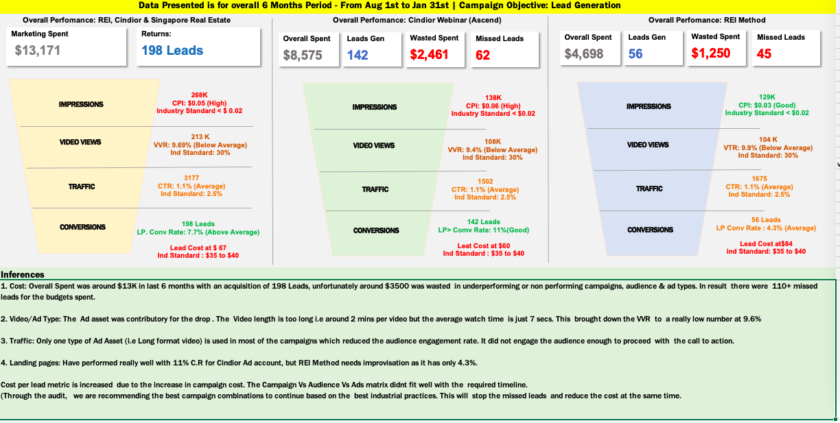
COST SAVING DERIVATION FOR A TOP REAL ESTATE AGENT IN SINGAPORE
Confidential @ Digifyce

Slide 18
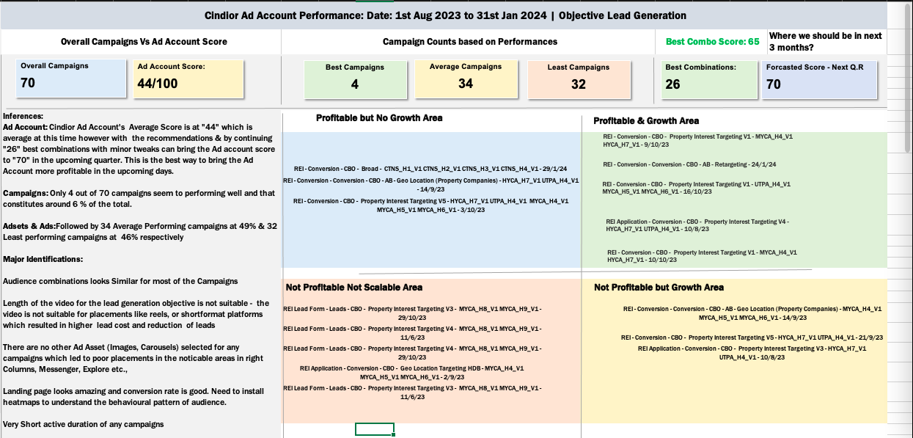
COST SAVING DERIVATION FOR A TOP REAL ESTATE AGENT IN SINGAPORE
Confidential @ Digifyce

Slide 19
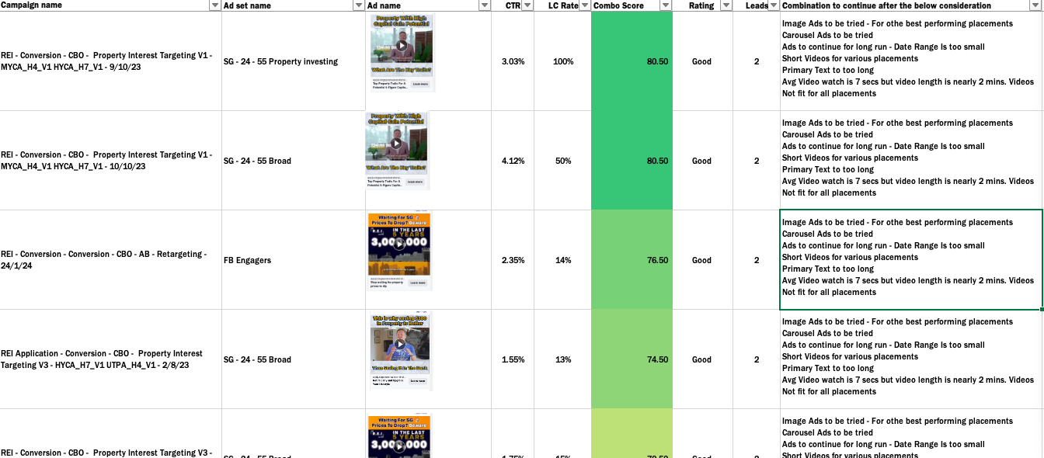
COST SAVING DERIVATION FOR A TOP REAL ESTATE AGENT IN SINGAPORE
Confidential @ Digifyce

Slide 20
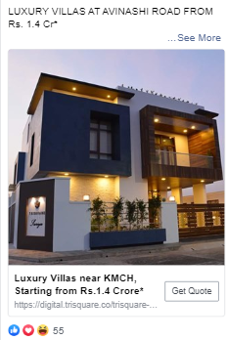
CASE STUDY 1: LUXURY REAL ESTATE BUILDER
OVERALL PERFORMANCE FUNNEL FOR LAST QUARTER
Successful Campaign Screenshots:
Reach =
2.5million
47%
Traffic = 13000
4.65 %
CAMPAIGN SNIPPETS:
45 % decrease in lead cost
SGD 30 million conversion value
55% increase in lead
Tools Used: Facebook | Instagram | Google Display | Google Search | Social CRM | Email (Social CRM) | Landing Pages
Leads=1400
Confidential @ Soul Creationz

Slide 21
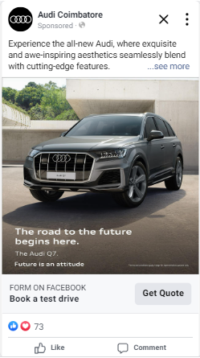

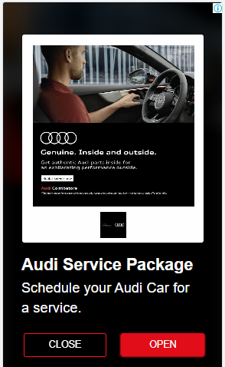
CASE STUDY 1: RENOWNDED AUTOMOBILE DEALERS FOR THE “AUDI BRAND”
OVERALL PERFORMANCE FUNNEL FOR LAST QUARTER
Successful Campaign Screenshots:
Impressions = 8,75,496
Reach = 2,50,469
28.6 %
Clicks = 18,417
7.35 %
Leads = 858
4.65 %
TEST DRIVES
96
CAMPAIGN SNIPPETS: (Oct, Nov & Dec 2023)
Facebook Leads: 499 Leads
Google Leads: 359 Leads
From our overall campaign strategy & executions, business received around 96 test drives from the 858 leads given in last 3 month i.e. (Oct, Nov, Dec 2023)
11.2 %
Confidential @ Soul Creationz

Slide 22


Get in Touch
Digifyce.
20+ Members Team
Singapore, Malaysia & India
#MarTech #Digital #Tech
Website
www.digifyce.com
RAJKUMAR
Director
rajkumar@digifyce.com
Ph: +91 99434 14300
RAGAV
Director
ragav@digifyce.com
Ph: +91 9025989708

