Slide 1
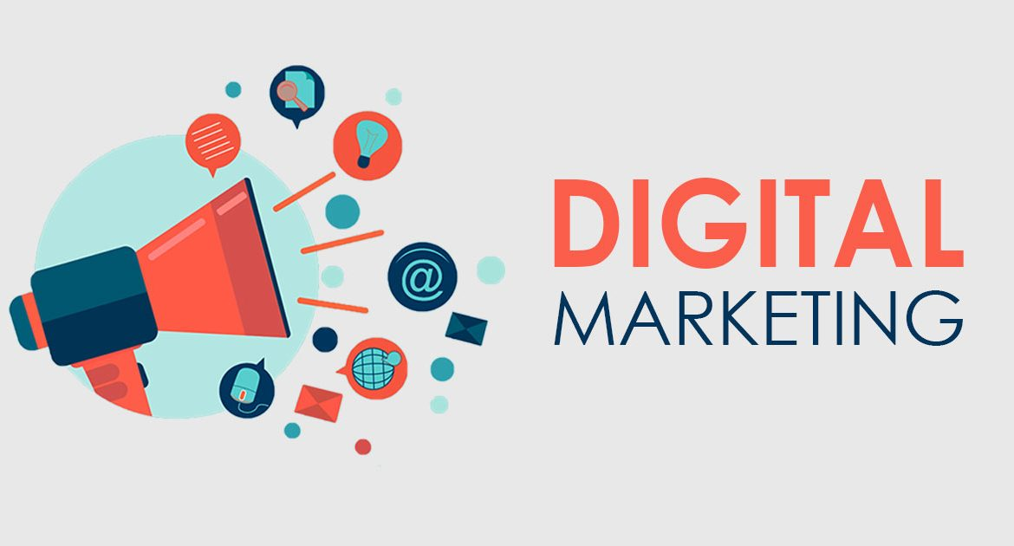
HELPING ORGANIZATIONS
GROW WITH DIGITAL
CASE STUDY ON E-COMMERCE PROJECT
17-MARCH-2021
Notes:
Introduce yourself to get things started.

Slide 2

TECHNOLOGY & MARKETING METHODOLOGIES APPLIED FOR THE BUSINESS
E-COMMERCE DEVELOPMENT
LOGISTICS SETUPS
VIDEO VIEWS
OCCASIONAL MARKETING
REAL ESTATE CONVERSION
E-COM SALES
BRAND RELAUNCH
ENQUIRY GENERATION
ONLINE UNIVERSITY
LAUNCH & ACTIVATION
COVID-19 DASHBOARD
CAUSE MARKETING
EXPO WALKINS
B2B LEAD GENERATION

Slide 3
1
Product Launch for a manufacturing company using
Digital Platforms

Slide 4

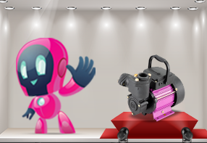
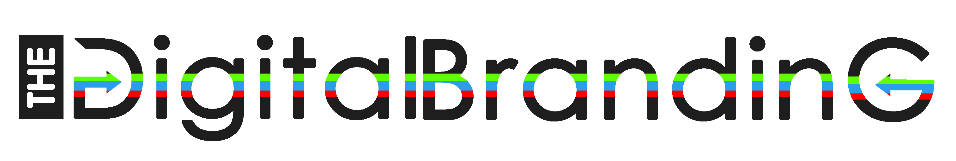
CASE STUDY1: A top-notch pump manufacturer launched a new water pumping product on digital platform aiming higher conversions in terms of product purchase
MASCOT DESIGNED SPECIFICALLY FOR THE CAMPAIGN
CLIENT STORY:
Industry: Manufacturing
Turn over: 1200 Crores
A multi-winged organization headquartered in the Manchester of South India manufactures and delivers perfectly engineered water pumping products to over 120 countries across the globe. With cutting-edge technology and state-of-the-art machinery, the client designs fluid management systems for residential, agricultural, industrial and commercial applications.
3X
Increase in reach
3000+
Products Sold
23%
Conversion Rate
40
Days as time taken

Slide 5
Problem Statement: While most manufacturing companies tend to prefer traditional marketing for the product launch, the client wanted to drive product awareness and customer acquisition via digital marketing. In such a case, the client was not sure about the right tactics and techniques to reach the target audiences.
Solutions Planned:
The client who trades reliable water pumps approached us to launch a new product in the digital media platforms. Based on the goals and objective of the client, our digital marketing team opted go-to-market strategy to implement a viral product launch campaign that could elevate awareness and sales. This detailed digital marketing plan with a blend of cost-effective techniques resulted in a 66% increase in reach at 0.03 CPR, which is lower than the usual market standards.
In the initial stage, the team divided the campaign into three phases - pre-launch, launch and post-launch phases to make the product launch more effective. As a part of the pre-launch stage, an appealing mascot was designed in such a way that it brings a remarkable connection between target audiences and the brand. To create a buzz among the audiences, curiosity-based photo ads and video ads were publicized in social media channels beforehand.
With the well-planned target audience database, the team segregated the digital media channels where the digital assets were to be promoted. During the launch phase, the product was unveiled in popular channels such as Facebook, Instagram and Twitter. Also, an optimized 10-second non-skippable video was posted on YouTube to grab the attention of target audiences visually.
Google display ads were published by targeting the viewers of trending videos and visitors of existing landing pages to increase brand awareness. A comprehensive landing page highlighting the features and applications of the product with a clear call-to-action was incorporated to prompt visitors with the product information.
Once the product launch was over, the team carried out specific processes to maintain the marketing momentum to ensure success and sustainable sales growth later. In the end, the intelligent marketing strategies and perfect implementation of the campaign at the right platforms brought a huge delight with a favourable outcome to the client.
RESULTS ACHIEVED
34L
REACH
100K+
VIEWS
13K+
TRAFFIC
3000+
SALES
KEY TAKEAWAYS
Cost per reach at : 3 Paise
(Industrial Standard at 10 Paise)
Cost per view at : 74 Paise
(Industrial Standard at Rs.1)
Cost Per Acquisition at – Rs.200
Tools Used: Display, Social, Hotstar, YouTube, SMS & Push Notification

Slide 6
2
App Install Campaigns for a Taxi Service Company in Digital Platforms

Slide 7
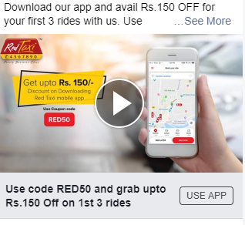
CASE STUDY 2: Prominent Taxi company's Mobile App installations shot up to 70K using Google & Facebook Ads in 6 months
ADVERT USED FOR THE CAMPAIGN
CLIENT STORY:
Industry: Taxi Services
Turn over: 100+ Crores
A popular cab service company head quartered in tier-two city of India has 1500+ cabs and operates in 5 cities. They provide cab services in different segments like Sedan, Hatchback, etc. The company operates on based on both kilometre and rental and it also offers outstation services.
67%
Increase in App Bookings
5
Cities Expansion
37%
Increase in active users
180
Days as time taken

Slide 8
Problem Statement: The Taxi service company built their Mobile application for Android & iOS users to book taxi online. Business performed well on direct call bookings in the local market. When they launched the app, the bookings through app was not as high as they expected and there was a set back.
Solutions Planned:
The cab service company designed their mobile application in such a way that it made online cab bookings convenient for its customers. They wanted to promote online bookings through both online and offline advertisements. Since, it was a mobile app and involved spontaneous bookings, our team suggested online platforms for promotions. To begin with, a trial run was initated in Coimbatore, Tamil Nadu for which exciting offers and coupons were planned for bookings done through apps.
To run the campaigns, Facebook & Google were chosen initially because of the volume of the users in these platforms. Initial setups like Facebook Developers account, Google Developers account, SDK set up & integration of SDK in the app, setting up firebase for both Android & iOS app installs were done.
Offer-based promotion:
The audience were targeted based on the types of cabs - business, economy, etc. - offered by the company The images and videos that highlighted the offers were curated to reach the potential riders. The websites which were the most visited by the company's potential customers were chosen and the curated ads were strategically placed. The offer-based promotion was an instant hit and 23K+ downloads were seen in the first few months of the campaign. The ads were also published on Facebook and Instagram which reached considerable number of customers and thus, had significant downloads.
The bid cost per app install was continuously monitored for each city & with respect to each city's population & brand's reach, the bid cost was adjusted to drive more results. A report was generated for each channel with respect to ROI & the most profitable channel for Android app installs & iOS app installs was identified. The content & creative collaterals were continuously monitored and optimised based on the rank & quality score. The placement of different ads was revised based on the trending topics, websites etc. Within a few months, the number of downloads had reached 63,796 downloads at a CPA of INR 3.59. A whopping conversion rate of 47.82% was also achieved through this strategy. The app install shot up to 70.59% with a 72.59% interaction
RESULTS ACHIEVED
4.4M
REACH
1.3L+
APP CLICKS
63K+
APP DOWNLOADS
47%
CONV.RATE
KEY TAKEAWAYS
Cost per reach at : 4 Paise
(Industrial Standard at 10 Paise)
Cost per Install at : Rs. 3.74/-
(Industrial Standard at Rs. 20)
Cost Per Acquisition at – Rs.20
Tools Used: Facebook App Install Ads | Google App Installs | Google Analytics | Facebook Developers | Google Developers | Firebase

Slide 9
3
Taking mileage of Farmer’s day to achieve good number of video views for a pump manufacturer

Slide 10
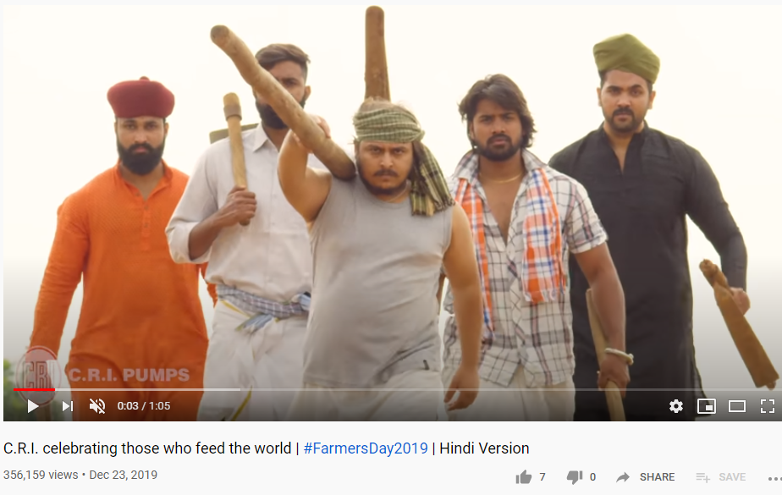
CASE STUDY 3: Sentimental marketing campaign on Farmer's Day triggered a 30% increase in video views costing 3 times less using an effective marketing strategy.
ADVERT USED FOR THE CAMPAIGN
CLIENT STORY:
Industry: Manufacturing
Turn over: 1200 Crores
The client is a well-known pump manufacturer in the country, with over 50 years of expertise. They provide agricultural pumps of the highest quality to increase farming efficiency and ease the farmer's life. The client has a strong presence in over 120 countries.
35%
Increase in video views
3
Times less cost
4
Different Languages
30
Days as time taken

Slide 11
Problem Statement: The client wanted to reach out to the entire farmer community of the country during the Farmer's Day, which was pretty hard due to the vast linguistic differences.
Solutions Planned:
The digital team planned a vernacular video and display ads in 4 different languages to reach the farmers across the country. This strategy resulted in bringing down the CPV to 3 times lower than market standards. The video ads were also triggered by 30% higher than the mean views.
A strategic road map was formulated based on the buyer persona. As per the framework, video ads were created as a tribute to the farmers incorporating information about agri-based pumps of the client. The ads were planned in 4 different languages, Hindi to cover the Northern parts of the country and Tamil, Telugu and Kannada for Southern regions of the country.
Google Display ads were run across various agri-based websites, news sites, social channels and YouTube. The Google Display ads triggered a stunning reach of 1.7M niche target audience. The bounce rate was low, and the CPC was also meagre at just Rs.7.
The language barrier was broken by creating language-specific landing pages to which the audience were redirected from the ads. The strategically placed lead forms on the vernacular landing pages provided plenty of leads from the campaign. A stunning 2M views for video ads was triggered at a CPV of just Rs.0.19. Facebook and Instagram alone contributed to around 60% of the campaign success. Facebook, Instagram, YouTube, Google search and display ads were the channels used in the campaign. The campaign reached a massive success rate across the country reaching over 7.4M audience with just Rs.0.05 CPI.
RESULTS ACHIEVED
7.3M
REACH
2.03M+
VIDEO VIEWS
124K+
TRAFFIC
35%
HIGHER VIEWS
KEY TAKEAWAYS
Cost per reach at : 5 Paise
(Industrial Standard at 10 Paise)
Cost per Video View at : 19 Paise
(Industrial Standard at Rs. 1)
Cost Per Traffic at – 25 Paise
Tools Used: Facebook | Instagram | Google Display | Google Search | Landing Pages | YouTube | SMS

Slide 12
4
On occasion of the World Water Day 2019 initiated by UN in the theme “Water for All – Leaving No One Behind”, Client initiated to execute a special series of social campaign based on the theme.

Slide 13
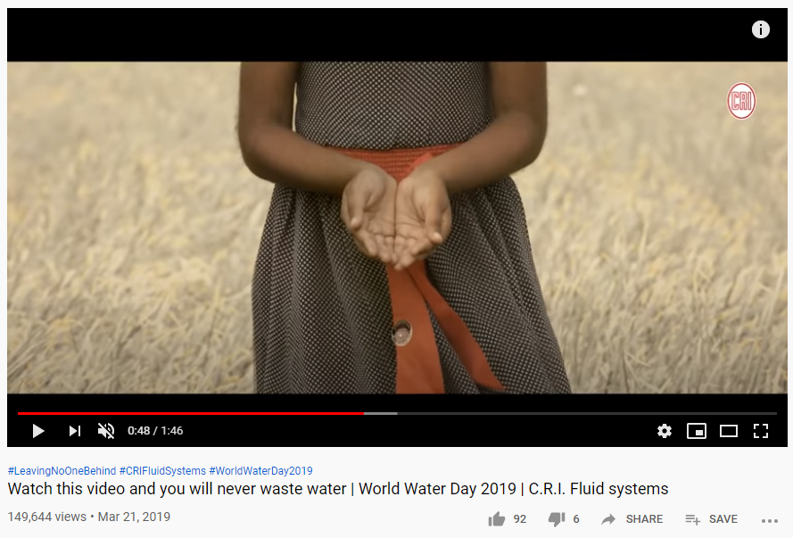
CASE STUDY 4: Activating 4.8 Million brand impressions in 72 Hours through a Occasional Marketing Campaign for World Water Day 2019
CLIENT STORY:
Industry: Manufacturing
Turn over: 250 Million USD
Client is a 250 Million USD fluid management solutions company head quartered in a tier 2 Indian city with over 6,000 product types relating to the water management sector. They are the global leader in the Fluid Management Solutions space. Their products are sold through 20,000 outlets over 120 countries backed by 1,500 service centres worldwide. The company has 21 manufacturing facilities across the world and has made acquisitions in the UK and Italy and over 11 wholly owned subsidiaries globally.
SERIES OF CREATIVES WERE USED FOR THE CAMPAIGN,
BUT THE MAIN VIDEO IS MENTIONED BELOW
20%
Increase in video views
2.8M
Impressions in Google
1.7M
Impressions in Facebook
72
Hours as time taken

Slide 14
Problem Statement: On occasion of the Water Day 2019, the client wanted to run a special social campaign based on the water day theme. They required a viral reach & wanted to show their support for a sustainable society but was unsure of the strategy & the channels.
Solutions Planned:
A strong content strategy was developed to revolve around the Water Day 2019 theme that consisted of different image posts resonating the importance of water. Also, a special 2 minute creative & emotional video was created to increase the engagement, reach & drive traffic. A dedicated landing page was designed with strong content, creatives & video.
Different channels including Facebook, Instagram, Google Display, YouTube ads, Publishers, Influencers were chosen to reach more people and to generate more video views. A series of posts were published in digital channels & the day before the Water Day, the video collateral along with the tailored sentimental marketing message were posted on different channels in order to generate emotional reactions from the users.
The placements & bid adjustments for the display ads and YouTube ads were adjusted in a way for the YouTube & display ads to appear more frequently on trending websites, videos, channels. Using the GYR calculators, bid adjustment strategies, the bid cost for each Google ad was optimised. A/B testing was done with different objectives like video views & traffic and the optimization of the campaigns were carried out.
RESULTS ACHIEVED
4.8 M
REACH
486K+
VIDEO VIEWS
24.4K+
TRAFFIC
20%
HIGHER VIEWS
KEY TAKEAWAYS
Cost per reach at : Paise
(Industrial Standard at 10 Paise)
Cost per Video View at : 40 Paise
(Industrial Standard at Rs. 1)
Tools Used: Facebook | Facebook Ads Reporting | Instagram | Google Display | Google Analytics | Google Video Ads | Publishers | Influencers

Slide 15
5
5 conversions with a sale value of 10 CR in a time duration of 1 Year

Slide 16
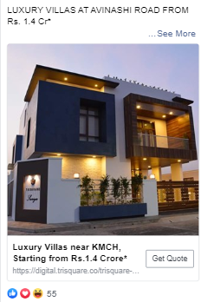
CASE STUDY 5: Targeting the right ICP with effective A/B test campaigns enabled a 45% decrease in lead cost for Rs. 2 crore property in tier 2 city which resulted in 5 closures.
CLIENT STORY:
Industry: Real Estate
Turn over: 200 CR
The client is a prestigious real estate promoter based out of Coimbatore. The luxury developer has many properties around the state of Tamil Nadu and is a leader when it comes to luxury housing. Their state-of-the-art technologies incorporated in the houses makes them a leader in this field.
ADVERT USED FOR THE LEAD CAMPAIGNS
45%
Decrease in lead cost
10CR
Conversion Value
55%
Increase in leads
365
Days as time taken

Slide 17
Problem Statement: A luxury real estate builder wanted to reach their target audience in digital space. When their strategy proved expensive, they wanted a renovated framework to accelerate their sales.
Solutions Planned:
The ICPs was segregated based on the Job titles, Device Usage, Behaviour & Income, and the creatives were planned according to the ICPs to bring in leads. Social CRM was used to segregate the leads based on interests. This gave us a clear prediction on future sales pipelines & personalization of the content on buyer persona. There was a 45% increase in lead quantity.
Our digital team did market research and made a SWOT analysis of the client to prepare a strategic framework and to tap the right target audience through the proper channels. Facebook, Instagram, Google display and Search ads were finalised as ideal channels. Landing pages were also created to increase the engagement rate based on content personalization. The conversion rate from landing page increased to 11% once the personalization strategy was adopted.
Target marketing was done on Facebook and Instagram to generate leads from the identified ICPs. There was an impressive reach of 2.5M audience. Apart from this brand awareness campaign, we also ran campaigns simultaneously with varied themes. Google search ads and Display ads based on geo-targeting further enhanced the lead generation campaign. The main objective was to drive website traffic & generate leads from the landing page. Keywords were optimized, and all the ads directed the users to the unique landing pages with personalized content. This resulted in generating more leads.
All the leads were fed into social CRM to segregate the leads based on their interests. And email marketing followed up. There was a massive 7% open rate on emails. An incredible conversion of 8 units was done at an amazing Cost per Lead of just Rs.67, which is 45% less than the average cost. The cost per acquisition was also very low for 2 Cr property. The lead campaign was run as per the framework, and it was a massive success with a reach of over 2.5M audience.
RESULTS ACHIEVED
2.5 M
REACH
13.9K+
TRAFFIC
1.48K+
LEADS
5
CONV
KEY TAKEAWAYS
Cost per reach at : 7 Paise
(Industrial Standard at 10 Paise)
Cost per Lead at : Rs. 67/-
(Industrial Standard at Rs. 200)
Tools Used: Facebook | Instagram | Google Display | Google Search | Social CRM | Email (Social CRM) | Landing Pages

Slide 18
6
A digital brand awareness which led to the rapid e-commerce sales of Rs.1.25 Lacs within 6 months

Slide 19
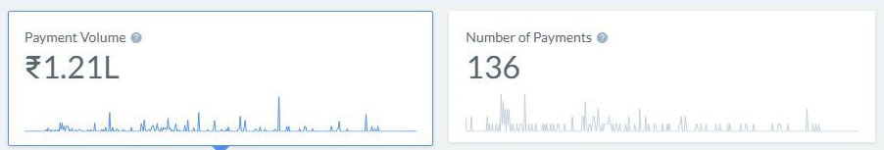
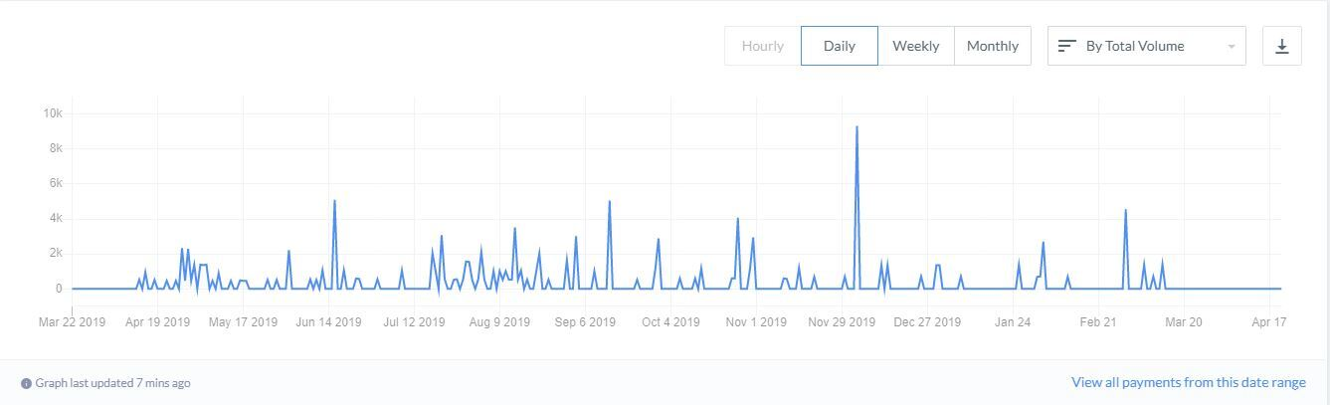
CASE STUDY 6: A digital brand awareness which led to the rapid e-commerce sales of Rs.1.25 Lacs within 6 months.
SALES DASHBOARD
CLIENT STORY:
Industry: FMCG
Turn over: 10 CR+
A leading manufacturer of pure cow ghee with an expertise experience of over 50 years in the South Indian market. The company promises quality and hygiene of the product from manufacturing, packaging and delivering. With an ISO and AGMARK certification, the company maintains the standards and helps to improve the experience of traditional ghee.
32%
Decrease in CPA
50%
Increase in Organic Sale
62%
Decrease in Bounce rate
180
Days as time taken

Slide 20
Problem Statement: The brand wanted to figure out what was the scope for the ghee products in the online market. To reach the target audience of 35 and above age group, creating a digital brand awareness was another major challenge. The brand looked forward to identifying the different channels where the ads could be promoted within the targeted segment.
Solutions Planned:
Our digital team brought out a strategy to meet the right audience through the right medium from which the brand could generate sales.
The marketing model was planned, which focused on driving the customers towards purchasing the product. The step-by-step process from creating brand awareness to sales included four major divisions like building trust or creating brand awareness, generating traffic, registrations and final result, the sales.
The market was filled with several other ghee brands. So, we had to identify different channels and interests of the target audience, including the influencers for further discoverability. The initial stage of brand awareness was done in channels like YouTube and Facebook. YouTube ads in the cooking and kitchen-related platforms along with Facebook ads were used as the major tools to bring more traffic to the website. The product details and the catalogue were curated in the respective landing pages based on the clicks and interests of the customers.
We crafted display ads for the customers who visited the website but did not engage. The ad recall navigated the users to the landing page, where attractive offers could be used. A complete user interface website helped the users to navigate between the pages where they could choose their product. Google shopping and search ads helped in the mileage of the registrations, which resulted in the final purchase.
RESULTS ACHIEVED
16 M
REACH
14.8K+
TRAFFIC
127
CUSTOMERS
1.25L
SALES
KEY TAKEAWAYS
Stats:
1. Up to 50% increase in organic traffic
2. Achieved 60% sales increase for each quarter
3. Bounce rate was decreased to 62%
4. Effectively reduced 32% in CPA
Tools Used: Facebook | Instagram | Google Display | Google Search | Google Shopping ad | SMS | Ecommerce site | Drip | Bots

Slide 21
7
Retail textile Industry wants to re-brand their name & bring more walkins for the newly opened physical store

Slide 22
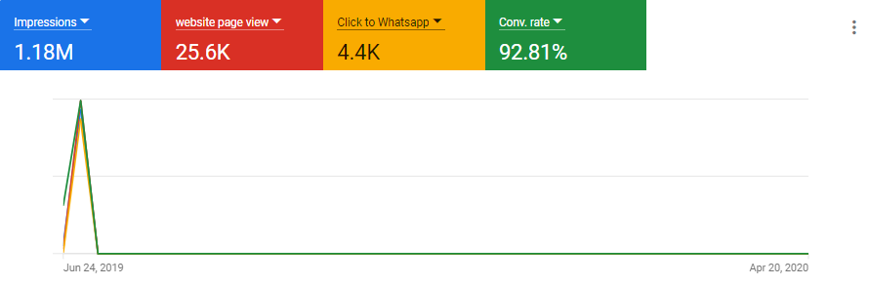
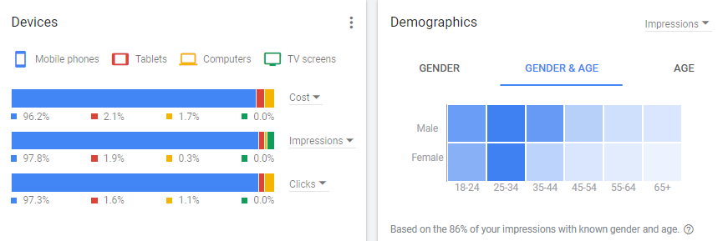
CASE STUDY 7: Viral marketing for rebranding results in 6.2K+ enquiries within 12 days at 92% conversion rate using display channels
CONVERSION DASHBOARD
CLIENT STORY:
Industry: Textile
Turn over: 50 CR+
The client is a leading innovator, manufacturer and seller of silk sarees. The client also boasts over 4 decades of presence in the field with sophisticated stores in two tier-two cities of Tamil Nadu. They offer all types of wedding clothes and modern clothings that suit the changing trends in fashion at attractive prices.
35%
Decrease in Reach Cost
92%
Conversion on Google
16%
Decrease in Enquiry Cost
12
Days as time taken

Slide 23
Problem Statement: The client wanted to rebrand and wanted the new brand name to go viral among the people who had an household income between INR 20K and INR 50K per month. Though the brand was popular among women, traditional marketing methods like newspaper ads and posters didn't work out the way the client had expected and the client didn't know how to execute a well-planned strategy that would go viral.
Solutions Planned:
Apart from its logo, name and mission statements, a brand is also the message it wants to convey to the world. For a company that wants to rebrand and relaunch themselves, customer retention and acquisition are equally essential. In order to popularise their new brand name among the customers, the client wanted to appeal directly to the customers' emotional state. This would also help in understanding the buyer persona and in creating suitable future offers.
Our team of experts suggested pull strategy approach in Digital Marketing platforms to reach the audience in a short time. Our digital team came up with a viral marketing idea that will make the brand name popular among the customers. The viral marketing was achieved by creating an attractive offers-based promotion which would require the customers to type the brand's new name and send it to a designated number on WhatsApp.
Two-Click Strategy: A strategy that simplified and streamlined the flow of enquiries was formulated. The complete registration was done in two clicks and the first click from Facebook & Instagram will redirect the customer to WhatsApp chat window where the new name of the brand will be readily available as a message. The customers had to just tap the 'send' button which accounted to the second click. The customer can walk in to the store showing the WhatsApp message and claim exciting offers. This also helped hugely in achieving brand association. The two-click strategy was incorporated in the image, and video ads run on social media platforms like Facebook & Instagram and the audience were targeted based on their interests. As mentioned earlier, whenever a user clicked on the ad, they were redirected to the WhatsApp chat window. The team conducted A/B testing on men & women and various metrics of the test were studied, and the ads were optimised accordingly on a regular basis.
Three-Click Strategy: Simultaneously, the websites that attracted a huge number of women who were 18 to 45 years old were carefully studied and chosen to run the ads. The ads were strategically positioned in the sites to attract the viewers' attention. The ads were also displayed on newspapers in regional languages to reach the masses. But the two-click strategy was not compatible with Google Display ads. To overcome this, a three-click strategy was formulated. A new step was added after the first click, which included creating a landing page under the brand's new name with an attractive banner. Clicking on the landing page would redirect the users to WhatsApp chat window. The two-click & three-click strategies together played a huge role in associating the new name to the brand, while also its optimised and streamlined methodology made it viral. This resulted in 35% decrease in reach cost than the regular cost.
The results were possible because of the right positioning and segmentation in the digital channels.
RESULTS ACHIEVED
13M
REACH
49K
VIDEO VIEWS
29K
PAGE VISITS
6,232
WHATSAPP ENQ
KEY TAKEAWAYS
Cost per reach at : 5 Paise
(Industrial Standard at 10 Paise)
Cost per enquiry at : Rs. 8/-
(Industrial Standard at Rs. 50)
Tools Used: Facebook | Instagram | Google Display | Google Search | Google Shopping ad | SMS | Ecommerce site | Drip | Bots

Slide 24
8
Brand re-launch & Enquiry generation engagement for a TMT bars manufacturer in Digital Platforms

Slide 25
CASE STUDY 8: A 10 day campaign about the relaunch of the logo and repositioning of the brand. It brought out 96 enquiries with a sale value of 401.15 ton steel and also 6 B2B distributorship leads.
CLIENT STORY:
Industry: Steel Manufacturing
Turn over: 200 CR+
A top South Indian steel producer with turnover of 200 Cr annually. The company is headquartered in a tier 1 city of India. It manufactures different grades of steel primarily for the construction purpose. The company is engaged in the production of steel in both large scale industry as well as small scale. The more customer oriented approach of the company had led the company to top the global market in both steel and metal production.
96
Business Enquiry
6
B2B Enquiry
10
Days as time taken

Slide 26
Problem Statement: The south Indian steel company wants to relaunch their brand with revised USPs. The production market is more prone to new ideas and techniques.The company needs to raise up to the high competition in the market. Therefore, the immediate need of an hour is to reposition the company which meets the new strategies of the market.
Solutions Planned:
To announce the relaunch of the logo and repositioning of the brand, curiosity campaigns were scheduled a week prior to the launch. This was mainly done to built an interest and eagerness among the audience. A few series of creative campaign was involved with pictures and videos which were subjected on the positioning of the statement.
The functional campaigns were shared in the databases of the distributors and dealers one week before the launch. The online campaign was done in Facebook, Instagram, LinkedIn, Whatsapp, Email, SMS & YouTube which mainly targeted the dealers, distributors & construction oriented audience. There was a special video made exclusively for the launch day which was made viral on all the online channels.
There was a streaming YouTube ad which also helped in gaining more attention on the relaunch. After the relaunch, there were different news articles and reports which were being circulated across the channels. These articles had helped really well in the promotions of the relaunch.
Few dedicated landing pages were created for the direct users which helped them to get more information about the the potiential customers of the clients who were interested in further proceedings. Furthermore, the company had location based customized campaigns which were narrowed and executed that had helped in the increased purchase from the targeted geolocations.
Also, these actions have helped to build a personal relation with the brand.
RESULTS ACHIEVED
318K
REACH
154K
VIDEO VIEWS
96
ENQUIRIES
401 TONNE
SALE VALUE
KEY TAKEAWAYS
The number of plays for the video content was up to 154K
In Facebook, the total number of plays for the video were over 133K and had impressions up to 255K. Based on this, there happened to be more than 1.3K landing page visits.
The cost obtained for per click was rated at Rs.0.10.
Around 96 enquiries were generated through digital marketing efforts

Slide 27
9
ONLINE UNIVERSITY - TEXILA

Slide 30
10
Internal Brand Activation for a Hotel chain

Slide 31
CASE STUDY 10:How an internal brand activation process improved the fun element and increased walk-ins to the property.
Problem: A pan-India hotel chain opened up a new concept hotel and wanted to position it as the Business Hub of the town, where non-resident walk-ins can utilize the property for both work and pleasure.
Solution: Camdew’s team understood the concept and identified various channels to communicate key messages about the hotel chain both in-house and online. Camdew team worked closely with the corporate heads of the hotel chain to create both a customer engagement and an employee engagement plan. Camdew also assisted with the execution of the plans with proper measurement metrics in place. Camdew also handled the design and development of the branding elements involved in the process.
Result: The programs created were targeted at multiple segments of the local crowd and with effective communication resulted in an average of 100+ walk-ins everyday. The restaurant in the hotel was running at 80% bookings for lunch and 95% bookings for dinner. The brand activation was measured quantitatively and also qualitatively by increasing social engagement in terms of tagging guests on Facebook, Instagram and Twitter. The social engagement program targeted at women, called “Rent a Chef” was also a great success with more than 40 participants.
Timeline = 6 months
Micro campaigns = 120
100+ walk-ins per day
Measurable returns for restaurant bookings
Improved brand presence in Social media
Increased engagement in social channels

Slide 32
11
COVID DASHBOARD

Slide 35
12
Greenspin Campaign

Slide 38
13
Walkins increased up to 30% for a real estate expo using digital brand awareness program

Slide 39

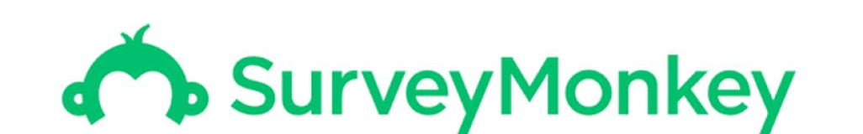
ADVERT USED FOR THE CAMPAIGN
CASE STUDY 13: DIGITAL BRAND AWARENESS INCREASES WALK-INS BY 30%
CLIENT STORY:
Industry: REAL ESTATE
The client is a registered body representing the organized property development sector of a tier 2 city. Also, the client hosts an annual event of over 3 days to showcase the latest developments which provides ample options to select properties for purchasing. This event creates rich dialogues between developers, policy influencers, the media and potential buyers.
Problem: The client wanted to increase the visibility of the 3-day real estate fair but lacked the proper execution idealogy. The client needed a sound strategy to increase walk-ins to the event by targeting the new property buyers and returning buyers
.
TOOLS PLANNED

Slide 40
Solutions Planned:
The client annually hosts a 3-day event bringing together more than 100 properties from over 35 realtors. The campaign to popularise the 3-day real estate expo was planned to roll out in 3 stages. The 16-day campaign revolved around brand awareness, reaching out to the targets and about the event that was to be held. Targeting the right ICP enabled a 30% increase of walk-ins in just a fortnight.
Stage-1, Conducting surveys Surveys were rolled out to the target profiles across the city. The surveys were done to understand the requirements of the property buyers, and they also served the purpose of branding. The ads were run targeting the audience who were interested in purchasing a property. Around 20% of the online enquiries came from this campaign.
Stage-2, Positioning the expo (Do you Know) Branding campaign was initiated on Facebook, Instagram and LinkedIn through interest-based targeting. This campaign focused on building trust between realtors and buyers. The creatives promoted the powers a property buyer enjoys over the promoter and the rules of the regulatory body governing the real estate sector.
Stage-3, Event invite Event promotion was the last stage. The 3-day real estate fair was widely promoted across multiple channels, and exclusive event invites were sent out to the target group. SMS, emails and influencer-based promotions were also done to maximise the reach. This campaign had 5.3x engagements than the survey campaign.
A landing page with complete details about the fair was created to which the ads were redirected upon clicks. The landing page also had lead forms inserted, which contributed to around 40% of the walk-ins. Only image and video ads were used in this campaign, and they were run on omnichannel.
A booming 3.7M impression was created at just Rs 0.07 within the campaign length of 16 days. Around 1300+ online enquires were generated across the digital platform under 2 weeks. Also, the 1 Lakh engagements during the campaign resulted in a 30% rise in the number of walk-ins that year.
30%
Increase in Walkins
3286+
Enquiry
3.7M
Impressions
15
Days as time taken

Slide 41
14
B2B Lead Generation campaigns using LinkedIn Bots

Slide 42
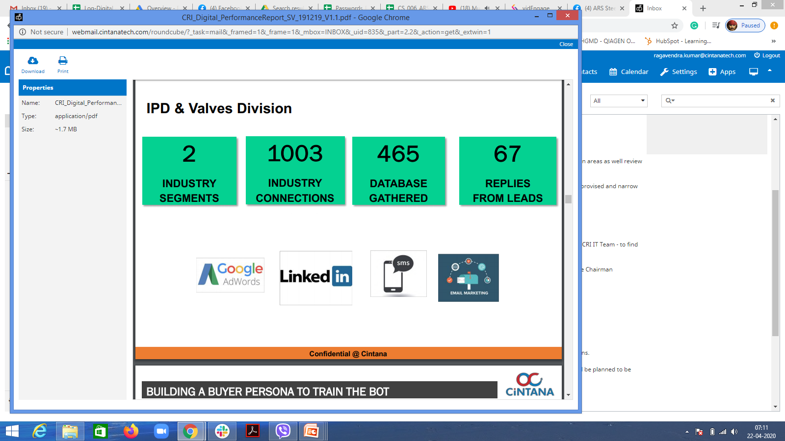
CASE STUDY 14: Usage of AI technology helped organization to increase up to 1K business connections in LinkedIn from which resulted in 14% conversion rate.
RESULTS ACHIEVED
CLIENT STORY:
Industry: Manufacturing
Turn over: 1200 Crores
A multi-winged organization headquartered in the Manchester of South India manufactures and delivers perfectly engineered water pumping products to over 120 countries across the globe. With cutting-edge technology and state-of-the-art machinery, the client designs fluid management systems for residential, agricultural, industrial and commercial applications.
TOOLS USED
DURATION – 2 MONTHS

Slide 43
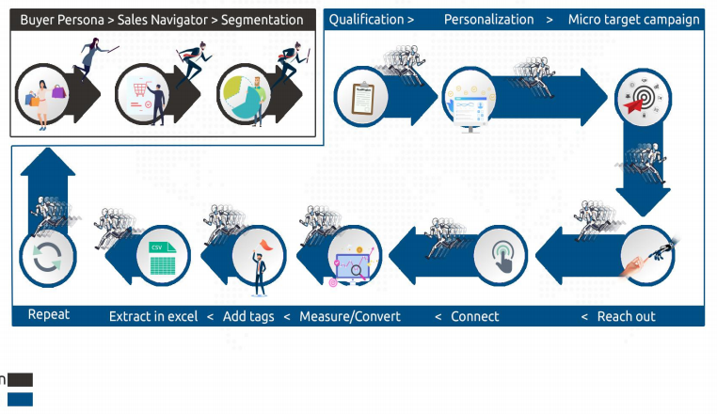
BOTS IN ACTION

Slide 44
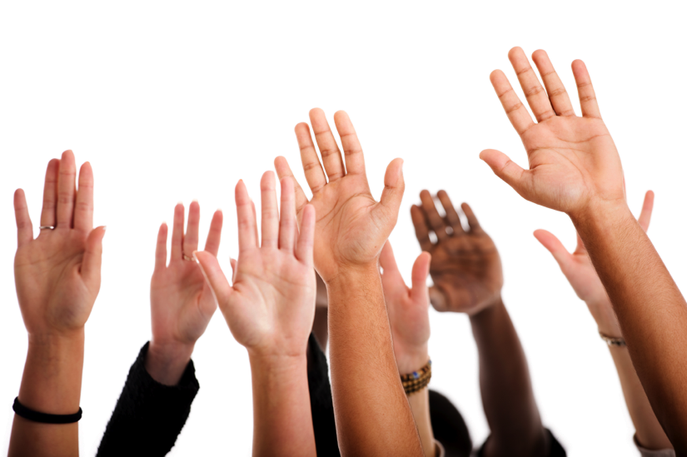
Questions?

