Slide 1
Assignment

Slide 2
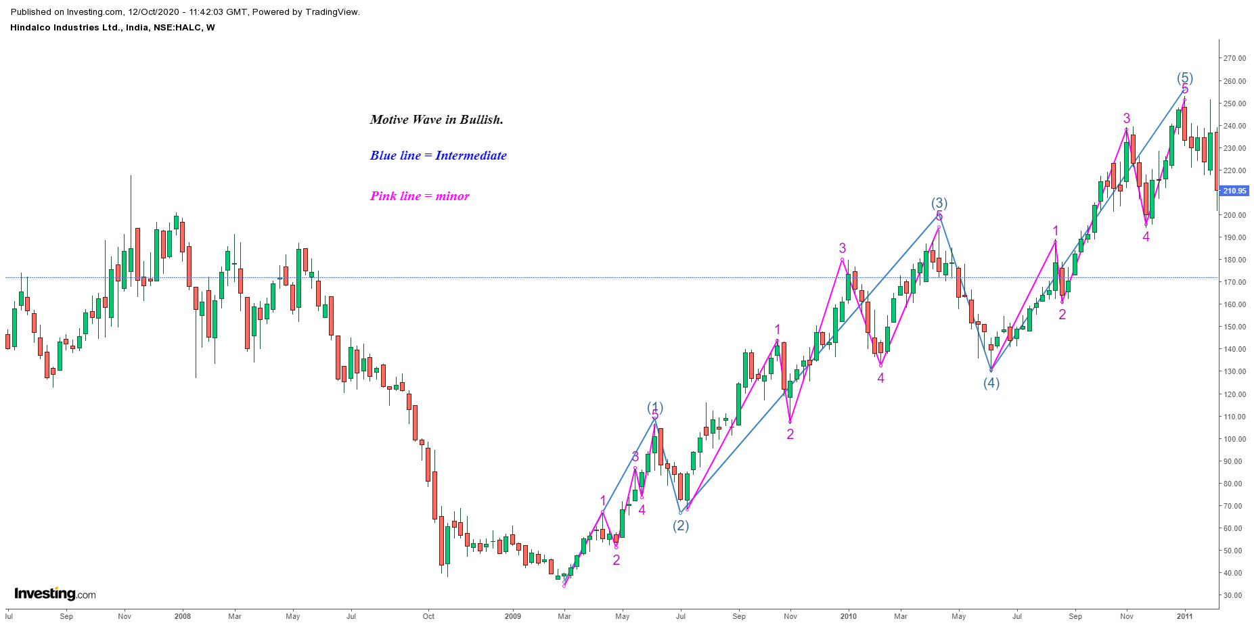
Bullish Example in Ghodha Motive wave (Weekly)

Slide 3
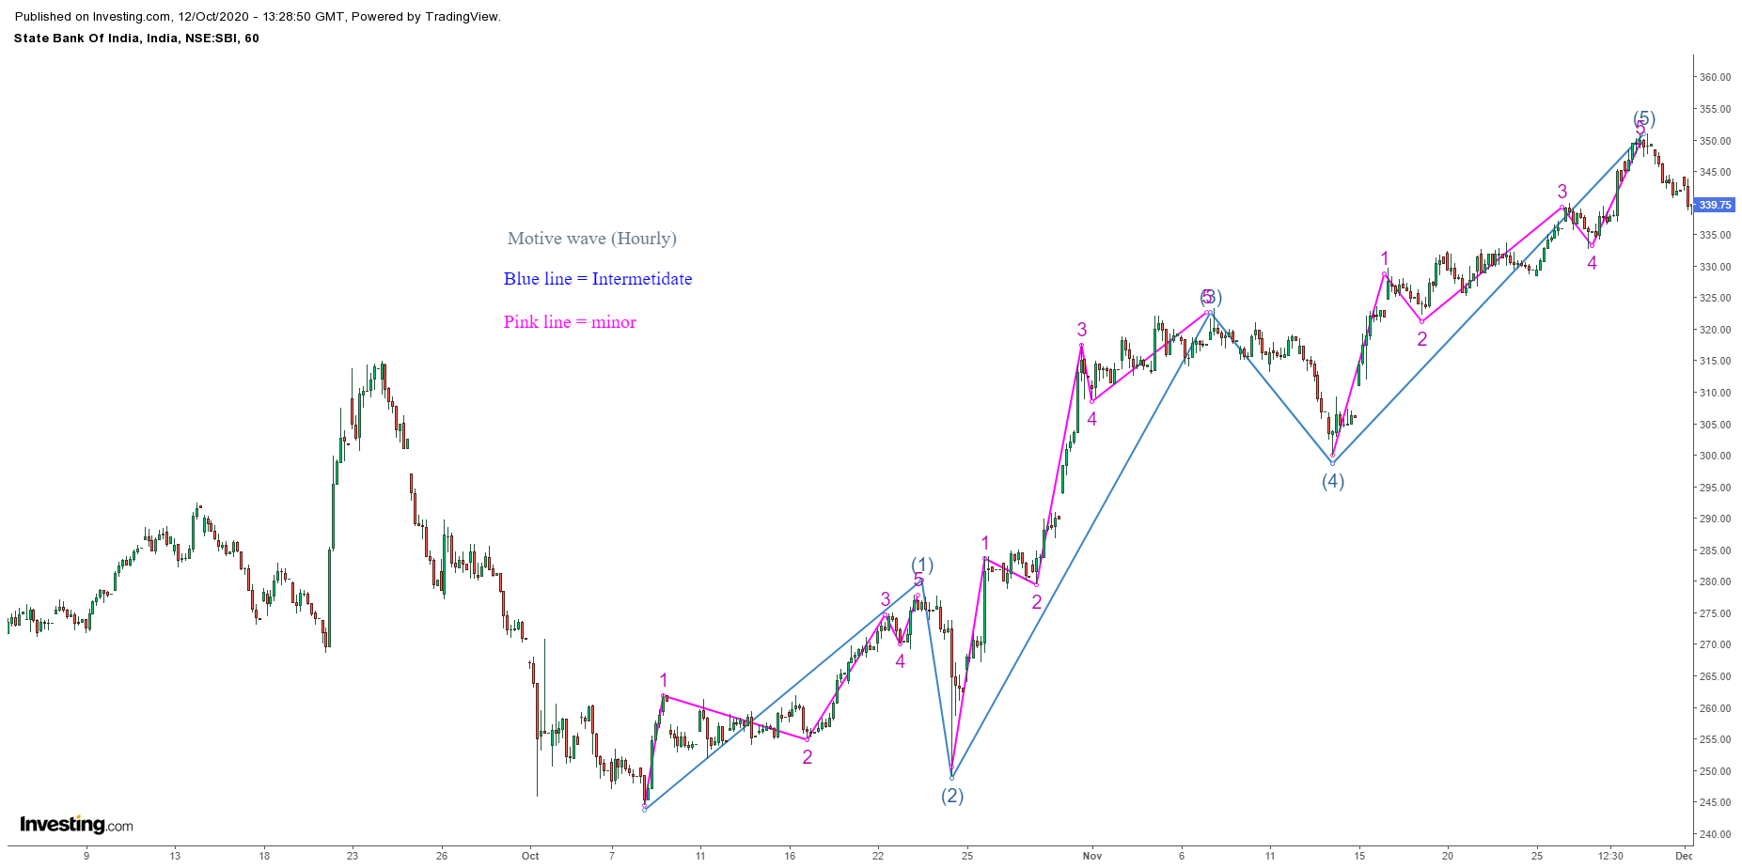
Bullish Example in Ghodha Motive wave (Hourly)

Slide 4
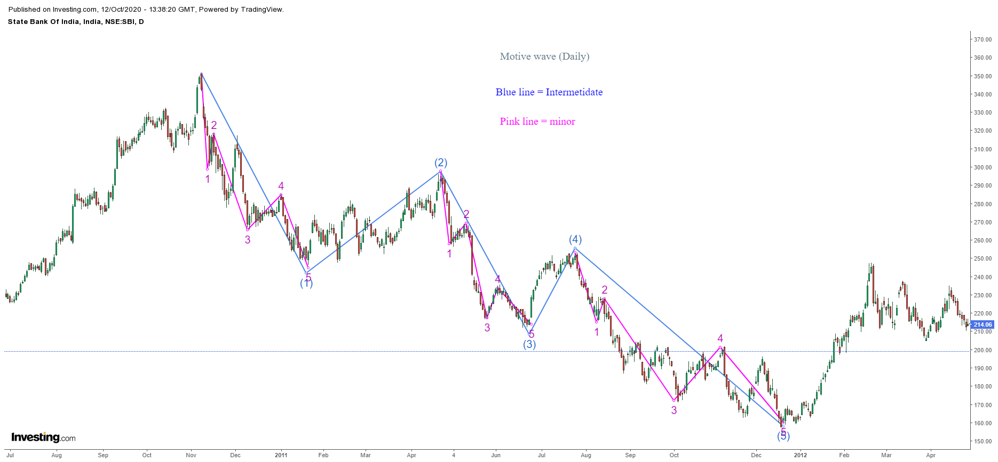
Bearish example in Ghadha Motive wave (Daily)

Slide 5
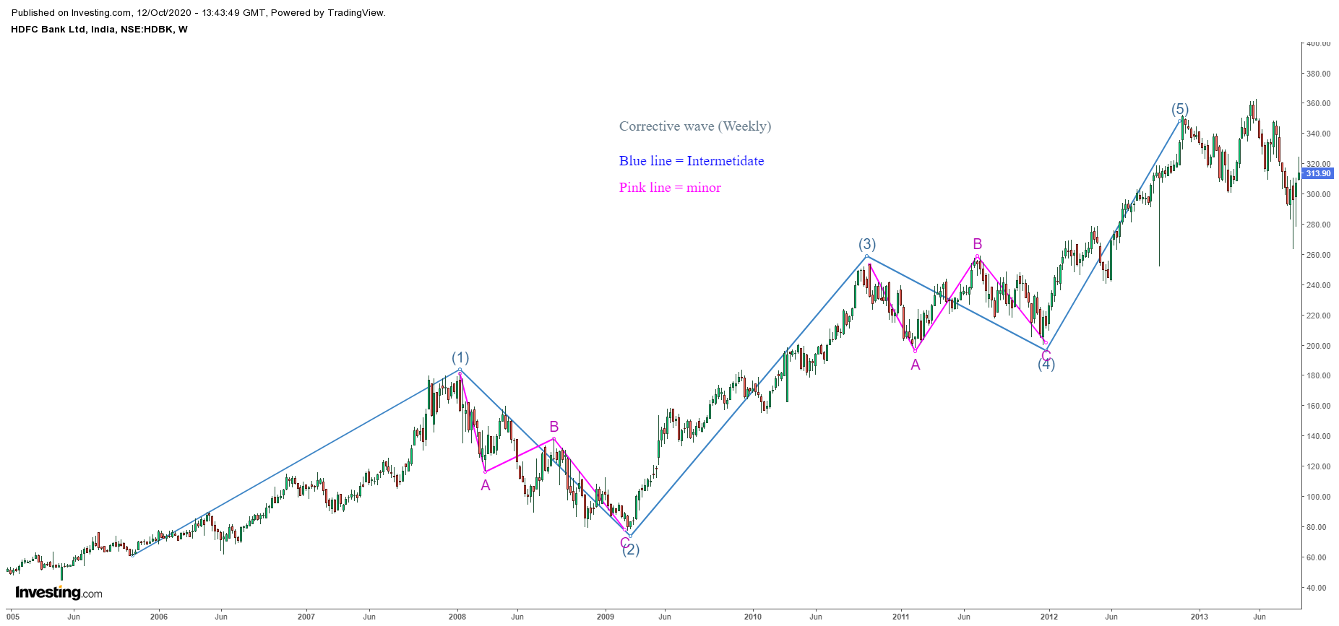
Bullish Example in Ghodha Corrective wave (Weekly)

Slide 6
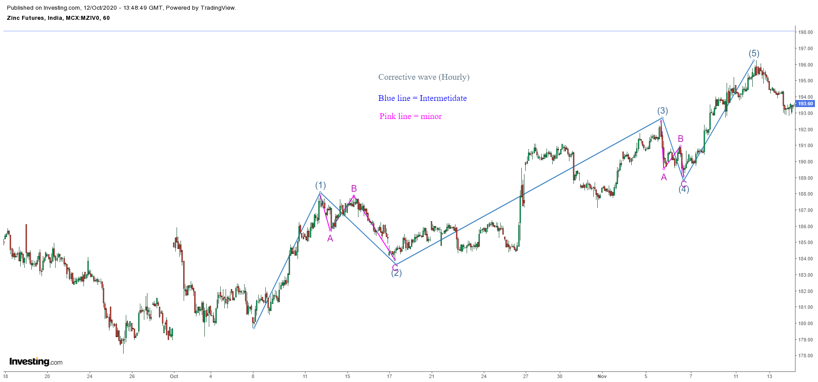
Bullish Example in Ghodha Corrective wave (Hourly)

Slide 7
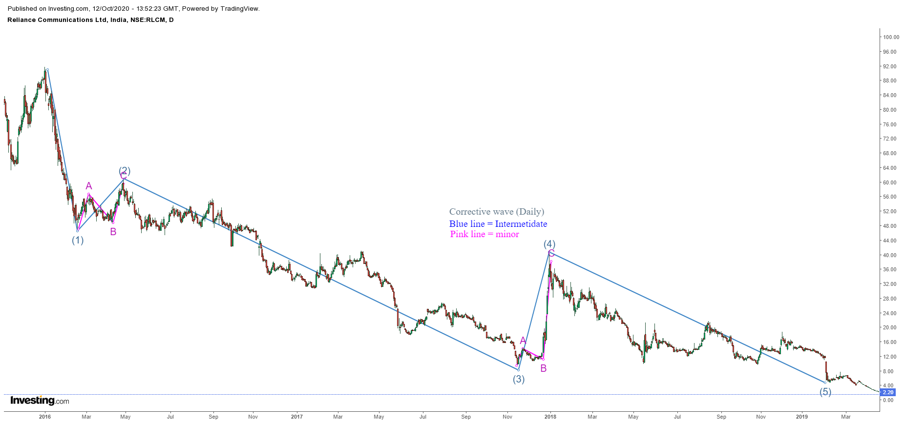
Bearish example in Ghadha Corrective wave (Daily)

