Slide 1

SurfTheTurf TEITA TEA1
St. Francis Institute of Technology
Department of Information Technology
Mini Project –Web Based Business Model (ITM 501)
Pranav Bangera 8
Harsh Bhikadiya 9
Shivam Bhosale 10
Parth Dali 17
Pranav Dalvi 18
Mentor:
Dr. Prachi Raut
Professor

Slide 2
Overview
Problem Statement
Business model canvas
System Design
Technology used
References
Demonstration

Slide 3
Problem Statement
As the demand for Turfs has been increasing rapidly, it is an ordeal for people to locate, fetch details and book a turf according to their requirements.

Slide 4
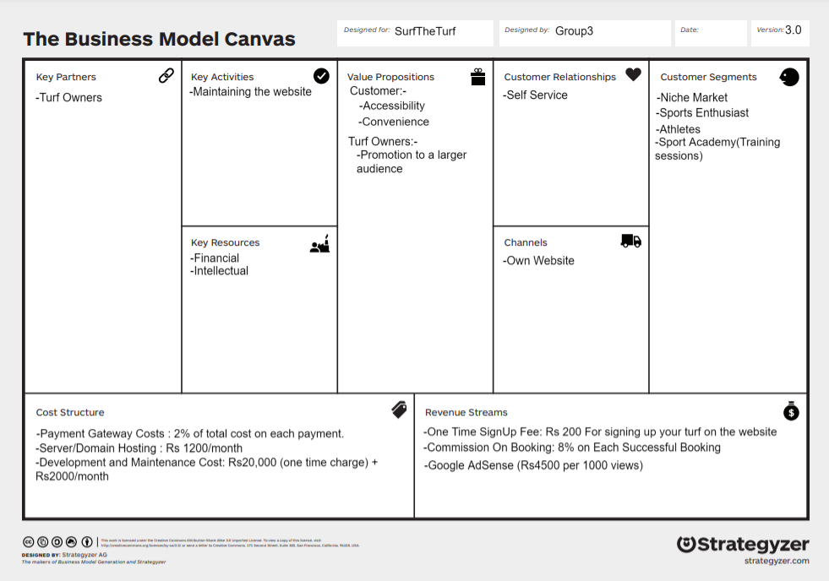
Business Model Canvas

Slide 5
Business Model
Customer Segments
Niche Market The Targeted Audience are: Sports Enthusiast, Athletes, Sport Academy(Training Sessions)
Customer Relationships
Our Business Model is a self service based model.
We provide all the necessary means for customers to help themselves and carry out the transaction through our website.
Channels
The primary channel of interaction with our key partners(Turf Owners) is through the SurfTheTurf Website.

Slide 6
Business Model contd.
Key Activities
Website Maintenance: We will regularly keep a check on our website for issues and bugs and keeping it updated and relevant.
Key Partners
Turf Owners: They play an integral part in our business model.
Key Resources
Financial: Founder’s Investment
Intellectual: These include Cloud Server/domain name, website codebase

Slide 7
Business Model contd.
Cost
Revenue
Payment Gateway Costs : 2% of total cost on each payment.
Server/Domain Hosting : Rs 1200/month
Development and Maintenance Cost: Rs20,000 (one time charge) + Rs2000/month
Total Cost:
1st month – Rs23,200
2nd month onwards – Rs3,200
Commission On Booking: 8% on Each Successful Booking
One Time SignUp Fee: Rs 200 For signing up your turf on the website
Google AdSense (Rs4500 per 1000 views)

Slide 8
Business Model contd.
Value Proposition:
Customer:-
Easy and convenient to book turfs.
All Turfs with different locations will be available.(Within Mumbai)
Turf Owner:-
Featuring their Turfs to a larger audience

Slide 9
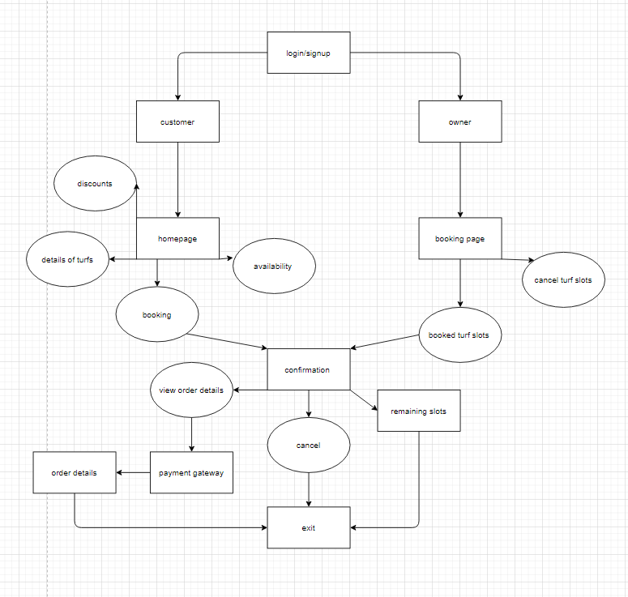
System Design

Slide 10
Technology Used
Front end : Html, CSS, Javascript, Bootstrap
Back end : Django, PostGre

Slide 11
References
Research paper:
Dinesh A. Pol, Piyush V. Patil, Rahul Shinde, Rohan Dange “ Online Ground Booking System using Android Mobile Application” International Journal for Scientific Research & Development| Vol. 7, Issue 10, 2019.
Online Articles:
Available Online: https://www.fatbit.com/fab/category/web- based- business-ideas/ (Accessed: July 24, 2021)
Available Online: https://softensy.com/how-to-create-payment-gateway-and-become-a-payment-service-provider/(Accessed: July 25, 2021)

