Slide 1
CURD OPERATIONS

Slide 2
Objective
Create
Delete
Update
View List

Slide 3
Tools
Spring Boot
Angular
MongoDB

Slide 4
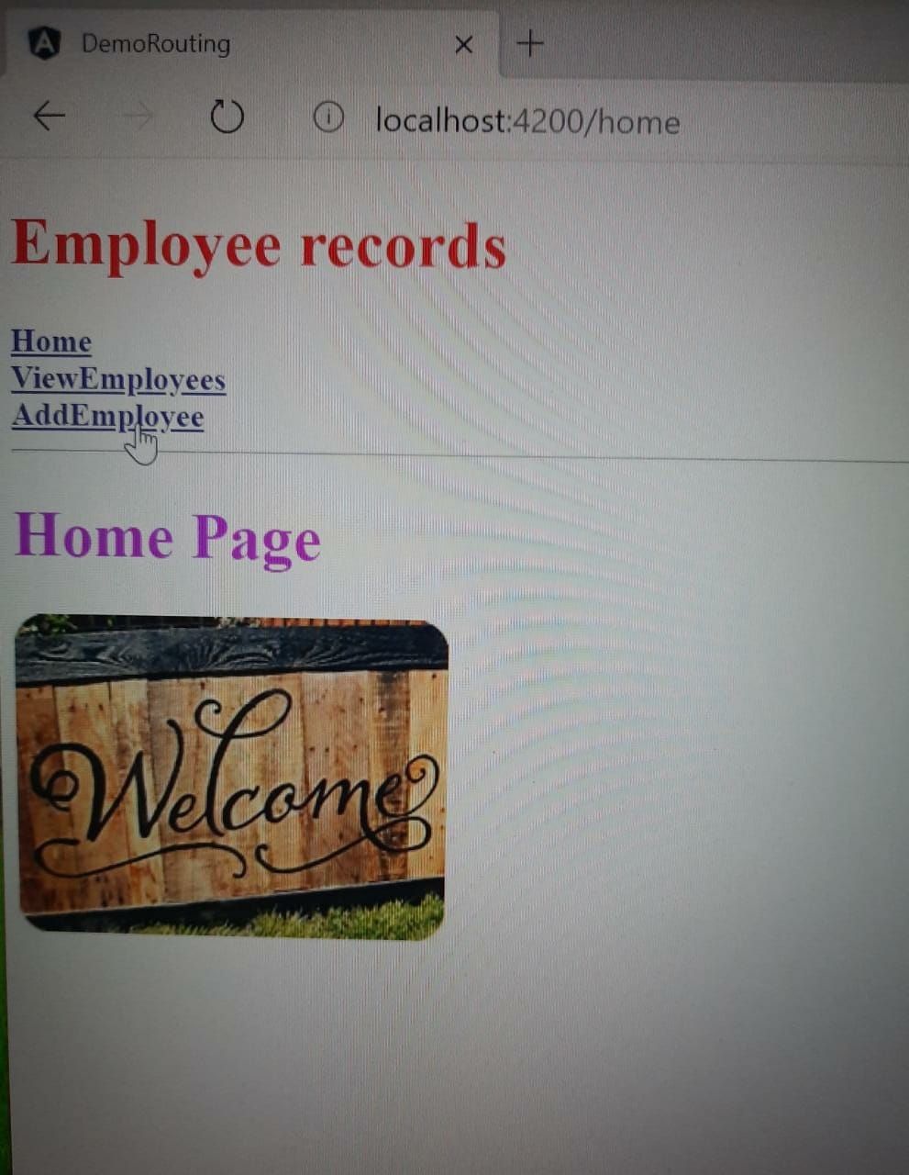
Home page

Slide 5
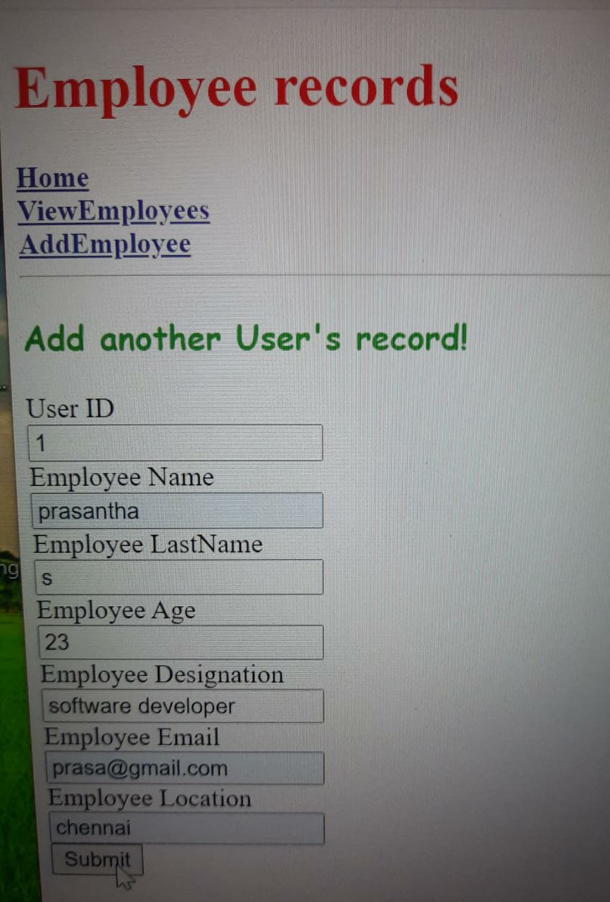
Create

Slide 6
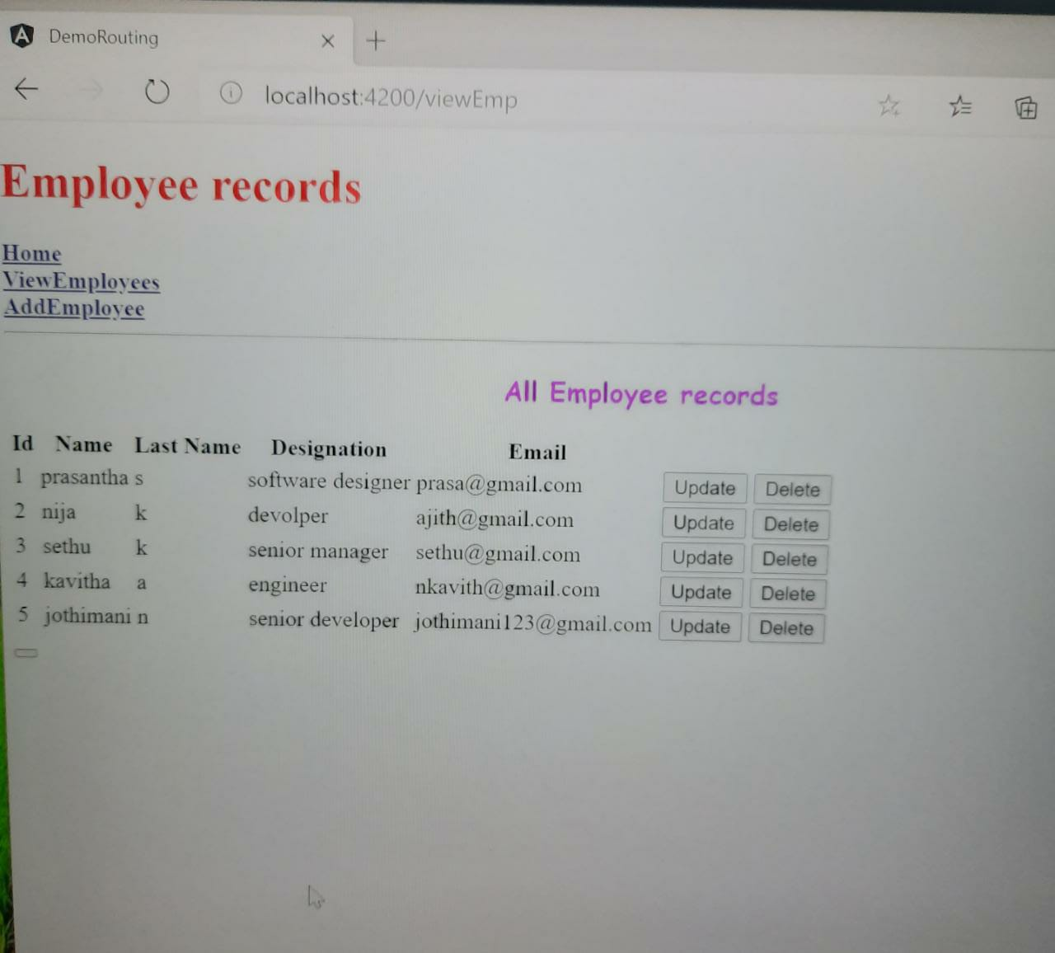
View list

Slide 7
Thank You

