Slide 1
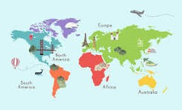



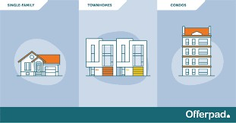
Hotel Aggregator Analysis Report
Power BI Desktop

Slide 2
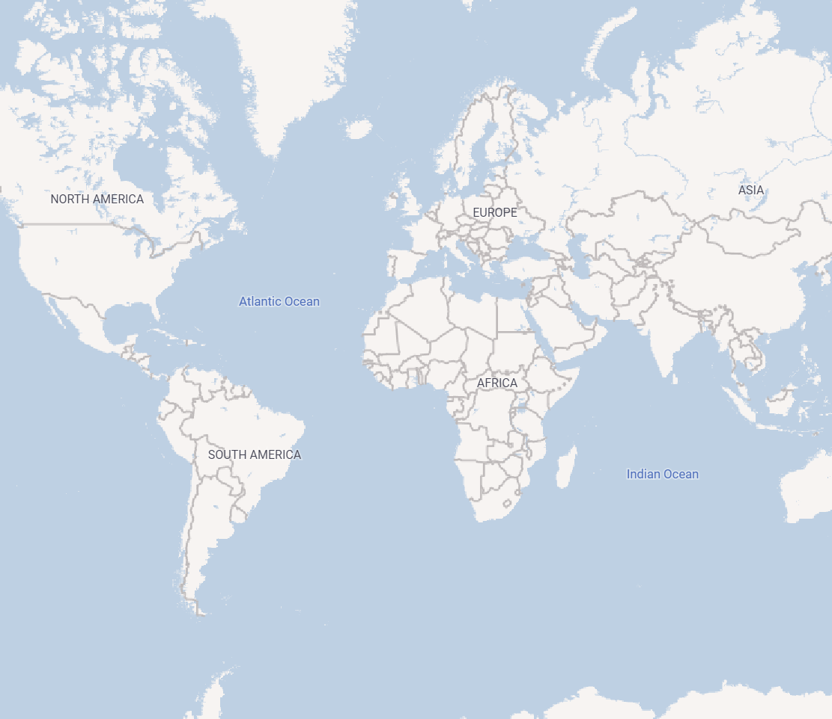
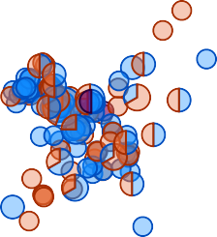
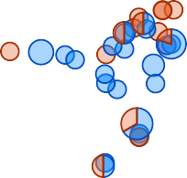

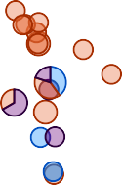
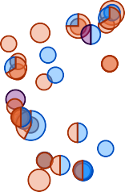


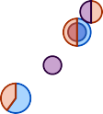
Geographical Insights
room_type Entire home/apt
Power BI Desktop
Country
 (Blank)
 AL
 Argentina
 Australia
 Austria
 Bangladesh
 Belgium
 Brazil

Hotel room
Private room
Shared room
State

 Abbotsford
 Aberfeldie
 Adelaide
 Agnes Water
 Aintree
 Aireys Inlet
 Airport West

© 2024 Miiccrrossofftt Corrporrattiion

Slide 3


  Entire home/apt
  Hotel room
  Private room
  Shared room

Power BI Desktop

0.00
5.00
  (Blank)
  AL
  Argentina
  Australia
  Austria
  Bangladesh
  Belgium
Price and Availability by bedrooms
Average of price Count of has_availability
$300
2.0
Average of price
$200
Count of has_availability
Average of price
$1K
1.5
$100
$0
$0K
0
2
4
6
8
10
12
14
1.0
Entire home/apt
Hotel room Private room
room_type
Shared room
bedrooms

Slide 4
host_location
host_name
host_is_superhost host_response_rate host_response_time host_acceptance_rate

Power BI Desktop
f
All

Olinda, Australia
(Maria) ANNA
f
100%
within a few hours
79%
360 (Hidden By Airbnb) f
100%
within an hour
97%
Roxburgh Park, Australia A
f
N/A
N/A
N/A
Melbourne, Australia
A&E
t
100%
within an hour
96%
Somerville, Australia
Aaron
f
0%
a few days or more
0%
Balwyn, Australia
Aaron
f
100%
within an hour
92%
Aaron
f
100%
within an hour
98%
Rye, Australia
Aaron
f
100%
within an hour
99%
Victoria, Australia
Aaron
t
100%
within an hour
100%
Aaron
t
100%
within an hour
100%
Melbourne, Australia
Aaron
t
100%
within an hour
88%
Greensborough, Australia
Aaron
t
100%
within an hour
98%
Aaron
f
N/A
N/A
N/A
Glen Iris, Australia
Aaron
f
N/A
N/A
N/A
Melbourne, Australia
Aaron
f
N/A
N/A
N/A
Tullamarine, Australia
Aaron
f
N/A
N/A
N/A
Windsor, Australia
Aaron
f
N/A
N/A
N/A
Aaron And Olivia
f
100%
within an hour
100%
Melbourne, Australia
Aarti
f
N/A
N/A
N/A
Melbourne, Australia
Aash
f
N/A
N/A
33%
Melbourne, Australia
Ab
f
N/A
N/A
N/A
Melbourne, Australia
Abbey
f
100%
within an hour
93%
Melbourne, Australia
Abbey
f
100%
within an hour
98%
Frankston, Australia
Abbey
f
N/A
N/A
N/A
Abbie
f
N/A
N/A
N/A

Slide 5
Host Location by host rating ,resopnse
Count of host_acceptance_rate Count of host_response_rate Count of host_is_superhost
Power BI Desktop


 Abbotsford, Australia
 Abbotsford, Canada
 Aberfeldie, Australia
 Adelaide, Australia
 Agnes Water, Australia
 Aintree, Australia
 Aireys Inlet, Australia
 Airport West, Australia
 Aix-en-Othe, France
 Albanvale Australia
7K
Count of host_acceptance_rate and Count of host_response_rate
80
6K
5K
Count of host_is_superhost
60
4K
40
3K
2K
20
1K
0
Melbourne, Australia
Victoria, Australia
Australia St Kilda, Australia
South Yarra, Australia Southbank, Australia Elwood, Australia
Fitzroy, Australia Northcote, Australia Brunswick, Australia
Port Melbourne, Australia Richmond, Australia Sydney, Australia
Hawthorn, Australia South Melbourne, Australia Williamstown, Australia
Carlton, Australia Healesville, Australia Preston, Australia
Brighton, Australia Docklands, Australia
Fitzroy North, Australia Glen Waverley, Australia
Olinda, Australia Abbotsford, Australia Collingwood, Australia
London, United Kingdom New South Wales, Australia Point Cook, Australia
Reservoir, Australia Saint Kilda, Australia Albert Park, Australia Brisbane, Australia
Clifton Hill, Australia Coburg, Australia
East Melbourne, Australia Kensington, Australia
Sandringham, Australia Yarraville, Australia
Brighton East, Australia Brunswick East, Australia
0K
host_location

Slide 6
host_location ×
Windsor, Australia
review_scores_r… ×
5
 room_type ×
Private room
 host_name ×
Aaron
 price ×
Power BI Desktop
Pascoe Vale, Australia 8
(Blank) 6
Aaron
1
$60
1
Private room
3
Prahran, Australia 8
5
5
Ben 1
Entire home/apt 2
Saint Kilda West, Austr… 8
4.5
2
Jessica 1
Seaford, Australia 8
4.6
2
Raymond 1
Count of property_ty…
83
Windsor, Australia
8
4.71
2
Sankit 1
Adelaide, Australia 7
4.87
2
Albert Park, Australia 7
0
1
Balaclava, Australia 7
1
1
Balwyn North, Australia 7
4.64
1

