Slide 1

Note: The data and information in this document is reflective of a hypothetical situation and client. This document is to be used for KPMG Virtual Internship purposes only.
Sprocket Central Pty Ltd
Data analytics approach
[Division Name] - [Engagement Manager], [Senior Consultant], [Junior Consultant]

Slide 2
Note: The data and information in this document is reflective of a hypothetical situation and client. This document is to be used for KPMG Virtual Internship purposes only.
Agenda
Introduction
Data Exploration
Model Development
Interpretation

Slide 3
Note: The data and information in this document is reflective of a hypothetical situation and client. This document is to be used for KPMG Virtual Internship purposes only.
Introduction
Problem statement:
Sprocket Central Pty Ltd , a medium size bikes & cycling accessories organization, has given their data sets for analytics team to provide optimizing marketing strategy.
Data Sets Given:
-Customer Demographics
-Customer Addresses
-Transactional Data
Data Cleaning: Given complete data has been cleaned to the appropriate quality data
Data Transformation: All the three given data sets (Customer Demographics, Customer Addresses, Transactional Data) have been merged to get the complete data in a single frame.
Data Exploration: To draw insights from the given data.
Goal: Need to provide suggestions to the organization and their team in optimizing their marketing strategy and provide a target group of customers to effectively use their resources in developing their business.

Slide 4
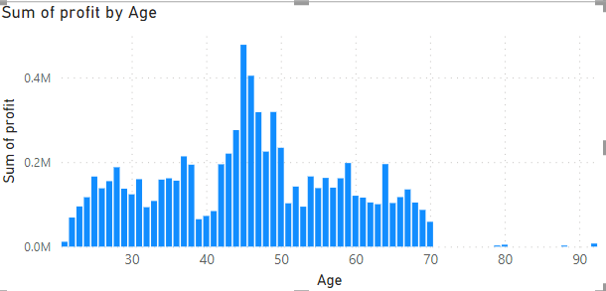
Note: The data and information in this document is reflective of a hypothetical situation and client. This document is to be used for KPMG Virtual Internship purposes only.
Data Exploration
This graph shows the Age wise transactions
We get that there were more transactions by the people whose are between 40-50 years of age and hence more profits are from this age group.

Slide 5
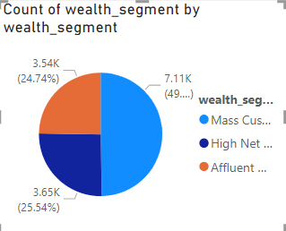
Note: The data and information in this document is reflective of a hypothetical situation and client. This document is to be used for KPMG Virtual Internship purposes only.
Data Exploration
Profits based on wealth segment of the customers
Almost 50% of the total transactions are by the Mass Customers. We can consider Mass customers are more profitable.

Slide 6
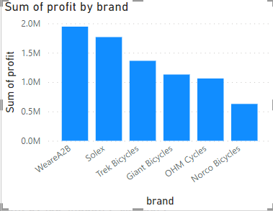
Note: The data and information in this document is reflective of a hypothetical situation and client. This document is to be used for KPMG Virtual Internship purposes only.
Data Exploration
Total profits based on Brand
WeareA2B and Solex are the two brands with more profits and followed by rest brands and Narco Bicycles are the least profitable brand.

Slide 7
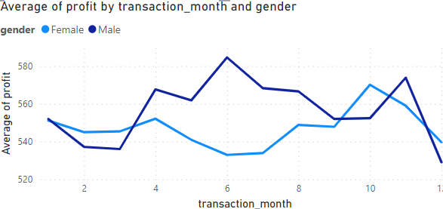
Note: The data and information in this document is reflective of a hypothetical situation and client. This document is to be used for KPMG Virtual Internship purposes only.
Data Exploration
Average monthly profit based on month and gender
There were more profits from the transactions made from April to August by males compared to rest of the year.
Similarly, there were more profits by the females in the month of October compared to rest of the year.

Slide 8
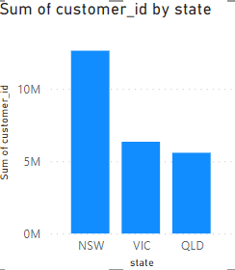
Note: The data and information in this document is reflective of a hypothetical situation and client. This document is to be used for KPMG Virtual Internship purposes only.
Data Exploration
Total customers based on State
There are more profitable customers from the state of New South Wales than in Victoria and QueensLand.

Slide 9
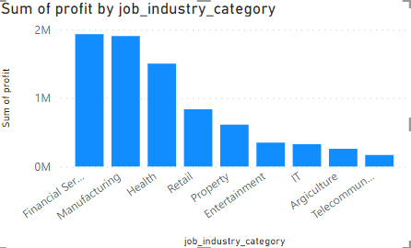
Note: The data and information in this document is reflective of a hypothetical situation and client. This document is to be used for KPMG Virtual Internship purposes only.
Data Exploration
Total profits based on the customers job industry.
Most of the profits are from the customers who work in Financial Services and Manufacturing sectors.

Slide 10
Note: The data and information in this document is reflective of a hypothetical situation and client. This document is to be used for KPMG Virtual Internship purposes only.
Model Development
The marketing team should target the customers based on:
Customers between 40-50 years of age group
Mass customers as Wealth Segment
Solex and WeareA2B Brands as product priority
Customers from New South Wales
Male customers from April to August and Female customers in the month of October
Customers from Financial Services and Manufacturing

Slide 11
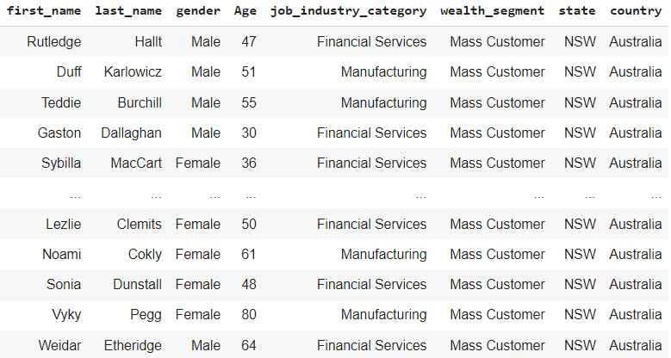
Note: The data and information in this document is reflective of a hypothetical situation and client. This document is to be used for KPMG Virtual Internship purposes only.
Interpretation
The following sample list gives the customers to be targeted according to the insights

Slide 12
Note: The data and information in this document is reflective of a hypothetical situation and client. This document is to be used for KPMG Virtual Internship purposes only.
Thank you

