Slide 1
CAPSTONE PRESENTATION
AI SalesGenie
Grounded lead qualification, catalog recommendations, and personalized follow-up drafts
Built for Oak & Ember Interiors
Langflow • OpenAI • Deterministic catalog guard • Langfuse
Submission deck
Notes:
Sources:
- Project repository: AI_SalesGenie (local project files)
- User-provided assignment context and implementation evidence

Slide 2
BUSINESS NEED
Sales teams lose time before the real conversation starts
SalesGenie turns unstructured inquiries into consistent, reviewable sales actions.
2–3
Inconsistent qualification
Risky recommendations
Lead tiers and missing fields depend on who reads the message.
Manual catalog matching can miss price, stock, or finish constraints.
hours per rep, per day
spent reading inquiries, extracting details, and deciding what to do next.
Slow visibility
Delayed follow-up
CRM updates and weekly reporting arrive late and take manual effort.
Even qualified prospects wait while reps draft routine responses.
The opportunity
Return that time to selling.
AI SalesGenie • Oak & Ember Interiors
02
Notes:
Sources:
- Business Requirements Document, section 2: Business Context and Problem Statement
- Product Requirements Document, problem statement

Slide 3
SOLUTION DESIGN
One flow qualifies, grounds, and drafts—another summarizes the week
01
02
03
04
05
06
Inquiry
Extract
Validate
Draft
Review
Act
Chat input
Structured output
Catalog guard
Follow-up model
Chat output
Rep / CRM
Weekly insight path
CRM lead CSV
→
Weekly Sales Aggregator
→
Lead mix • categories • average budget
AI SalesGenie • Oak & Ember Interiors
03
Notes:
Sources:
- Exported Langflow flows: 01_router_extractor.json, 02_catalog_recommender_followup.json, 03_weekly_summary.json
- Repository README architecture description

Slide 4
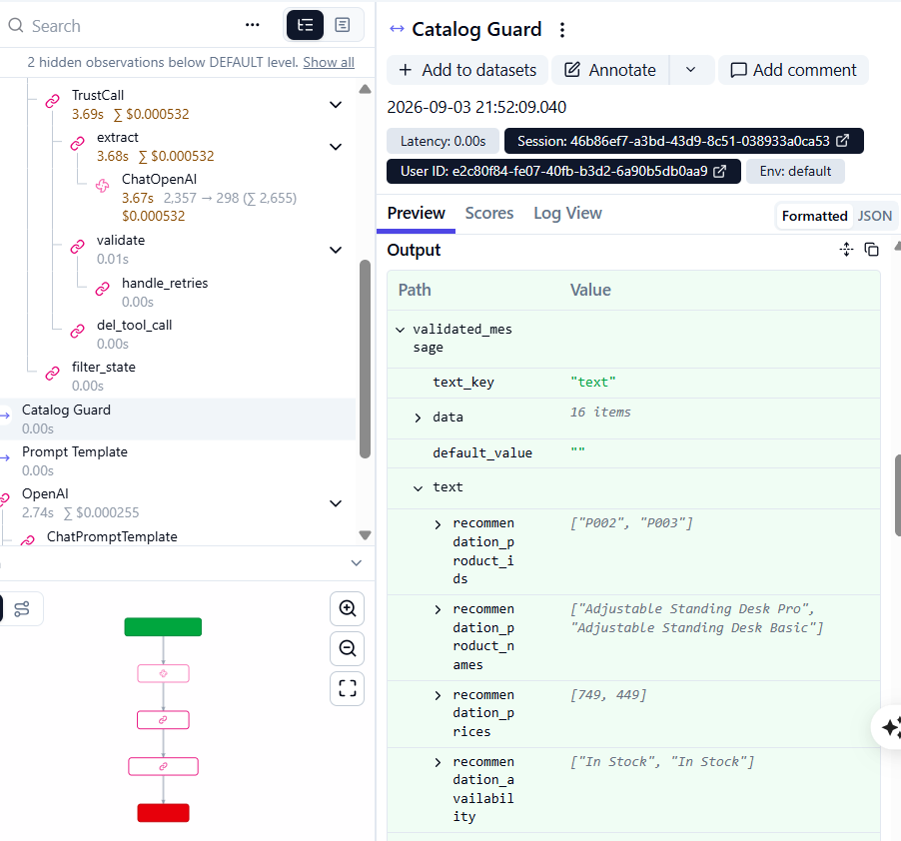
WORKFLOW IN ACTION
A standing-desk inquiry becomes a catalog-safe answer
Test T1: home-office desk, dark walnut preference, total budget $800.
P002 • $749
Adjustable Standing Desk Pro retained.
P003 • $449
Adjustable Standing Desk Basic retained.
P004 • $899 rejected
The guard enforced the $800 budget and surfaced that dark walnut was not confirmed for retained desks.
AI SalesGenie • Oak & Ember Interiors
04
Notes:
Sources:
- evaluation/evidence/langfuse/04-catalog-guard-output.png
- Evaluation baseline T1 and catalog guard output

Slide 5
TRUST LAYER
The catalog guard turns model suggestions into deterministic output
The LLM interprets intent; code enforces the business rules.
1
Product identity
Reject IDs or names absent from the catalog.
Why this matters
Grounding is measurable
2
Price
Every retained recommendation has an exact catalog row.
Remove products above total or per-unit budget.
Failures are explainable
3
Availability
Do not recommend out-of-stock items.
Rejections name the product and the rule that blocked it.
Claims
Human review stays in control
4
Drafts are produced for review; they are not sent automatically.
Use catalog descriptions and state unconfirmed constraints.
AI SalesGenie • Oak & Ember Interiors
05
Notes:
Sources:
- langflow/catalog_guard_component.py
- PRD functional and non-functional requirements
- README security and privacy notes

Slide 6
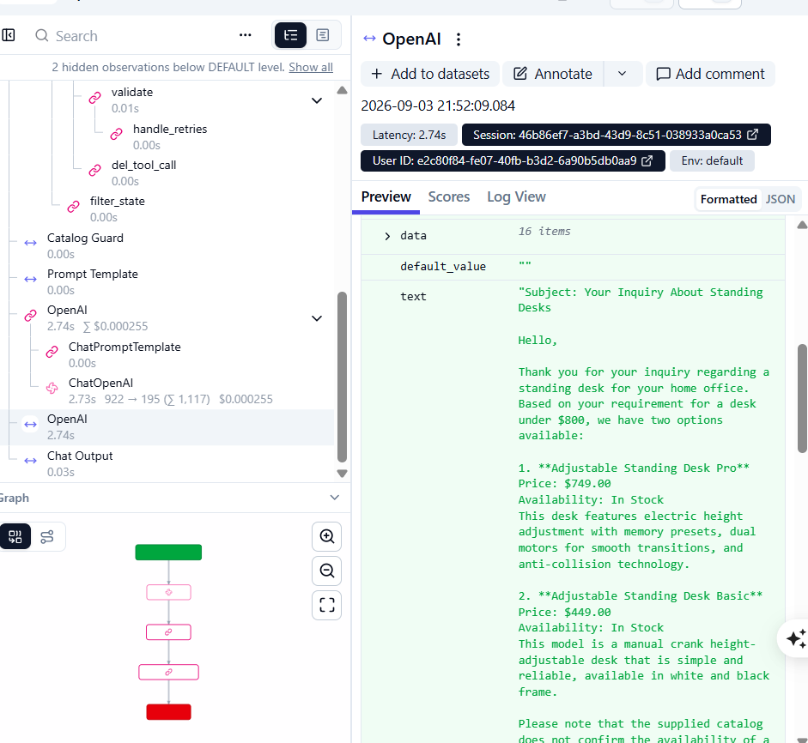
EXTENDED CAPABILITY
Personalized follow-up drafting closes the response-time gap
The validated record and original inquiry are converted into a review-ready email.
Personalized
Uses customer context, budget, products, prices, and stock.
Grounded
Mentions only products and limitations passed by the catalog guard.
Actionable
Includes a clear next step and remains a draft for sales review.
AI SalesGenie • Oak & Ember Interiors
06
Notes:
Sources:
- evaluation/evidence/langfuse/06-follow-up-email-output.png
- Exported flow 02_catalog_recommender_followup.json
- Extended capability: Automated Follow-Up Drafting

Slide 7
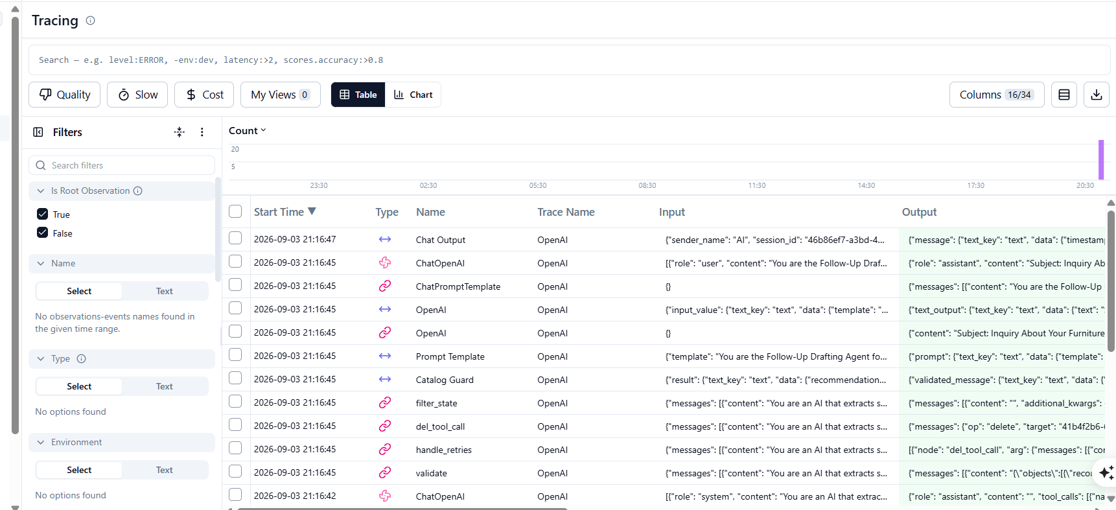
EVALUATION
Eleven baseline scenarios passed with trace-level evidence
Langfuse connects outcomes to model calls, cost, latency, inputs, and outputs.
11 / 11
baseline tests passed
Covers recommendation, stock, comparison, vague, and spam cases.
Representative T1 trace
3,772
$0.000787
6.40 s
tokens
model cost
model latency
Manual score: overall_pass = True
AI SalesGenie • Oak & Ember Interiors
07
Notes:
Sources:
- evaluation/BASELINE_RESULTS.md
- evaluation/evidence/langfuse/01-tracing-overview.png
- evaluation/evidence/langfuse/02-router-model-usage.png
- evaluation/evidence/langfuse/05-follow-up-model-usage.png
- evaluation/evidence/langfuse/07-manual-overall-pass-score.png

Slide 8
WEEKLY INTELLIGENCE
Seven leads become a clear sales snapshot
The aggregator provides management visibility without manually assembling a report.
Lead tier distribution
$18,960
average known budget • 5 known / 2 missing
Top categories
Desk • Full Office Package
Management value
Prioritize hot leads, identify category demand, and track missing budget data.
AI SalesGenie • Oak & Ember Interiors
08
Notes:
Sources:
- Weekly Sales Aggregator output supplied by the user
- Exported flow 03_weekly_summary.json
- CRM sample source lead IDs L001–L007

Slide 9
FROM PROTOTYPE TO PILOT
A controlled rollout keeps quality visible
01
02
03
Pilot
Tune
Scale
3–5 sales representatives
Prompt + guard rules
Up to 20 users
Validate outputs and collect corrections.
Use trace scores and failure patterns.
Monitor latency, cost, and adoption.
Submission evidence
2 exported Langflow flows • deterministic guard components • BRD + PRD • baseline test report • Langfuse screenshots
AI SalesGenie
09
Notes:
Sources:
- BRD rollout and success criteria
- PRD roadmap and quality requirements
- Repository contents and evaluation evidence

