Slide 1
Machine Breakdown
By
Prasanth Sabnaveesu

Slide 2
Problem Statement
Dataset consists of anonymized features of machines environment. predict whether machine will breakdown. The data is collected from a fleet of machines of the same type. Each machine starts with different degrees of initial wear and manufacturing variation which is unknown to the user.

Slide 3
Analyzing Attributes
Breakdown is my Predicted variables.
There are 136399 observations and 24 attributes
There are only two numerical attributes v19, v20. Rest all attributes are converted into categorical because there are only levels less than 25

Slide 4
Preprocess steps
Read data into R-file and converted all missing values into NA’s
Omitted missing values
Checked for duplicated observations.
Converted necessary variables into categorical
Removed unique attribute
Splitted data into train and test using caret package
Dummification is also done.

Slide 5
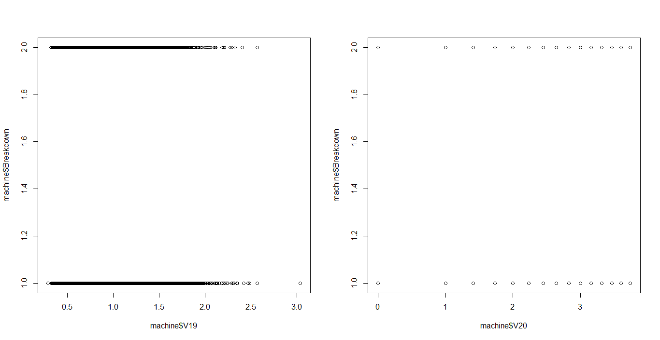
Plots

Slide 6
Models applied
C5.0
Random Forest
Ada Boosting
SVM using linear Kernel

Slide 7
Random Forest
Train:
Accuracy: 100
Test:
Accuracy: 84.44

Slide 8
C50
Train: Accuracy: 84.34
Test:
Accuracy: 84.63

Slide 9
Ada-Boosting
Train: Accuracy: 84.34
Test:
Accuracy: 84.63

Slide 10
Either C5.0 and Ada-Boosting is predominant
Model Name | Train Accuracy | Test Accuracy
C5.o | 84.34 | 84.63
Ada | 84.34 | 84.63
Random Forest | 100 | 84.44

Slide 11
Thank you

