Slide 1



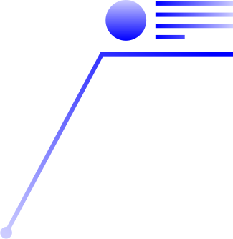

Data Visualization
Page 01
Seaborn
Matplotlib

Slide 2
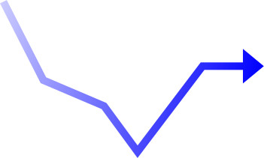
Page 02
Topic We present.
Seaborn
Matplotlib
Swarm Plot
Bar Plot
Joint Plot
Strip Plot

Slide 3

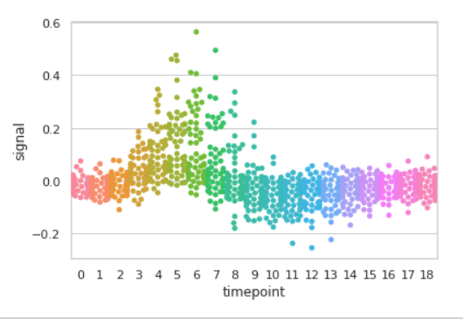
Page 03
Swarm Plot in Seaborn
Ajay Jose.D(BP241022)
Prasanth.S(BP241021)

Slide 4

Swarm Plot Using Seaborn
Page 04
Seaborn is an amazing visualization library for statistical graphics plotting in Python. It provides beautiful default styles and color palettes to make statistical plots more attractive. It is built on the top of the matplotlib library and also closely integrated into the data structures from pandas.

Slide 5
Page 05
What is a Swarm Plot?
A swarm plot shows individual data points in a category.
It spreads points to avoid overlap, making every value visible.
Used to compare numeric values across categories like gender.
Helps identify clusters, patterns, and outliers clearly.
Useful in Exploratory Data Analysis (EDA) for real datasets.
More detailed than boxplots because all points are shown.

Slide 6

Page 06
Why use Swarm Plot?
Shows exact distribution instead of summaries.
Makes gaps and patterns easy to observe.
Helps compare categories side-by-side visually.
Better clarity when dataset size is manageable.
Displays outliers that boxplots may hide.
Ideal for gender, department, or rank comparisons.

Slide 7
Page 07
Syntax for Swarmplot
Syntax:
seaborn.swarmplot(x=None, y=None, hue=None, data=None, order=None, hue_order=None, dodge=False, orient=None, color=None, palette=None, size=5, edgecolor='gray', linewidth=0, ax=None, **kwargs)
Parameter:
x, y, hue: Inputs for plotting long-form data.
data: Dataset for plotting.
color: Color for all of the elements
size: Radius of the markers, in points.

Slide 8
Page 08
Sample Output for swarmplot

Slide 9
Python code
Page 09
import seaborn as sns
sns.swarmplot(x='sex', y='salary', hue='rank’,
data=dataset, palette='Set2', dodge=True)
‘sex’ is the category,
‘salary’ is the numeric value.
‘hue’ adds color for different ranks.
Seaborn auto-adjusts points to avoid overlaps.

Slide 10


Page 10
Practical Demo on swarmplot

Slide 11
Page 11
Joint Plot in Seaborn
Pranav.S(BP241023)
Nelson.A(BP241036)
Amarthiyasen.K(BP241027)

Slide 12
What is Joint Plot?
Page 12
A joint plot is a single chart that combines:
  A plot showing the relationship between two variables
  The distribution of each variable on the sides
So we get three views in one figure:
  A scatter plot in the center.
  A histogram of the x-variable on top
  A histogram of the y-variable on the right
  This helps us understand the data more clearly.

Slide 13
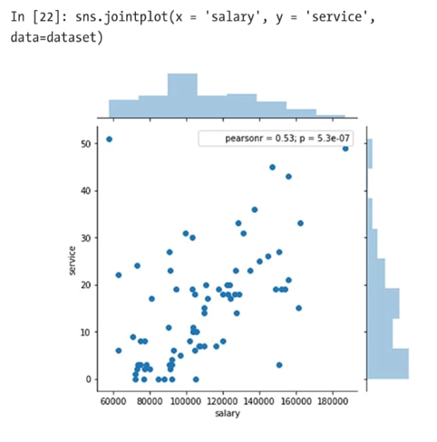
Basic Joint Plot.
Page 13
The simplest joint plot is:
    sns.jointplot(x='salary', y='service', data=dataset)
This shows how salary and years of service are related.
We also see a small box showing the Pearson correlation number.
In the example, the correlation is around 0.53, which means a moderate positive relationship — as salary increases, service also tends to increase

Slide 14
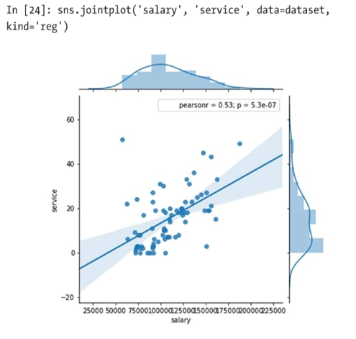
Page 14
Joint Plot with Regression line.
If we want to see a trend line, we use:
sns.jointplot(..., kind='reg’)
This adds:
    A straight regression line.
    A shaded confidence region.
    It makes the relationship easier to interpret.

Slide 15
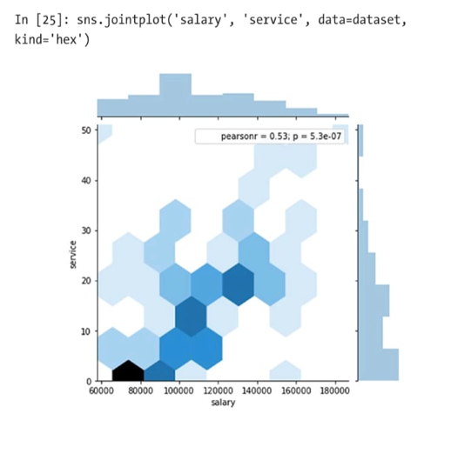

Hexbin and KDE Plots
Page 15
Seaborn also offers other styles:
    Hex Plot
    kind='hex’
    Shows hexagonal blocks.
Useful when there are many points overlapping.
    KDE Plot
    kind='kde’
    Shows smooth contour shapes that represent data density.
    These help us see where most data points are concentrated.

Slide 16
Customizing the joint plot
Page 16
We can also add:
Spearman correlation for non-linear relationships
Contour lines
Rug plots on the margins
All these add more detail to the same visualization.
Summary:
Joint plots combine scatter + distribution in one figure.
They help understand both relationship and distribution.
Different styles like scatter, regression, hex, and kde are used based on the data.
Closing:
Joint plots are simple, powerful, and very common in data analysis.
They give a complete picture of how two variables behave together.

Slide 17
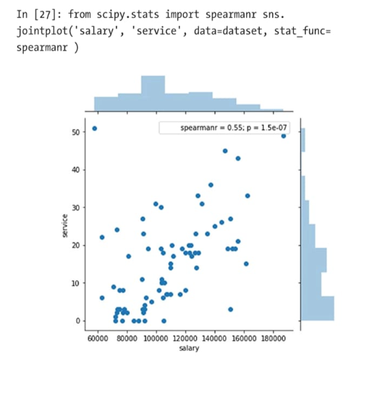
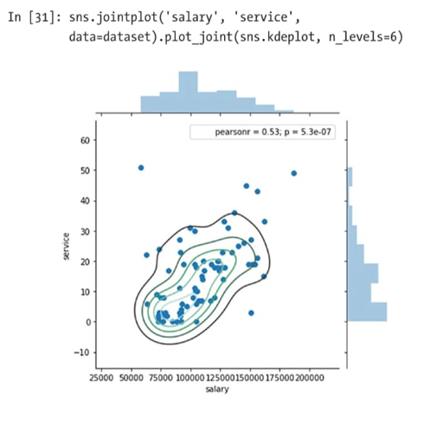
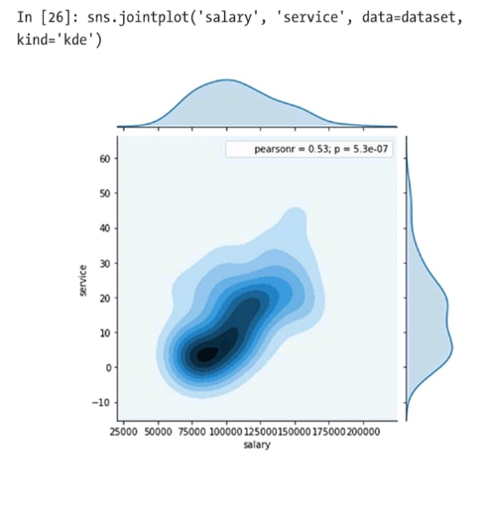
Page 17

Slide 18
Page 18
Practical Demo on swarmplot.

Slide 19
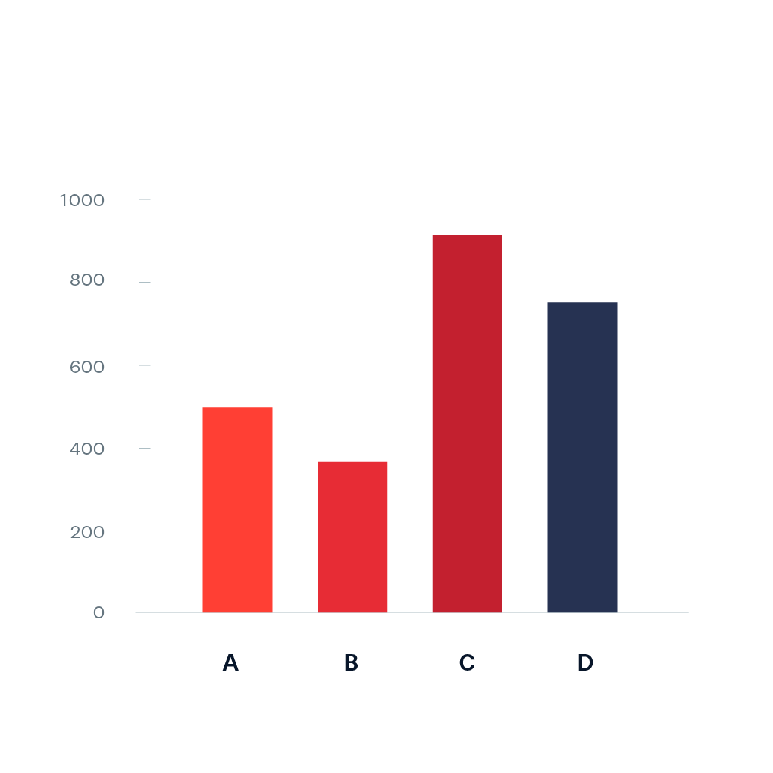
Page 19
Bar Plot in Matplotlib
Jayachandiran.S(BP241024)
Kaviyarasan.K(BP241029)

Slide 20
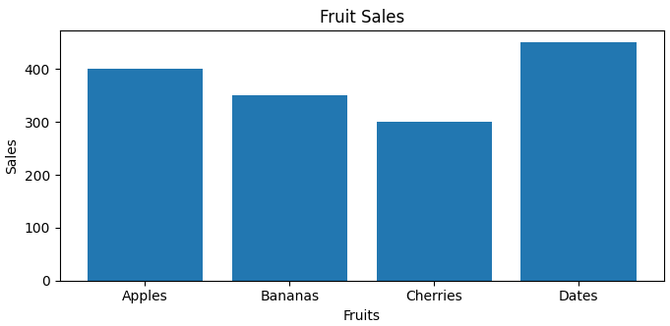
Page 20
A bar plot uses rectangular bars to represent data categories, with bar length or height proportional to their values. It compares discrete categories, with one axis for categories and the other for values.

Slide 21
This function takes Several Parameter
Page 21
x: The categories (e.g., fruits).
height: The corresponding values (e.g., sales).
width: The width of the bars (default is 0.8).
bottom: The baseline for the bars (default is 0).
align: How to align bars ('center' or 'edge')

Slide 22
Page 22
Why Use Bar Plots?
Bar plots are significant because they provide a clear and intuitive way to visualize categorical data. They allow viewers to quickly grasp differences in size or quantity among categories, making them ideal for presenting survey results, sales data, or any discrete variable comparisons.
Syntax: plt.bar(x, height, width, bottom, align)

Slide 23
Page 23
Practical Demo on matplotlib

Slide 24
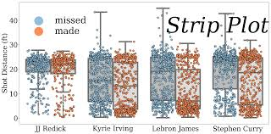
Page 24
Strip Plot in Matplotlib
Dinesh.G(BP241038)
Dominic Xavier.J(BP241034)
Tamizharasan.A(BP241035)

Slide 25
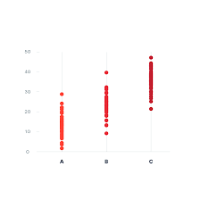
Page 25
What is Strip plot?
A strip plot is a type of scatter plot.
  X-axis shows a categorical variable.
  Y-axis shows a numerical variable.
  Each data point appears as a single dot.
  Helps visualize how values are spread across categories.

Slide 26
Page 26
Purpose of Strip plot.
To observe the distribution of data.
  • To identify outliers.
  • To compare different categories.
  • Works well for small datasets.
Use Cases:
  • Student marks comparison.
  • Height difference between genders.
  • Weight distribution of patients.
  • Employee performance spread.

Slide 27

How Strip plot works?
Page 27
Syntax
sns.stripplot(x='category', y='value', data=df, jitter=True)
• X-axis → Category (e.g., Gender).
• Y-axis → Numerical value (e.g., Marks).
• Each observation is displayed as a dot.
• Jitter can be used to spread overlapping points.
Usage

Slide 28

Page 28
Advantage and Disadvantage
Advantages:
  • Simple and easy to understand.
  • Clearly shows outliers.
  • Best for small datasets.
  • Good for comparing groups.
Disadvantages:
• Overlaps when dataset is large.
• Can become crowded.
• Patterns may be hidden.
• Swarm plot sometimes gives better clarity.

Slide 29
Page 29
Practical Demo on stripplot.

Slide 30
Page 30
Thank You.

