Slide 1
Introduction to Data Mining
— Unit 2—

Slide 2
Topics Covered…
Data Mining
Definitions
KDD Vs Data Mining
Stages of KDD
Selection
Preprocessing
Transformation
Data Mining
Interpretation and Evaluation
Data Visualization
Data Mining Techniques
Verification Model
Discovery Model
Discovery of Association Rules
Clustering
Discovery of Classification rules
Frequent Episodes
Deviation Detection
Issues and Challenges in Data Mining.

Slide 3



What Is Data Mining?
Data mining (knowledge discovery in databases):
  Extraction of interesting (non-trivial, implicit, previously unknown and potentially useful)
information or patterns from data in large databases
Alternative names and their “inside stories”:
  Knowledge discovery(mining) in databases (KDD), knowledge extraction, data/pattern analysis, data archeology, business intelligence, etc.

Slide 4
Definition
It is the process of discovering interesting patterns and knowledge from large amounts of data.
The data sources can include databases, data warehouses, the web, other information repositories or data that are streamed into the system dynamically.

Slide 5
Other Definitions of DM..
It is the non-trivial extraction of implicit, preciously unknown and potentially useful information from data. This encompasses a number of technical approaches, such as clustering, data summarization, classification, finding dependency networks, analyzing changes and detecting anomalies.
It is the search for the relationships and global patterns that exist in large databases but are hidden among vast amounts of data.
It refers to using a variety of techniques to identify nuggets of information or decision – making knowledge in the database and extracting these in such a way that they can be put to use in areas such as decision support, prediction, forecasting and estimation.
Data mining system self-learns from the previous history of investigated system, formulating and testing hypothesis about rules which system obey.
It is the process of discovering meaningful, new correlation pattern and trends by shifting through large amount of data stored in repositories, using pattern recognition techniques as well as statistical and mathematical techniques.

Slide 6
Examples: What is (not) Data Mining?
What is not Data Mining?
  Look up phone number in phone directory
  Query a Web search engine for information about “Amazon”
What is Data Mining?
  Certain names are more prevalent locations (Anna nagar, anna avenue… in Tamil nadu)
  Group together similar documents returned by search engine according to their context (e.g. Amazon rainforest, Amazon.com,)

Slide 7
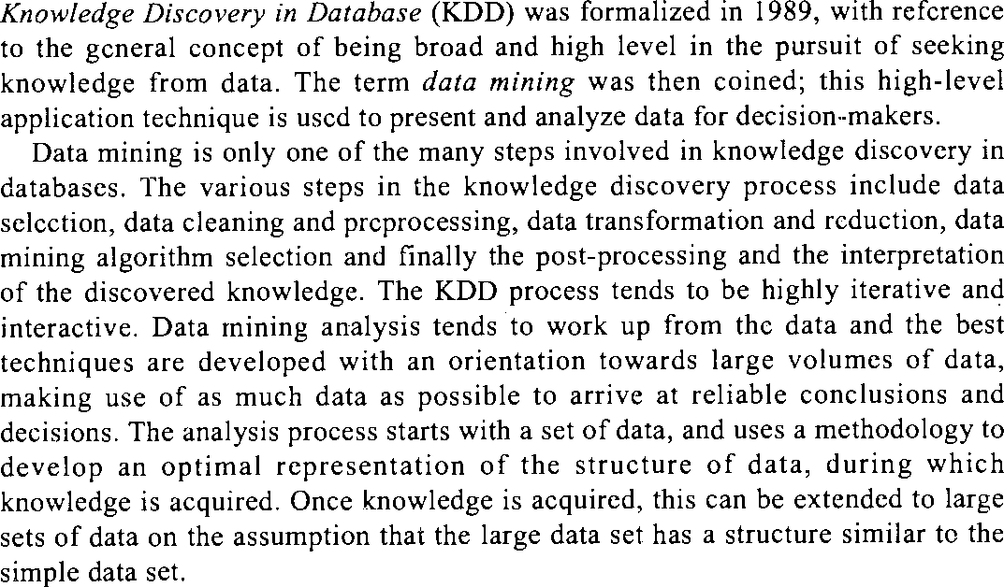
KDD vs Data Mining

Slide 8
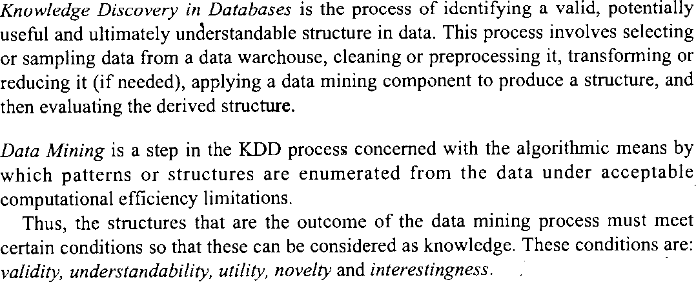
KDD vs Data Mining

Slide 9
KDD Vs Data Miining
Feature | KDD | Data Mining
Scope | Entire process of knowledge discovery | Specific step within KDD focused on pattern identification
Process | Iterative, encompassing data cleaning, preprocessing, mining, and evaluation | Focused on applying algorithms to find patterns
Goal | Extracting useful and understandable knowledge from data | Discovering patterns, trends, and relationships in data

Slide 10



Data Mining: A KDD Process
Pattern Evaluation
– Data mining: the core of knowledge discovery process.
Data Mining
Task-relevant Data
Data Selection Data Preprocessing
Data Warehouse
Data Cleaning Data Integration
Databases

Slide 11
Steps of a KDD Process
Learning the application domain:
– relevant prior knowledge and goals of application
Data cleaning: to remove noise and inconsistent data.
Data integration: where multiple data sources may be combined.
Data selection: data relevant to the analysis task are retrieved
from the database.
Data transformation: data are transformed or consolidated into forms appropriate for mining by performing summary or aggregation operations.
Data mining: an essential process where intelligent methods are applied in order to extract data patterns.
Pattern evaluation: to identify the truly interesting patterns
representing knowledge based on some interestingness measures.
Knowledge presentation: visualization and knowledge representation techniques are used to present the mined knowledge to the user.

Slide 12
Knowledge Discovery in Databases (KDD)
Knowledge Discovery in Databases (KDD) is the process of identifying a valid, potentially useful and ultimately understandable structure in data.
This process involves selecting or sampling data from a data warehouse, cleaning or preprocessing it, transforming or reducing it, applying data mining component to produce a structure, and then evaluating the derived structure.
Data mining is a step in the KDD process concerned with the algorithmic means by which patterns or structures are enumerated from the data under acceptable computational efficiency limitations.

Slide 13
Stages of KDD
The stages of KDD, starting with the raw data and finishing with
the extracted knowledge.
Selection : This stage is concerned with selecting or segmenting the data that are relevant to some criteria. For example, for credit card customer profiling, we extract the type of transactions for each type of customers and we may not be interested in details of the shop where the transaction takes place.
Preprocessing: is the data cleaning stage where unnecessary information is removed.
For example, it is unnecessary to note the gender of a patient when studying pregnancy! When the data is drawn from several sources, it is possible that the same information is represented in different sources in different formats. This stage reconfigures the data to ensure a consistent format, as there is a possibility of inconsistent formats.

Slide 14
Stages of KDD
Transformation: The data is not merely transferred across, but transformed in order to be suitable for the task of data mining. In this stage, the data is made usable and navigable.
Data mining: This stage is concerned with the extraction of patterns from the data.
Interpretation and evaluation: The patterns obtained in the data mining stage are converted into knowledge, which in turn, is used to support decision-making.

Slide 15
Stages of KDD
Data visualization: makes it possible for the analyst to gain a deeper, more intuitive understanding of the data and as such can work well alongside data mining. Data mining allows the analyst to focus on certain patterns and trends and explore them in-depth using visualization.
On its own, data visualization can be overwhelmed by the volume of data in a database but in conjunction with data mining can help with exploration.
It helps users to examine large volumes of data and detect the patterns
visually.
Visual displays of data such as maps, charts and other graphical representations allow data to be presented compactly to the users.
A single graphical screen can encode as much information as a larger number of text screens.

Slide 16
Stages of KDD
For example, if a user wants to find out whether the production problems at a plant are correlated to the location of the plants, the problem locations can be encoded in a special colour, say red, on a map.
The user can then discover locations in which the problems are occurring.
He may then form a hypothesis about why problems are occurring in those locations, and may verify the hypothesis against the database.

Slide 17
Data Mining Techniques
Researchers identify two fundamental goals of data mining:
Prediction and description.
Prediction - makes use of existing variables in the database in order to predict unknown or future values of interest.
Description - focuses on finding patterns describing the data and the subsequent presentation for user interpretation.
The relative emphasis of both prediction and description differ with respect to the underlying application and the technique. There are several data mining techniques fulfilling these objectives. Some of these are associations, classifications, sequential patterns and clustering.
  The basic premise of an association is to find all associations, such that the presence of one set of items in a transaction implies the other items.
  Classification develops profiles of different groups.
          Sequential patterns identify sequential patterns subject to a user- specified minimum constraint.
          Clustering segments a database into subsets or clusters.

Slide 18
Data Mining Techniques
Another approach of the study of DM techniques is to classify the techniques as
  User-guided or verification-driven data mining, and
  Discovery-driven or automatic discovery of rules
Most of the techniques of data mining have elements of both the models.

Slide 19
Data Mining Techniques
VERFICATION MODEL
  In this process of data mining, the user makes a hypothesis and tests the hypothesis on the data to verify its validity. The emphasis is on the user who is responsible for formulating the hypothesis and issuing the query on the data to affirm or negate the hypothesis.
  In a supermarket, for example, with a limited budget for a mailing campaign to launch a new product, it is important to identify the section of the population most likely to buy the new product.
  The user formulates a hypothesis to identify potential customers and their
common characteristics.
  Historical data about transactions and demographic information can then be queried to reveal comparable purchases and the characteristics shared by those purchasers.
  The whole operation can be repeated by successive refinements of
hypotheses until the required limit is reached. The user may come up with a new hypothesis or may refine the existing one and verify it against the database.

Slide 20
Data Mining Techniques
DISCOVERY MODEL
  The discovery model differs in its emphasis, in that it is the system automatically discovering important information hidden in the data. The data is sifted in search of frequently occurring patterns, trends and generalizations about the data without intervention or guidance from the user.
  The manner in which the rules are discovered depends on the class of
the data mining application.
  An example of such a model is a supermarket database, which is mined to discover the particular groups of customers to target for a mailing campaign.
  The data is searched with no hypothesis in mind other than for the system to group the customers according to the common characteristics found.

Slide 21
Typical Discovery Driven Task
The typical discovery driven tasks are
Discovery of association rules
Discovery of classification rules
Clustering
Discovery of frequent episodes
Deviation detection,
These tasks are of an exploratory nature and cannot be directly handed
over to currently available database technology.

Slide 22
DISCOVERY OF ASSOCIATION RULES
Association rule mining is one of the most important techniques in data mining used to find interesting relationships, patterns, or associations among a set of items in transactional databases, relational databases, or other information repositories
Definition:An association rule is an implication expression of the form:
A ⇒ B
where A and B are disjoint itemsets (i.e., they don’t have any items in common).
A is called the antecedent (LHS - Left Hand Side).
B is the consequent (RHS - Right Hand Side).

Slide 23


DISCOVERY OF ASSOCIATION RULES
Support: How often the itemset appears in the dataset.
Confidence: How often B appears in transactions that contain A
3. Lift: Shows how much more likely B is to happen when A has occurred.
Lift > 1: A and B are positively correlated
Lift = 1: A and B are independent
Lift < 1: A and B are negatively correlated

Slide 24
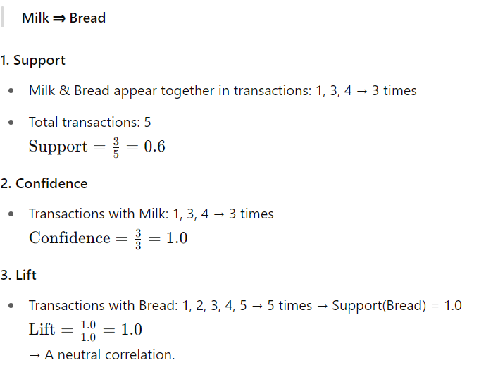
DISCOVERY OF ASSOCIATION RULES
Example: Market Basket Analysis
Let's say we have a small transactional dataset from a supermarket:
Transaction ID | Items Bought
1 | Milk, Bread, Butter
2 | Bread, Butter
3 | Milk, Bread
4 | Milk, Bread, Butter
5 | Bread, Butter

Slide 25
DISCOVERY OF CLASSIFICATION RULES
  Classification is a supervised learning technique in data mining used to predict the class label of new data based on past data with known class labels.Classification rules are if-then statements that help in categorizing data into predefined classes.
  A set of classification rules are generated by such a classification process, which can be used to classify future data and develop a better understanding of each class in the database. This is termed as supervised learning.
  There are several classification discovery models. They are: the decision trees, neural networks, genetic algorithms and the statistical models like linear/geometric discriminates.
  The applications include the credit card analysis, banking, medical
applications etc.

Slide 26
tudent Performance Classification
Sample Dataset:
Student | Attendance | Marks | Class
A | High | High | Pass
B | High | Medium | Pass
C | Medium | High | Pass
D | Low | Low | Fail
E | Medium | Medium | Pass
F | Low | Medium | Fail
From the Data, You Can Discover Rules Like:
IF Attendance = Low AND Marks = Low THEN Class = Fail
IF Marks = High THEN Class = Pass
IF Attendance = High AND Marks = Medium THEN Class = Pass

Slide 27
CLUSTERING - is a method of grouping data into different groups, so that
the data in each group share similar trends and patterns.
Clustering constitutes a major class of data mining algorithms. The algorithm attempts to automatically partition the data space into a set of regions or clusters, to which the examples in the table are assigned, either deterministically or probability-wise.
The goal of the process is to identify all sets of similar examples in the
data, in some optimal fashion.
Clustering according to similarity is a concept which appears in many
disciplines.
lf a measure of similarity is available, then there are a number of
techniques for forming clusters.
Another approach is to build set functions that measure some
particular property of groups which is known as optimal partitioning.

Slide 28
The objectives of clustering are:
  to uncover natural groupings
  to initiate hypothesis about the data
  to find consistent and valid organization of the data.
A retailer may want to know where similarities exist in his customer base, so that he can create and understand different groups. He can use the existing database of the different customers or, more specifically, different transactions collected over a period of time.
The clustering methods will help him in identifying different categories of
customers.
During the discovery process, the differences between data sets can be discovered in order to separate them into different groups, and similarity between data sets can be used to group similar data together.

Slide 29
FREQUENT EPISODES - are the sequence of events that occur frequently, close to each other and are extracted from the time sequences. How close it has to be to consider it as frequent is domain dependent. This is given by the user as the input and the output, which are the prediction rules for the time sequences.
  Given a set R of event types, an event is a pair (A, t) where A ∈ 𝑅 is an event type and t is an integer, we can calculate the occurrence time of the event. An event sequence S of R is a triple (T_{s}, T_{c}, S), where T_{s}<T_{c} are integers. T_{s} is the startingtime and T_{c} is the ending time.
S - {(A₁, t₁), (A₂, t₂), (A_{n}, t_{n})} is the ordered sequence of events, such that A ∈ R
and T_{s} ≤ t_{i}≤ Tc for all i = 1, 2. . . n--1.
  These episodes can be of three types:
– The serial episodes which occur in sequence.
– The parallel episodes in which there are no constraints on the order of the
event types A and B given.
– The non-serial and non-parallel episodes which occur in a sequence if the occurrences of A and B precede an occurrence of C, and there is no constraint on the relative order of A and B given.
  The applications include telecommunications, and share market analysis, and
these are mainly used for temporal data.

Slide 30
DEVIATION DETECTION
Deviation detection is to identify outlying points in a particular data set, and explain whether they are due to noise or other impurities being present in the data or due to trivial reasons.
It is usually applied with the database segmentation, and is the source of true discovery, since the outliers express deviation from some previously known expectation and norm. By calculating the values of measures of current data and comparing them with previous data as well as with the normative data, the deviations can be obtained. They can be applied in forecasting, fraud detection, customer retention, etc.

Slide 31
ISSUES AND CHALLENGES IN DM
Data mining systems depend on databases to supply the raw input and this raises problems, such as that databases tend to be dynamic, incomplete, noisy and large.
Other problems arise as a result of the inadequacy and
irrelevance of the information stored.
The difficulties in data mining can be categorized as
Limited information
Noise or missing data
User interaction and prior knowledge
Uncertainty
Size, updates and irrelevant fields

Slide 32
ISSUES AND CHALLENGES IN DM
Limited information: A database is often designed for purposes other then that of data mining and, sometimes, some attributes which are essential for knowledge discovery of the application domain are not present in the data. Thus, it may be very difficult to discover significant knowledge about a given domain.
Noise and missing data: Attributes that rely on subjective or measurement judgments can give rise to errors, such that some examples may be misclassified. Missing data can be treated in a number of ways – simply disregarding missing values, omitting corresponding records, inferring missing values from known values, and treating missing data as a special value to be included additionally in the attribute domain. The data should be cleaned so that it is free of errors and missing data.

Slide 33
User interaction and prior knowledge An analyst is usually not a KDD expert, but simply a person making use of the data by means of the available KDD techniques. Since the KDD process is by definition interactive and iterative, it is challenging to provide a high performance, rapid-response environment that also assists the users in the proper selection and matching of the appropriate techniques to achieve their goals. There needs to be more human-computer interaction and less emphasis on total automation, which supports both the novice and expert users. The use of domain knowledge is important in all steps of the KDD process. It would be convenient to design a KDD tool which is both interactive and iterative.
Uncertainty This refers to the severity of error and the degree of noise in the data. Data precision is an important consideration in a discovery system.
Size, updates and irrelevant fields Databases tend to be large and dynamic, in that their contents keep changing as information is added, modified or removed. The problem with this, from the perspective of data mining, is how to ensure that the rules are up-to-date and consistent with the most current information.

Slide 34
End of Unit 1

