Slide 1
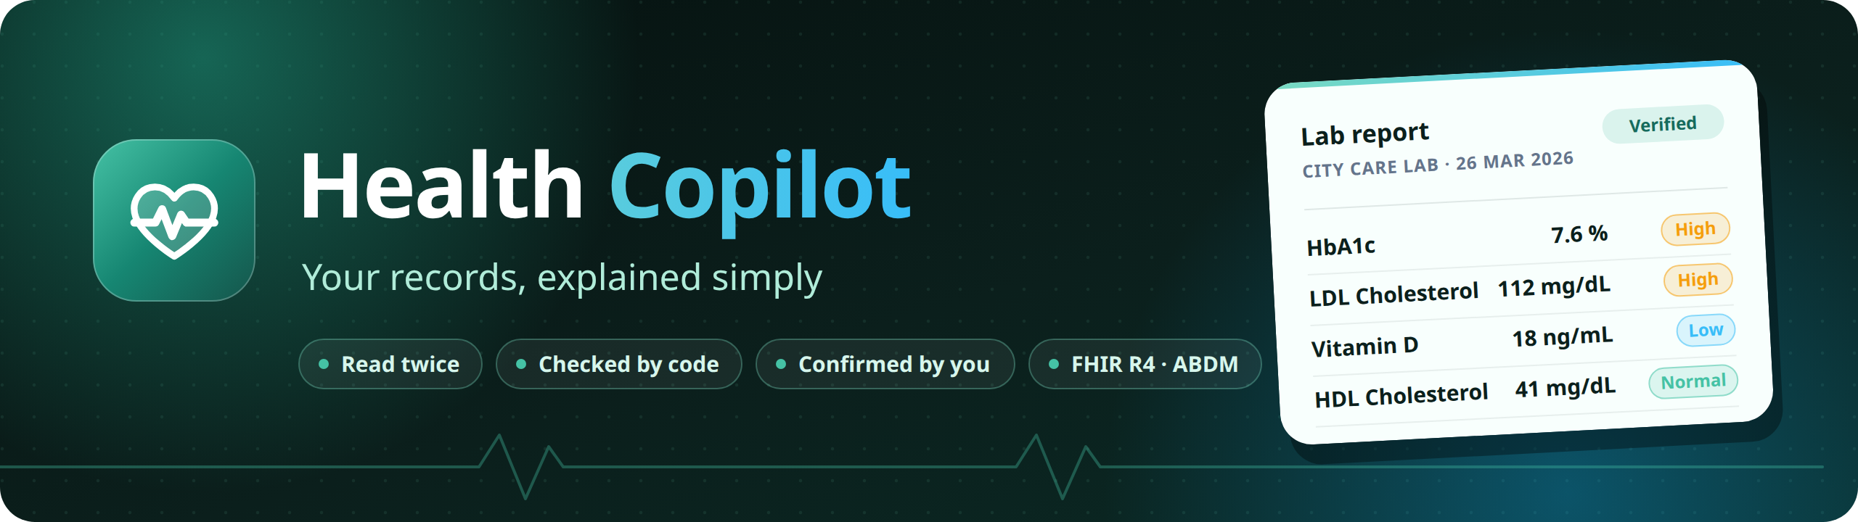
Your family's medical paperwork, read twice, checked by code and confirmed by you, then explained in your own language.
Altrix Labs Hackathon
AI-Powered Personal Health Copilot
Team hack_masters
Notes:
Hi, we're team hack masters, and this is Health Copilot: an AI-powered personal health copilot for Indian families. It reads your medical paperwork twice, checks it with code, lets you confirm it, and then explains it in your own language.

Slide 2
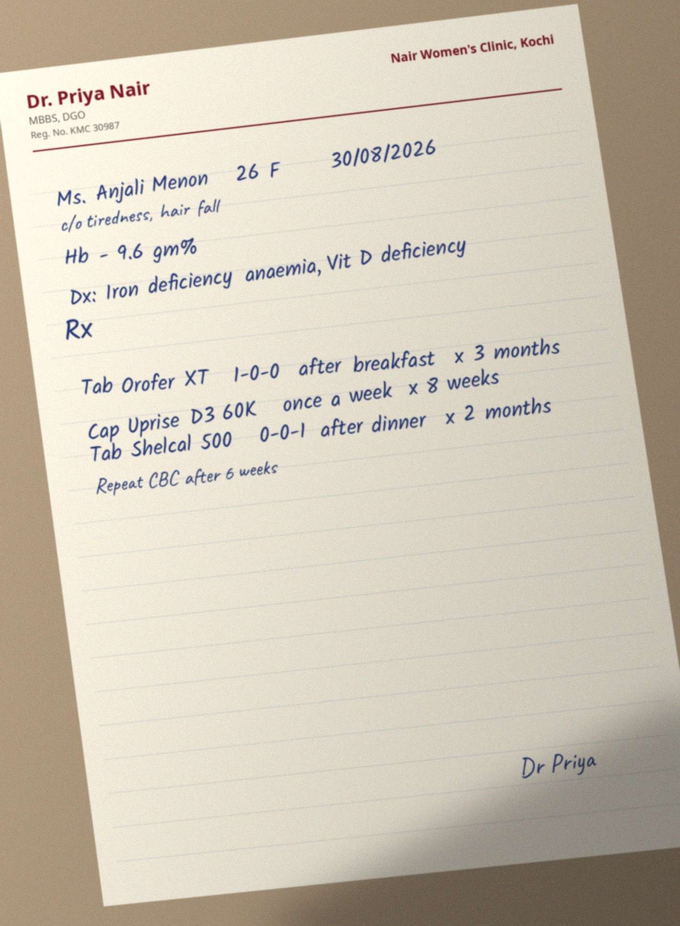
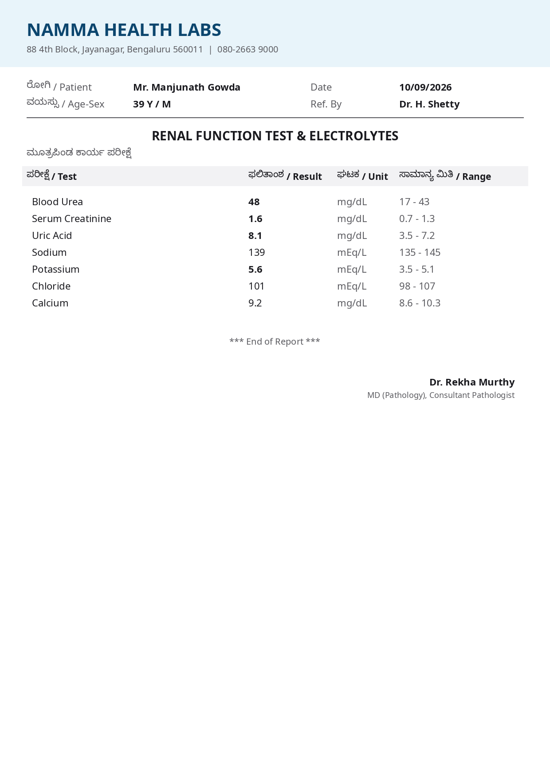
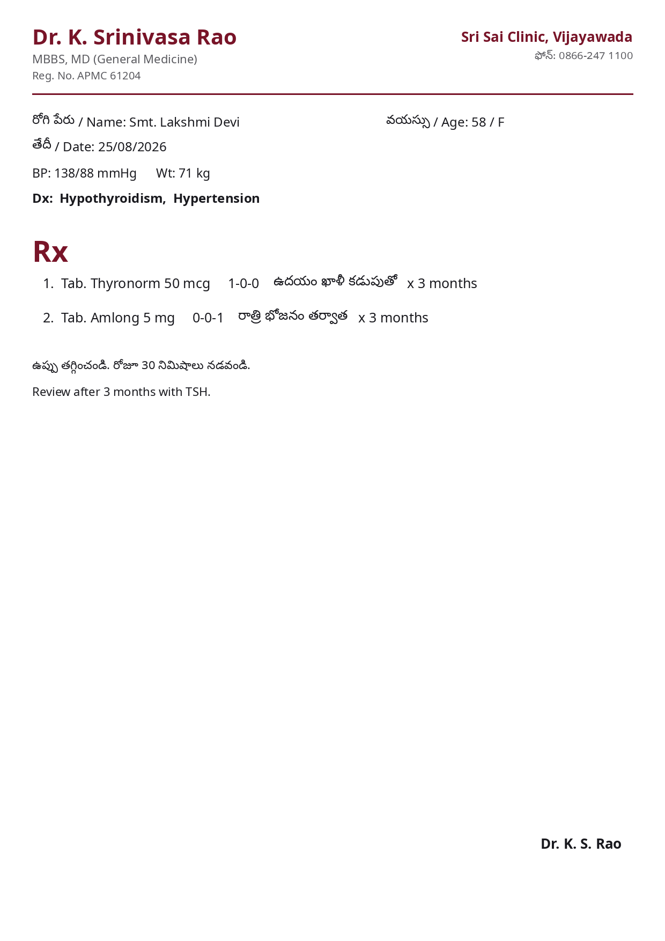
THE PROBLEM
Health records in India still live on paper
1
Handwritten and mixed-language
Prescriptions, lab printouts and discharge summaries, in English plus Hindi, Telugu, Tamil or Kannada.
2
Nobody explains the results
Abnormal values go unexplained; old prescriptions linger.
3
Records don't travel
Each hospital keeps its own paper folder.
4
ABDM needs structured data
Records must be FHIR, linked to an ABHA, before they can move between providers.
Synthetic sample documents from the evaluation set
Notes:
Indian patients carry their health history on paper: handwritten prescriptions, lab printouts and discharge summaries, often mixing English with Hindi, Telugu, Tamil or Kannada. Nobody explains the abnormal values, and records don't move between hospitals. ABDM can carry them, but only as structured FHIR, linked to an ABHA.

Slide 3
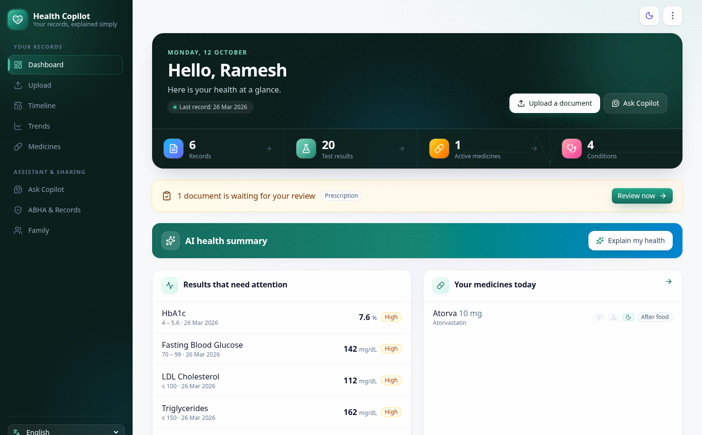
WHAT WE BUILT
One verified record for the whole family
• Upload: photo, scan or PDF, any of 5 languages
• Read twice: Gemini extracts, a second model verifies
• Checked by code: units, ranges, flags, drugs, dates
• Confirmed by you: side-by-side review before saving
• Explained: summaries and cited chat in your language
• Shared: FHIR R4 bundles and ABHA
Notes:
The dashboard brings every document together: results that need attention, today's medicines, and conditions. The High and Low flags are computed in code from the report's own reference range, never by the AI.
Let's see it live. You sign in with your email or your mobile number, and a password. One account holds a whole family, and it only ever sees its own records.

Slide 4
HOW IT WORKS
AI reads. Code decides. You confirm.
Photo / PDF
Preprocess
Extract
Validate
Verify
You confirm
camera, scan, multi-page
deskew, enhance, text layer
Gemini vision, strict schema
units, ranges, drugs, dates
a second model re-reads
side-by-side review
AI reads
Code decides
A person confirms
Unified record
Explanations and chat
FHIR R4 · ABHA
Timeline, trends with reference ranges, active and past medicines, conditions.
Grounded in the record, cited, safety-checked, in 5 languages.
NRCeS-profile bundles, mock ABHA link, consent and hospital import.
Flags, unit conversions, LOINC and ICD-10 codes and medicine schedules come from a curated knowledge base (60 lab tests, 213 Indian drug brands, dosage shorthand like 1-0-1 AC), never from the model.
Notes:
Now let's upload a photo of a bilingual Telugu prescription. The pipeline deskews and enhances the page, classifies it, and extracts it with Gemini vision into a strict schema. Every value is checked in code, and then a different model re-reads the page, focusing on whatever looked suspicious. An upload can even be deleted before it's reviewed.

Slide 5
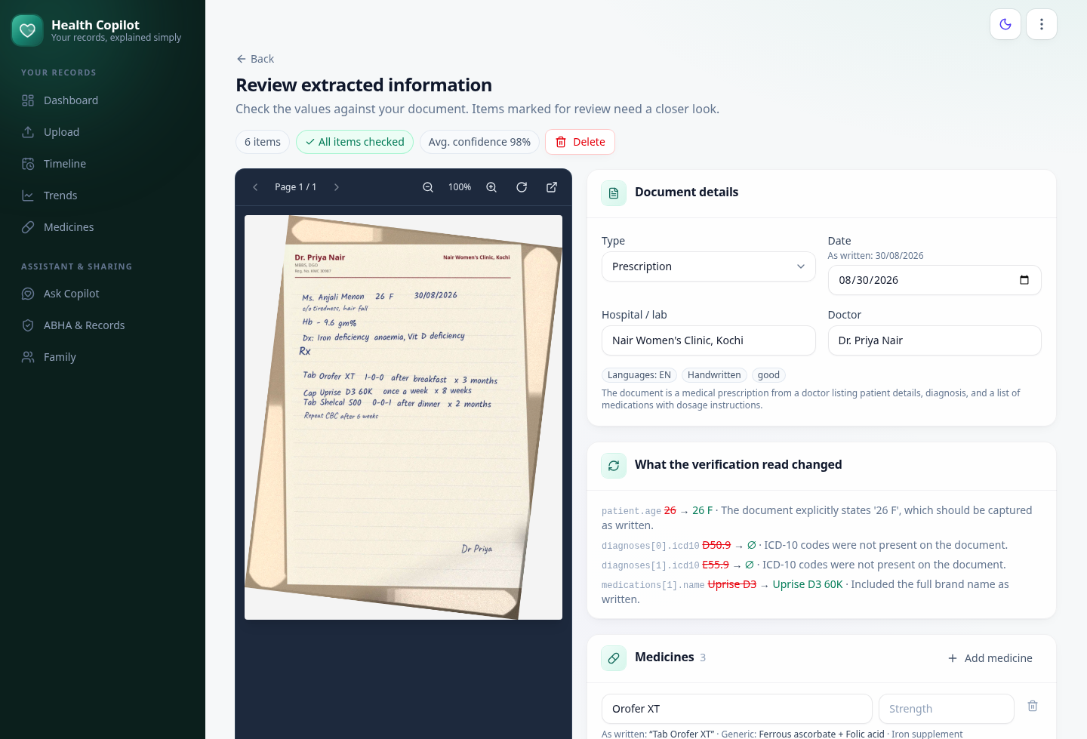
HUMAN IN THE LOOP
Nothing is saved until a person confirms it
• Side by side: the deskewed page next to every editable field
• Confidence: per item, plus whether both AI reads agree
• Verifier changes: e.g. the full brand name Uprise D3 60K, and ICD-10 codes removed because they weren't on the page
• Schedules: 1-0-0 becomes morning, afternoon and night pills
• Delete any time: even while a document is still being read
Notes:
While that runs, here's the review screen for a handwritten prescription photo. The original page sits next to every extracted field, with its confidence, and whether both AI reads agree. This card shows what the verification read changed: it caught the full brand name, Uprise D3 60K, and removed codes that weren't on the page. Nothing reaches the record until a person confirms it.
Our Telugu prescription is ready. A quick check, then one tap on Confirm and save, and it joins the family record.

Slide 6
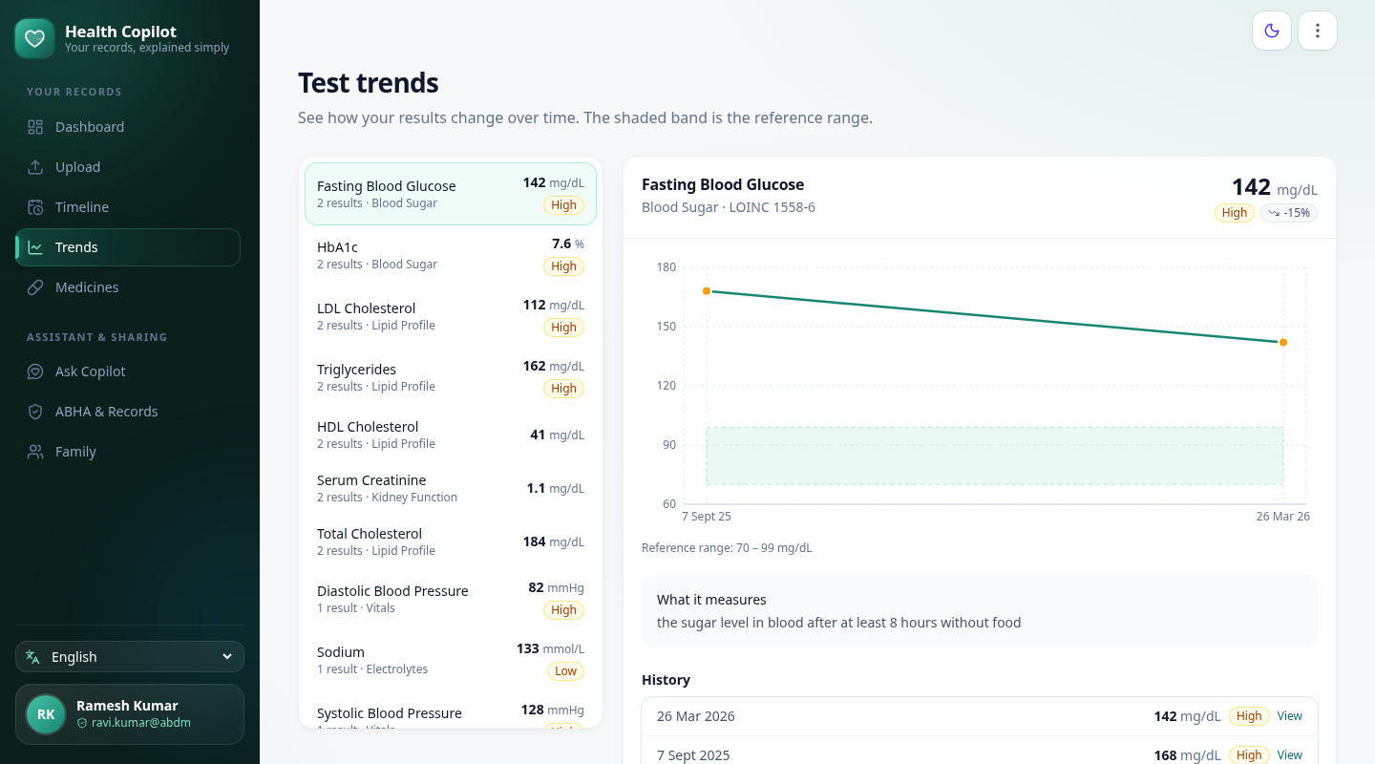
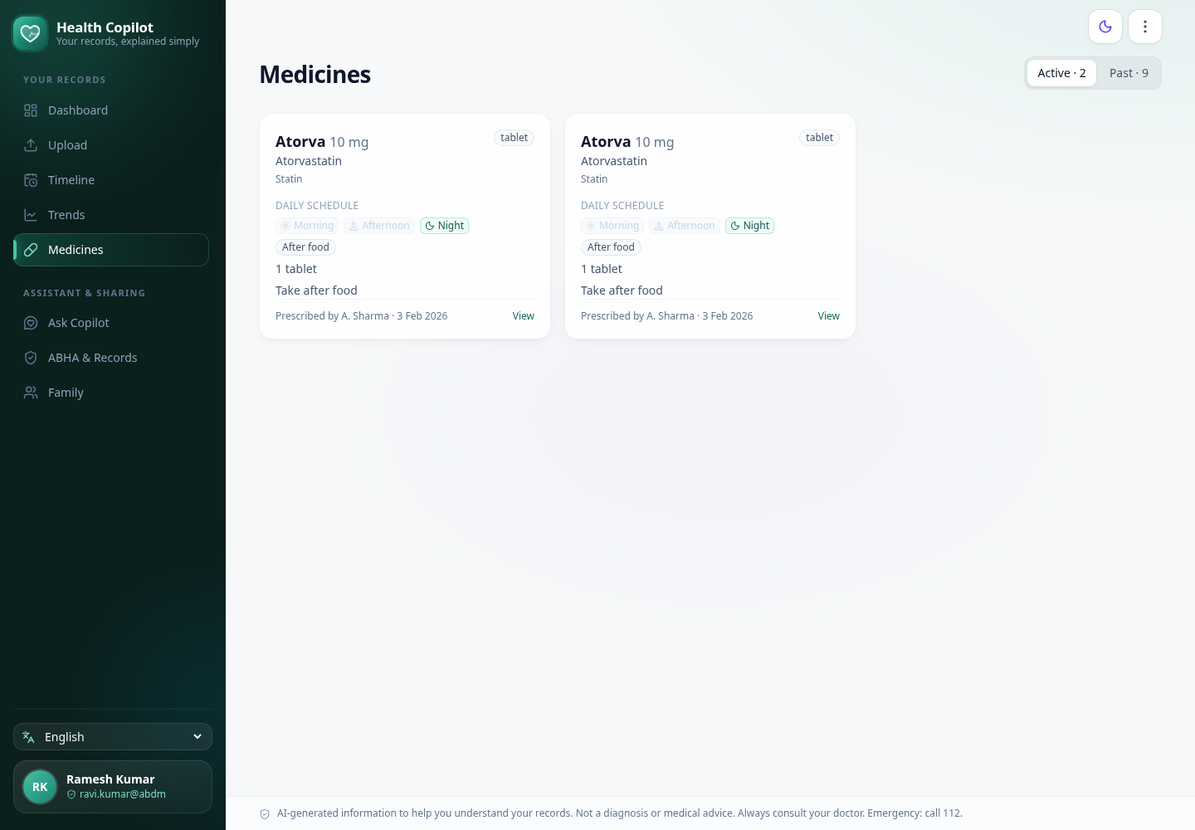
UNIFIED PROFILE
Every document builds one record
Trends against shaded reference ranges, e.g. fasting glucose 168 → 142 mg/dL. Medicines with a daily schedule; a newer prescription of the same drug supersedes the older one.
Notes:
Trends plot every result across the year, with the reference range shaded. HbA1c came down from 8.1 to 7.6 percent: better, but still above the range.

Slide 7
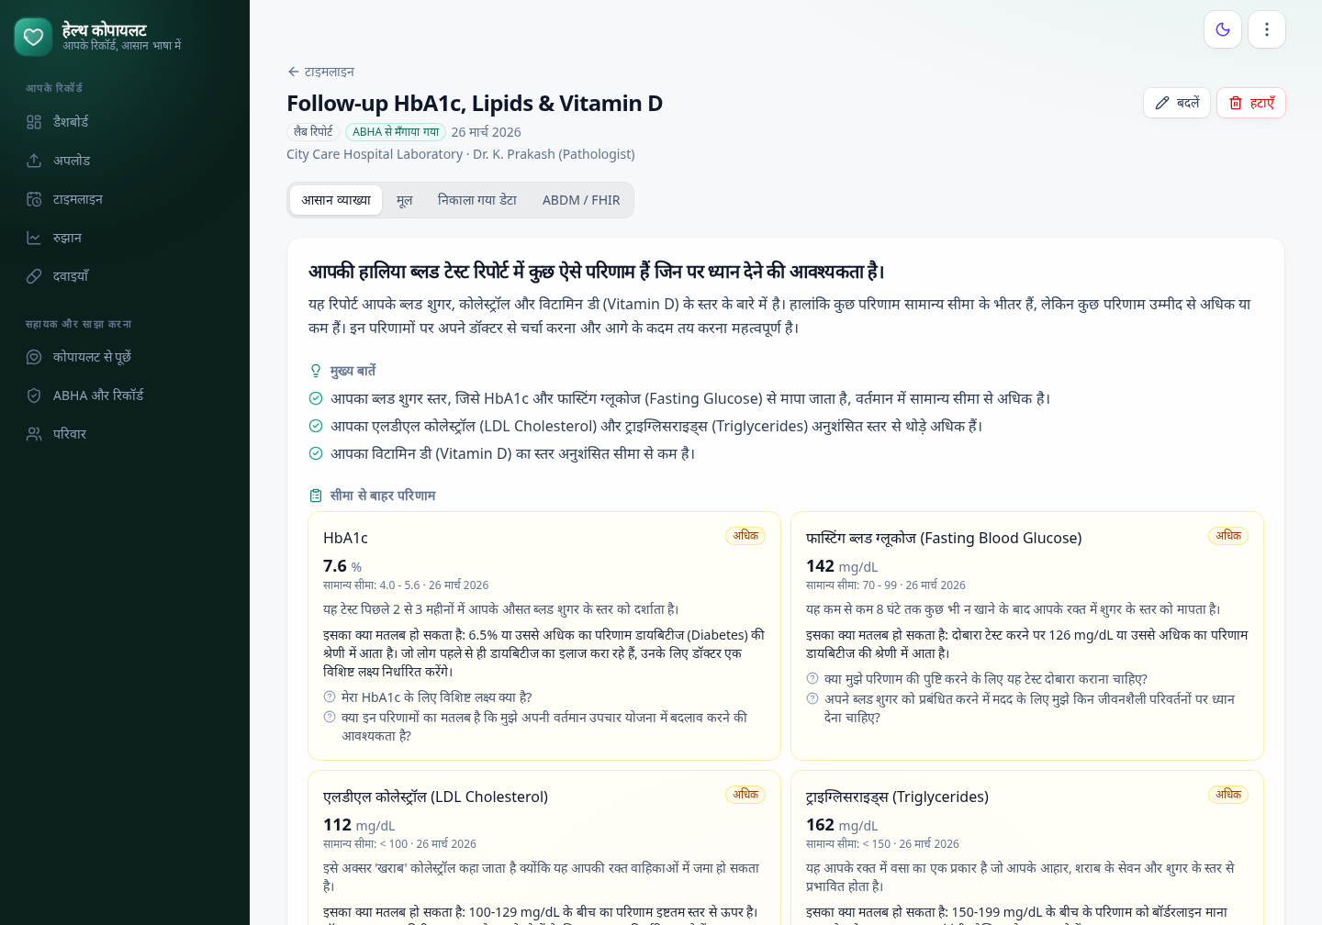
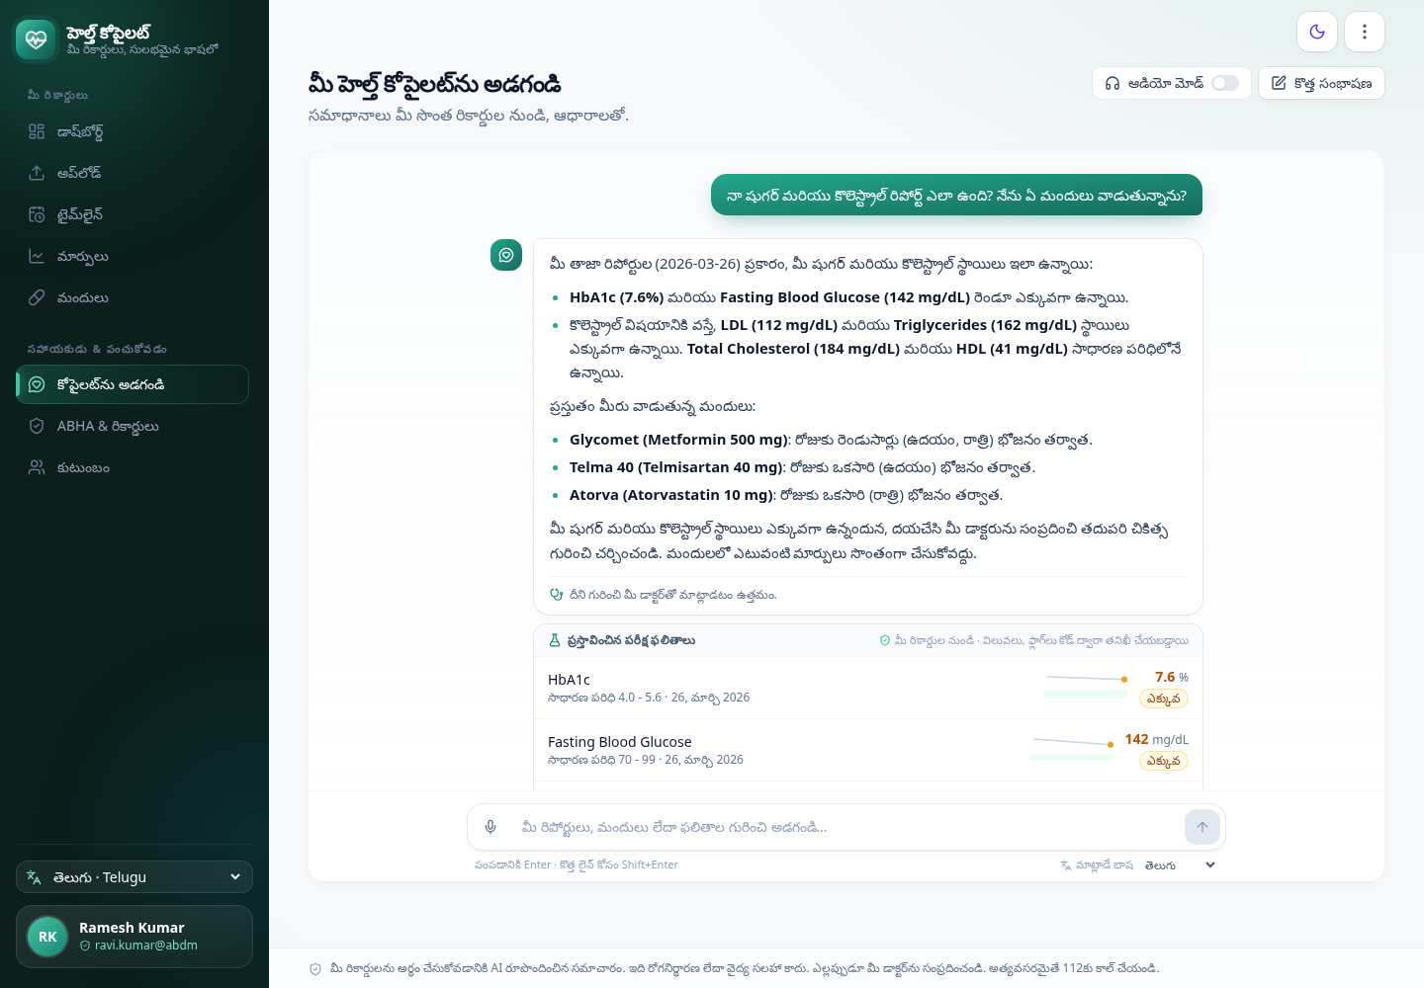
IN YOUR LANGUAGE
Explained in English, हिन्दी, తెలుగు, தமிழ், ಕನ್ನಡ
The AI writes only the prose. Numbers, flags and schedules are attached from the database; a safety filter blocks dosing advice and diagnoses, and chat answers come only from the patient's records, with citations and read-aloud.
Notes:
Every document gets a plain-language explanation, here in Hindi. The AI writes only the prose. Each number, flag and schedule is attached from the database, and a safety filter blocks dosing advice and diagnoses.
Ask Copilot answers questions from your own records only, with citations. Here I'm asking in Telugu about my sugar and cholesterol, and which medicines I take. The answer comes back in Telugu, with the results and medicines it used, and it can read the answer aloud.

Slide 8
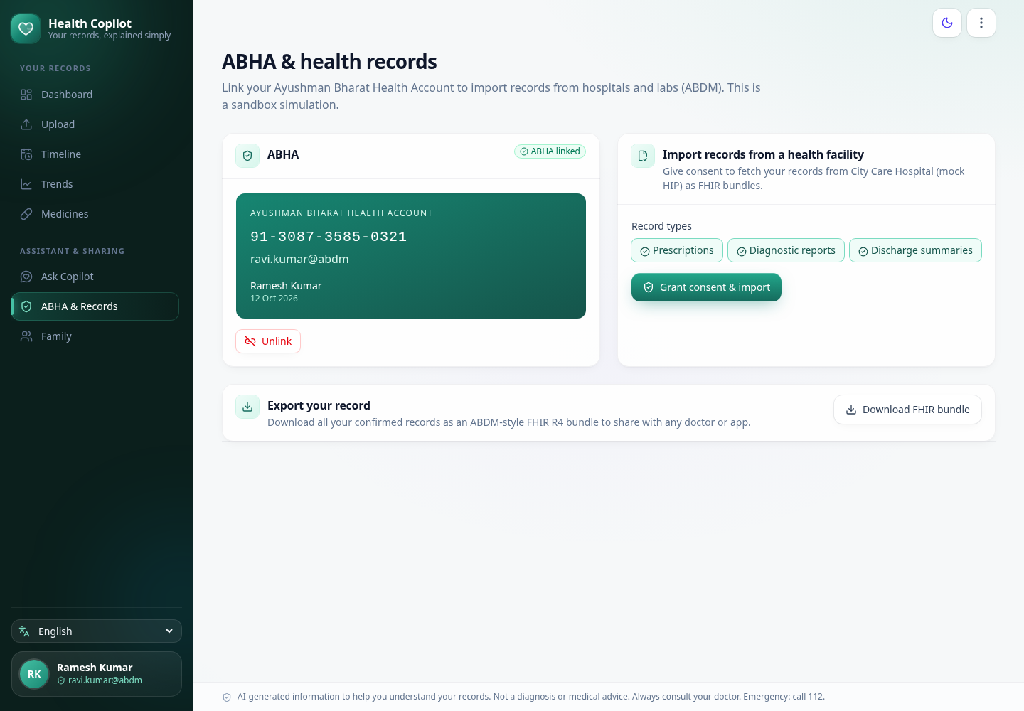
ABDM-READY
FHIR R4 records, linked to an ABHA
• NRCeS profiles: PrescriptionRecord, DiagnosticReportRecord and DischargeSummaryRecord bundles
• Standard codes: LOINC, UCUM, ICD-10, SNOMED composition types
• Mock ABDM flow: ABHA link with OTP, consent artefact, pull from a Health Information Provider
• Same checks: imported records go through the same validators
• Readable bundle view: with the raw JSON one click away, and one-file export
Notes:
It's ready for ABDM. Link an ABHA with a one-time password, grant consent, and pull records from a hospital. Every confirmed document becomes an NRCeS-profile FHIR R4 bundle, readable here, with the raw JSON one click away.

Slide 9
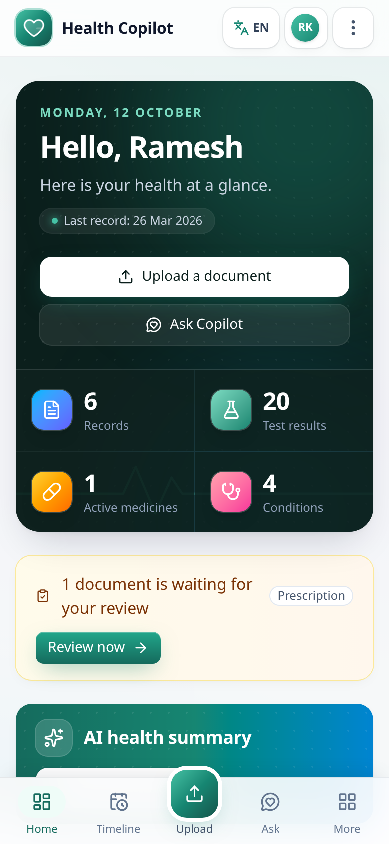
PHONES AND FAMILY ACCOUNTS
Built for the phone in your pocket
• Sign in with email or mobile number: and a password; sign-up is verified by an email code
• One account, whole family: each member has their own records; accounts are isolated
• Phone layout: bottom tab bar, account menu in the corner, screens from 360 px wide
• Installs like an app: web app manifest and icons
• Security alerts and reminders: new sign-ins, password changes, medicine courses ending, weekly summary
Notes:
And it's built for phones: a bottom tab bar, the account menu in the corner, and it installs to the home screen like an app. Everything works in five languages.

Slide 10
SAFE BY CONSTRUCTION
Guardrails in code, not in the prompt
1
Code decides what is abnormal
2
Grounded explanations
High, Low and Critical flags, unit conversions and schedules are computed deterministically.
Summaries use only numbers that are in the record; translations must preserve every number.
3
No dosing advice, no diagnosis
4
Privacy
A safety filter blocks them; critical values and emergency symptoms point to a doctor or 112.
Models see clinical facts, gender and age only: no names, phone numbers or ABHA IDs.
Nothing is saved without a person confirming it. Low-confidence, disputed and verifier-added items are highlighted on the review screen, and imported FHIR records go through the same validators.
Notes:
Safety is built into the design, not added at the end. Code decides what is abnormal; the AI only explains. Nothing is saved without human confirmation, and the models never see names, phone numbers or ABHA IDs.

Slide 11
MEASURED, NOT CLAIMED
Accuracy on a re-scorable evaluation suite
100%
99.8%
100%
single pass, no verifier
medicines F1
of 477 checked fields correct with verification, on 10 synthetic documents with 96 items
100%
4
lab and vital results F1
Indian scripts, plus handwriting
Printed
Handwritten
Phone photo
Multi-page PDF
हिन्दी
తెలుగు
தமிழ்
ಕನ್ನಡ
The samples are synthetic, so real handwriting will be harder; that is why every document is reviewed. Re-run with eval/run_eval.py, or re-score saved outputs without any AI calls.
Notes:
We measured accuracy instead of claiming it. On ten test documents, including handwriting, phone photos and four Indian scripts, the pipeline with verification got all 477 checked fields right.

Slide 12
ARCHITECTURE
Production on free tiers only
Backend
Frontend
Free hosting
• FastAPI and SQLModel
• Background pipeline workers
• Gemini model chains with fallback (OpenAI optional)
• FHIR R4 with fhir.resources
• React 19, Vite, TypeScript
• Tailwind CSS 4, TanStack Query
• i18next: 5 languages
• Installable web app
• Render (Docker)
• Private GitHub repo as the datastore
• Gmail through Apps Script
• GitHub Actions: tests, gated deploys, daily job
96 backend tests, type check, lint and build run on every push; Render deploys only after they pass.
Notes:
Under the hood: FastAPI on the back end, React 19 on the front end, and Gemini model chains with automatic fallback. And it all runs on free tiers: Render, a private GitHub repository as the datastore, Gmail through Apps Script, and GitHub Actions.

Slide 13
IMPACT AND NEXT STEPS
From a paper folder to a record that travels
Who it helps
Next steps
Chronic patients (diabetes, blood pressure, thyroid) tracking results across labs and hospitals.
Caregivers managing a parent's medicines and schedules.
Doctors receiving a structured, ABHA-linked history instead of a paper folder.
ABDM sandbox: HIU registration and Fidelius encryption.
Medicine interaction checks on top of the extracted schedule.
A larger evaluation set with real, consented documents, and calibrated confidence.
Voice summaries in regional languages.
Notes:
Who it helps: chronic patients tracking results across labs, caregivers managing a parent's medicines, and doctors who receive a structured, ABHA-linked history instead of a paper folder.

Slide 14
AI reads and explains.
Code checks.
You confirm.
Your record, in your language, ready for ABDM.
health-copilot-kl7g.onrender.com
github.com/prasanthselam-arch/health-copilot
Team hack_masters · Apache License 2.0
Notes:
AI reads and explains. Code checks. You confirm. Your record, in your language, ready for ABDM. Thank you!

