Slide 1
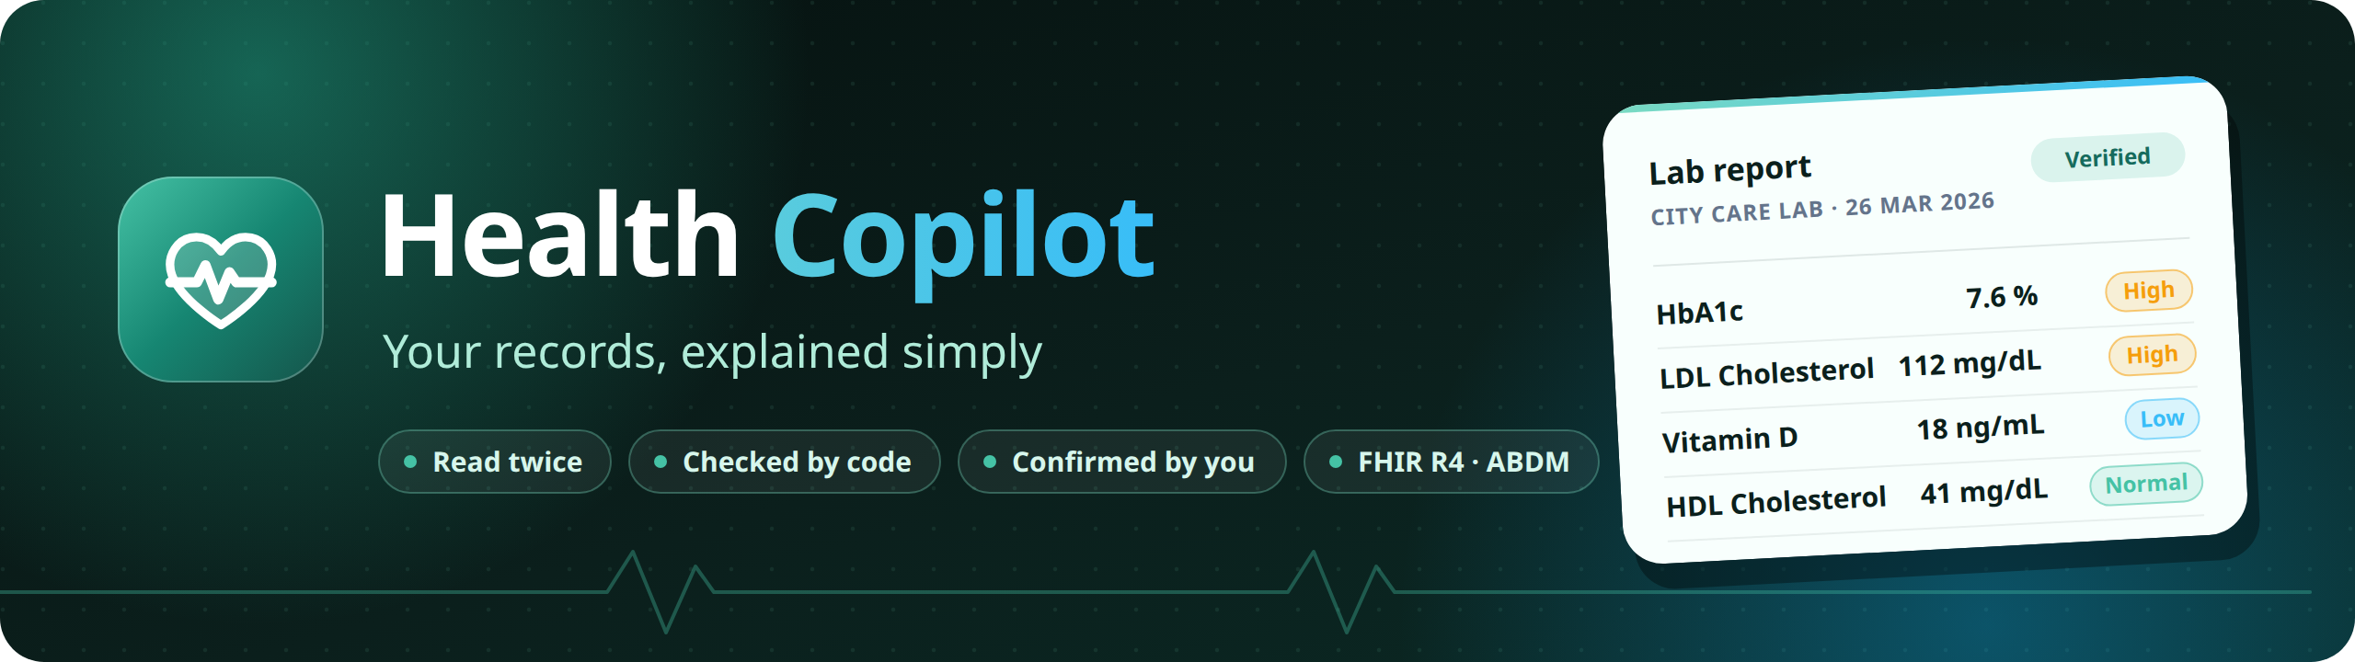
Your family's records, verified and explained, then a copilot that guides you between doctor visits, in English and 12 Indian languages.
Altrix Labs Hackathon
AI-Powered Personal Health Copilot
Team hack_masters
Notes:
Hi, we're team hack masters. Health Copilot turns a family's paper records into a verified health record, and then guides them between doctor visits. It answers from their own records, reminds them at the right time, spots trends and risks, and acts on its own, while they stay in control.

Slide 2
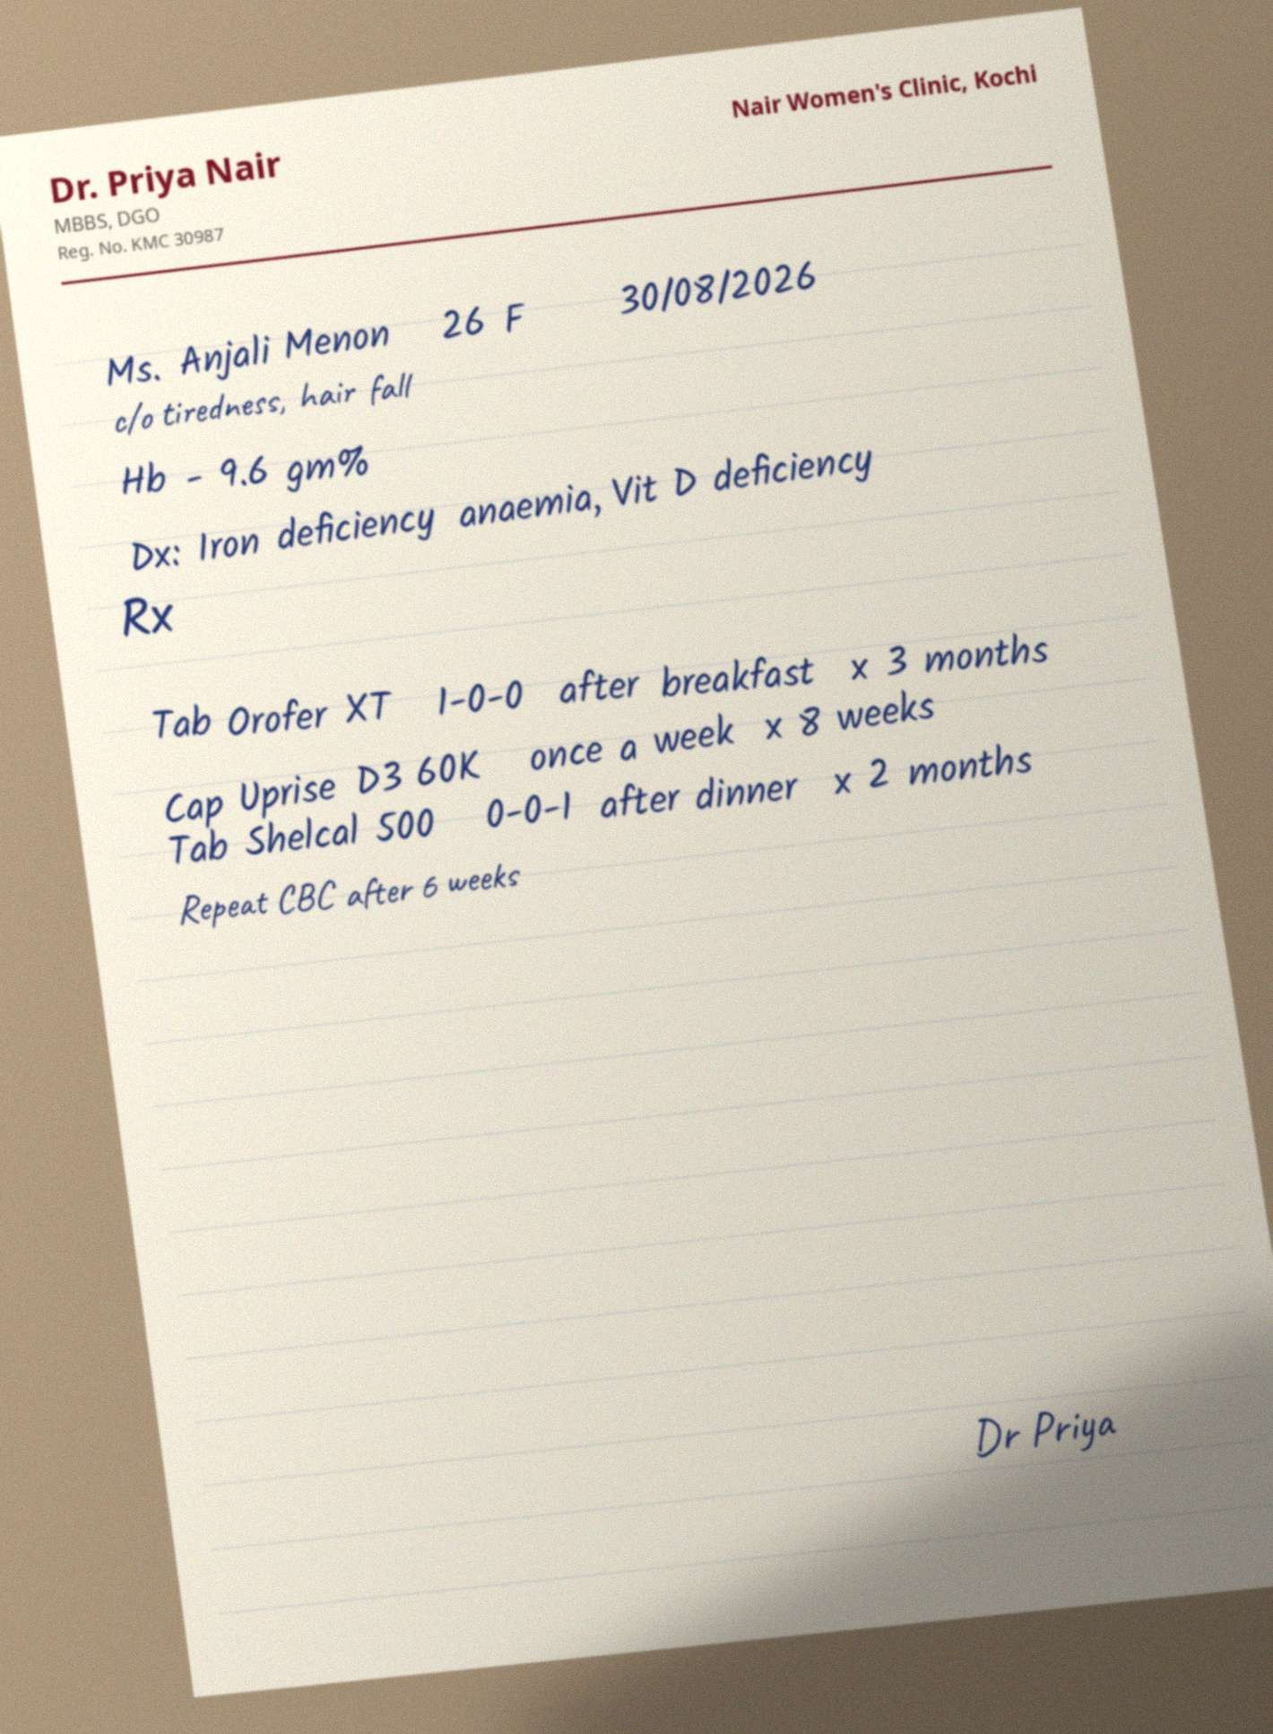
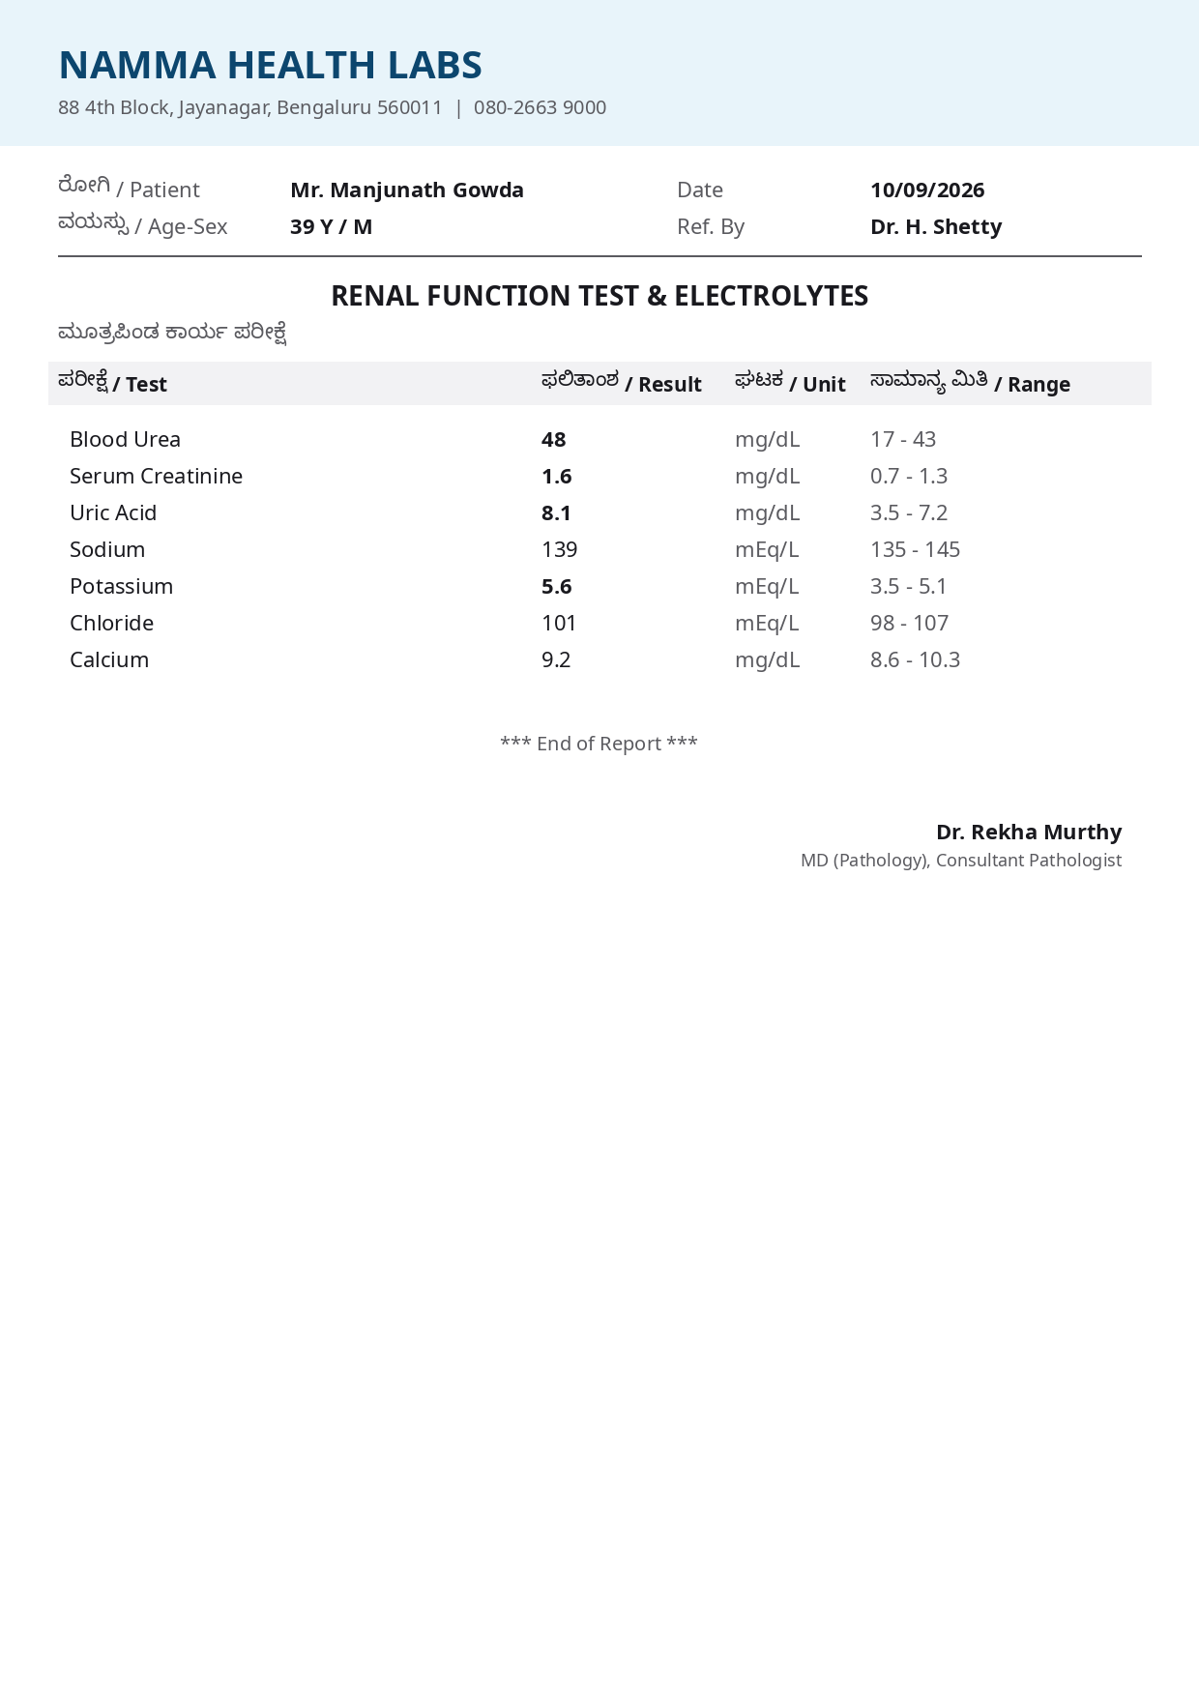
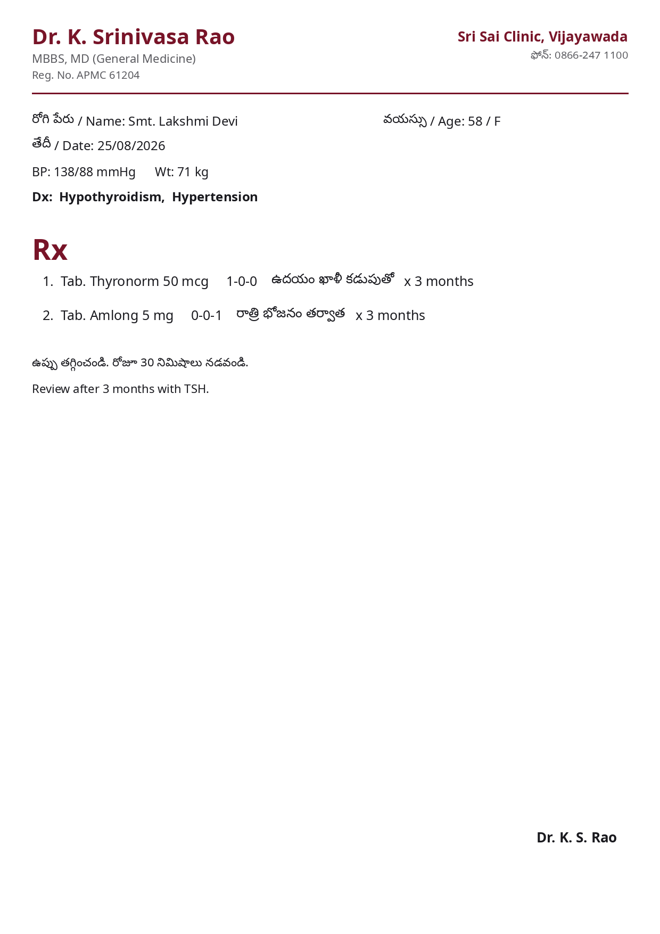
THE PROBLEM
Understanding a report is not managing your health
1
Medicines get forgotten
Different times, before or after food, courses that end on their own.
2
Follow-ups and repeat tests slip
"Review after 1 month" and "repeat HbA1c in 3 months" stay on paper.
3
Nobody knows what to ask
Trends across reports go unnoticed until the next visit.
4
One person carries the family
Parents' records, many documents, many languages.
Synthetic sample documents from the evaluation set
Notes:
Understanding a report is not the same as managing your health. People forget medicines, miss follow-ups, don't repeat tests on time, and don't know what to ask the doctor. In Indian families, one person often carries this for their parents too, across many documents and languages.

Slide 3
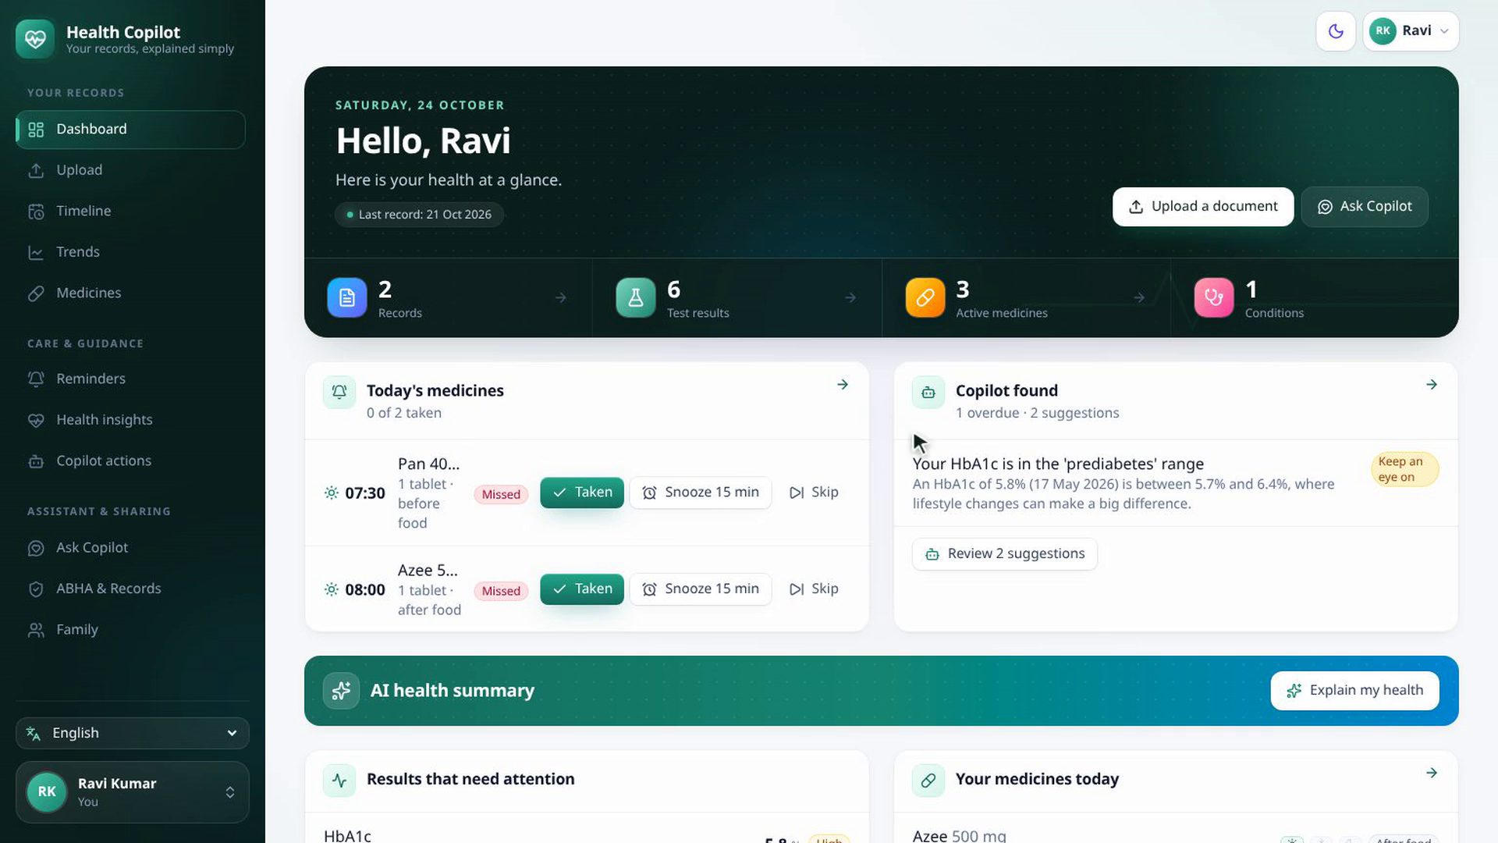
WHAT IT DOES
A copilot for the whole family
• Ask Copilot: answers from your own records, with sources
• Reminders: every medicine at the prescription's times, push to the phone
• Insights and risks: trends across reports, overdue tests
• Wellness: personal tips, each with a reason
• Acts for you: schedules, follows up, drafts questions; keep, edit or undo
• Voice, family profiles, 13 languages
Notes:
This is Ravi's account. He also looks after his father and mother. The home screen shows today's medicines for him, with Taken and Snooze buttons, and what the copilot found in his records.

Slide 4
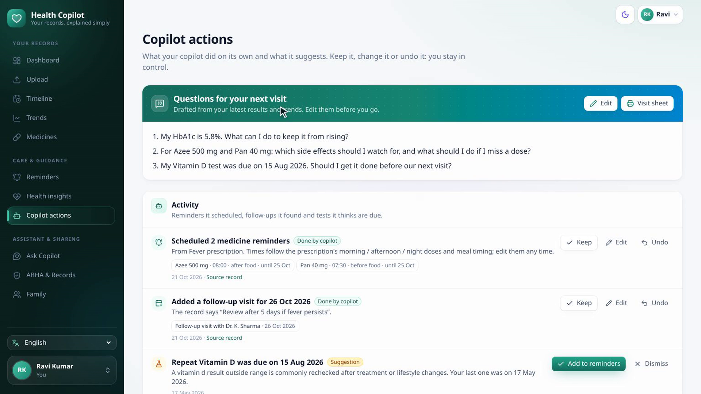
SCENARIO 1 · NEW PRESCRIPTION
Reminders and questions, scheduled by the copilot
• On confirm: Azee once a day for 5 days, Pan 40 before breakfast
• Skipped on purpose: Dolo is SOS, so no reminder
• Follow-up: "review after 5 days" becomes a dated visit
• Three questions for the next visit, editable, with a printable visit sheet
• Every action: Keep, Edit or Undo
Notes:
Scenario one: a new prescription. Ravi saw a doctor for fever three days ago. When he confirmed the prescription, the copilot scheduled the reminders by itself: the antibiotic once a day for five days, the antacid before breakfast, and no reminder for the fever tablet, because it's only taken when needed. It also drafted three questions for his next visit. Every action can be kept, edited or undone.

Slide 5
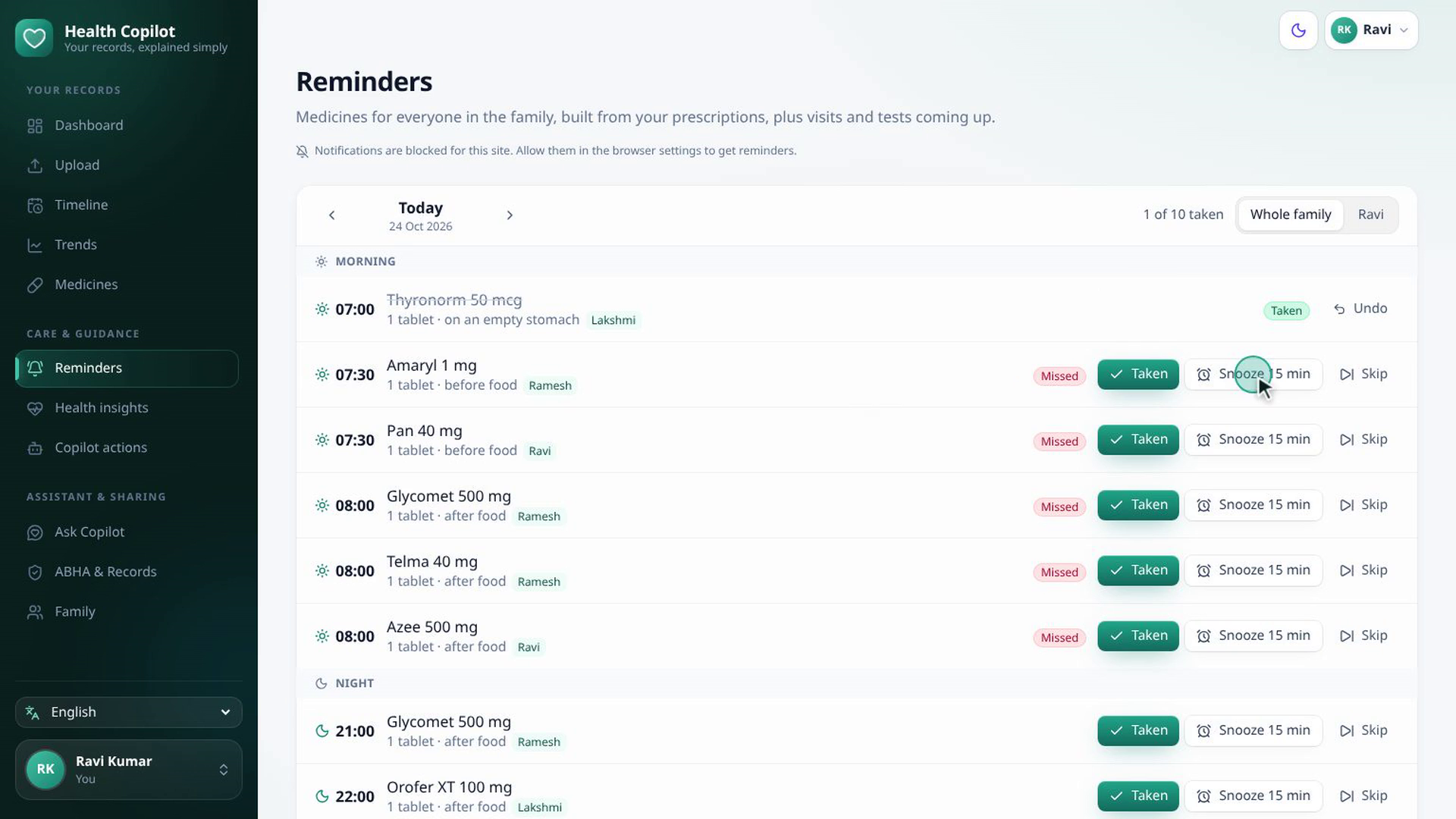
REMINDERS
The whole family's day, on one screen
• Taken, Snooze 15 min or Skip, from the app or the notification
• Courses end by themselves: the antibiotic stops after 5 days
• Edit, pause or stop any reminder
• Visits and tests read from the doctor's notes
• Web Push reaches the phone even when the app is closed, in the person's language
Notes:
Reminders cover the whole family's day, at each prescription's own times. Mark a dose as taken, or snooze it for fifteen minutes. A course ends by itself, so the antibiotic stops after five days. Follow-up visits and repeat tests come from the doctor's notes, and push notifications reach the phone even when the app is closed.

Slide 6
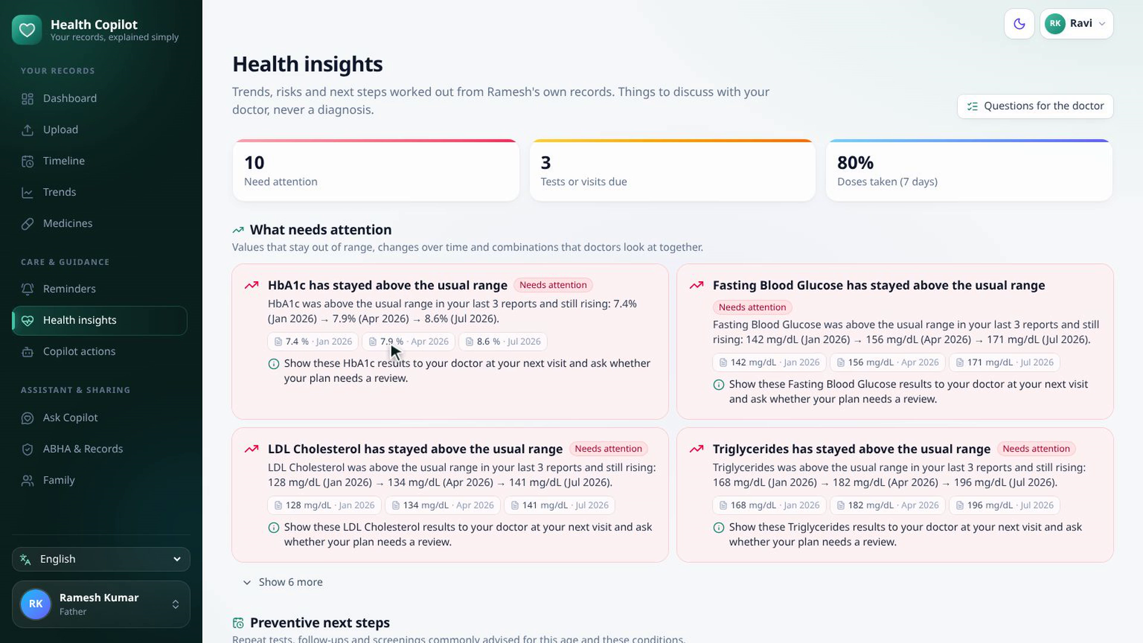
SCENARIO 2 · FATHER'S RISING SUGAR
HbA1c 7.4 → 7.9 → 8.6%, flagged with its sources
• Trend: above range in 3 reports and still rising
• Cited: each result with its date, linked to the source report
• Combinations: high sugar with high LDL, kidney results alongside diabetes
• Worked out in code from his own results, worded for the doctor, never a diagnosis
Notes:
Scenario two: Ravi's father, Ramesh. His HbA1c was above the range in three reports, and still rising: 7.4, then 7.9, then 8.6 percent. The copilot flags the trend, shows each result with its date, and links to the report it came from. It also looks at combinations, like high sugar with high LDL cholesterol, or kidney results alongside diabetes.

Slide 7
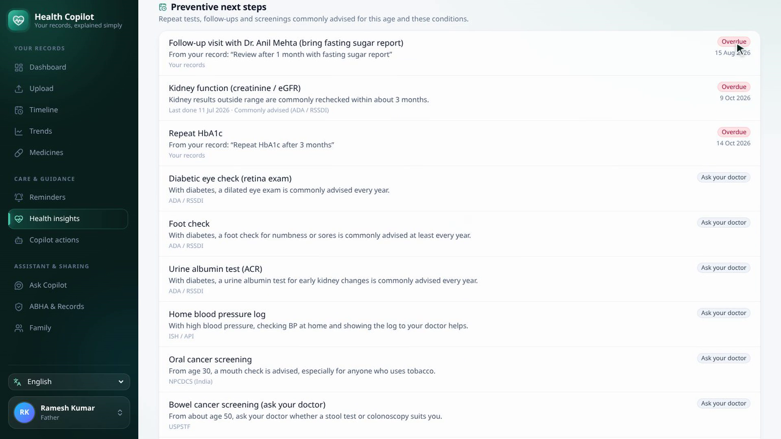
PREVENTIVE STEPS AND WELLNESS
What's overdue, and why each tip
• Overdue: the follow-up visit and the repeat HbA1c
• Screenings for his age and conditions: eye check, foot check, urine albumin, vaccines
• Wellness plan: diet, activity and habits, each with "Why" from his values
• One click: add a due test to reminders
Notes:
His follow-up visit and his repeat HbA1c test are overdue, so the copilot prompts both, with screenings that suit his age and his diabetes. Every wellness tip says why it is suggested, from his own values. All of this is worked out in code, and worded for a talk with the doctor, never as a diagnosis.

Slide 8
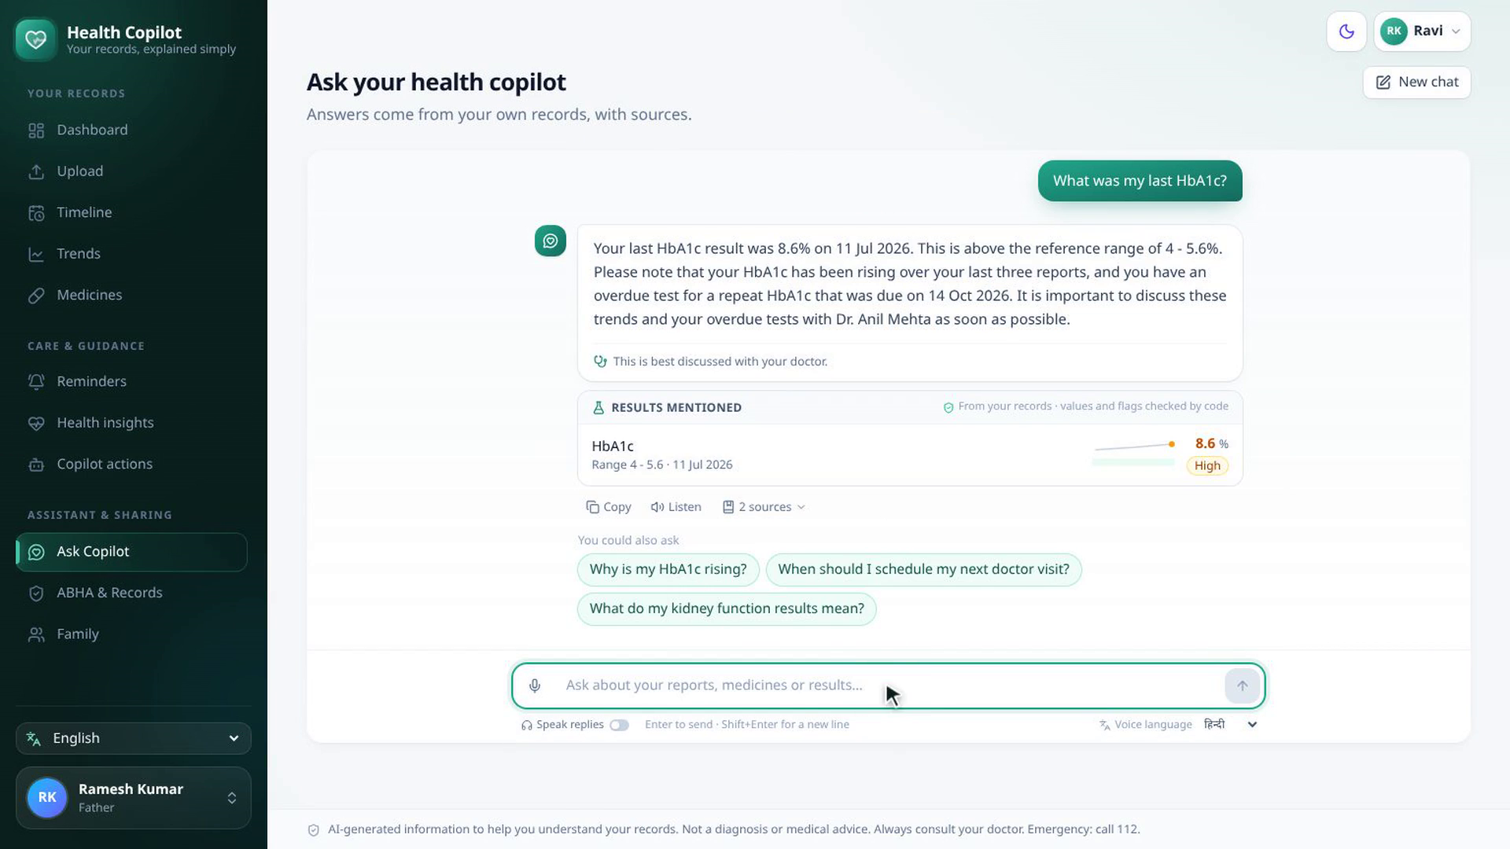
ASK COPILOT
Grounded, honest and safe
• Grounded: answers only from the person's records, with the results it used
• Honest: if it isn't in the records, it says so
• Safe: never changes a medicine or dose; emergencies point to 112
• Follow-up questions suggested after every answer
Notes:
Ask Copilot answers from his own records, and shows the results it used. If something isn't in the records, it says so instead of guessing. And it never changes a medicine or a dose: for that, it sends him to his doctor.

Slide 9
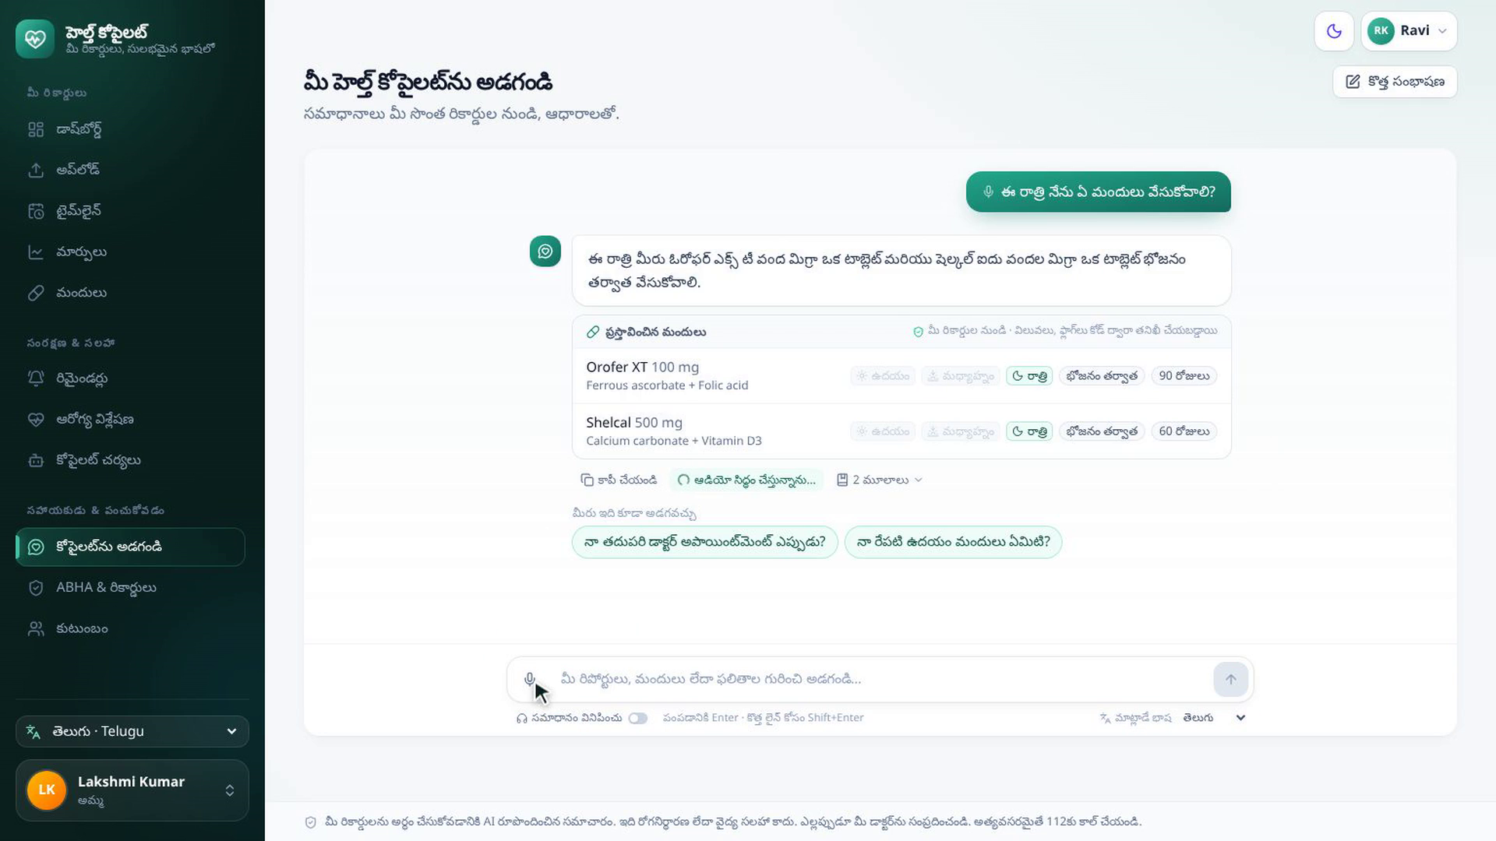
SCENARIO 3 · ELDERLY USER, BY VOICE
"ఈ రాత్రి నేను ఏ మందులు వేసుకోవాలి?"
• Ask by voice: "Which medicines do I take tonight?" in Telugu
• Answer from her own reminder schedule: Orofer XT and Shelcal at 10 PM
• Read aloud in Telugu; Speak replies reads every answer
• Listens in each family member's language, with pauses for slow speakers
Notes:
Scenario three: Ravi's mother, Lakshmi, prefers Telugu. She taps the microphone and asks which medicines to take tonight.
The answer came from her own reminder schedule, and was read aloud in Telugu. Health Copilot speaks English and twelve Indian languages, including right-to-left Urdu. Each family member keeps their own language, for the screens, chat, voice and reminders.

Slide 10
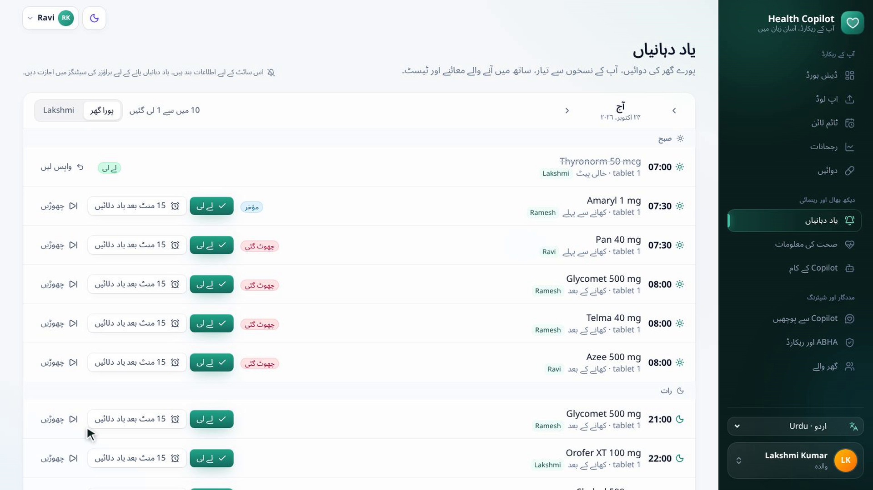
IN YOUR LANGUAGE
English and 12 Indian languages
English
हिन्दी
বাংলা
मराठी
తెలుగు
தமிழ்
ગુજરાતી
اردو
ಕನ್ನಡ
ଓଡ଼ିଆ
മലയാളം
ਪੰਜਾਬੀ
অসমীয়া
Screens, summaries, chat, voice and push reminders. Urdu is right to left. Each family member keeps their own language. The demo video has narration in 10 of them and subtitles in all 13.
Notes:
The answer came from her own reminder schedule, and was read aloud in Telugu. Health Copilot speaks English and twelve Indian languages, including right-to-left Urdu. Each family member keeps their own language, for the screens, chat, voice and reminders.

Slide 11
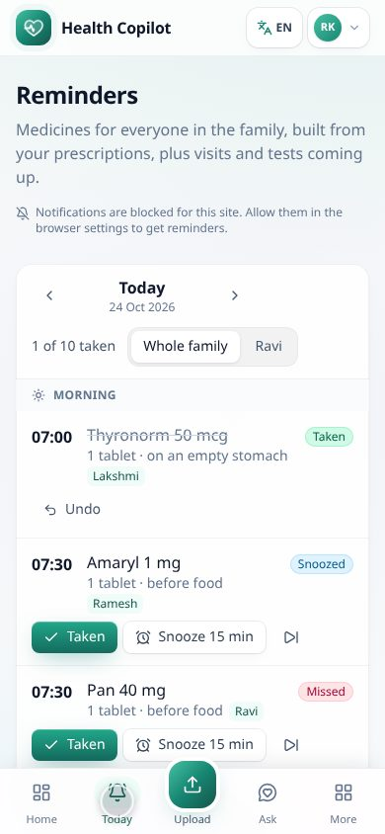
ON THE PHONE
Works like an app
• Bottom tab bar: home, reminders, chat, records, one thumb
• Today's doses: Taken and Snooze one tap away
• Push reminders with Taken and Snooze buttons on the notification
• Installs to the home screen, from 360 px wide
• One account for the family; each person's records stay separate
Notes:
On a phone, it works like an app: a bottom tab bar, the day's doses one tap away, and it installs to the home screen.

Slide 12
HOW IT WORKS
AI reads and explains. Code decides.
Record
Insights
Copilot
You decide
Reaches you
read twice, checked by code, you confirm
trends, combinations, overdue tests
daily check, schedules, follows up
keep, edit or undo
push, chat, voice, 13 languages
Backend
Frontend
Hosting
• FastAPI, SQLModel, SQLite
• Scheduler: doses, daily copilot check
• Gemini chains that race and fall back
• FHIR R4, ABHA link
• React 19, Vite, TypeScript
• Tailwind 4, TanStack Query
• i18next: 13 languages
• Web Push, installable
• AWS EC2 free tier, always on
• Docker and Caddy (HTTPS)
• 106 backend tests
• Works without the AI for reminders and insights
Notes:
Under the hood. Records are read twice, checked by code and confirmed by a person. Insights, reminders and the copilot's decisions are plain code on top of that record, and the AI only reads and explains.

Slide 13
SAFE BY CONSTRUCTION
Guardrails in code, not in the prompt
1
Code decides
2
Grounded and cited
Flags, trends, due tests and reminder times are computed deterministically from the record.
Chat answers only from the person's records and says when something isn't there.
3
No dosing advice, no diagnosis
4
You stay in control
Medicine and dose changes go to the doctor; emergencies point to 112.
Every copilot action is shown with Keep, Edit and Undo; nothing is saved without confirmation.
Privacy. The models see clinical facts, gender and age only: no names, phone numbers or ABHA IDs. Each account's family records are isolated.
Notes:
Safety is built into the design. Code decides what is abnormal and what is due; the AI only explains. The copilot shows everything it does, and the person can keep, edit or undo it.

Slide 14
AI reads and explains.
Code decides.
You stay in control.
Your family's health, in your language, between doctor visits.
healthcopilot.duckdns.org
github.com/prasanthselam-arch/health-copilot
Team hack_masters · Apache License 2.0
Notes:
Under the hood, insights, reminders and the copilot's decisions are plain code, so they work even when the AI is busy, on an always-on free-tier server. AI reads and explains. Code decides. You stay in control. Thank you!

