Slide 1
Owl–a design study material app
Submitted by:
Suriya.p.b
Mohamed Arsal.A
Prasanth.T
Sharan.S

Slide 2
Description:
The Owl M app is to provide an engaging educational platform that allows users to explore and learn various skills in design, art, architecture, and fashion through a user-friendly interface that adheres to Material Design principles. This enhances the learning experience by ensuring intuitive navigation and visually appealing content. Key Objectives of Owl M – A Material Design Study App User –Centric Learning Experience: Create an intuitive interface that prioritizes user engagement and ease of navigation. Incorporate interactive elements that facilitate active learning and retention of information. Material Design Integration: Utilize Material Design principles to ensure a visually appealing and cohesive aesthetic throughout the app. Implement responsive layouts and animations that enhance user interaction and satisfaction. Community and Collaboration Foster a community where users can share their work, provide feedback, and collaborate on projects. Integrate social features that allow users to connect and learn from each other.

Slide 3
Source code:
Overall Directory Layout : ``` Owl/ assets/ # Static files (images, fonts, translations, e
lib/ # Source code (Flutter app logic and UI components) ─ components/ # Reusable UI components screens/ # Individual screen layouts models/ # Data models services/ # API calls, authentication, and backend communication providers/ # State management files (e.g., using Provider or Riverpod) utils/ # Utility functions and constants main.dart # App entry point test/ # Unit and integration tests.docs/ # Documentation for developers and contributors android/ # Android-specific files ios/ # iOS-specific files ─ web/ # Web-specific files (if applicable) pubspec.yaml # Project dependencies and configuration Readme.md # Project overview and setup guide

Slide 4
The core source code of the application. - Components: Reusable widgets for consistent design and functionality. lib/components/ buttons/ # Button components (e.g., primary, secondary) cards/ # Card components (e.g., lesson cards, progress cards) modals/ # Modal or dialog components - Screens: UI layouts for each app screen lib/screens/ auth/ # Authentication screens (login, signup, forgot password) dashboard/ # Main dashboard for users learning/ # Learning modules and lesson screens
tools/ # Creative tools (sketching, 3D viewer, etc.) community/ # Discussion forums and collaboration spaces settings/ # User settings and preferences

Slide 5
Test/ unit/ # Tests for individual functions and logic
widget/ # Tests for individual components and UI integration/ # End-to-end tests for user flows # d. `docs/` Documentation to support development and collaboration. docs/ API.md # Details of API endpoints and usage CONTRIBUTING.md # Guidelines for contributors STYLEGUIDE.md # Code styling and best practices

Slide 6
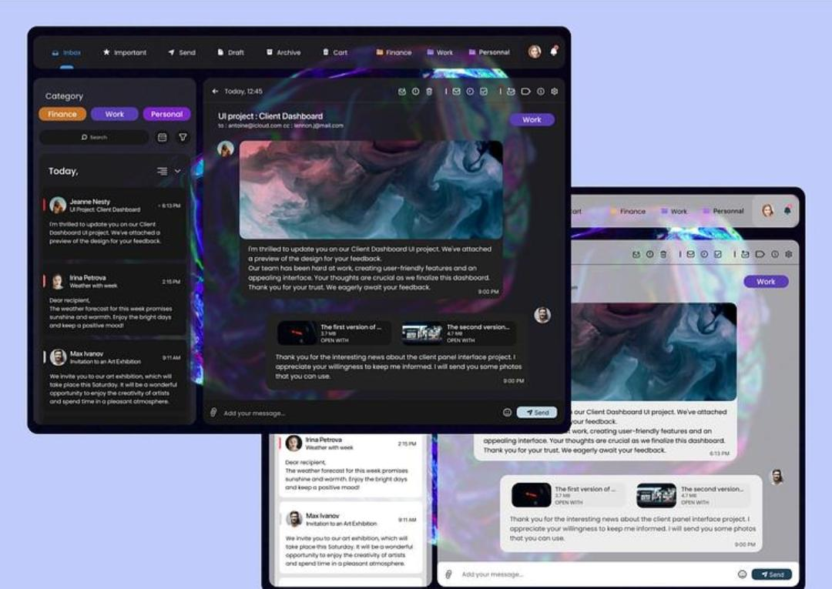
Output

