Slide 1

Basics of Grant/Contract Proposal
Budgeting
October 14, 2010

Slide 2

Budget Development
OSP will assist you to develop your budget
after you have defined your goals, objectives
and activities.

Slide 3
Budget Development
Identifying Budget Items
Refer to your goals, objectives and activities to think about what kinds of resources you will need
Budget items flow naturally from a well-developed methodology section

Slide 4
Types of Costs
There are two types of costs in most grant budgets:
Direct Costs
Facilities and Administrative (Indirect) Costs
Both are real costs

Slide 5

Direct Costs
Direct costs are those specifically assigned to this particular project.
Salaries
Fringe benefits
Equipment
Travel
Supplies
Contractual
Other Costs

Slide 6
Salaries
Faculty – AY release time, AY supplemental pay, summer salary, max suppl pay is 40%
Administrators – supplemental pay
Graduate students – assistantships, hourly wage
Undergraduate students – hourly wage
Clerical support – supplemental pay must be at 1 ½ x hourly rate (Civil Service), must be for duties outside the scope of his/her normal duties
All WIU employees paid on the project must be listed in the Personnel section of the budget

Slide 7
How to Calculate Salary Costs
1. Name the person(s) if possible
2. decide # of months to work on the project – academic year, summer, or both
3. determine %’age of time
J. Marshall $5000/mo. x 9 months x 25% AY = $11,250
J. Marshall $5000/mo. x 3 months x 100% SU = $15,000

Slide 8
Fringe Benefits
This is the WIU-paid portion of health insurance, retirement, Medicare, etc.
Budgeted for all WIU employees receiving salaries from the grant budget
All student wages/assistantships are excluded
In-load salaries – 42% x salaries
Summer/supplemental pay – 12% x salaries

Slide 9

Equipment
For federal agencies, equipment is anything that costs $5,000 or more PER ITEM
When the grant period ends, the equipment usually stays at the University

Slide 10
Travel
Use State-approved travel rates
Mileage - $.50/mile
Per Diem - $28/day in-state; $32/day out-of state
Lodging – depends on the location . There are several rates for in-state and several rates for out-of state
Travel section is used for WIU employee travel only
Be sure to check the WIU Travel Guide at
http://www.wiu.edu/businessservices/travguid.shtml

Slide 11
Supplies
Same as “Commodities”
consumable items such as pens, blank cd-roms, paper, rats, computers (under $5,000 each), printers, etc.
General purpose supplies or general office supplies are usually not allowable

Slide 12
Contractual Services
Services provided by outside entities or independent University entities:
Stipends paid to non-University personnel
Subcontracts to partner institutions
Payments to outside consultants/evaluators
Payments to human subjects
Payments to CAIT, DPS, WSRC, etc.
Travel costs for non-WIU personnel

Slide 13
Other Costs
Telecommunications
Publication costs
Equipment maintenance contracts
Advertising for new employees to be hired
Anything that doesn’t fit into one of the defined categories.

Slide 14
Facilities and Administrative Costs (Indirect Costs)
Costs not specifically allocated to this project
Use the institutionally approved rate OR
use the agency rate if one is stated
Includes library, payroll, space, heat, lights, physical plant, central administration, computer usage, etc.
36% x modified total direct costs

Slide 15
Cost Sharing/Matching Funds
Institution or partners share costs with the sponsoring agency
Check proposal guidelines for requirements
Difference between cash and “in-kind”
cash – money is actually paid out for goods or services
in-kind – no money is exchanged for goods or services (volunteers/donations)

Slide 16
Additional Budget Issues
Follow the agency guidelines format
Budget for annual increases in salaries and fringes
Reviewers should find no surprising items in the budget
Break items down (number of trips, cost of airfare, nights of lodging, etc.)
Write a budget narrative to fully justify each line item

Slide 17
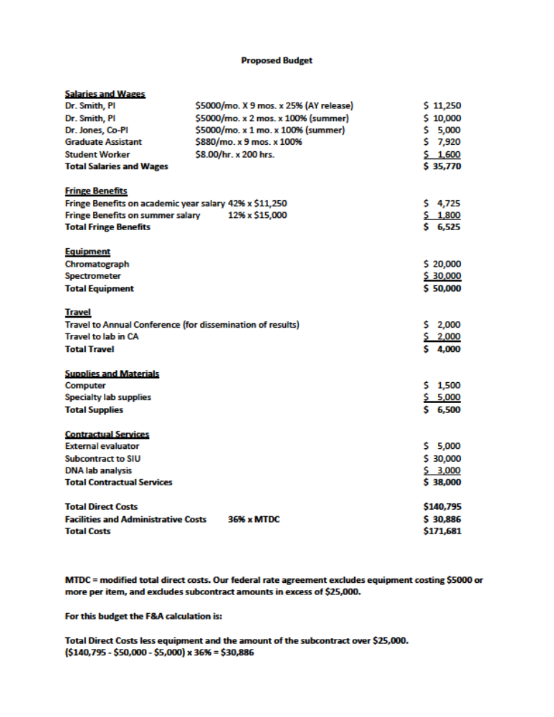

Slide 18


Questions?

