Slide 1
De-Stress – A battle against depression
Prasanth P - 2015103601
Abhishek r - 2015103579

Slide 2
Introduction
Depression is a leading cause of mental ill health, which has been found to increase risk of early death. Moreover it is a major cause of suicidal ideation and leads to significant impairment in daily life.
More than 300 million people suffer from depression worldwide.
Suicide is the 13th leading cause of death globally, accounting for 5-6% of all deaths.

Slide 3
Objective
To design a system which can detect depression from people’s tweets and help them in any way possible.

Slide 4
Problem Definition
Analysing and processing people’s tweets using Natural Language Processing and Machine Learning , determining the intensity of depression.

Slide 5
Literature Survey
S.NO | Authors | Publication | Year | Methods Used | Advantages and limitations
1. | Mandar Deshpande Vignesh Rao Depression Detection using Emotion Artificial Intelligence | Proceedings of the International Conference on Intelligent Sustainable Systems | 2017 | Machine Learning Naïve Bayes SVM | Naïve Bayes has more accuracy than SVM. This system could not handle a few words such as “thank you“when it is typed as “ty”

Slide 6
S.No | Authors | Publication | Year | Methods Used | Advantages and Limitations
2. | Huma Parveen Prof. Shikha Pandey Sentiment Analysis on Twitter Data-set using Naive Bayes Algorithm | 2nd International Conference on Applied and Theoretical Computing and Communication Technology | 2016 | Machine Learning Naive Bayes Algorithm | Successfully implemented sentiment analysis for movie data set and analysed it with large number of tweets. In the future Tweets can also be used in prediction of product sales, quality of services offered by company, feedback of users etc

Slide 7
S.NO | Authors | Publication | year | Methods Used | Advantages and limitations
3. | Mitali Desai Mayuri A. Mehta Techniques for Sentiment Analysis of Twitter Data: A Comprehensive Survey | International Conference on Computing, Communication and Automation | 2016 | Machine Learning Naïve Bayes, Maximum Entropy, SVM,Random Forest | Classifying highly unstructured data of Twitter into positive or negative categories.

Slide 8
S.no | Authors | Publication | year | Methods Used | Advantages and limitations
4. | Benjamin L. Cook,1 Ana M. Progovac,1 Pei Chen,2 Brian Mullin,1 Sherry Hou,1 and Enrique Baca-Garcia Novel Use of Natural Language Processing (NLP) to Predict Suicidal Ideation and Psychiatric Symptoms in a Text-Based Mental Health Intervention in Madrid | Computational and Mathematical Methods in Medicine Volume | 2016 | Natural Language Processing – Machine Learning | reasonably high predictive value for suicidal ideation and heightened psychiatric symptom

Slide 9
S.no | Authors | Publication | year | Methods Used | Advantages and Limitations
5 | Moin Nadeem, Mike Horn, Glen Coppersmith, Johns Hopkins University and Dr. Sandip Sen Identifying Depression on Twitter | Johns Hopkins University | 2016 | Machine Learning Decision Trees, a Linear Support Vector Classifier, Naïve Bayes | results with an 86% classification accuracy were shown.

Slide 10
Problems Identified leading to the Problem Definition.
Although researches have been carried out on depression detection, no suitable strategy implementation exists.
People nowadays have more Facebook friends that real friends. The time we spend speaking with our friends is minimal. We prefer sharing our stories with the entire world but not to the people we are close with. When such posts are posted on social networking sites to express our feelings, people just scroll through it without understanding that a friend is in need of help.

Slide 11
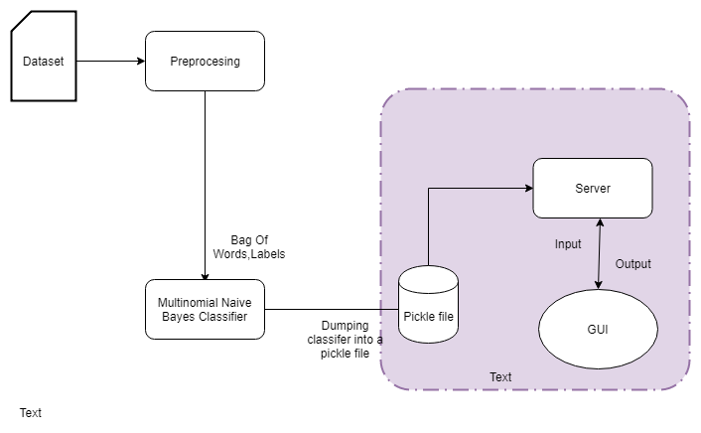
Macro level Block Diagram

Slide 12
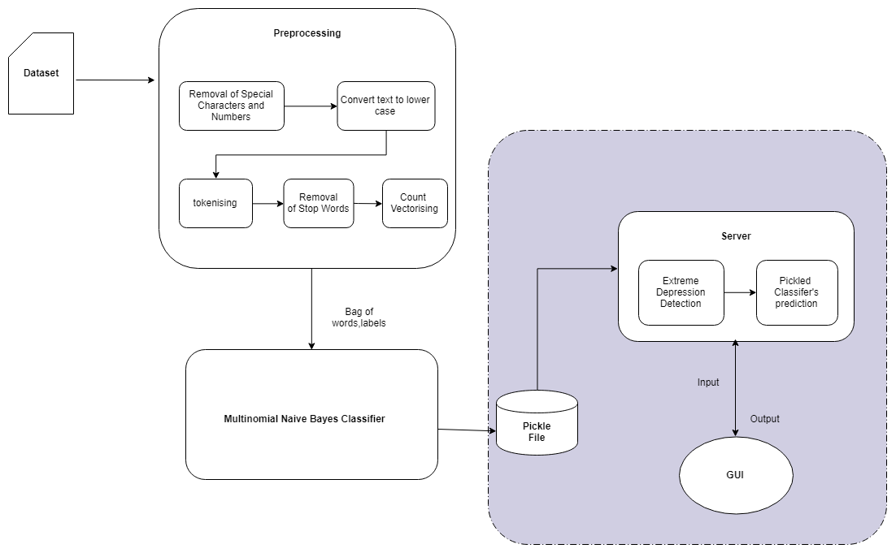
Micro level Block Diagram

Slide 13
Preprocessing
Input : Dataset
Output : Bag of words and labels.
Removal of Special Characters
The input is searched for special characters such as #,@,… and they are removed if found.
Convert text to lower case
The input after the removal of special characters is converted to lower case.

Slide 14
Contd..
Tokenising:
The pre-processed data is broken down into tokens.The tokens could be words , phrases or other elements.
Removal of stop words
Commonly used words such as “a” ,”an” , “the” , “is” , etc are removed.
Count Vectorising
The count vectoriser processes the tokenised input and builds a vocabulary of known words along with the occurrence of each word.

Slide 15
Multinomial Naïve Bayes Classifier
Input : Bag-of-words , labels
Output : Pickle file
Training
The classifier is trained with 80% of the dataset.
Testing
The classifier is tested with 20% of the dataset.

Slide 16
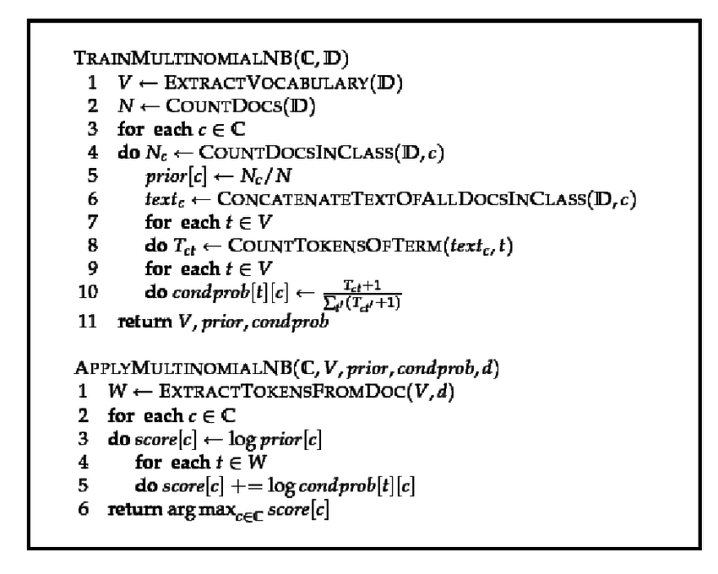
Algorithm

Slide 17
Server
Input: user entered text
Output:prediction
Extreme Depression Detection.
The input is validated for extreme depression against a suicidal words dataset.
Pickled Classifier’s prediction.
it makes use of the Machine Learning Algorithm.

Slide 18
GUI
Input : user’s text
Output: appropriate steps to fight against depression.

Slide 19
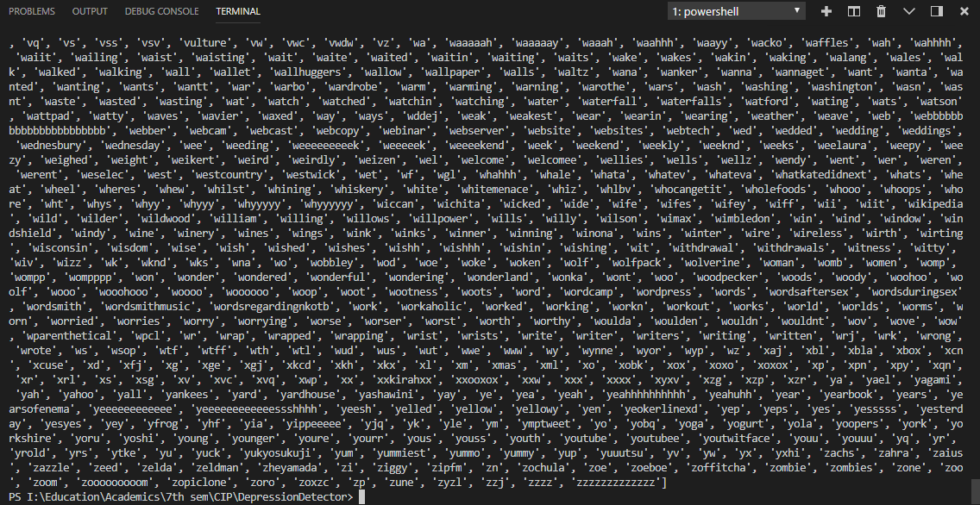
Preprocessing

Slide 20
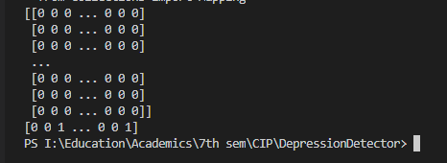
Bag of words

Slide 21

Pickle file generation

Slide 22
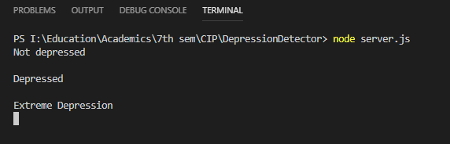
Server

Slide 23
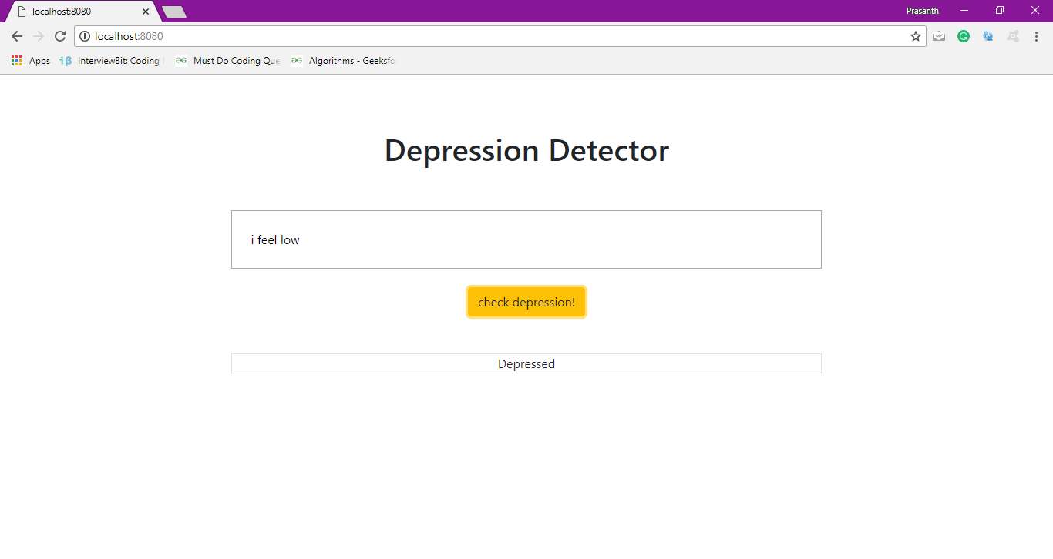
GUI

Slide 24
Dataset Description and Experimental Setup
The following are used:
Twitter dataset
Python
Anaconda
Numpy, Pandas, Sklearn, Nltk
NodeJs
Bootstrap
CSS
HTML

Slide 25
Reference
Dataset – Kaggle (https://www.kaggle.com/anishman/twitter-emotion)
M.S.Neethu, Rajsree, ”Sentiment analysis in twitter using machine learning techniques”,Fourth International Conference on Computing, Communications and Networking Technologies (ICCCNT), 2013
Mitali Desai, Mayuri A. Mehta,”Techniques for sentiment analysis of Twitter data: A comprehensive survey”, International Conference on Computing, Communication and Automation (ICCCA), 2016

