Slide 1
De-Stress – A battle against depression
Prasanth P - 2015103601
Abhishek R - 2015103579

Slide 2
INTRODUCTION AND PROBLEM STATEMENT
Technology has certainly brought about improvements in physical health and comfort.
Medical technology is always improving, leading to lower infant mortality, cures for diseases, and many more improvements in quality of life.
Mental health and comfort, however, have not improved as technology has advanced. Suicide rates are higher than ever, especially in developed countries.
Depression is on the rise, and is now one of the most common medical conditions.
More than 300 million people suffer from depression worldwide.
Suicide is the 13th leading cause of death globally, accounting for 5-6% of all deaths.
. Early detection, intervention, and appropriate treatment can promote remission, prevent relapse, and reduce the emotional and financial burden of the disease.

Slide 3
LITERATURE SURVEY
S.No | Name | Author | Publication | Year | Methodology | Advantages | Limitations
1. 2 | Depression Detection using Emotion Artificial Intelligence Sentiment Analysis on Twitter Data-set using Naive Bayes Algorithm | Mandar Deshpande Vignesh Rao Huma Parveen Prof. Shikha Pandey | Proceedings of the International Conference on Intelligent Sustainable Systems 2nd International Conference on Applied and Theoretical Computing and Communication Technology | 2017 2016 | Preprocessing followed by depression detection using Naïve Bayes and SVM Sentiment analysis using Hadoop Mapreduce . | Naïve Bayes has more accuracy than SVM. Emoticons were also considered while analyzing data | This system could not handle a few words such as “thank you“when it is typed as “ty” Dataset had more false positives which in turn affected accuracy

Slide 4
LITERATURE SURVEY
S.No | Name | Author | Publication | Year | Methodology | Advantages | Limitations
3. 4. | Techniques for Sentiment Analysis of Twitter Data: A Comprehensive Survey Novel Use of Natural Language Processing (NLP) to Predict Suicidal Ideation and Psychiatric Symptoms in a Text-Based Mental Health Intervention in Madrid | Mitali Desai Mayuri A. Mehta Benjamin L. Cook,Ana M. Progovac,Pei Chen, Brian Mullin,1 Sherry Hou, and Enrique Baca-Garcia | International Conference on Computing, Communication and Automation Computational and Mathematical Methods in Medicine Volume. | 2016 2016 | Preprocessing followed by feature extraction and training the classifier-Machine Learning Naïve Bayes, Maximum Entropy, SVM,Random Forest. Short Mess age Ser v ice ( SMS, or text mess ag ing) is analysed in order to predic t suicidal ideation and heightened psychiatric symptoms | Classifying highly unstructured data of Twitter into positive or negative categories. Reasonably high predictive value for suicidal ideation and heightened psychiatric symptom were obtained | Results obtained were domain specific Results were restricted to SMS sent by the patients under study.

Slide 5
LITERATURE SURVEY
S.No | Name | Author | Publication | Year | Methodology | Advantages | Limitations
5 6 | Identifying Depression on Twitter ”Sentiment analysis in twitter using machine learning techniques | Moin Nadeem, Mike Horn, Glen Coppersmith, Johns Hopkins University and Dr. Sandip Sen M.S.Neethu and R.Rajsree, | Johns Hopkins University Fourth International Conference on Computing, Communications and Networking Technologies (ICCCNT) | 2016 2013 | Preprocessing followed by Training the classifier -Decision Trees, a Linear Support Vector Classifier, Naïve Bayes After pre processing and label extraction Naive Bayes, SVM, Maximum entropy and ensemble classifier are used for classification | Naïve Bayes approach attained an average of an 86% accuracy, Performance of various classifiers are determined | No information on spatiotemporal behaviour. All classifiers have almost similar accuracy and hence the best classifier cant be determined

Slide 6
LITERATURE SURVEY
S.No | Name | Author | Publication | Year | Methodology | Advantages | Limitations
7. | “Sentiment analysis of twitter data using machine learning approaches and semantic analysis | G. Gautam and D. Yadav, | 7th Int. Conf. on Contemporary Computing | 2014 | Preprocessing the dataset, feature extraction and applying machine learning based classification algorithms namely: Naive Bayes, Maximum entropy and SVM along with the Semantic Orientation based WordNet | Naïve bayes classifier has the highest value of precision | The model is language specific and treats other language characters as noise.

Slide 7
ISSUES IDENTIFIED
Although researches have been carried out on depression detection, no real time implementation exists.
The advancements in technology don’t ease man of his mental stress.
Not much effort is taken in identifying depression among people.
Depression has now become one of the most common mental illness that most people suffer from.

Slide 8
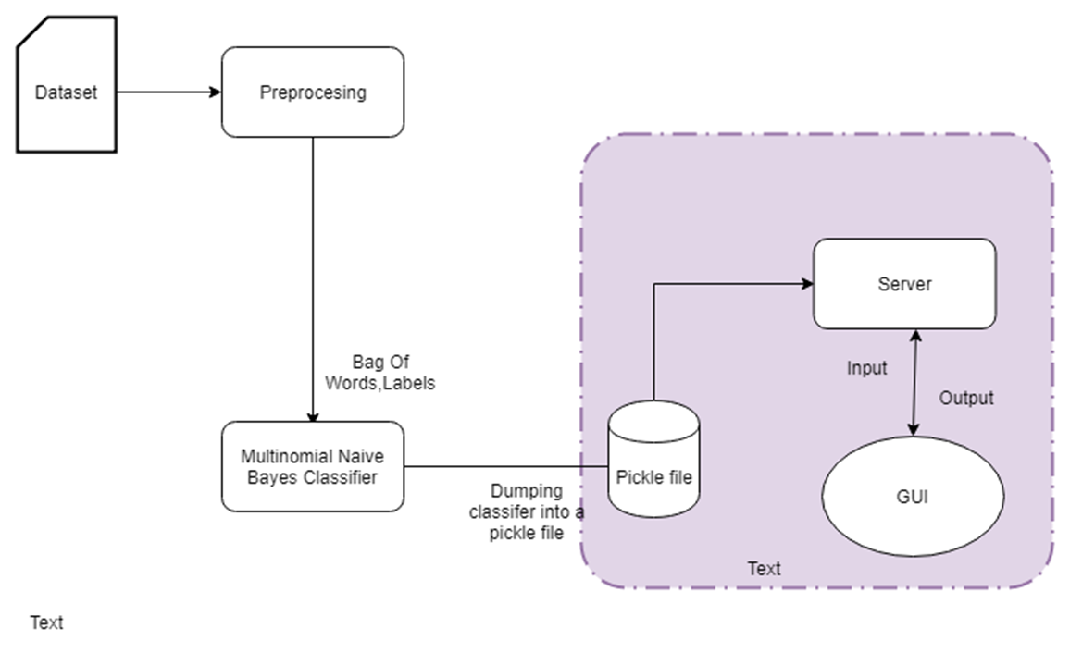
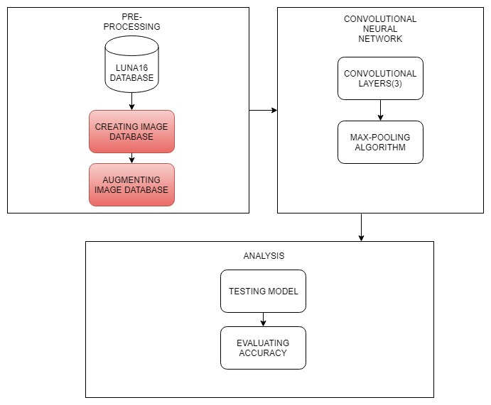
BLOCK DIAGRAM(MACRO LEVEL)

Slide 9
MODULES WITH INPUT AND OUTPUT
MODULE 1 : Pre-processing
INPUT : Dataset
OUTPUT : Bag-of-words and Labels
PSEUDO CODE :
Remove special characters such as #,@,…
Convert text to lower case
Data is broken down into tokens.
Remove stop words such as “a” ,”an” , “the” , “is” , etc
Processes the tokenised input and builds a vocabulary of known words along with the occurrence of each word.
Extract labels

Slide 10
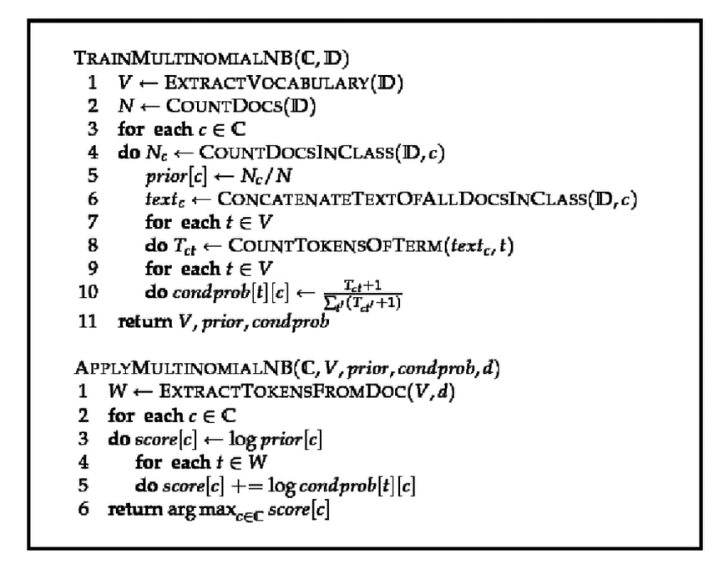
MODULES WITH INPUT AND OUTPUT
MODULE 2 : Multinomial Naïve Bayes Classifier
INPUT : Bag-of-words,Labels
OUTPUT : Pickle file is generated
PSEUDO CODE :
Train the classifier with 80% of the dataset
Test the classifier with 20% of the dataset.

Slide 11
MODULES WITH INPUT AND OUTPUT
MODULE 3 : Server
INPUT : User’s tweets
OUTPUT : Intensity of depression
PSEUDO CODE :
The user’s input is preprocessed.
The input is validated for extreme depression levels
Compares the data with the results in pickle file.
Output the intensity of depression

Slide 12
MODULES WITH INPUT AND OUTPUT
MODULE 4:GUI
INPUT : User’s tweet/twitter username
OUTPUT : Motivation quotes or suggests the link to suicide helpline forums based on the level of intensity
PSEUDO CODE :
Get user’s tweets from twitter.
Check for extreme depression levels.
Compare results with those stored in pickle file.

Slide 13
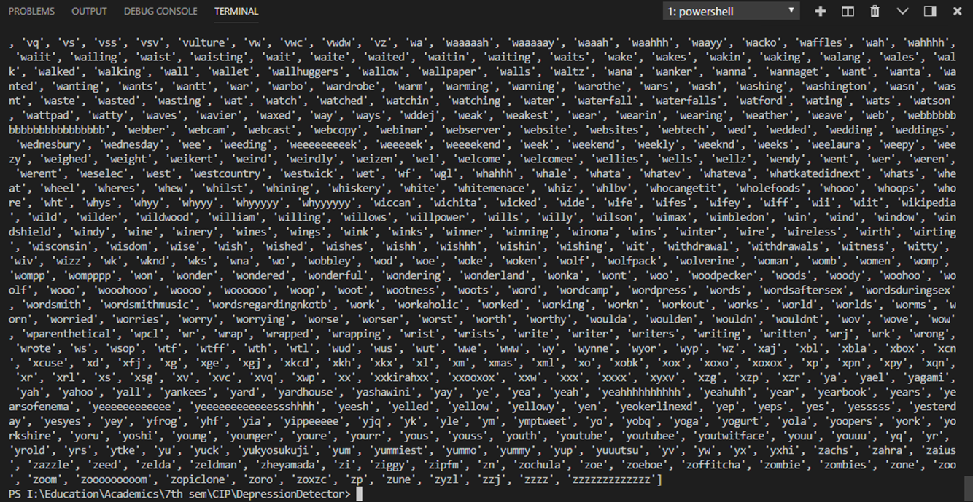
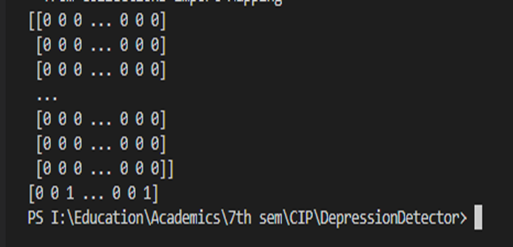
SCREENSHOTS FOR EACH MODULE
AND INTERMEDIATE RESULTS
MODULE 1 : Pre-processing
Tokenised text Bag-of-Words

Slide 14
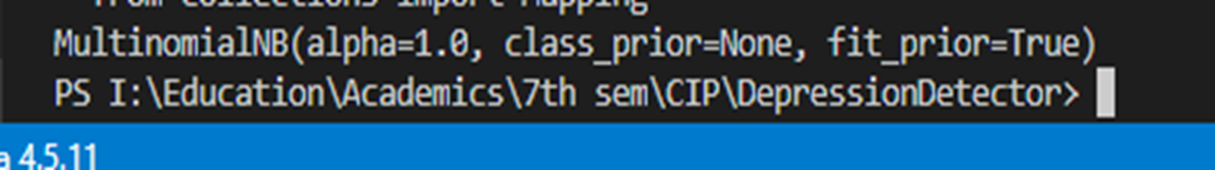
SCREENSHOTS FOR EACH MODULE
AND INTERMEDIATE RESULTS
MODULE 2 : Multinomial Naïve Bayes Classifier
Pickle file

Slide 15
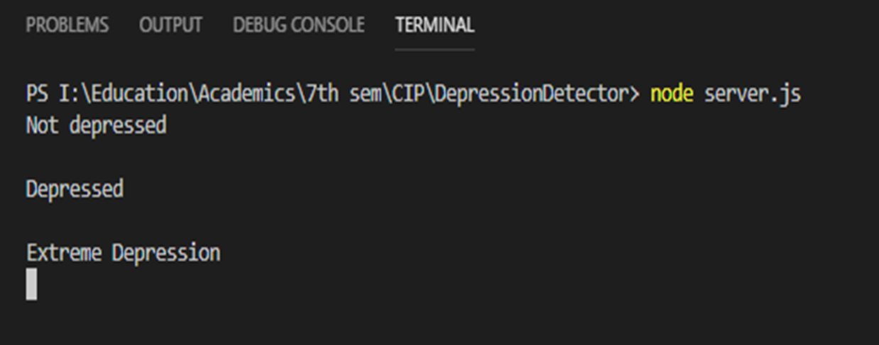
SCREENSHOTS FOR EACH MODULE
AND INTERMEDIATE RESULTS
MODULE 3 : Server
Output as shown in server

Slide 16
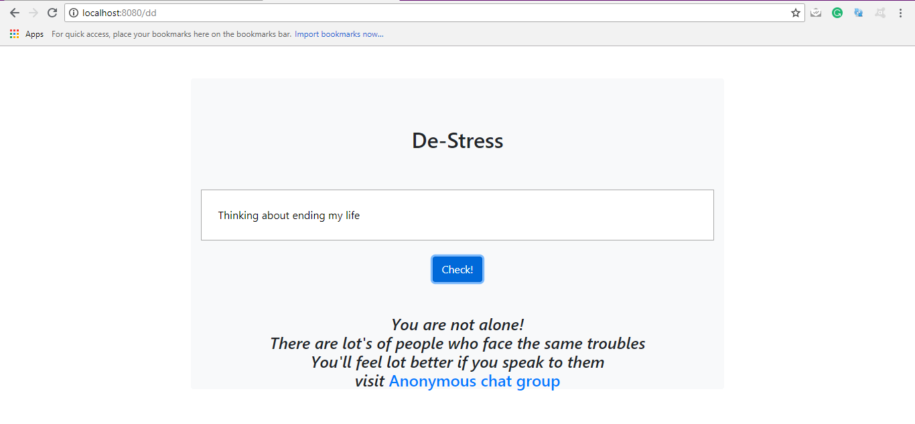
SCREENSHOTS FOR EACH MODULE
AND INTERMEDIATE RESULTS
MODULE 4 :GUI

Slide 17

SCREENSHOTS FOR EACH MODULE
AND INTERMEDIATE RESULTS
MODULE 5 : ANALYSIS
This outputs the confusion matrix and the precision, recall and accuracy of the model.

Slide 18
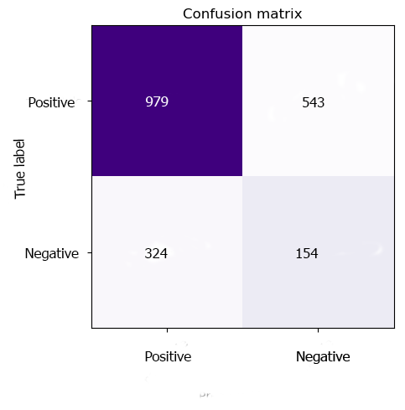
EVALUATION METRICS
The module has :
Precision : 75.3% Precision = TP*1.0/(TP+FP)
Recall : 86.40% Recall = TP*1.0/(TP+FN)
Accuracy : 76% TN*1.0/(TN+FP)
The confusion matrix plots the matrix depressed and not depressed.
F1 score = 80.39%
F1 score =(2 ∗ P ∗ R)/P + R
Here, P stands for Precision and R is the Recall.
 | Precision | Recall | F1-score | Accuracy
Multinomial Naive Bayes Classifier | 0.7513 | 0.8640 | 0.8039 | 76%

Slide 19
REFERENCES
[1] Mandar Deshpande and Vignesh Rao,”Depression Detection using Emotion Artificial Intelligence” in Proceedings of the International Conference on Intelligent Sustainable Systems,2017.
[2] Huma Parveen and Prof. Shikha Pandey,”Sentiment Analysis on Twitter Data-set using Naive Bayes Algorithm” in 2nd International Conference on Applied and Theoretical Computing and Communication Technology,2016.

