Slide 1

Master in Data Science Data Mining project work: Breweries and Brew Pubs in the USA A list of over 7,000 breweries and brew pubs in the USA.
Group 5: Odysseas Aslanidis,Prasanth Vattikonda, Nicola Petruzzelli, Paul Alexander Diaz Frag

Slide 2
Project Details
Project Details
This is a list of over 7,000 breweries and brewpubs in the USA provided by Datafiniti's Business Database. The dataset includes the category, name, address, city, state, latitude, longitude and more for each listing. This however is a sample of a large dataset.
According to the Kaggle Project we can use this geographical and categorical information for business locations to determine which cities and states have the most breweries.
Top 10 Cities with breweries or brew pubs.
Top 10 States with breweries or brew pubs.
What is the City with the most breweries or brew pubs?
What is the State with the most breweries or brew pubs?
Top 10 States with the most breweries or brew pubs per capita?

Slide 3
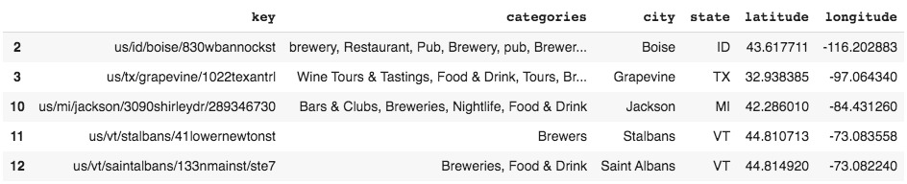
Data set information, exploration
We tried to explore the dataset on perspective of different kinds of feature and corresponding values
1) Unsupervised problem having no definite target variable
2) This actual give us a thought , what kind of analysis that we need to do
3) Figured out the longitude and latitude values are key input variables
4) Figures out the not necessary features which won't any value for analysis

Slide 4
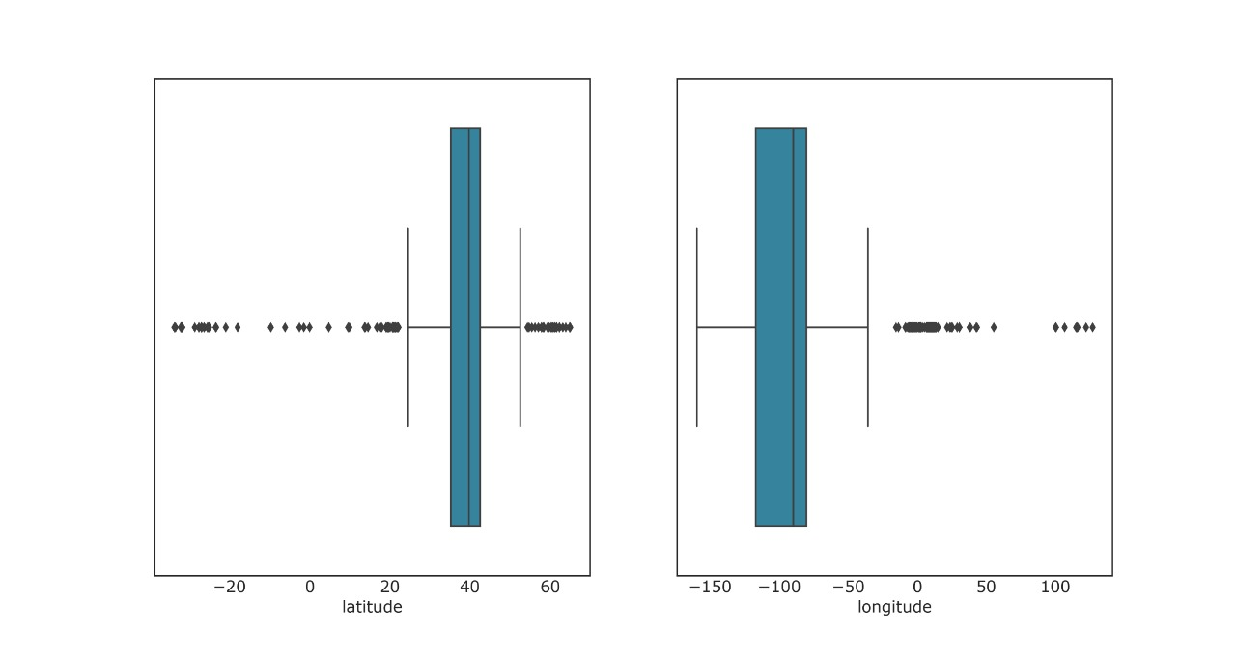
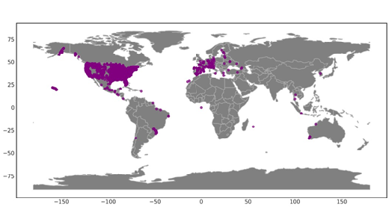
Outliers Detection
Identifying outliers using box plots for the longitude and latitude columns
Also, we came to know that direct mathematical approach is not a better approach deal with them, because they are geometric coordinates
Trying to Visualize how the data points are spread across the world.
Here , the data points are located outside the US country. But our problem is particular to United States.

Slide 5
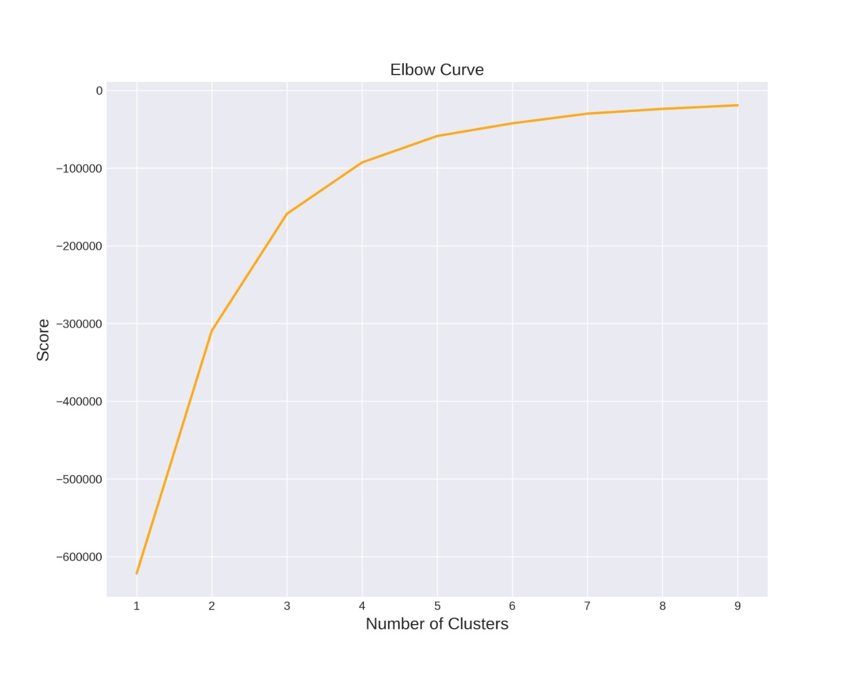
K-Means Modelling (Elbow method)
To find the optimal number of clusters we trying to make an 'elbow' plot of the within group sum of square distance
From this chart we can see clearly that the optimal number of clusters is 3
This is the number of k, which refers to the number of centroids that will be used to cluster our data set.

Slide 6
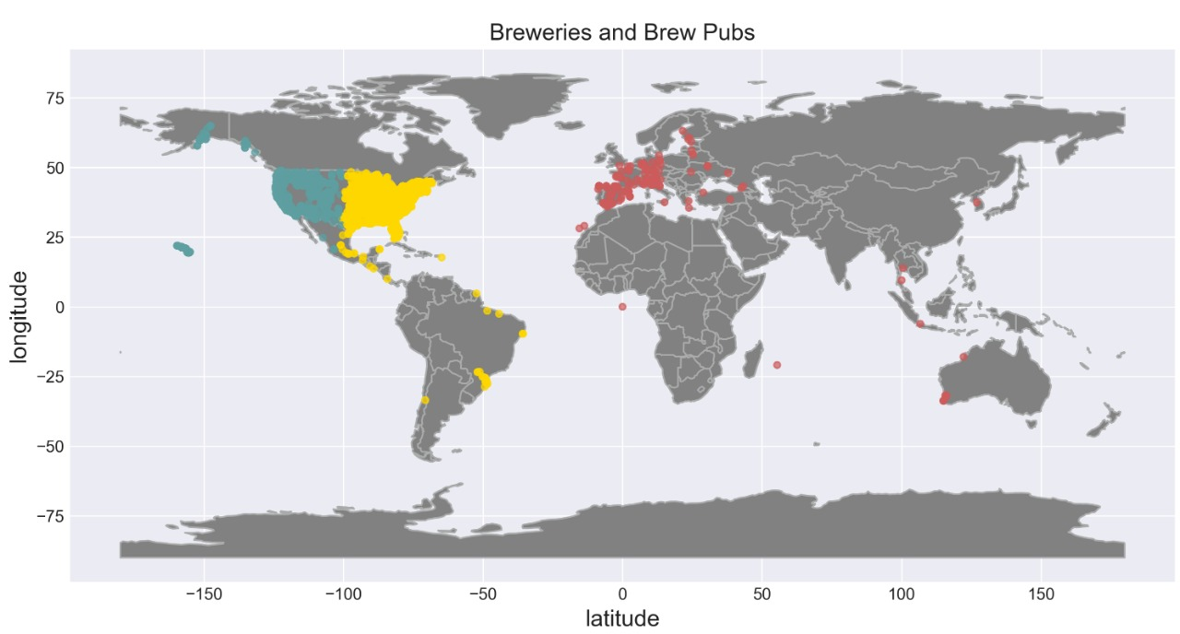
K-Means Results Plotting
Now that we determined the optimal number of centroids and we clustered our data set into 3 clusters we will plot the clustered data on the world map to check our results.

Slide 7
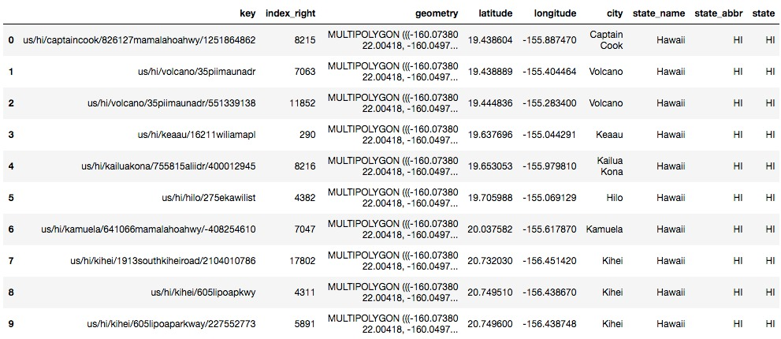
Creating the final data set (Multi polygon)
To be able to be able to use and plot the correct data we do the following:
- We need convert them into geometric coordinates because GeoPandas cannot the accept the lat/long values.
- We will also convert the Data frame containing our brewery date into a GeoPandas Data frame to be able to join it later with the US Data frame.
- The US data frame contains multi-polygons which are used to identify the US and state boundaries.

Slide 8
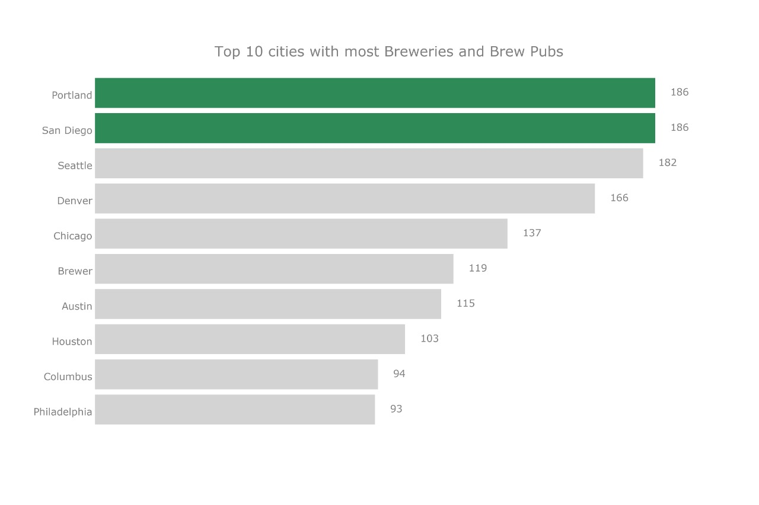
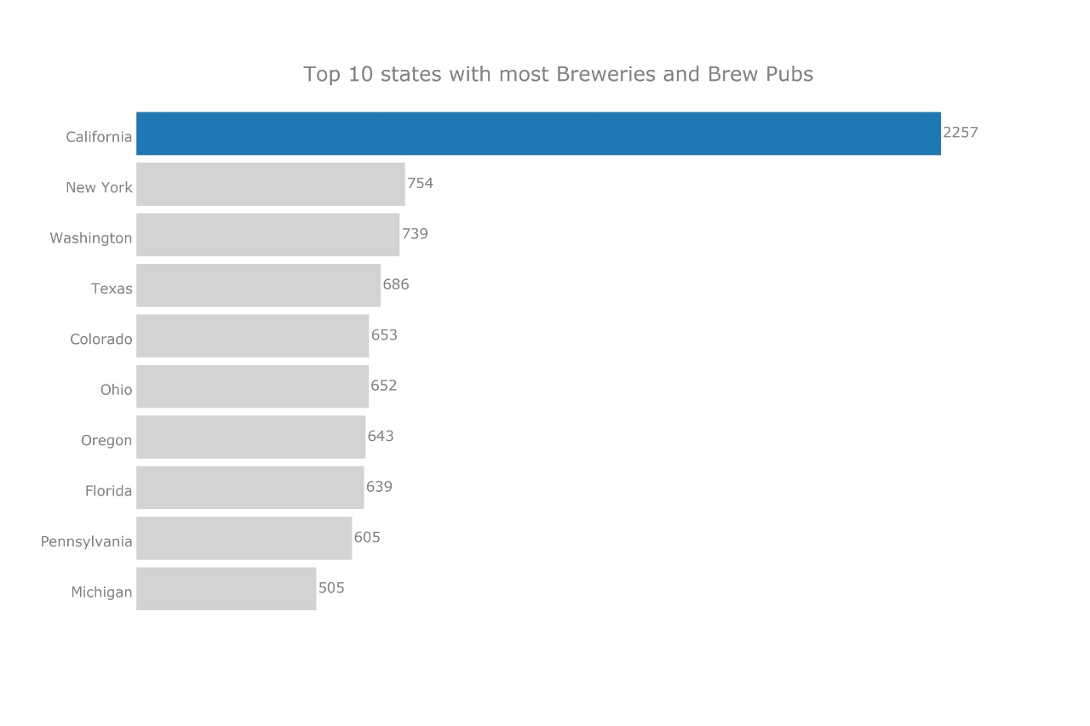
Data Visualization Top 10 Cities and States
Based on the geolocations we have as the top cities with breweries, Portland and San Diego.
The state of California seems to have the most breweries than any other state in USA.
Even though we have huge number of Breweries and Brew Pubs in California State. The City with Most Breweries like Portland is not from California but, of course on other side San Diego is from California as we expect .

Slide 9
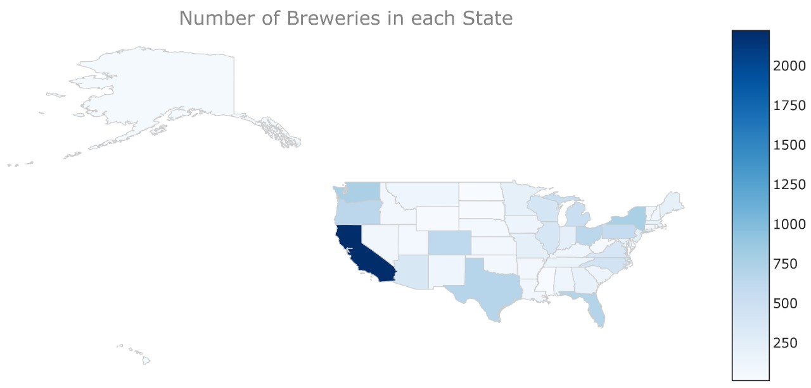
Breweries and Brew Pubs per Capita on a Map
Breweries and Brew Pubs on the U.S.A. map
When plotting the number of breweries on the Geopandas map, it is clear that State California has the most breweries than any other state. But is this correct?
In order to have the right picture on what is going on with the Breweries in each state, we have to include the population data in our analysis. This means calculating the Breweries per capita in each State will give us a better understanding of how breweries are spread in the US.

Slide 10
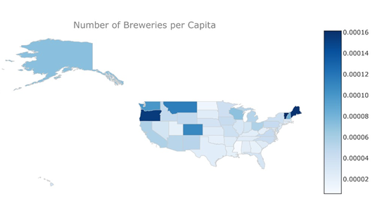
Breweries and Brew Pubs per Capita on a Map
Breweries and Brew Pubs per Capita on a Map
Including the population data produced an entirely different result. Now the state of Vermont has the most breweries based on its population.

Slide 11
Creating the final data set (Multi polygon)
Conclusion
There are some Common Assumptions found for this Contrast Results might be :
Coastal Locations
Business
International Visits (Tourist Spots, Holiday Spot)
Different Tastes and styles of Beers availability
Future Possible work depending on the Growing Population and above assumptions we can able to conclude that there is possible raise in number of breweries and brew pubs in the states like Newyork, Oregon , Texas and Florida

Slide 12



Libraries Used
GeoPandas:Used to plot on the US map the Breweries and Brew Pubs data.
BeautifulSoup: Used to scrap the population data from the web.
Request: Used to make a GET request to fetch the raw HTML content.

