Slide 1

Master in Data Science Field Of Work Project :Time series forecasting for a chemical company
Group 4: Marco Pantaleoni, Nicola Petruzzelli , Veli Saarinen, Prasanth Vattikonda

Slide 2
Project Details
Chemical company needs efficient sales forecasts 6 months before hand
Project background: Chemical company in need of efficient sales forecasts 6 months beforehand
Chemical company needs to understand sales patterns 6 months beforehand
In order to accommodate reasonable demand planning and safety measures the company needs to react 6 months before the initial sales happen
At the moment the company lacks an efficient way to forecast sales
Currently there is no efficient method in place which would allow the forercasting of sales early enough
This lack of forecasting leads to decisions being taken based on heritage infromation, resulting in inefficiencies in the production process
The chemical company has asked Group 4 to develop a functional sales forecasting system
The required system must be able to forecast product sales on Acitve Pharmaceutical Ingredients (API) family level and if possible, on a weekly basis
The forecasts should be based on historical sales data as well as inventory, booking and reservation information if necessary

Slide 3
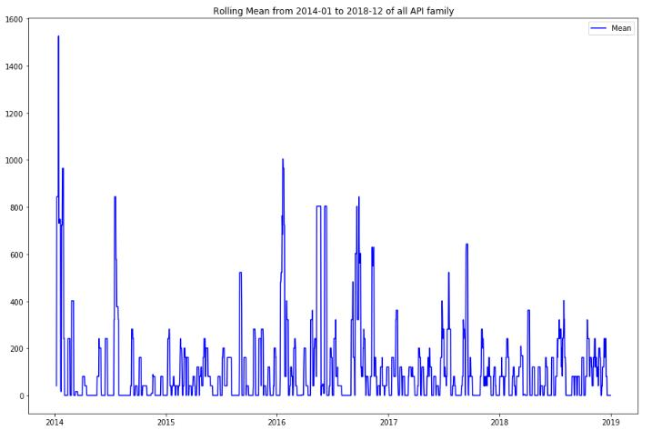
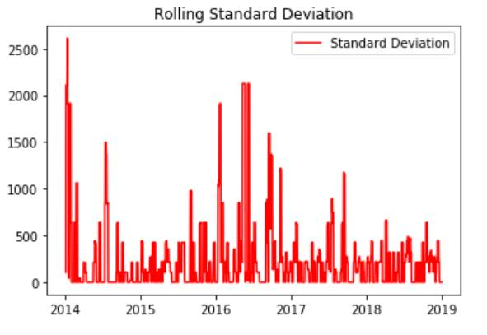
Overview: API sales highly volatile with lots of sales peaks and zero-sales periods on a weekly level
Rolling mean from 2014-01 to 2018-12 of all API families
Initial Observations
Sales volumes vary with no clearly visible patterns
Even with all the API sales combined, periods with zero sales clearly visible
High sales peaks 1-3 times per year with no apparent pattern
No initial valuation can be made regarding the time series stationarity
2014
2015
2016
2017
2018
2019
Rolling standard deviation from 2014-01 to 2018-12 of all API families
2014
2015
2016
2017
2018
2019

Slide 4
Our Approach: The API families were divided into 3 forecast group based on sales frequency and forecasted separately
Group criteria
High
Dataset:
63 API families
historical daily time series data from 2014-01 to 2018-12
Weekly sales frequency more than 80%
Group 1:
Weekly ARIMA forecasting
2 API families
Monthly sales frequency more than 80%
Group 2:
Monthly ARIMA forecasting
10 API families
Expected quality of forecast
Monthly sales frequency more than 33%
Group 3:
Min and max estimate of historical 6 month sales periods
10 API families
Monthly sales frequency
less than 33%
Not forecastable API Families
41 API Families
Low

Slide 5
Group 1 and Group 2 constitute 82% of the sales volume although representing only 20% of the API families
65%
47%
35%
16%
16%
12%
7%
3%
Group 1
Group 2
Group 3
No forecasts
% of n.o. API Families
% of total sales volume

Slide 6
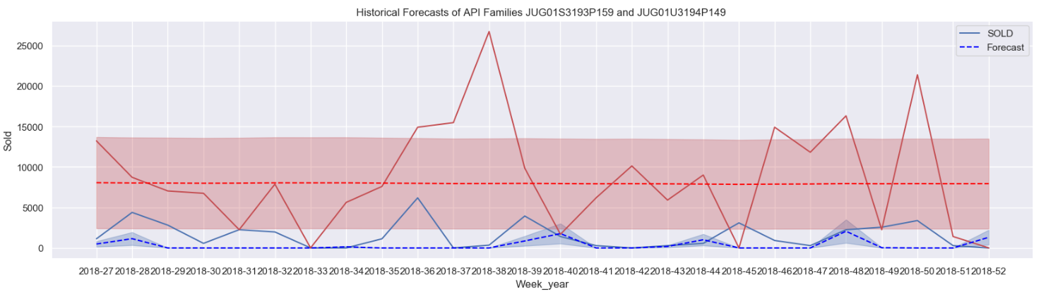
Group 1 API families were forecasted on a weekly basis with an ARIMA model
Forecast accuracy⁽¹⁾
JUG01S3193P159
62%
JUG01U319P149
58%
(1) Calculated as the percentage of historical sales within the 70% forecasting interval

Slide 7
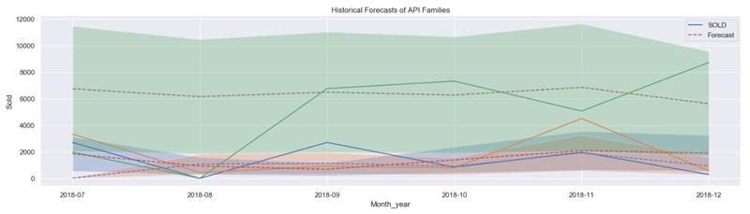
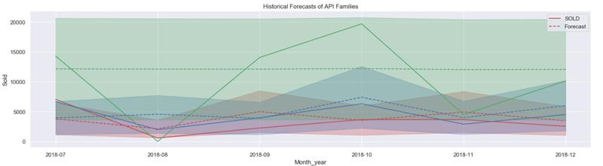
Group 2 API families were forecasted on a monthly basis using ARIMA technique
Forecast accuracy⁽¹⁾
JUG01U3194P1659
67%
JUG01R3355P109
83%
JUG01Q1104P109
83%
JUG01U5602P109
83%
JUG01I6090P109
100%
JUG01E4357P109
83%
(1) Calculated as the percentage of historical sales within the 70% forecasting interval

Slide 8
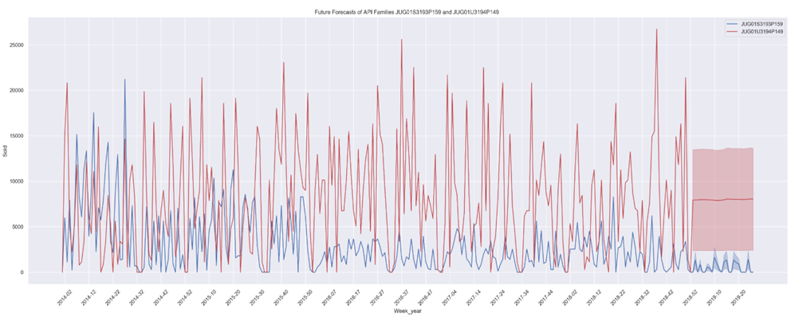
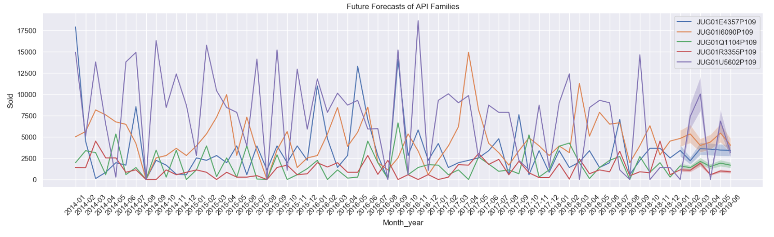
Future forecasts were made for Group 1 and Group 2 API families for the first half of 2019
Group 1 API Families with weekly intervals
Group 2 API Families with monthly intervals

Slide 9
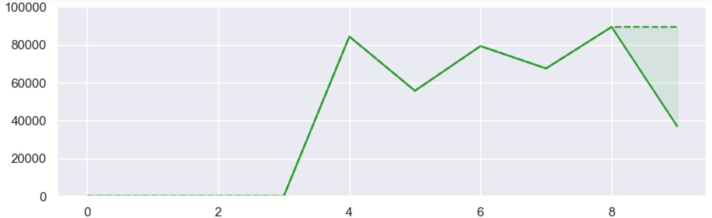
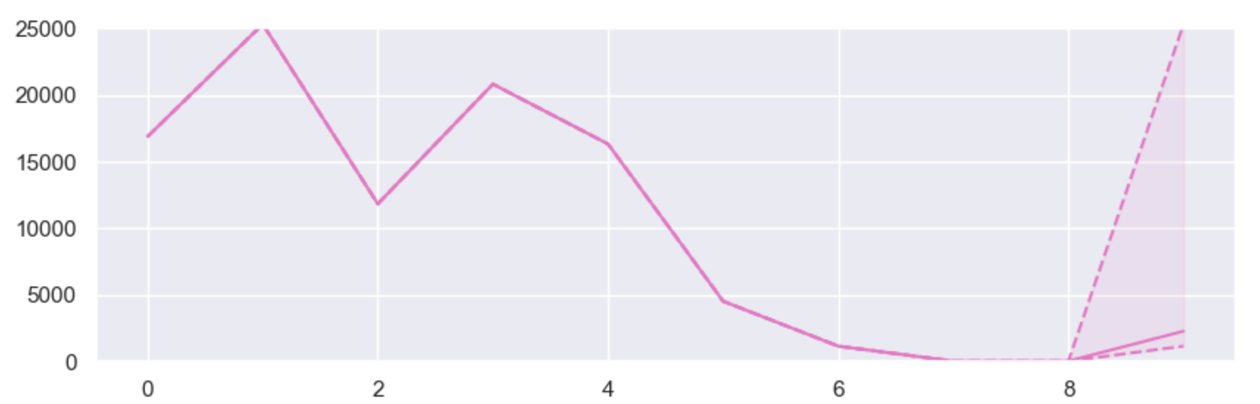
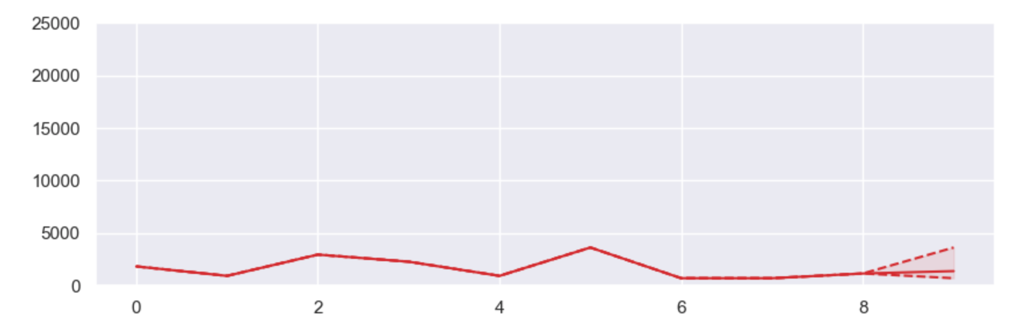
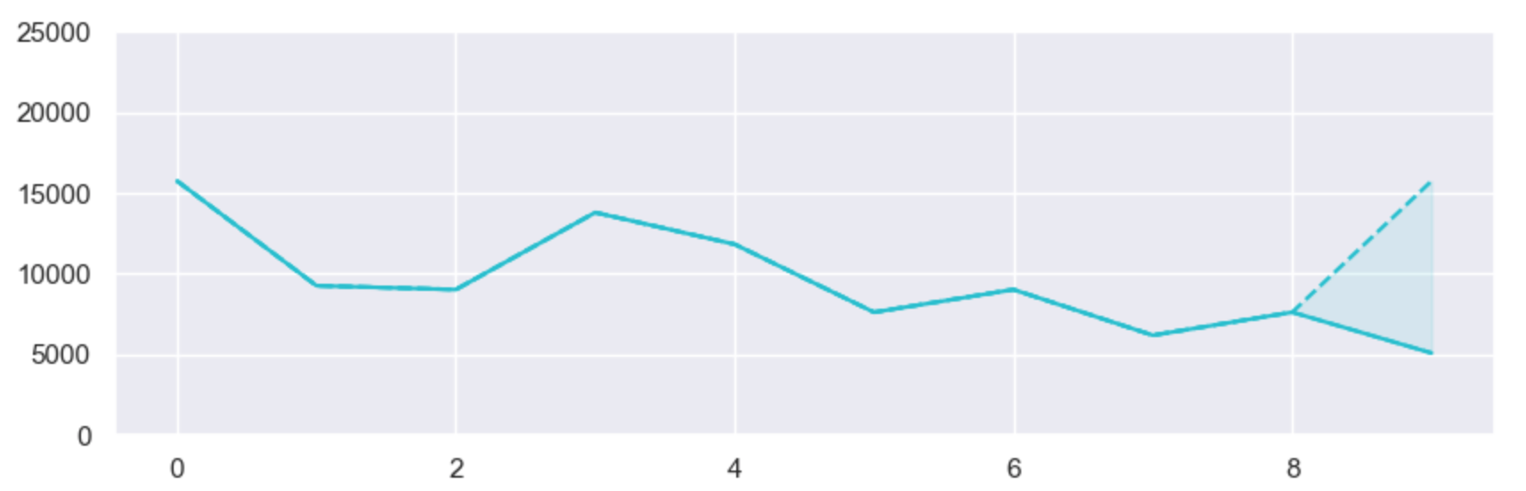
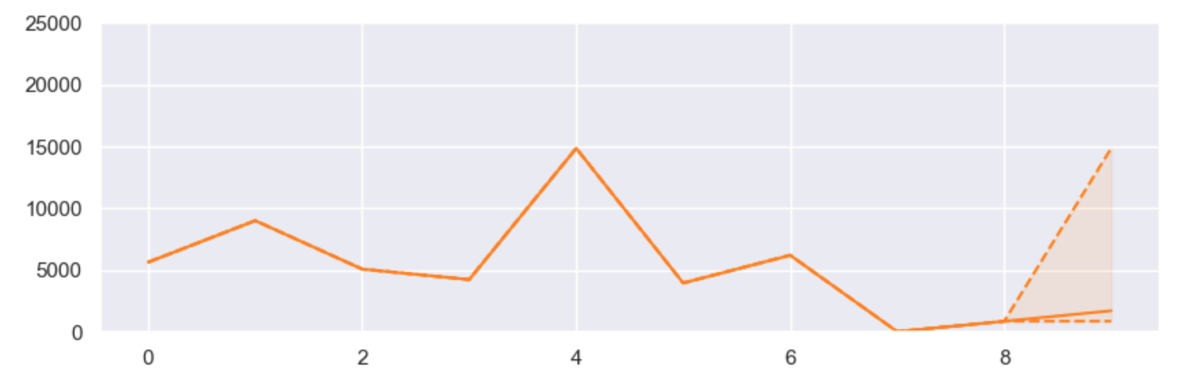
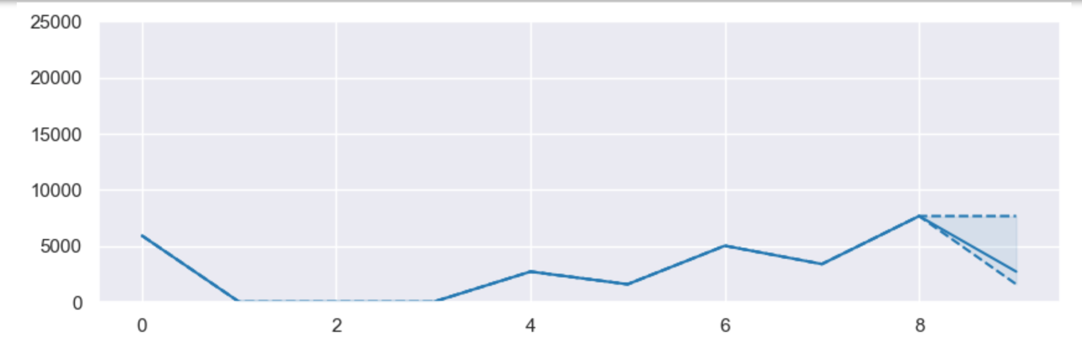
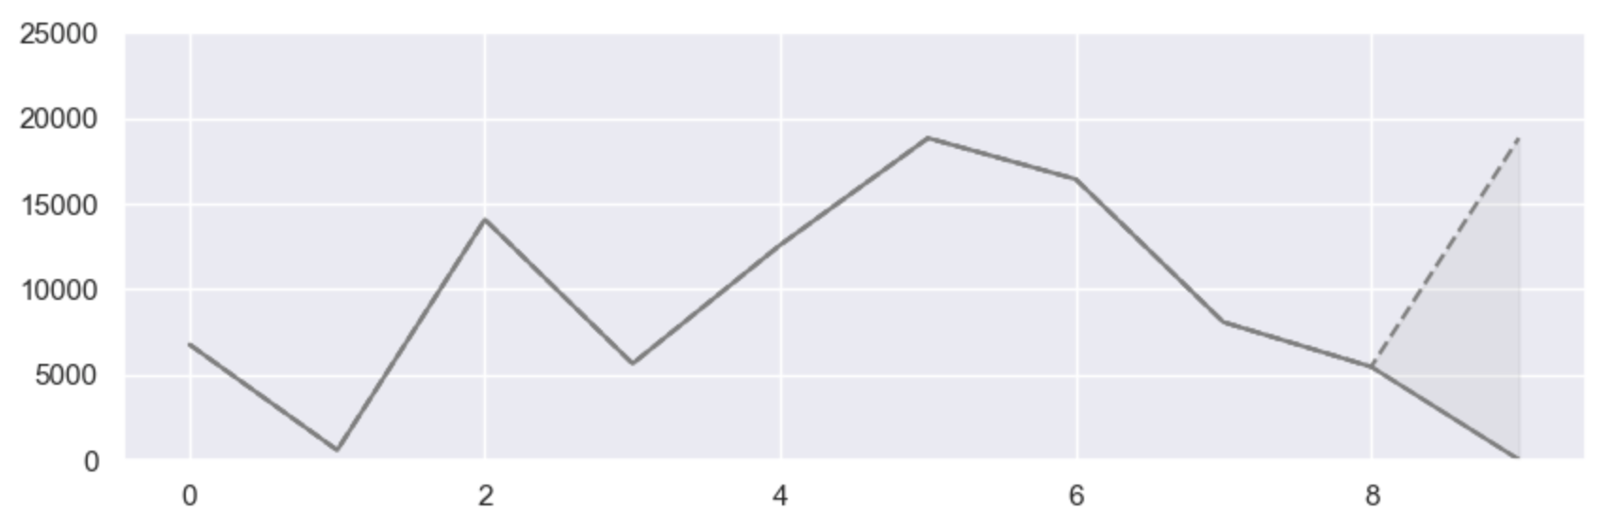
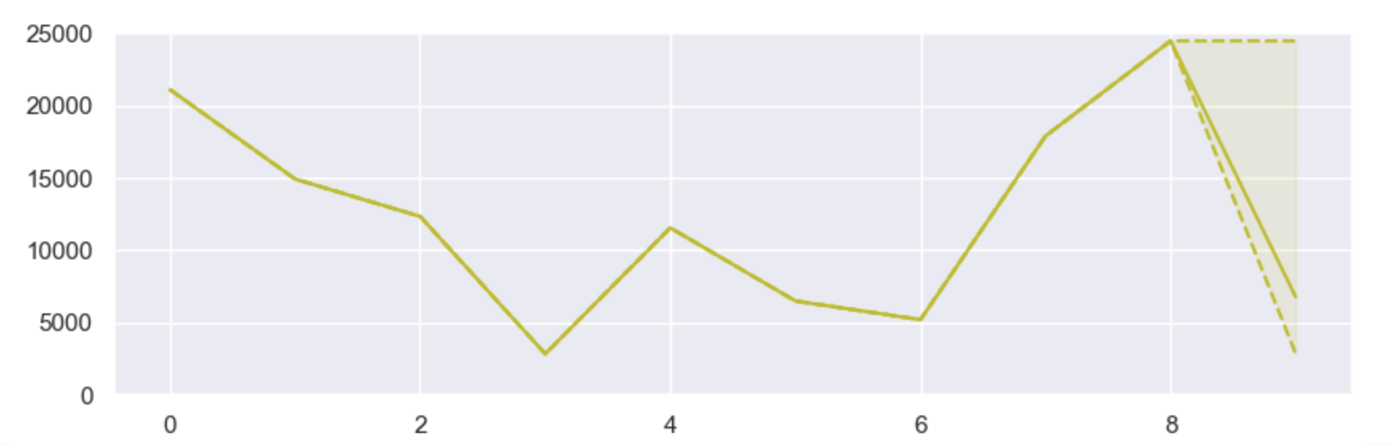
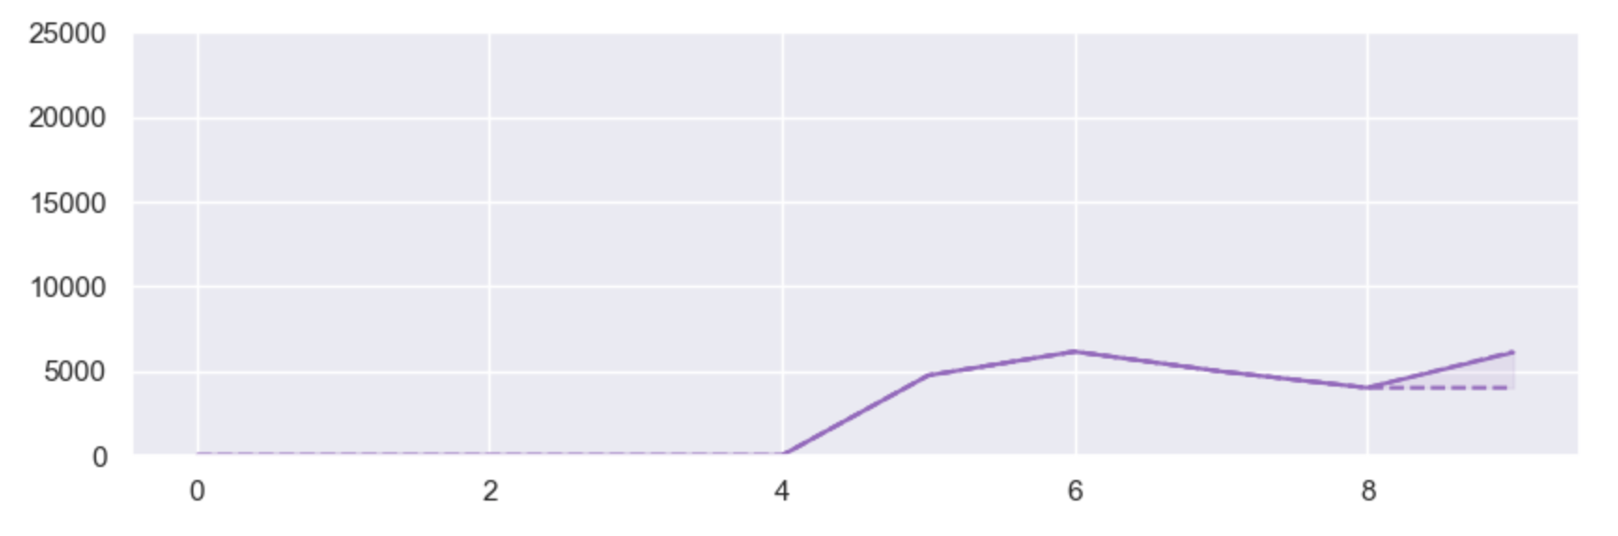
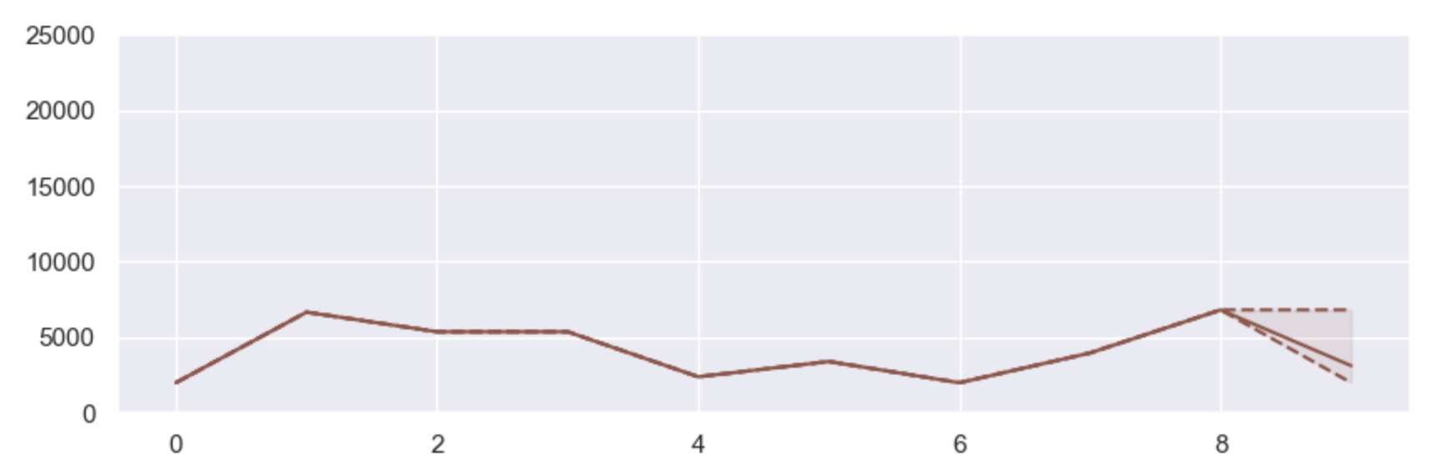
Group 3 sales were estimated aat an interval of 6 months as the range between min. and max. 6 months historical sales
JUG01S4193P159
JUG01U3194P1529
Min sales: 36.900 kg
Min: 1.125 kg
Max. sales: 15.998.580 kg
Max: 25.313 kg
JUG01R3355C1359
JUG01U5194C179
Min: 675 kg
Min: 5.063 kg
Max: 3.600 kg
Max: 15.738 kg
JUG01S3193L0389
JUGI5090C1459
Min 844 kg:
Min: 1.575 kg
Max: 14.850 kg
Max: 7.650 kg
JUG01U4194P179
JUG01U4194Lo399
Min: 8 kg
Min: 2.813 kg
Max: 18.826 kg
Max: 24.469 kg
JUG01U3194P1159
JUG01S5193L0389
Min: 3.994 kg
Min: 1.969 kg
Max: 6.131 kg
Max: 6.789 kg

Slide 10
Conclusion: Exact forecasting of demand proofed challenging. Levelled out on longer interval forecasts both useful and fairly accurate
Data and methodology
As suspected, the high sales peaks and frequent zero-sales periods made the forecasting difficult
The metric used for separating forecasting group, the sales frequency was not waterproof: Despite frequent sales, the forecasting of certain API’s proofed to be difficult
Forecast performance
Overall, the forecasting accuracy is satisfactory: 73% (Computed as simple average of Group 1 and Group 2 forecasts)
The differences between forecast and observed value at specific time point are levelled out in the long run
Generally, production according to forecasts should result in a correct demand within a few-week interval
Future
Improvement possibilities
Elimination of sales peaks for example by outlier detection techniques
Inspection of alternative forecasting techniques for hard-to-forecast API families
Acquiring of industry domain knowledge could help understand the demand drivers behind the data

Slide 11

Thank you !

