Slide 1



Slide 2


AI and Machine Learning : Multi Dimensional Perspectives
Dr Srinivas Padmanabhuni
CTO
Tarah Technologies
http://www.tarahtech.com
http://tarah.ai
Contact:
srinivas@tarahtech.com

Slide 3



About Tarah Technologies (Tarah.AI)
Tarah Technologies is a Big Data Consultancy firm focusing on
    Big Data
    Data Analytics
    Hadoop
    Spark
    Machine Learning
    Artificial Intelligence
    Deep Learning
    Cloud Computing
    Docker & Containers
    Software Packages including WeKA, R, Python
    Design Thinking
We also specialize in CRM services including customization of
    Salesforce CRM,
    Open Source CRM softwares like SugarCRM and VTiger.

Slide 4
Social Presence
1. Facebook → http://www.facebook.com/tarahtech
2. Twitter → http://www.twitter.com/tarahtech

Slide 5
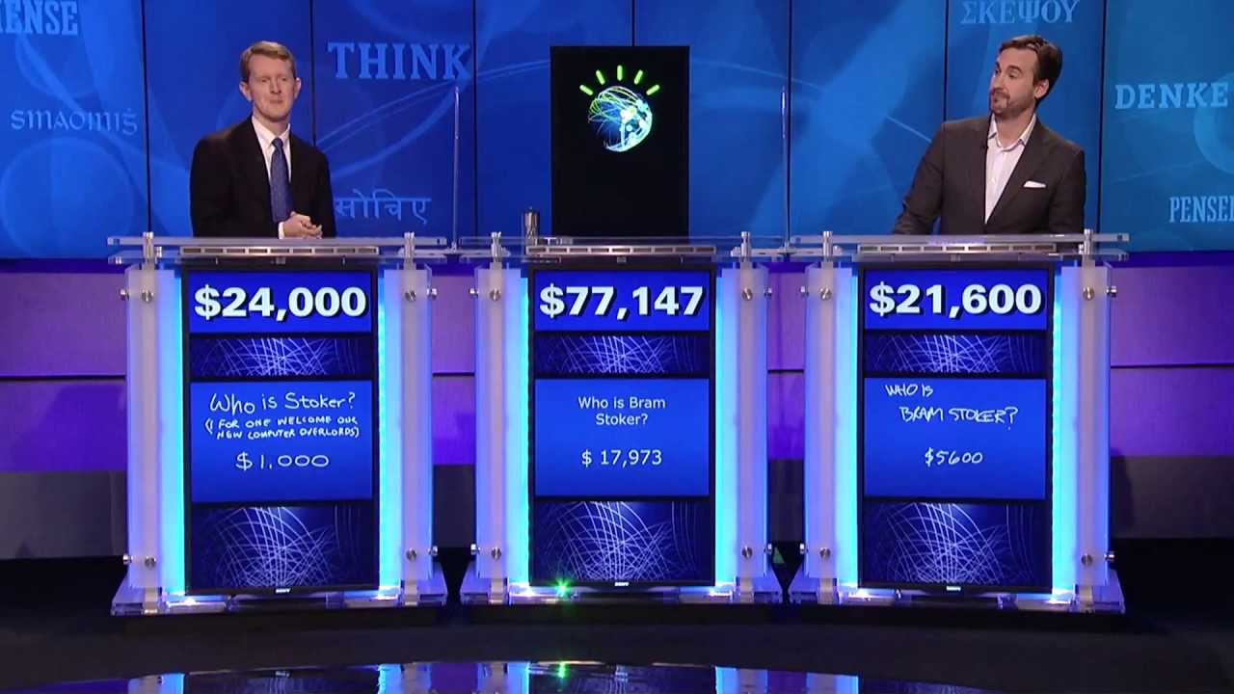
The famous example?

Slide 6
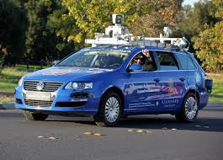
Yet Another one?

Slide 7
AI
Wikipedia
  “intelligence exhibited by machines”

Slide 8
3 types
ANI
AI that is good at performing a single task, such as playing chess or Go
AGI
Artificial Intelligence that can understand and reason its environment as a human would
ASI
AI becomes much smarter than the best human brains in practically every field, including scientific creativity, general wisdom and social skills

Slide 9
I AM AI ?
Click on the video at
https://www.youtube.com/watch?v=SUNPrR4o5ZA

Slide 10
AI Conundrum
Machine Learning
Natural Language Processing
Speech Processing
Computer Vision
Knowledge Representation
Reasoning and Logic
Constraints and Optimization
Games

Slide 11
Key empowering Technology: Machine Learning

Slide 12
Machine Learning Defined
A computer program is said to learn from experience if its performance at tasks improves with experience .
-Can be Unsupervised, or Supervised.

Slide 13
The path of pursuit
Data
Information
Knowledge
Wisdom

Slide 14
ML as a continuum of analytics
Descriptive Analytics
Cognitive Analytics
Inferential Analytics
Exploratory Analytics
Predictive Analytics

Slide 15
USE CASES OF MACHINE LEARNING
BUSINESS USE CASES OF MACHINE LEARNING
In Today’s scenario,
Machines can See
Machines can talk
Machines can play games
Machines can listen to you
Machines can draw
Machines can write
Machines can read
Machines can monitor your home
Machines can predict what you are going to buy
Machines can help you decide which stock to buy
Machines can help you decide which recipe to make
Machines can help you decide on which route to take to office
Machines can help you decide what to learn next
Machine can help you choose your life partner
Machines can help you navigate
Machines can help you shop
Machines can argue for you;

Slide 16
Granular Machine Learning Tasks
Predict if a customer transaction is a fraud one
Predict who is high net worth customers
In Search, which ad is relevant for the searcher
Predicting buying patterns in e-commerce or retail
Recognizing people in videos, for Security
Automated Loan Underwriting
Classification of Financial Documents
Portfolio Optimization in Insurance and Financial Services
Understand written texts, say old classics
Recognizing speech as in Automation of Call Centre
Separating HeadNotes in Legal Documents
Recognizing an animal in Youtube
Finding obstacles and avoiding it in Robots
Pinpoint Breast cancer occurrence to guide Doctors
Understand Dementia Patients and Guiding them to the context

Slide 17
Machine Learning Use Cases
Robotics (Manufacturing, High Tech)
Autonomous vehicles (Transportation, Logistics)
Speech recognition (Financial Services, BPO)
Language recognition (Publishing, Media, Healthcare, Social Media)
Diagnostics (Healthcare, MRO, Manufacturing)
Recommendation Systems (Retail, e-commerce, Healthcare)
Web Scale Analytics (All verticals)
Customer Insights (All verticals)
Fraud Detection (Financial Services, Banking, Insurance, Healthcare)
Vision (Robotics, Transportation, Healthcare)
Software Analytics (IT)
IT Service Automation (IT Services, BPO)

Slide 18
Types of Machine Learning

Slide 19
SPECTRUM OF MACHINE LEARNING
Machine Learning Use Cases
Supervised
Supervised
A human builds a classifier based on labelled input and output data
That classifier is trained with a training set of data
That classifier is tested with a test set of data
Deployment if the output is satisfactory
Unsupervised
Unsupervised
No notion of labeling of data, No output variable.
Detection of patterns/associations/features etc.
Reinforcement
Reinforcement
That algorithm presents a state dependent on the input data in which a user rewards or punishes the algorithm the via action the user took, this continues over time
That algorithm learns from the reward/punishment and updates itself, this continues as it moves towards the goal. Commonly used by Robots to drive towards the goal.

Slide 20
Reinforcement Learning
Play the video at https://www.youtube.com/watch?v=V1eYniJ0Rnk

Slide 21
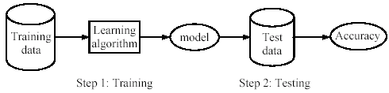
Supervised Learning
Supervised Learning – Infer a pattern (function) from labelled training data. The inferred function used to determine class labels for unseen data.
  Notion of a target concept (function)
  Training Data (as a input vector with an output value) used to derive the possible function
  Testing of the model using unseen test data to assess the model accuracy

Slide 22
Classification vs Regression
In classification, the target variable is categorical.
  For a new input, you have to put it in one of the categories into which it will fit
  Example : Classify Sentiments from Tweets into Neutral, Positive and Negative.
  Example: Classifying patient profiles as risky or safe based on historical data
Simplest: binary classification
Given: a set of m examples (xi,yi) i = 1,2…m sampled from some distribution D, where xi∈Rn and yi∈{-1,+1}
Find: a function f f: Rn -> {-1,+1} which classifies ‘well’ examples xj sampled from D.
In regression, the target variable is continuous.
  For a new input you have to predict the potential value of the output
  Example: Derive the model for Fuel Consumption based on model, time of day, age of vehicle etc.
  Example: Derive the potential future price of a stock based on historical analysis of data deriving from features like stock, quantity, news related to stock etc.

Slide 23
Classification versus Regression
Classification
F(x)
F(x))
Regression
Y
x

Slide 24

Labelling : A crucial need for supervised learning?
Source: Amazon Mechanical Turk

Slide 25
Unsupervised Learning
No Target Concept or Function. Explore Data to find intrinsic structures.
  Identifying hidden patterns
  No notion of error to evaluate the output solution
  Very closely Related to Data Mining
  Also related to Statistics and Information Theory
  Examples include
    Clustering of similar inputs
      K-Means clustering
      Hierarchical Clustering
    Association Rule Mining
    Feature Extraction techniques
    Recommendation Systems
  Use Cases
    Retail Shopping Cart Analysis for Upselling and Cross Selling
    Identifying dominant concepts in an essay/speech/blog
    Extracting Top Concepts in news feeds
    Extracting Features (like human body outlines) in large videos as in Youtube

Slide 26
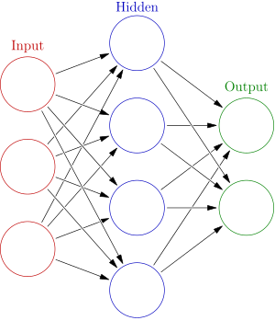
Deep Learning – What is it?
Based on the idea of Neural Networks
They are inspired by our understanding of the biology of our brains
Each node a neuron
A neural network has
  An output layer
  An input layer
  Multiple hidden layers
Deep Learning consists of
Several hidden layers
Have proven successful for
unstructured data – text, image, video, audio

Slide 27
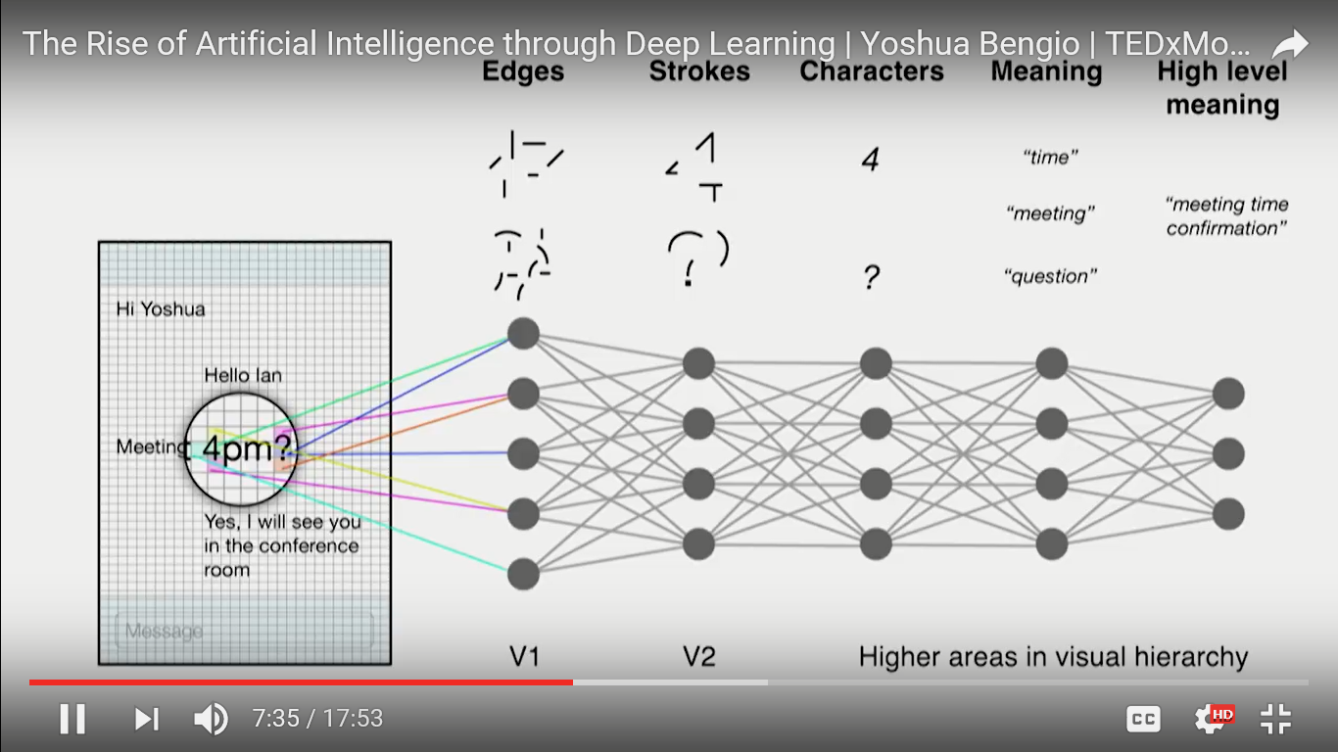
Works on a hierarchy of representations
Source: yoshua bengio’s talk at TedX montreal

Slide 28
Overall Venn Diagram
AI
Machine Learning
Deep Learning

Slide 29
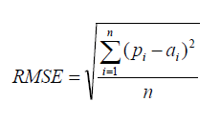
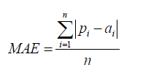
Model Evaluation Techniques
Regression Model Evaluation Techniques
Diverse notions of Error is used in Regression.
Some Common notions are as below
Root Mean Square Error
Mean Absolute Error

Slide 30
Model Evaluation Techniques
Classification Model Evaluation Techniques
Diverse notions of Error is used in Classification.
Usual Method is to hold out 10 to 20 percent as Test Set

Slide 31
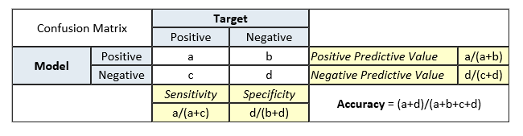
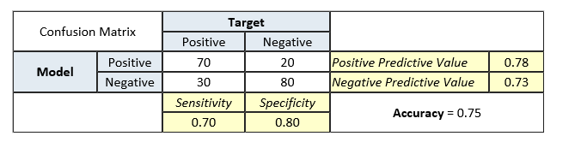
Model Evaluation Techniques
Classification Model Evaluation Techniques
One popular technique giving additional detail is Confusion Matrix
A confusion matrix shows the number of correct and incorrect predictions made by the classification model compared to the target values in the data

Slide 32
Unsupervised ML Techniques
Clustering
K-Means clustering
Hierarchical Clustering
Association Rule Mining
Apriori algorithm
Recommendation Systems
Matrix Factorization
Feature extraction
Unsupervised Deep Learning

Slide 33
Supervised ML Techniques
Regression Methods
Classification Methods
Ensemble Methods

Slide 34
Supervised ML Techniques: Regression
Linear Regression Methods
Multiple Linear Regression Methods
Ridge Regression Methods
Regression trees
SVR
Random Forest Regression
Lasso Regression
kNNR

Slide 35
Supervised ML Techniques: Basic Classification Techniques
Logistic Regression
Decision Tree
Naive Bayes
kNearestNeighbour
SVM

Slide 36
Supervised ML Techniques: Ensemble Classification Methods
Boosting algorithms like AdaBoost
Bagging algorithms like Random Forest
Stacking algorithm

Slide 37
Deep Learning Methods
Feed Forward Networks
Recurrent Neural Networks
CNN
LSTM
Word Embeddings

Slide 38
Thank you

