Slide 1


www.tarahtech.com

Slide 2

Dimensionality Reduction

Slide 3

Dimensionality Reduction:
Dimensionality reduction techniques → used for to reduce the number of features in a dataset without having to lose much information retaining the model’s performance.
Below are just some of the examples of the kind of data being collected:
  Facebook collects data of what you like, share, post, places you visit, restaurants you like, etc.
  Your smartphone apps collect a lot of personal information about you
  Amazon collects data of what you buy, view, click, etc. on their site
  Casinos keep a track of every move each customer makes

Slide 4
Dimensionality Reduction Techniques:
Dimensionality reduction can be done in two different ways:
  By only keeping the most relevant variables from the original dataset (this technique is called feature selection)
  By finding a smaller set of new variables, each being a combination of the input variables, containing basically the same information as the input variables (this technique is called dimensionality reduction)

Slide 5
Various dimensionality reduction techniques :
Missing Value Ratio
Low Variance Filter
High Correlation Filter
Random Forest
Backward Feature Elimination
Forward Feature Selection
Factor Analysis
Principal Component Analysis

Slide 6
Missing Value Ratio
While exploring a dataset with plenty of missing values
Imputing them or drop the variables entirely which have missing values (using appropriate methods).
Too many missing values – Better drop the variable, as it will not have much information.
Setting a threshold value and if the percentage of missing values in any variable is more than that threshold, drop the variable.

Slide 7


Import the libraries as
Read the csv(comma separated values) file using pandas.
Review the first 5 rows of our data using the head( ) function on the pandas DataFrame.

Slide 8
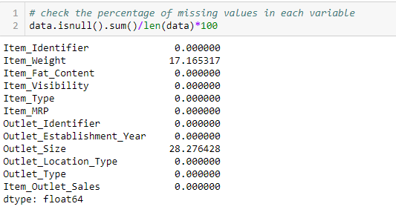
Check the percentage of each missing value in each column.We can use .isnull().sum() to calculate this.

Slide 9
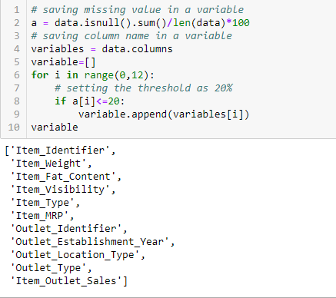
Set a threshold of, say 20%, and remove the variable having more than 20% missing values.

Slide 10
Low Variance Filter :
Calculate the variance of each variable.
Drop the variables having low variance as compared to other variables in our dataset.
Variables with a low variance will not affect the target variable.
First impute the missing values in the Item_Weight column using the median value of the known Item_Weight observations.
For the Outlet_Size column, use the mode of the known Outlet_Size values to impute the missing values.

Slide 11

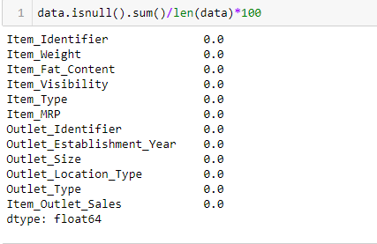
Let’s check whether all the missing values have been filled:

Slide 12
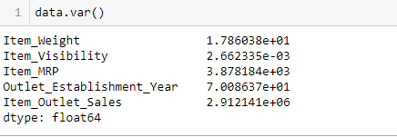
let’s calculate the variance of all the numerical variables.
As the above output shows, the variance of Item_Visibility is very less as compared to the other variables
Safely drop this column. This is how apply low variance filter.

Slide 13
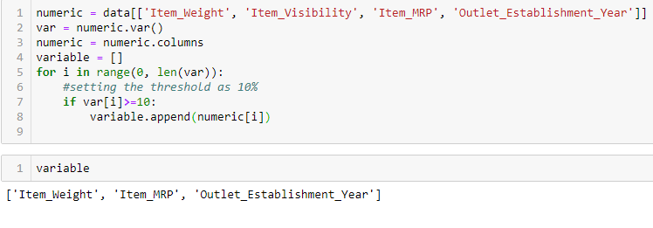

Slide 14
High Correlation filter
High correlation between two variables means they have similar trends and are likely to carry similar information.
Calculate the correlation between independent numerical variables that are numerical in nature.
If the correlation coefficient crosses a certain threshold value, drop one of the variables
Let’s perform the correlation calculation in Python. drop the dependent variable (Item_Outlet_Sales) first and save the remaining variables in a new dataframe (df).

Slide 15
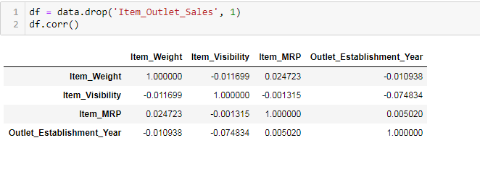
drop the dependent variable (Item_Outlet_Sales) first
we don’t have any variables with a high correlation in our dataset.

Slide 16
Backward Feature Elimination:
This module can be used for dimensionality reduction on sample sets, either to improve estimators’ accuracy scores or to boost their performance on very high-dimensional datasets.
Recursive feature elimination is to select features by recursively considering smaller and smaller sets of features. First, the estimator is trained on the initial set of features and the importance of each feature is obtained.
Least important features are pruned from current set of features.
Follow the below steps to understand and use the ‘Backward Feature Elimination’ technique:
First take all the n variables present in our dataset and train the model using them.
Now, we compute the performance of the model after eliminating each variable (n times), i.e., we drop one variable every time and train the model on the remaining n-1 variables
Identify the variable whose removal has produced the smallest (or no) change in the performance of the model, and then drop that variable.
Repeat this process until no variable can be dropped.

Slide 17
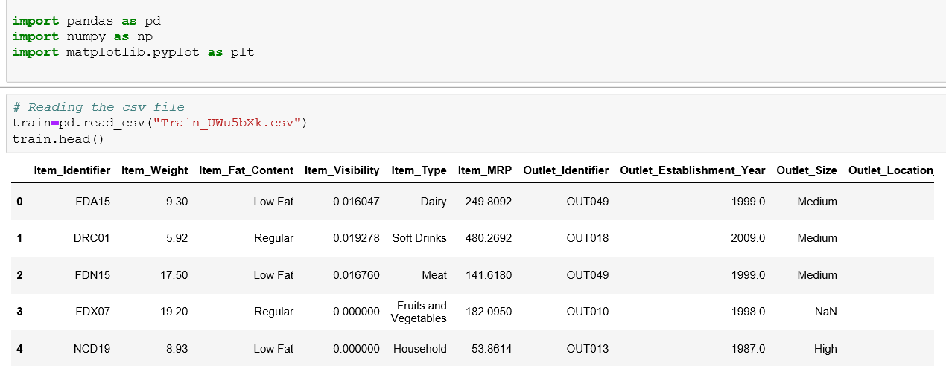
This method can be used when building Linear Regression or Logistic Regression models.
First we import The libraries.
To read the CSV file.

Slide 18
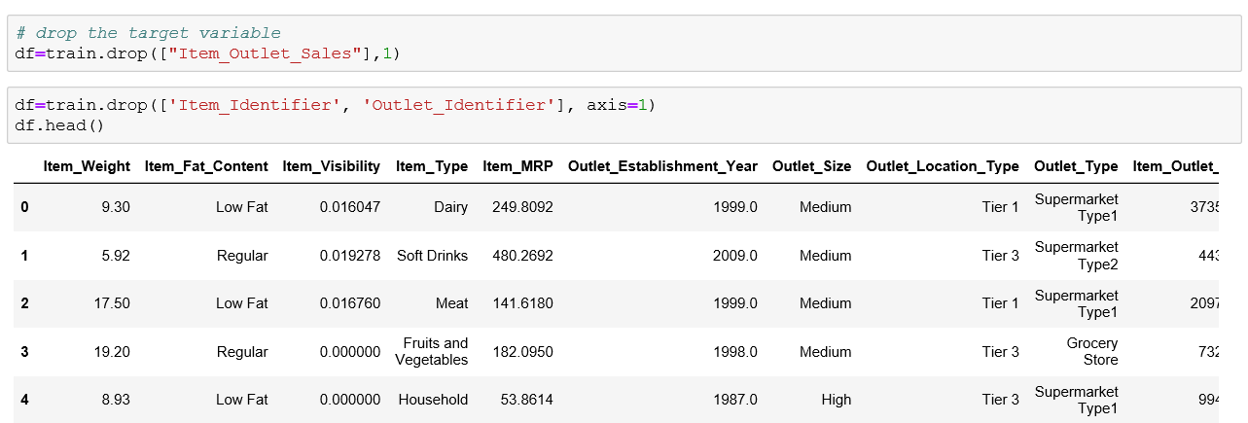
Drop the target variable from the Dataset and we also we drop the features which we don’t use for predicting.

Slide 19
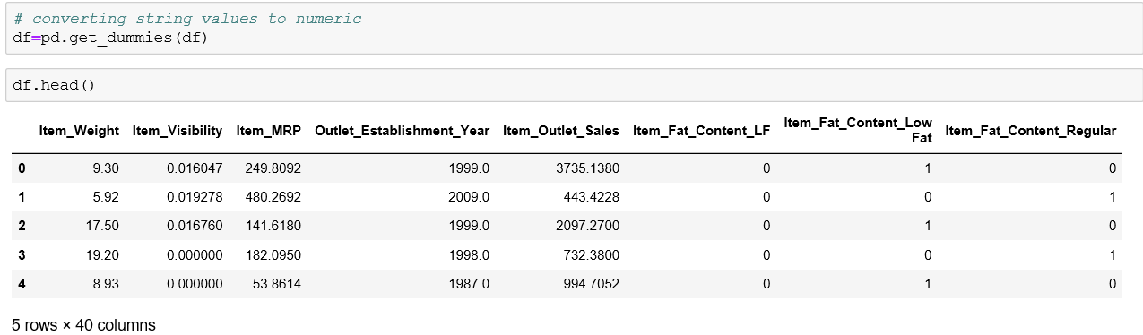
Convert the categorical features to numeric:

Slide 20
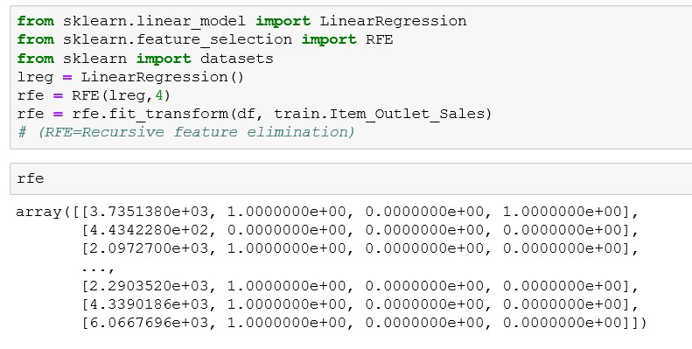
Importing RFE function and run the model.
In the algorithm to specify the number of features to select, and we get back the list of variables obtained from backward feature elimination.

Slide 21
Forward Feature Selection:
This is the opposite process of the Backward Feature Elimination.
Instead of eliminating features, we try to find the best features which improve the performance of the model.
Start with a single feature. Essentially, we train the model n number of times using each feature separately
The variable giving the best performance is selected as the starting variable
Then we repeat this process and add one variable at a time. The variable that produces the highest increase in performance is retained
Repeat this process until no significant improvement is seen in the model’s performance.

Slide 22
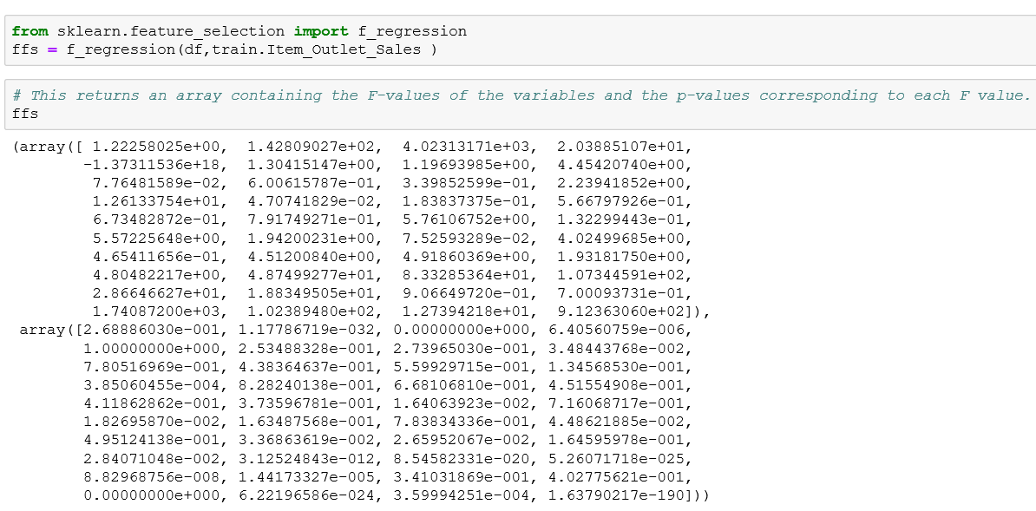
Apply the Forward Feature selection in python:
In the above an array containing the F-values of the variables and the p-values corresponding to each F value.

Slide 23
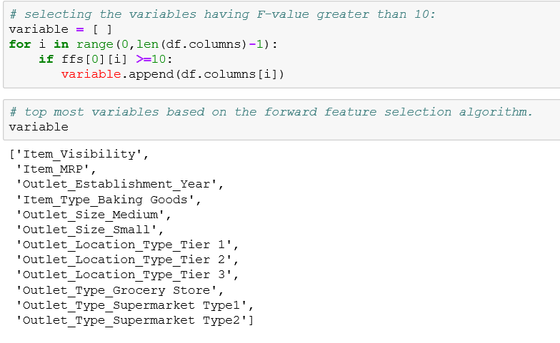
To select the top most variables based on the forward feature selection algorithm.we will select the variables having F-value greater than 10.
Both Backward Feature Elimination and Forward Feature Selection are time consuming and computationally expensive.
They are practically only used on datasets that have a small number of input variables.

Slide 24
Factor Analysis:
Factor analysis is a statistical technique used to identify latent relationships among sets of observed variables in a dataset.
This model has a large set of observed variables as linear combinations of some smaller set of unobserved, latent factors.
Factor loadings, generated from an Factor Analysis model describes the underlying relationships between each variable and the latent factors.
The factor analysis model can be estimated using a variety of standard estimation methods minres or MLE.
Number of factors (K) is selected such that it is substantially smaller than the number of variables.
Factor loadings are similar to standardized regression coefficients.

Slide 25
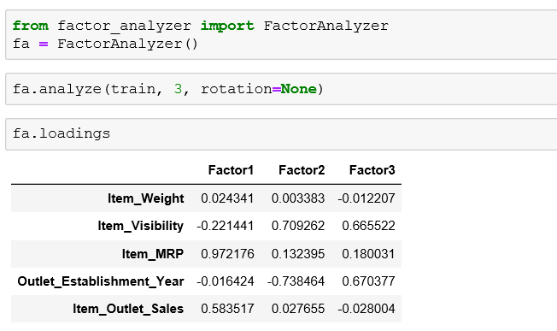
For Factor Analysis we have a stand-alone Python module FactorAnalyzer() class.

Slide 26
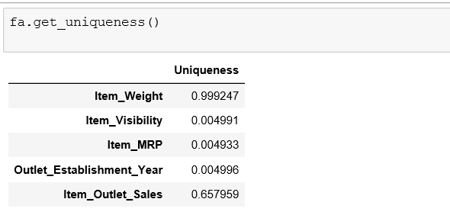
Select which feature have the heighest uniqueness value that feature is the first importent variable.

Slide 27
Principal Component Analysis (PCA):
Principal component analysis is a method of extracting important variables from a large set of variables available in a data set.
In this technique, variables are transformed into a new set of variables, which are linear combination of original variables. These new set of variables are known as principal components.
It is always performed on a symmetric correlation or covariance matrix. This means the matrix should be numeric and have standardized data.

Slide 28
Principal components:
A principal component is a normalized linear combination of the original predictors in a data set.
We have a set of predictors x1,x2 ….xn
The principal component can be written as:
Z¹ = Φ¹¹X¹ + Φ²¹X² + Φ³¹X³ + .... +Φp¹Xp
First principal component(z1):
This is a linear combination of original predictor variables .
which captures the maximum variance in the data set.
It determines the direction of highest variability in the data.
Larger the variability captured in first component, larger the information captured by component.
No other component can have variability higher than first principal component.
It minimizes the sum of squared distance between a data point and the line.

Slide 29
Second principal component(z2):
Is also a linear combination of original predictors which captures the remaining variance in the data set and is uncorrelated with z1.
The correlation between first and second component should is zero.
It can be represented as:
Z² = Φ¹²X¹ + Φ²²X² + Φ³²X³ + .... + Φp2Xp
If the two components are uncorrelated, their directions should be orthogonal .
The correlation between these principle components in zero.
All succeeding principal component follows a similar concept i.e. they capture the remaining variation without being correlated with the previous component
In general, for n × p dimensional data, min(n-1, p) principal component can be constructed.

Slide 30
Normalization of variables:
The principal components are supplied with normalized version of original predictors.
The original predictors may have different scales.so we normalize the data.
Performing PCA on un-normalized variables will lead to insanely large loadings for variables with high variance.
This will lead to dependence of a principal component on the variable with high variance. This is undesirable.

Slide 31
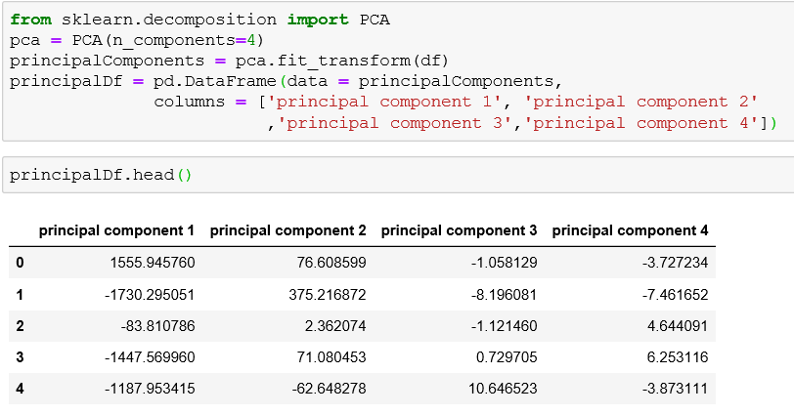
Implement PCA in python:

Slide 32
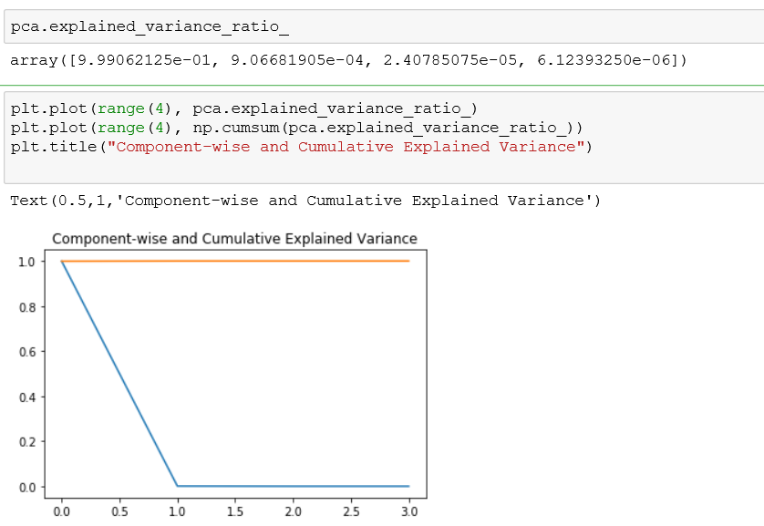
Visualize how much variance has been explained using these 4 components.
Using explained_variance_ratio_ to calculate the variance ratio of the components.
In the above graph, the blue line represents component-wise explained variance while the orange line represents the cumulative explained variance.
We are able to explain around 98% variance in the dataset using just four components

Slide 33
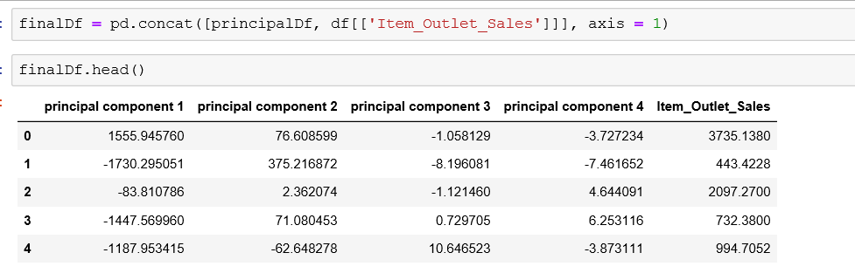
Finally concate the target variable to the principal components and we run the algorithm what we want.

Slide 34
Summary:
In this Slide show we covered some topics on Dimensionality reduction. Which are
Missing Value Ratio
Low Variance Filter
High Correlation Filter
RandomForest
Backward Feature Elimination
Forward Feature Selection
Factor Analysis
Principal Component Analysis

Slide 35
Thank You

