Slide 1
Text File Sharing with Digital Signature in Intranet
- A final year project

Slide 2
Introduction
A digital signature scheme is a mathematical scheme for demonstrating the authenticity of digital documents. A valid digital signature gives a recipient reason to believe that the message was created by a known sender, and that it was not altered in transit.
First described by Whitfield Diffie and Martin Hellman
Provide a high level of assurance that the digital signature is genuinely the signer's
During the communication between two parties, it ensures both of them that the message has not been tempered with by any third parties in between the communication.

Slide 3
Problem Statement
The major problem is the document being modified/tempered during the course of transmission.
The sender may deny sending a document that s/he has actually sent called repudiation.
The receiver may itself modify the document and claim that the sender has sent it.
The identity of sender not being known when documents are encrypted with receiver’s public key.

Slide 4
Objective
To enable end-user come out with a file transfer using digital signature

Slide 5
Literature Review
RSA is the first algorithm known to be suitable for signing as well as encryption, and one of the first great advances in public key cryptography. RSA is very widely used today for secure Internet communication (browsers, S/MIME, SSL, S/WAN, PGP, and Microsoft Outlook), operating systems (Sun, Microsoft, Apple, Novell) and hardware (cell phones, ATM machines, wireless Ethernet cards, Mondex smart cards, Palm Pilots).[1]
A message can be “signed" using a privately held decryption key. Anyone can verify this signature using the corresponding publicly revealed encryption key. Signatures cannot be forged, and a signer cannot later deny the validity of his signature. This has obvious applications in “electronic mail" and “electronic funds transfer" systems.[2]

Slide 6
Requirement Analysis
The system should allow user to send file to another user.
The system should have the functionality of signing & verifying the digital signature.
The system should alert the user if file has been tempered.

Slide 7
Methodology

Slide 8
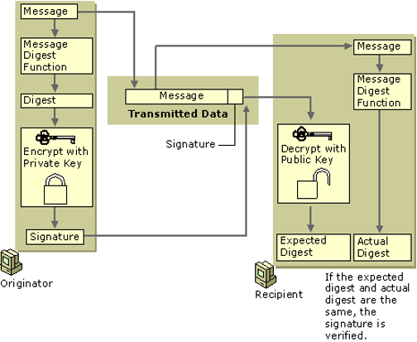
Block Diagram

Slide 9
Sequence Diagram

Slide 10
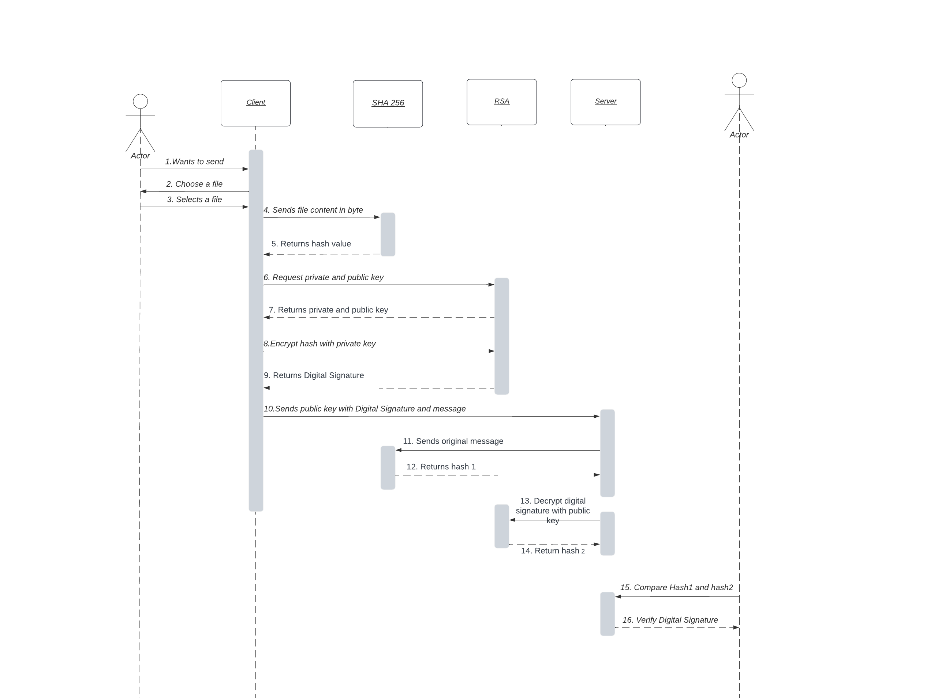

Slide 11
Key Generation
Select random prime numbers p and q, and check that p != q
Compute modulus n = p*q
Compute phi = (p - 1)(q - 1)
Select public exponent e, 1 < e < phi such that gcd(e,phi) = 1
Compute private exponent d = e⁻¹ mod phi
Public key is {n, e}, private key is {n,d}
Signing: S = m^{d} mod n, Verifying: H = c^{e} mod n

Slide 12
Implementation tools/techniques
Draw.io & Lucid Chart
Apache NetBeans
Java Programming Language
Java File handling
Java Socket Programming
Java Swing for GUI

Slide 13
Result Analysis
Sender changing a single letter in the document
The system alerts the recipient with the message "The file if tempered". Thus the data integrity is provided by the system.
Changing the file name without changing the file content
When the server clicked on "Verify" button, the system alerted, "The file is not tempered".
Receiver changing the file content
The system alerted “File is tempered” when trying to verify the signature bringing the truth forward.

Slide 14
Conclusion
The system is designed to provide the simple text file sharing from client to server with digital signature functionality. It was just the modality of what can be achieved using digital signature.
The problem of whether the file has been tempered or not was solved.
The system has proved to maintain the integrity of the information secured since the length of the message is preserved during any of the operations of encryption and decryption. The system has therefore eliminated the fear of losing vital information to an eavesdropper or an enemy at any point in time.

Slide 15
Future Enhancement
Although the system can be used to share any kind of multimedia files, only the file with .txt extension could be signed.
The encryption and decryption facility can be incorporated to make the sharing of information more confidential.

Slide 16
Reference
[1] Application of Digital Signature for Securing Communication Using RSA Scheme based on MD5, Stephen Fashoto, University of Swaziland, Kwaluseni Swaziland
[2] A Method for Obtaining Digital Signatures and Public-Key Cryptosystems. R.L. Rivest, A. Shamir, and L. Adleman

