Slide 1
Pig, Making Hadoop Easy

Slide 2
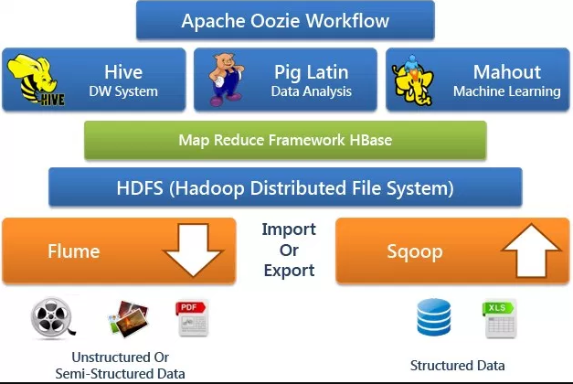
Hadoop Ecosystem

Slide 3
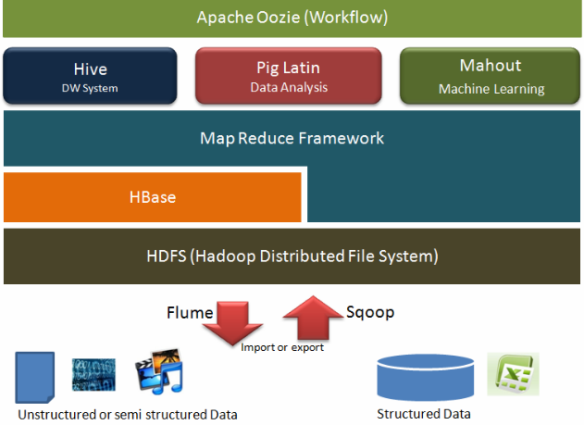
Hadoop Ecosystem

Slide 4
Motivation By Example
Suppose you have user data in one file, website data in another, and you need to find the top 5 most visited pages by users aged 18 - 25.
Load Users
Load Pages
Filter by age
Join on name
Group on url
Count clicks
Order by clicks
Take top 5

Slide 5
In Map Reduce

Slide 6
In Pig Latin
Users = load ‘users’ as (name, age); Fltrd = filter Users by age >= 18 and age <= 25; Pages = load ‘pages’ as (user, url); Jnd = join Fltrd by name, Pages by user; Grpd = group Jnd by url; Smmd = foreach Grpd generate group, COUNT(Jnd) as clicks; Srtd = order Smmd by clicks desc; Top5 = limit Srtd 5; store Top5 into ‘top5sites’;

Slide 7
Pig and Pig Latin

Slide 8
What is Pig?
Apache Pig is a Hadoop platform for creating MapReduce jobs. Pig uses a high-level, SQL-like programming language named Pig Latin.
The benefits of Pig include:
Run a MapReduce job with a few simple lines of code.
Process structured data with a schema, or Pig can process unstructured data without a schema. (Pigs eat anything!)
Pig Latin uses a familiar SQL-like syntax.
Pig scripts read and write data from HDFS.
Pig Latin is a data flow language, a logical solution for many MapReduce algorithms.

Slide 9
Pig Latin
Pig Latin is a high-level data flow scripting language.
Pig Latin scripts can be executed one of three ways:
Pig script: write a Pig Latin program in a text file and execute it using the pig executable.
Grunt shell: enter Pig statements manually one-at-a-time from a CLI tool known as the Grunt interactive shell.
Embedded in Java: use the PigServer class to execute a Pig query from within Java code.

Slide 10
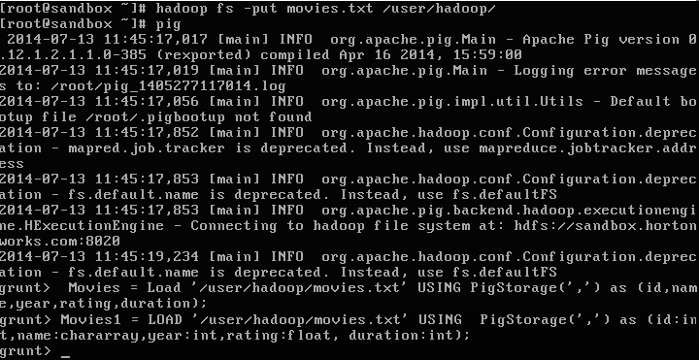
The Grunt Shell
Grunt is an interactive shell that enables users to enter Pig Latin statements and also interact with HDFS.
To enter the Grunt shell, run the pig executable in the PIG_HOME\bin folder:

Slide 11
Pig Execution Modes
Pig has two execution modes or exectypes:
Local Mode - To run Pig in local mode, you need access to a single machine; all files are installed and run using your local host and file system. Specify local mode using the -x flag (pig -x local).
Mapreduce Mode - To run Pig in mapreduce mode, you need access to a Hadoop cluster and HDFS installation. Mapreduce mode is the default mode;

Slide 12
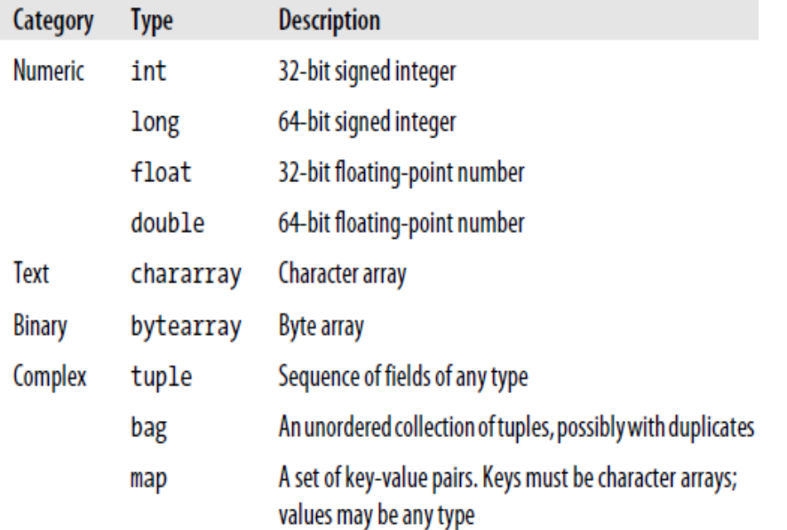
Pig Latin Types

Slide 13
Who uses Pig for What?
70% of production jobs at Yahoo
Also used by Twitter, LinkedIn, Ebay, AOL, …
Used to
Process web logs
Build user behavior models
Process images
Build maps of the web
Do research on raw data sets

Slide 14
LOAD command
student_data = LOAD '/samples/students.txt' USING PigStorage(',');
student_data = LOAD '/samples/students.txt' USING PigStorage(',') as (id:int, firstname:chararray, lastname:chararray, age:chararray, phone:chararray, city:chararray );
dump student_data;
describe student_data;

Slide 15
STORE Command
STORE students_data INTO ' /s4/' USING PigStorage (',');

