Slide 1

Practical Hadoop with Pig

Slide 2
HDFS

Slide 3


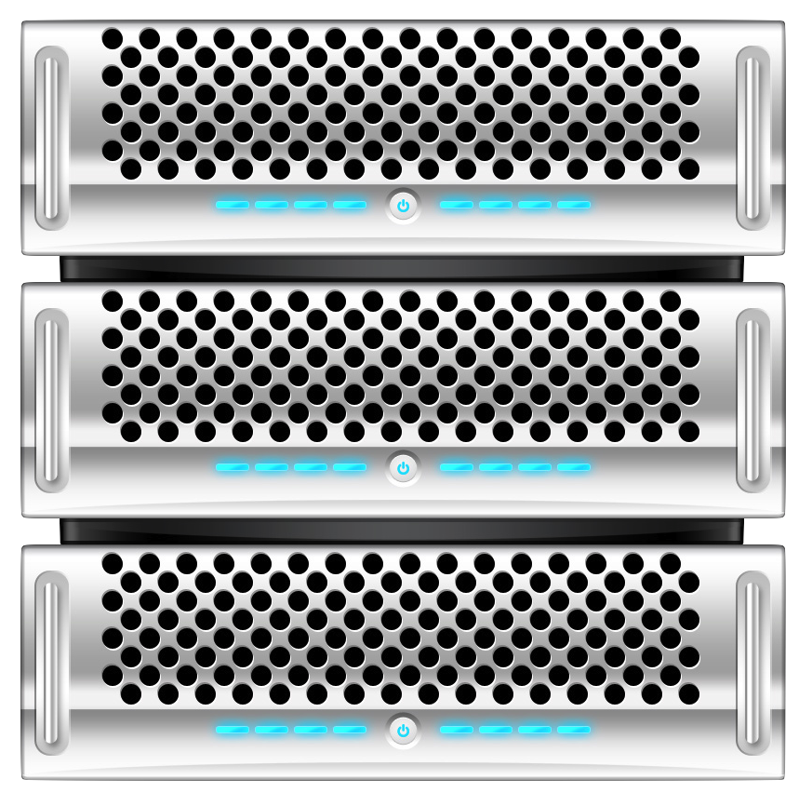
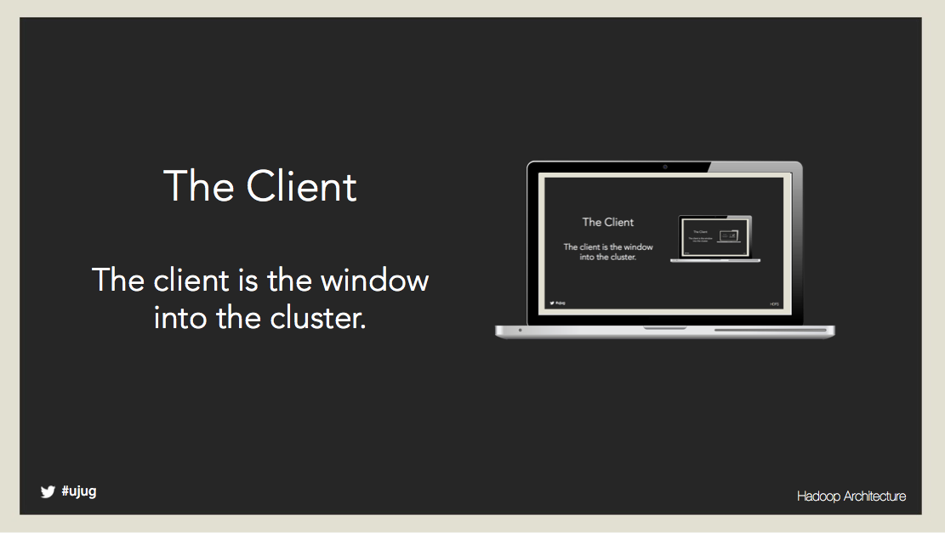
HDFS has 3 main actors

Slide 4
The Name Node The Name Node is “The Conductor”. It directs the performance of the cluster.

Slide 5
The Data Nodes: A Data Node stores blocks of data. Clusters can contain thousands of Data Nodes. *Yahoo has a 40,000 node cluster.

Slide 6
The Client The client is a window to the cluster.

Slide 7
The heart of the System. Maintains a virtual File Directory. Tracks all the nodes. Listens for “heartbeats” and “Block Reports” If the NameNode is down, the cluster is offline.
The Name Node

Slide 8
Storing Data

Slide 9
The Data Nodes

Slide 10
Add a Data Node: The Data Node says “Hello” to the Name Node. The Name Node offers the Data Node a handshake with version requirements. The Data Node replies back to the Name Node, “Okay”, or “Shuts Down”. The Name Node hands the Data Node a NodeId that it remembers. The Data Node is now part of cluster and it checks in with the Name Node every 3 seconds.

Slide 11
Data Node Heartbeat: The “check-in” is a simple HTTP Request/Response. This "check-in" is very important communication protocol that guarantees the health of the cluster. Block Reports – what data I have and is it okay. Name Node controls the Data Nodes by issuing orders when they return and report their status. Replicate Data, Delete Data, Verify Data Same process for all nodes within a cluster.

Slide 12
Writing Data

Slide 13

The client “tells” the NameNode the virtual directory location for the file.

Slide 14

The client “tells” the NameNode the virtual directory location for the file. The Client breaks the file into 64MB “blocks”
A64
B64
C28

Slide 15
The client “tells” the NameNode the virtual directory location for the file. The Client breaks the file into 64MB “blocks” The client “ask” the NameNode where the blocks go.
A64
B64
C28

Slide 16
The client “tells” the NameNode the virtual directory location for the file. The Client breaks the file into 64MB “blocks” The client “ask” the NameNode where the blocks go. The Client “stream” the blocks, in parallel, to the DataNodes.
A64
B64
C28
A64
B64
C28

Slide 17
The client “tells” the NameNode the virtual directory location for the file. The Client breaks the file into 64MB “blocks” The client “ask” the NameNode where the blocks go. The Client “stream” the blocks, in parallel, to the DataNodes. DataNode(s) tells the NameNode they have the data via the block report
A64
B64
C28

Slide 18
The client “tells” the NameNode the virtual directory location for the file. The Client breaks the file into 64MB “blocks” The client “ask” the NameNode where the blocks go. The Client “stream” the blocks, in parallel, to the DataNodes. DataNode(s) tells the NameNode they have the data via the block report The NameNode tells the DataNode where to replicate the block.
A64
A64
A64

Slide 19
Reading Data

Slide 20
The client tells the NameNode it would like to read a file.

Slide 21

The client tells the NameNode it would like to read a file. The NameNode reply’s with the list of blocks and the nodes the blocks are on.

Slide 22
The client tells the NameNode it would like to read a file. The NameNode reply’s with the list of blocks and the nodes the blocks are on. The client request the first block from a DataNode
B64
C28
A64

Slide 23
The client tells the NameNode it would like to read a file. The NameNode reply’s with the list of blocks and the nodes the blocks are on. The client request the first block from a DataNode The client compares the checksum of the block against the manifest from the NameNode.
A64
B64
C28

Slide 24
The client tells the NameNode it would like to read a file. The NameNode reply’s with the list of blocks and the nodes the blocks are on. The client request the first block from a DataNode The client compares the checksum of the block against the manifest from the NameNode. The client moves on to the next block in the sequence until the file has been read.
A64
B64
C28
B64
C28

Slide 25
Failure Recovery

Slide 26
A Data Node Fails to “check-in”
A64

Slide 27
A Data Node Fails to “check-in” After 10 minutes the Name Node gives up on that Data Node.
X
A64

Slide 28
A Data Node Fails to “check-in” After 10 minutes the Name Node gives up on that Data Node. When another node that has blocks originally assigned to the lost node checks-in, the name node sends a block replication command.
X
A64
A64
A64

Slide 29
A Data Node Fails to “check-in” After 10 minutes the Name Node gives up on that Data Node. When another node that has blocks originally assigned to the lost node checks-in, the name node sends a block replication command. The Data Node replicates that block of data. (Just like a write)
X
A64
A64
A64
A64

Slide 30
Interacting with Hadoop HDFS Shell Commands

Slide 31
HDFS Shell Commands.
> Hadoop fs –ls <args>
Same as unix or osx ls command.
/user/hadoop/file1
/user/hadoop/file2
...

Slide 32
HDFS Shell Commands.
> Hadoop fs –mkdir <path>
Creates directories in HDFS using path.

Slide 33
HDFS Shell Commands.
> hadoop fs -copyFromLocal <localsrc> URI
Copy a file from your client to HDFS.
Similar to put command, except that the source is restricted to a local file reference.

Slide 34
HDFS Shell Commands.
> hadoop fs -cat <path>
Copies source paths to stdout.

Slide 35
HDFS Shell Commands.
> hadoop fs -copyToLocal URI <localdst>
Copy a file from HDFS to your client.
Similar to get command, except that the destination is restricted to a local file reference.

Slide 36
HDFS Shell Commands.
cat
chgrp
chmod
chown
copyFromLocal
copyToLocal
cp
du
dus
expunge
get
getmerge
ls
lsr
mkdir
movefromLocal
mv
put
rm
rmr
setrep
stat
tail
test
text
touchz

