Slide 1
Algebraic data types, Data Oriented Programming and Pattern Matching in C#
Praseed Pai K.T.

Slide 2
Algebraic Data Types (Some theory!)
Product Types ( aka Records )
Sum Types ( aka Union types )
Exponential Types ( aka Function Types )
Adhoc Polymorphism using Sum,Product,Exponential Types
Data Oriented Programming
Switch Expressions
Pattern Matching

Slide 3
Sum Types
Represent a value that can be one of several types.
Common in functional languages like F#, Rust, and Haskell.
In C# 10, you emulate this using abstract records and pattern matching.
public abstract record Expr;
public record Constant(double Value) : Expr;
public record Add(Expr Left, Expr Right) : Expr;
Evaluated using switch expressions and type patterns.

Slide 4
Product Types
Represent a value that combines multiple fields.
like a tuple or struct — each instance holds multiple values.
public record Person(string Name, int Age);

Slide 5
Exponential Types (aka Function Types )
Represent a mapping from one type to another: A → B.
In category theory, this is analogous to exponentiation: B^A.
In C#, this is expressed via delegates or lambdas:
Func<int, string> describe = age => $"Age: {age}";

Slide 6
How these are combined together?
C# 10 brings these concepts closer to functional programming:
Sum types via abstract records + pattern matching
Product types via concise record syntax
Exponential types via lambdas, delegates, and Func<>
Switch expressions unify control flow with pattern matching

Slide 7
What about .NET 9 and before?
Sum Types can be implemented using OneOf library
/////////////////////////////////////
//
// A Simple Shape Hierarchy
public record Circle(double rad);
public record Rectangle(double l , double b );
public record Triangle(double b , double h );
public class Shape : OneOfBase<Circle,Rectangle,Triangle> {
public Shape( OneOf<Circle,Rectangle,Triangle> inp ) : base(inp){}
}

Slide 8
Goodbye Composite/Visitor
Algebraic data types help you to model Types
Processing is done through Recursive function, Functional switch
No complicated manouever like Double Dispatch etc
Enables Adhoc polymorphism

Slide 9
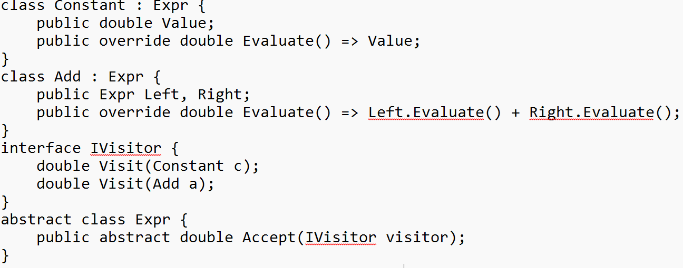
Composite/Visitor version of Evaluator

Slide 10
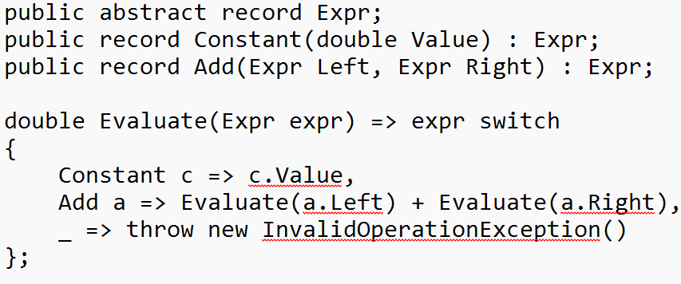
Algebraic data type version of Evaluator

Slide 11
Four Principles of Data Oriented Programming
Separate Code from Data
Represent Data Types with Generic structures (Records,Unions,List,Tuple)
Use data validation as a Separate Concern
Model state with Immutable Data

Slide 12
Questions?
If any!

