Slide 1
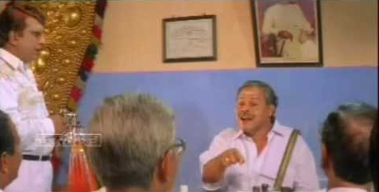
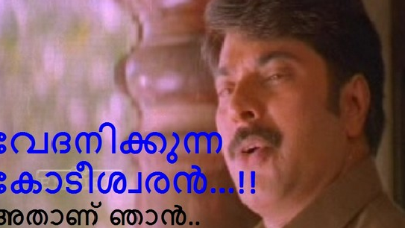
Patterns of Snobbery and Tactics to deal with them – A Personal saga
Praseed Pai K.T.

Slide 2
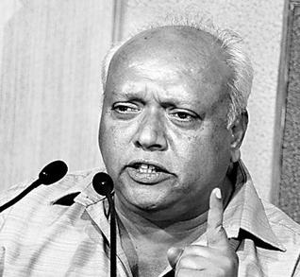
Das Kapital
“The Whole world is in the clutches of the capital, where Individuals do not have much say”

Slide 3

Only problem out there in the world!
“My uncle is a Pilot, What about yours?”

Slide 4
Variations of the theme
“my friend has studied in IIM,what about you?”
“I’m from IIT , you moron!”
“I have started, Why you have not started yet?”
“my son is already placed by TCS,what about your nephew?”
“I’m with Microsoft, why you are loafing around?”
“Bangalore is the place to be, Why you are still in Kochi?”
“I want to leave this f****** Country, why you still fool around?”
“Your English is lousy, look at mine!”
“Despite age why you are sticking with low level stuff, grow up and become a manager like me. How do you feel about my growth?”
“I know Analog Electronics, Digital is shit! If you want to do Embedded Systems, you should know Analog deep”
“My daughter is earning high in Bangalore, why should I give her off to a person working in an unknown company”
“My friend is a Microsoft MVP, Since he says so, I have got every reason to trust him over you”
“My sons take me everywhere they stay, Why you do not do it?”

Slide 5
Some Taxonomy
Intellectual Snobbery
Accomplishment Snobbery
Entrepreneurship Snobbery

Slide 6

Accomplishment Snobbery
“Proud Dad” Attack
“Flying Mom” Attack
Yield and Counter Attack
Domain Attack

Slide 7

Proud Dad

Slide 8

Flying Mom

Slide 9
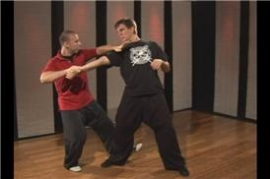
Yield and Counter Attack

Slide 10
Domain Attack
Attack based on the Semantics of Activities!

Slide 11
Entrepreneurship
“Back paper” Entrepreneurship
“Career Crisis” Entrepreneurship
“Social Pressure” Entrepreneurship
“IDEA” – Identity driven Entrepreneurial architecture

Slide 12
Intellectual Snobbery
Direct Attack – Tackling them making things explicit
Relevance attack – “A five ton person things that he is better than a three ton person for a two ton Job”
Semantic attack - “How Intelligent you are?” vs “How are you intelligent?”
Crowd Sourced attack – Override the weightage by “Crowd sourced” Knowledge

Slide 13
Why do people Snob?
First Rank Holder Syndrome – They are trained that way
Low ROI – due to information revolution, elite school learning does not pay
Proxy Gratification – Accomplishment of wards, relatives, friends as an alibi to override someone
Expectations mismatch – Stateful life of a Successful person and his temperament does not match
Emotional Ventilation – Frustration with peer group non-acceptance

Slide 14
Constructive Solutions

Slide 15
How I tackled Snobs and Snubs?
Created a digital identity by writing a generic Blog
Public speaking on mostly Technical matters
Published an Open Source Compiler ( more to be published soon)
Created awareness about this phenomena around and how to tackle them ( This presentation is a testimony!)

Slide 16
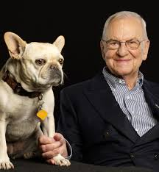
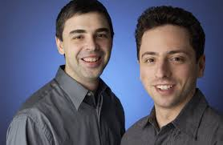

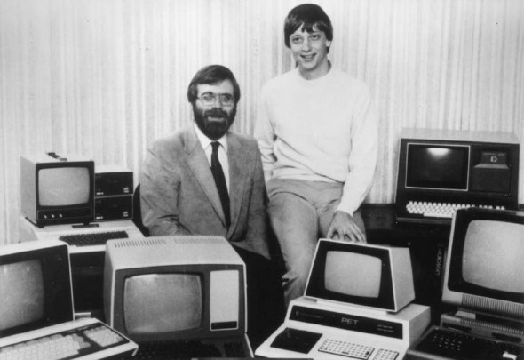
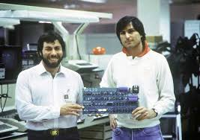
Do no go by “Tall” Stories!

Slide 17
Better People “Fallacy”
http://praseedp.blogspot.in/2010/03/better-people-syndrome.html
“When Netherlands and Korea Play soccer, it is expected that Dutch will win every time. Give One extra player to the Korean team. The Korean team will win more times. ( As the differential between players at international level is small)”

Slide 18
Know what you are doing?
Five class of “makers”!
Thinkers
Entrepreneur mindset
Process Mindset
Craftsmen Mindset
Technicians Mindset

Slide 19
A “Total”Electronics/Embedded Self Learning Conceptual Toolkit
Came out of a “Snob/Snub” battle
Layer 1 – Discrete Circuits/PCB systems
Layer 2 - Discrete Circuits/Mup systems
Layer 3 - Micro Processor based Systems
Layer 4 - VHDL/FPGA
Layer 5 - VHDL/ASIC – Custom Fabrication

Slide 20
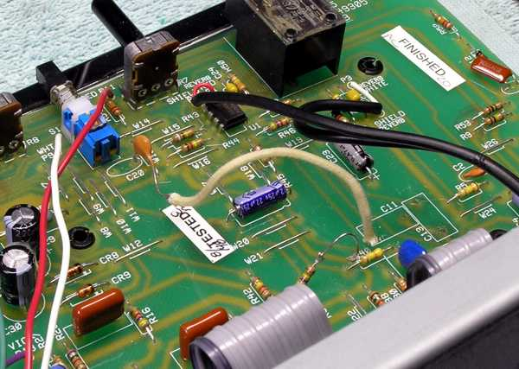
Layer 1 – Discrete Circuits/PCB

Slide 21
Layer 2 – MicroController based Embedded Systems (AVR/PIC/8051/Ardiuno)

Slide 22
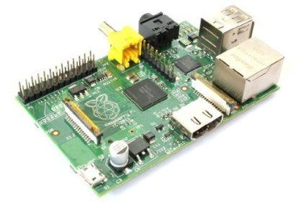
Layer 3 -Microprocesser based Embedded Systems
ARM , x86 and Rasberry Pi

Slide 23
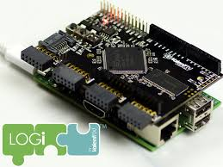
Layer 4 – VHDL/FPGA systems

Slide 24
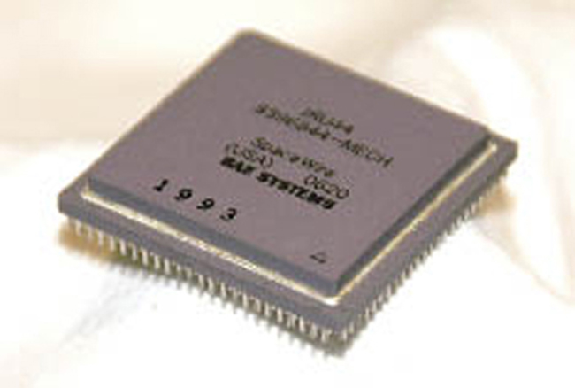
Layer 5 – VHDL/ASIC

Slide 25

A Platform for Collaborative learning
LearnForIndia.org
http://learnforIndia.org
Virtual “Stanford” | “Harvard”

Slide 26
Thank You
Questions?

