Slide 1
Philosophy – How Can It Help You? - Western and Indian
Praseed Pai K.T.

Slide 2
Some Uses of Philosophy
A source to broaden our Intellectual horizon
Every man has a Philosophy. Studying it, makes us to align our beliefs with some kind of standard. Helps communicate ideas better
A Grammar for Thought (If we are looking for one)
A great Emotional Shock Absorber
Character Transformation through deliberate study of Philosophy
Ability to articulate complicated and deep topics succinctly
Study of Philosophy will make you a universal citizen.
Ability to Study vast amount of topics
“Unusual effectiveness” of Philosophy in Professional Life

Slide 3
Some Key ideas of Western Philosophy
Epochs
Greek, Medieval, Renaissance (Modern), Post-Modern
Branches
Metaphysics, Epistemology, Ethics, Aesthetics, Politics, Logic
Fundamental Questions
Who am I?, What Can I Know?, What Should I do?
Primary Methodology
Analytical, Reductionist
Humanistic Traditions
Externalism,, Phenomenology ,Nihilism , Dialectical Materialism (Marxian)
Philosophy of Science Methods
Induction, Deduction ,Abduction,Falsificationism

Slide 4
Indian Philosophy
Vedas and Upanishads
Rig, Yajur, Sama, Atharva
Various Upanishads
Main Schools
Heterodox (Veda not as a Testimony ) , Orthodox (Veda as Testimony)
Three Hetrodox Schools
Carvaka , Jaina , Budhist Traditions
Six Orthodox Schools (Darshana)
{Nyaya, Vaisesika} , {Samkhya, Yoga}, {Mimamsa, Vedanta}
Philosophical Methods
Holism and Intuitionistic
Method of Philosophical Arguments ( a form of Dialectic)
Purva Paksha (apriori ) , Khantana (Refutations), Uttara Paksha (Conclusion)

Slide 5
Philosophy in My Professional Life (Software Engineering)
Reductionism as a Tool for Learning Vast Amount of Subjects
Regular Expressions, SQL Query, Functional Programming are variants of Closure (Reductionism)
Design of Primitives while writing Software Engines
Turing Machine , Lambda Calculus and Predicate Logic as foundations for Paradigms
KISS Principle is a solution for “Problem of Induction”
Party Idiom in Entity Management (Customer, Vendor, Government body, NGOs)
Define a Core, Rest should be Deduction from the Core
Functional Core of a Functional Programming language
Philosophical Ontology
Ontology is study of what exists out there. Useful for defining Vocabulary for Systems and Implementation of Domain Specific Languages
Wrote a Paper titled, “An Ontology and Its Realization on Mobile Devices – a HealthCare Case Study)
Software Design and Enterprise Ontology
Entity Archetypes as a structuring mechanism ( Arlow/Nuestadt)
Holism for Designing UX
Limitations of Analytics ( Analytic Reduction vs Systems Thinking)

Slide 6
Applied “Philosophy” (Bit satirical)
Entrepreneurship –
Is it for you?
- A “Psycho-Philosophical” analysis

Slide 7
SME vs Integrator Temperament
Loners
Adjustment Problems
Synchronous
Socially Active Only for making a living
Individualistic
Emphasizes IQ
Extroverts
Go Getters
Handle Asynchrony better
They Live in the Society
Social
EQ

Slide 8
Seven Classes of Entrepreneurship
Back paper Entrepreneurship
Career Crisis entrepreneurship
Social Pressure Entrepreneurship
"Can Afford Failure" Entrepreneurship
"B-School" Entrepreneurship
“Idea Driven” Entrepreneurship
Accidental entrepreneurship (Self Employment getting scaled)

Slide 9
Aftermath of a Failure (for SME)
Most SMEs will be like a village girl who lost her "Virginity“
Some will be drifting into Corporate Jobs
Most often, they barge on to next integrator

Slide 10
Aftermath of a Failure (for Integrator)
Most Integrators think like a urban girl who had a one night stand!
Most often they move to the next entrepreneurship venture
Even if, they go corporate, they will succeed in Operational roles and go high in the career ladder.

Slide 11
SMEs in the Corporates
SMEs grow very fast, initially
After five years, SMEs need to make a choice
- Go People vs Stay Tech
If they succeed in People role, they drift to Integrator spectrum
If they fail or stay stagnant, grow nihilistic and poke at Integrators
if they fail or stay stagnant, and are +ve, they will indulge in Music, arts, Philosophy, Painting

Slide 12
Thank You
Questions?

Slide 13
Appendix

Slide 14
Nyaya Philosophy
Analysis of Logic and Epistemology
Detailed work on Anumana (“Inference”)
Right knowledge for “Liberation” ( from suffering)
perception (pratyaksha), inference (anumana), comparison (upamana), and sound/testimony (shabda) are source of valid knowledge
Invalid knowledge involves memory, doubt, error, and hypothetical argument.
Algined with Vaisesika (Merged with it)
Cause as an invariable and un-conditional precedence for effect. ( an effect does not pre-exist in it’s cause)
Three kinds of causes
Material (Inherent) cause - The substance out of which an effect is produced
Non-Inherent cause - helps in the production of a cause,
Efficient cause - the power that helps the material cause produce the effect
God is not the material cause of the universe.

Slide 15
Samkhya System
A Dualistic Philosophy – Matter (Prakriti) and Eternal Spirit (Purusha)
Right knowledge comes from separation of Purusha and Prakriti
Four higher level functions of Purusha are
Buddhi (“consciousness”)
Ahamkara(“I-consciousness”)
Manas (“Mind”)
Prana (“Breath”)
Infinite Purusha and Prakriti is enough (No God). Prakriti springs to action when Purusha gets connected to it.
Purusha impinges on Prakriti to form Consciousness (Budhi) and next to evolve is Ahamkara, which deludes Purusha to think, Ego is the center of its Objective Existence.
Ahmkara can be divided into
Five Gross Elements (Water, Air, Space, Earth , Fire) - Tanmatra
Five Fine Elements (Touch, Sound , Sight, Taste, Smell) - Mahabuthas
Five Organs of Perception ( Skin,Ear,Eyes, Tongue, Nose) - Janendriya
Five Organs of Activity (Speak, Grasp, Move, Procreate,Evacuate) - Karmendriyas
Mind ( Controller of Senses)
Three Primal Qualities of Matter (Gunas) make up prakirti
Tamas (Obscurity, Ignorance,Inertia) – Darkness (InAction)
Rajas ( Activity, Passion, Intensivity) - passion (Action – but, fails often)
Satvik ( , Purity, Dispassion, Light ) – Goodness (Equanimity)

Slide 16
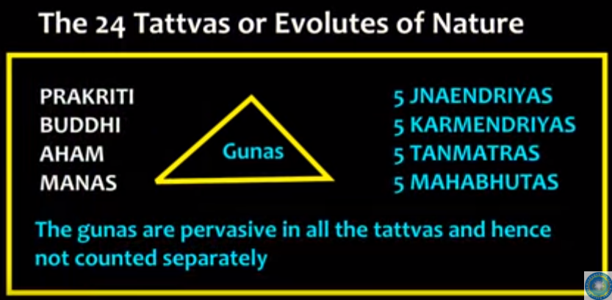

Slide 17
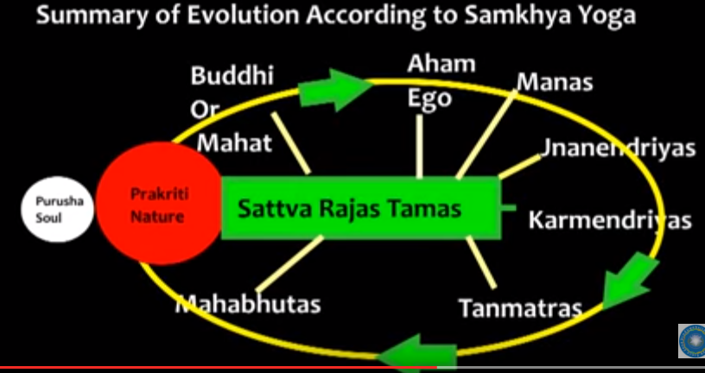

Slide 18
Carvaka System
Also called Lokayata (Earthly Philosophy)
Rejects Vedas, Karma, Moksha , Immortality of Self
Direct Perception as Source of Knowledge ( Anubhava or Experience). Rejects Anumana, Upamana and Shabd as source of knowledge
Everything in this world is some kind of Accident ( Akasmika Vada or Accidentalism)
A Materialist School of Thought
Make merry in this world. Tomorrow, Does it Exist?
Some Believe, Kautilya’s Arthasastra could be written in a Carvaka context

