Slide 1
Bharatiya Darshan & Western Philosophy – An Applied Approach
Praseed Pai K.T.

Slide 2

About the Speaker
Has made more than two hundred presentations in various forums on various technology topics
The Primary Author of SLANG4.net compiler infrastructure system ( http://slangfordotnet.codeplex.com )
The co-author of a book titled,". NET Design Patterns” published by Packt Publishing
A “Scholar” in “Philosophical Tools for Software Engineering” and “Cross Cultural Encounters” in Software Engineering
Maintains an avid interest in Rapid Skill Acquision in Programming,Software Engineering and Domain Engineering

Slide 3
What I do?
I am currently designated as a Senior Solutions “Architect” in a Company.
Architect (n) – Any person who has “fooled” around in the Software Industry for sizeable time (ever shrinking span) who is past his prime,as a Programmer Or Engineer, Systematically moved up in the hierarchy to obey “Peter Principle”.
-

Slide 4
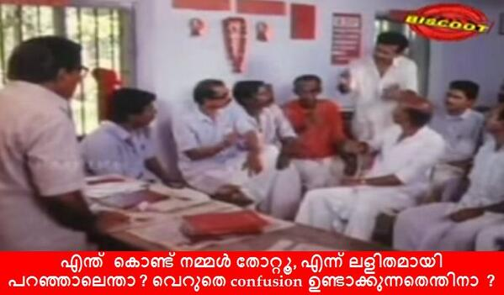
I will try to make it Simple!
Vikhatana Vaadhikalum Prathikriya vaadhigalum bhoorshvasigalum pradhama drishtya agalchayyil aayirunenkilum avar thammillulla andhardhara sajeeva aayirunn ennu venam karudhan. Bhoorsvasikalum thakkam parthirikukka aayirunnu. adhannu nammal thottathu.
"MANASILLAYILLA“
Athayyathu vargadhipathyavum colonialist chinthasaranigalum radicalayya matamalla, ippol manasillayyo.
Notes:
Prima Facie, Seperaists and Reactionary forces were at different camps. But, we assume there were some undercurrents Bourgies were also waiting for an ooportune movement. That is why we lost.
I did not get it at all
That means, Proletraits and Colonolist streams , It is not a Radical change. Now, did you get it ?

Slide 5
Some Uses of Philosophy
A source to broaden our Intellectual horizon
Every man has a Philosophy. Studying it, makes us to align our beliefs with some kind of standard. Helps communicate ideas better
A Grammar for Thought (If we are looking for one)
A great Emotional Shock Absorber
Character Transformation through deliberate study of Philosophy
Ability to articulate complicated and deep topics succinctly
Study of Philosophy will make you a universal citizen.
Ability to Study vast amount of topics
“Unusual effectiveness” of Philosophy in Professional Life

Slide 6
Indian Philosophy and Western Philosophy - An Introduction

Slide 7
Some Key ideas of Western Philosophy
Epochs
Greek, Medieval, Renaissance (Modern), Post-Modern
Branches
Metaphysics, Epistemology, Ethics, Aesthetics, Politics, Logic
Fundamental Questions
Who am I?, What Can I Know?, What Should I do?
Primary Methodology
Analytical, Reductionist
Humanistic Traditions
Existenalism, Phenomenology ,Nihilism , Dialectical Materialism (Marxian)
Method of Philosophical Arguments
Aristotelian Logic and Symbolic Logic

Slide 8
Some Key ideas of Indian Philosophy
Vedas and Upanishads
Rig, Yajur, Sama, Atharva
Various Upanishads
Main Schools
Heterodox (Veda not as a Testimony ) , Orthodox (Veda as Testimony)
Three Hetrodox Schools
Carvaka , Jaina , Budhist Traditions
Six Orthodox Schools (Darshana)
{Nyaya, Vaisesika} , {Samkhya, Yoga}, {Mimamsa, Vedanta}
Philosophical Methods
Holism and Intuitionistic,Experiential in nature
Method of Philosophical Arguments ( a form of Dialectic)
Purva Paksha (apriori ) , Khantana (Refutations), Uttara Paksha (Conclusion)

Slide 9
Western Philosophy vs Indian Philosophy
1 | Western Philosophy | Indian Philosophy
2 | Objective Reasoning (Content based) | Subjective Reasoning (Context based)
3 | Materialistic | Idealistic
4 | Reductionist | Holistic
5 | Logic | Dialectics
6 | Entity | Relationship
7 | Linear | Cyclical

Slide 10
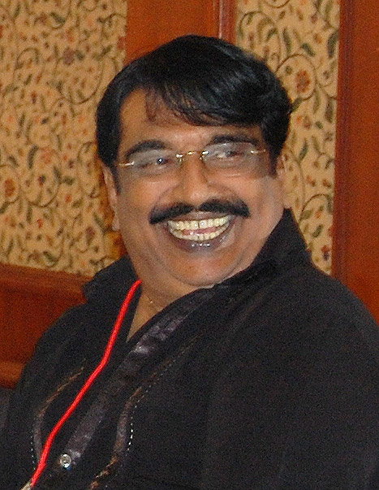
Indian vs Western Philosophy ? Ala Car or a Boat?
In India, it is like this, I do not know how it is in Punjab?
- Punjabi House

Slide 11
Pitch Your Idea better
LOGOS,ETHOS,PATHOS and MYTHOS

Slide 12
LOGOS,ETHOS,PATHOS and MYTHOS
Aristotle's Rhetoric strategies
“MYTHOS” from Dev Dutt Patnaik

Slide 13
Organize your thought with greater Discretion
Reductionism vs Holism
Materialism vs Idealism ( Metaphysics)
Empiricism vs Rationalism (Epistemology)
Induction, deduction and abduction (Method of Science and Thinking in General)
Science and Falsificationism
Philosophy,Theology,Theosophy

Slide 14
Understand the Contextual truth
Dialectics , Logic & Reductio Ad Absurdum

Slide 15
Dialectics vs Logic
Laws of Logic
Law of Identity ( A = A or A <> something else)
Principle of Non Contradiction ( A and not A => false)
Law of Excluded Middle ( Things should be True or False, not in between)
Laws of Dialectics
Process of Change
Reality is modelled as a process of change. What is true can become false in the future
Principle of Contradiction
- Since change is constant , Contradiction being the dynamic underlying change is also constant
Principle of Relationship
- Parts are Meaningful only in the relationship to the whole (context)

Slide 16
Reductio Ad Absurdum
Also known as Proof by Contradiction
Useful when a constructive proof is time consuming and economically not viable
Rather than trying to prove something as correct, we assume what we are trying to prove is correct and find contradictions, if it were true
Successfully used in Mathematics,Arguments and in Courts

Slide 17
Four Topics (Out of Many)
Vedanta and Advaita Philosophy of Sankara
Western Universalism and Its “Perils”
Cultural Marxism
Europen Imperialism and Sanskrit

Slide 18
VEDANTA PHILOSOPHY
Based on Upanishads
Philosophy of Atman/Brahman
Badaryana Vyasa’s “Brahmah Sutra”
Prasthana Thraya – Upanishads,Brahma Sutra and Bhagavad Gita
Key masters are Sankara,Madhava and Ramanuja
Kevala Advaita,Vishita Advaita and Dvaita Vedanta

Slide 19
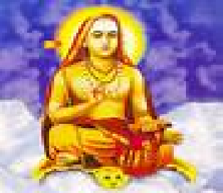
Advaita Vedanta – Sri Sankara
Lived between 788 AD – 820 AD
Travelled across India to fight ritualism, heterodox schools and unified India at a spiritual level
Bhajagovindam “story”
Paragaya Pravesha of Sankara

Slide 20
Sankara’s teaching in a Sentence
Brahma Satyam. Jagat Mithya. Jivo Brahmaiva Na Parah

Slide 21
Western Universalism
Renaissance Project
A Society based on Logic and Science
Unusual stress on “Materialism”
Rajiv Malhotra’s Reason for reversing the Gaze
Lack of Historic Centrism
Integral Unity of Indian thought
Indian comfort with Chaos
Untraslatables in Sanskrit

Slide 22
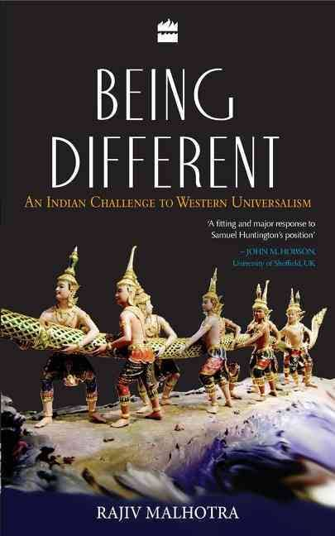
A Must read for all of us!

Slide 23
Marxian Ideology and its perils
Based on a school of thought called “Dialectical Materialism”
Hegal,Marx and DM
Cultural Marxism (More dangerous)
From Colonialist masters to Marxian “Intellectual”
Why it “failed” in India?

Slide 24
Marx’s “Judeo-Xian” lineage
 | Xian | Communist
1 | Jehovah | Dialectical Materialism
2 | Messiah | Marx
3 | Chosen People | Working class (Proletariat)
4 | Church | Communist Party
5 | Second Coming | Revolution
6 | Hell | Punishment of Capitalists
7 | Heaven | Communist Rule
8 | Saints | Polibeaurau
9 | Martyrs | Martyrs

Slide 25

A Remarkable Book!

Slide 26
Cultural Imperialism and Sanskrit Language
European Gaze on India and Hegelian “Dialectical” Template
Buddhism projected as a anti-thesis to Vedic Teachings ( as opposed to Dharma Tradition)
Associating Sanskrit to Varna System (Thus oppressive)
Western Indologists and how they dabble with Indian Politics

Slide 27

Understand Dharmic Tradition and Sanksriti

Slide 28
Philosophy in My Professional Life (Software Engineering)
Reductionism as a Tool for Learning Vast Amount of Subjects
Regular Expressions, SQL Query, Functional Programming are variants of Closure (Reductionism)
Design of Primitives while writing Software Engines
Turing Machine , Lambda Calculus and Predicate Logic as foundations for Paradigms
KISS Principle is a solution for “Problem of Induction”
Party Idiom in Entity Management (Customer, Vendor, Government body, NGOs)
Define a Core, Rest should be Deduction from the Core
Functional Core of a Functional Programming language
Philosophical Ontology
Ontology is study of what exists out there. Useful for defining Vocabulary for Systems and Implementation of Domain Specific Languages
Wrote a Paper titled, “An Ontology and Its Realization on Mobile Devices – a HealthCare Case Study)
Software Design and Enterprise Ontology
Entity Archetypes as a structuring mechanism ( Arlow/Nuestadt)
Holism for Designing UX
Limitations of Analytics ( Analytic Reduction vs Systems Thinking)

Slide 29
Q&A
Any Questions ?

Slide 30
Appendix

Slide 31
Nyaya Philosophy
Analysis of Logic and Epistemology
Detailed work on Anumana (“Inference”)
Right knowledge for “Liberation” ( from suffering)
perception (pratyaksha), inference (anumana), comparison (upamana), and sound/testimony (shabda) are source of valid knowledge
Invalid knowledge involves memory, doubt, error, and hypothetical argument.
Algined with Vaisesika (Merged with it)
Cause as an invariable and un-conditional precedence for effect. ( an effect does not pre-exist in it’s cause)
Three kinds of causes
Material (Inherent) cause - The substance out of which an effect is produced
Non-Inherent cause - helps in the production of a cause,
Efficient cause - the power that helps the material cause produce the effect
God is not the material cause of the universe.

Slide 32
Samkhya System
A Dualistic Philosophy – Matter (Prakriti) and Eternal Spirit (Purusha)
Right knowledge comes from separation of Purusha and Prakriti
Four higher level functions of Purusha are
Buddhi (“consciousness”)
Ahamkara(“I-consciousness”)
Manas (“Mind”)
Prana (“Breath”)
Infinite Purusha and Prakriti is enough (No God). Prakriti springs to action when Purusha gets connected to it.
distinguish between universal intelligence (mahat) and individual intelligence (buddhi).
Buddhi is that mode of energy that operates as intelligence and is the basis of all mental processes
Purusha impinges on Prakriti to form Consciousness (Budhi) and next to evolve is Ahamkara, which deludes Purusha to think, Ego is the center of its Objective Existence.
Ahmkara can be divided into
Five Gross Elements (Water, Air, Space, Earth , Fire) - Tanmatra
Five Fine Elements (Touch, Sound , Sight, Taste, Smell) - Mahabuthas
Five Organs of Perception ( Skin,Ear,Eyes, Tongue, Nose) - Janendriya
Five Organs of Activity (Speak, Grasp, Move, Procreate,Evacuate) - Karmendriyas
Mind ( Controller of Senses)
Three Primal Qualities of Matter (Gunas) make up prakirti
Tamas (Obscurity, Ignorance,Inertia) – Darkness (InAction)
Rajas ( Activity, Passion, Intensivity) - passion (Action – but, fails often)
Satvik ( , Purity, Dispassion, Light ) – Goodness (Equanimity)

Slide 33
Carvaka System (Materialist)
Also called Lokayata (Earthly Philosophy)
Rejects Vedas, Karma, Moksha , Immortality of Self
Direct Perception as Source of Knowledge ( Anubhava or Experience). Rejects Anumana, Upamana and Shabd as source of knowledge
Everything in this world is some kind of Accident ( Akasmika Vada or Accidentalism)
A Materialist School of Thought
Make merry in this world. Tomorrow, Does it Exist?
Some Believe, Kautilya’s Arthasastra could be written in a Carvaka context

Slide 34
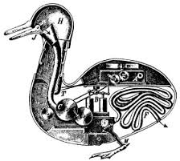
Understand the Gist of the world and also see the Big Picture)
REDUCTIONISM and HOLISM

Slide 35
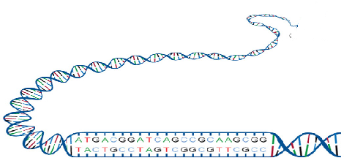
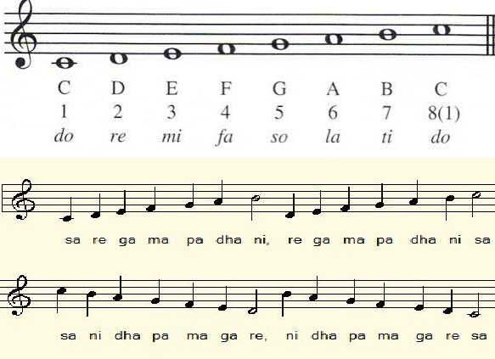
Reductionism in Life & Music
Notes:
Mera joota hai japani yeh patloon englishtani Sar pe laal topi roosi phir bhi dil hai hindustani Mera joota...

Slide 36
What has Regular Expression,SQL Query and Functional Composition has in common?
Notes:
Mera joota hai japani yeh patloon englishtani Sar pe laal topi roosi phir bhi dil hai hindustani Mera joota...

Slide 37
CLOSURE

Slide 38
Other instances of Reductionism
Dance Forms
Photo Plotters
LISP interpreter
Digital Gates and Computer Construction
Programming Languages ( SEQuence,Branching,Iteration,Recursion)
Gesture based UX ( A set of primitive Gestures)
The List Goes on
Notes:
Mera joota hai japani yeh patloon englishtani Sar pe laal topi roosi phir bhi dil hai hindustani Mera joota...

Slide 39
Limits of Reductionism
Assumes Sum of Parts is Equivalent to the whole
Cannot Model Emergent Behavior due to the Inter-dependence of parts
Limits of Machine Learning – A case study

Slide 40
Holism
Whole is more than sum of parts
Models Emergent Behavior
Successful in Evolutionary Biology, Social Sciences and Systems Modelling
Software Requirement Analysis
Design of UX
Mental Model of the Users
Considering the User Value System (Culture)

