Slide 1

Cognitive tools from Vedanta Philosophy
By Praseed Pai K.T.
Sr. Solutions Architect ,UST Global

Slide 2
About the Presenter
Co-Author of Books, “ .NET Design Patterns” and “C++ Reactive Programming” (writing) for Packt Publishing
Has Written a university level accredited paper on “Ontology”
Has created a course on “Philosophical Tools for Software Engineering” ( Presented @ Rubyconf India – Preconference)
Presented in more than 200 events
“Father” of SLANG Compiler Infrastructure
Slang4.net,Slang4Jvm, Slang4CPP (LLVM),SlangJs,
Slang4Py, Slang4VB.net
A budding expert on comparative philosophy (Indian/Western)
A Critique of Digital Solutioning and Technology Fads
Sr. Solutions Architect @ UST Global
-

Slide 3
Who is Vedanta?
In a nutshell, Philosophical school of thought based on the Upanishads
Upanishad falls under the last section of Vedas
Chronologically, Upanishad period is the last age of vedic period
-

Slide 4
Atman/Brahman Philosophy
According to Advaita Vedanta, Brahman is the Absolute Reality
The Universe is called “JAGAT”
Anything which is in a flux like JAGAT might be having a non dual, unchanging and overarching force seems to be a plausible thing ? Answer from the common sense says Yes
If such h a force exists , it will be stationary or omnipresent ? The omnipresent seems to be the most probable answer.
if it is omnipresent, you / me and all you see around is part of that one force right?
If that is the case, whatever is permanent in your or me is that ! ( Body, mind, intellect , I conscious goes away ) What remains is ATMA, which is part of the Brahman. Thus, Atman is Brahman .
Four Mah Vakyas
Prajnanam Brahma (प्रज्ञानम् ब्रह्म)
Aham Brahma Asmi (अहम् ब्रह्म अस्मि)
Tat Tvam Asi (तत् त्वम् असि)
Ayam Atma Brahma (अयम् आत्मा ब्रह्म)
-

Slide 5
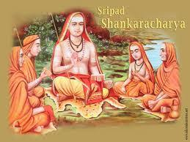
Advaita Vedanta – Sri Sankara
Lived between 788 AD – 820 AD
Travelled across India to fight ritualism, heterodox schools and unified India at a spiritual level
Wrote Commentaries on Brahma Sutra, Bhagavad Gita and Ten Upanishads
Wrote “Prakarana Granthas” ( Philosophical treaites ) like Bhaja Govinda, Atma Bodha , Viveka Chudamani

Slide 6
Essence of Advaita, as per Sankara
Brahma Satya, Jagan Mithya. Jivo Brahmaiva Na Parah
-

Slide 7
Three Levels of Reality/Consciousness
Three Levels of Reality
Vyvaharika ( Transactional Reality )
Prathibhasika ( Phenomenal state )
Paramarthika ( Ultimate Reality )
Three Levels of Consciousness (Avasta Traya )
Jagrat ( Conscious state )
Swapna (Sub Conscious sate )
Sushupti (Un-Consciouss state )
Thuriya (Fourth state , Beyond all these , Super-Consciouss )

Slide 8
EEpistemological Sources for Advaita
Perception (Pratyaksha)
Inference (Anumana)
Comparison (Upamana)
Testimony (Sabd)
Postulation ( Arthapathi ) – Contextual Implication
Non – Availability ( Anupalabdi )

Slide 9
ETool #0
Key notions of Philosophy for discrentionary power

Slide 10
Some key notions from Philosophy
Reductionism vs Holism
Materialism vs Idealism ( Metaphysics)
Empiricism vs Rationalism (Epistemology)
Induction, deduction and abduction (Method of Science and Thinking in General)
Science and Falsificationism
Philosophy,Theology,Theosophy

Slide 11
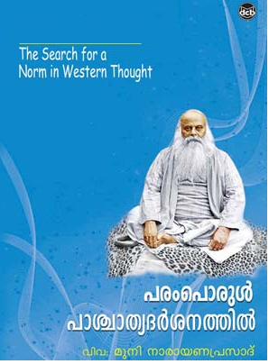
ETool #1
IMPORTANCE OF HAVING A NORM OR THE ABSOLUTE

Slide 12
Importance of having Norm or the Absolute
If there is Norm specified , we will do a relative evaluation of everything
Abstaining from a “White Paper Contest”
How to Interview a Candidate?

Slide 13
ETool #2
Purva Paksha Style of Argument

Slide 14
EPurva Paksha style of argument
Understand the view of the opponent thoroughy and stae them in a phologically correct manner and without logical fallacies
Understand and specifiy reason (Cause/Effect) for each of the assertions made by the opponent.
Specify the epistemological sources for the assertions made by the opponent.
Suggest a alternate universal premise for the statements you want to refute , along with a concrete example
After refutation, specify new assertion about the same.

Slide 15
ETool #3
Logic vs Dialectics - Dialectical Approach of Vedanta discourse

Slide 16
Stress on Dialectics in Advaita Philosophy
Laws of Logic
Law of Identity ( A = A or A <> something else)
Principle of Non Contradiction ( A and not A => false)
Law of Excluded Middle ( Things should be True or False, not in between)
Laws of Dialectics
Process of Change
Reality is modelled as a process of change. What is true can become false in the future
Principle of Contradiction
- Since change is constant , Contradiction being the dynamic underlying change is also constant
Principle of Relationship
- Parts are Meaningful only in the relationship to the whole

Slide 17
ETool #4
Negation as a way to prove something

Slide 18

Proof by Negation in Advaita
Neti Neti (Via Negativa)
How to Talk about Limits of something?
Notes:
Once you eliminate the impossible, whatever remains, no matter how improbable, must be the truth.

Slide 19
ETool #5
Prroof by Cotnradiction as tool in Vedanta

Slide 20
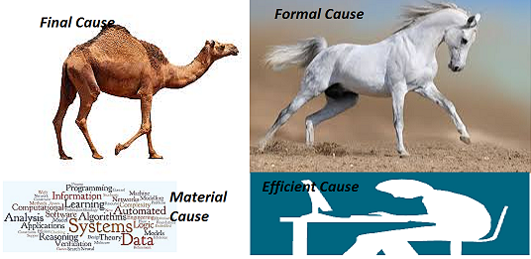
Cause and the Effect!
-

Slide 21
Proof by Contradiction in Advaita
Is there a Creator God for this Universe?
What is the Material Cause of the Universe?
The Creator can be Efficient Cause or Instrument, but should not be the Material Cause. If that is the case, we need to agree that Creator is everything. Thus, something which evolves into everything will eventually vanish, as anything which evolves has to die. So creator will die like any created things
If the creation happened with material cause which existed besides the creator, the existence of material should be equalent to the creator. Thus, if Material can exist without a creator, why cannot Universe emerge itself ( will be a lingering doubt). Why creator chose to creator this universe itself has lot of paradoxes! As someone with Goal won’t be Perfect. IF there is a second ( Material ). Then creator is not omniscient. Anything finite will evolve and die. So creator is not a possibility, as the creator will itself search for its own creator

Slide 22
ETool #6
Understand the Impedence mismatch between India and the West

Slide 23
Western Thinking vs Indian Reasoning
1 | Western Philosophy | Indian Philosophy
2 | Objective Reasoning (Content based) | Subjective Reasoning (Context based)
3 | Materialistic | Idealistic
4 | Reductionist | Holistic
5 | Logic | Dialectics
6 | Entity | Relationship
7 | Linear | Cyclical

Slide 24
ETool #7
Positive Affirmation of Brahman – A way to look at the world

Slide 25
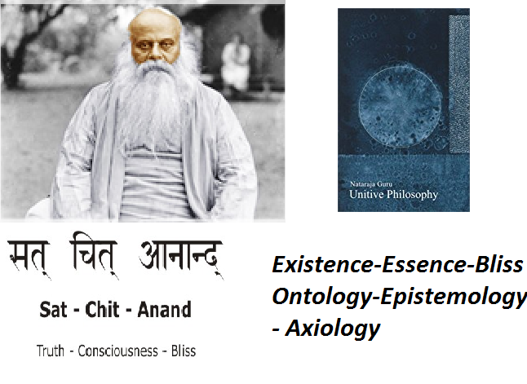
Positive Affirmation of Brahman
-

Slide 26
A mapping of “SAT-CHIT-ANAND”
.
SAT | CHIT | ANANDA
Existence | Essence | Bliss
Ontology | Epistemology | Axiology
Who am I? | What Can I know? | What should I do?
Matter | Mind | Bliss
Structure | Behavior | Function

Slide 27
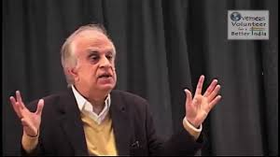
Tool #8 - Challenging the Western Universalism

Slide 28
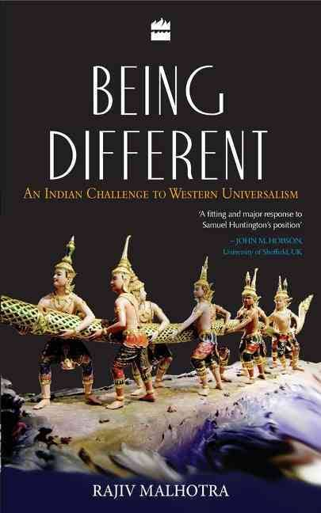
A Must read for all of us!

Slide 29
Western Universalism
Renaissance Project
A Society based on Logic and Science
Unusual stress on “Materialism”
Rajiv Malhotra’s Reason for reversing the Gaze
Lack of Historic Centrism
Integral Unity of Indian thought
Indian comfort with Chaos
Untraslatables in Sanskrit

Slide 30
ETool #9
Converse vs Communicate

Slide 31
Better English through Better Vernacular skill
Language is more than words, sentences and phonetics
How to communicate Emotions really well?
Understand the literal and the implied meaning
?Necessity ofn nuanced communication in the local language

Slide 32
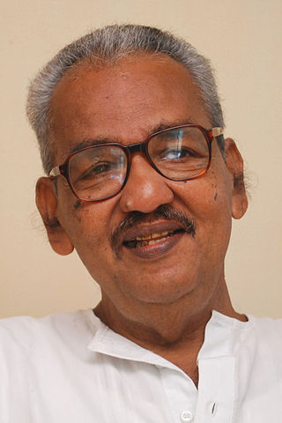
ETool #10
Vary of the Dialectical Materialist Template as a Lens to view things

Slide 33

A Remarkable Book!

Slide 34
Marxian Philosophy and its shortcomings
Based on a school of thought called “Dialectical Materialism”
Hegal,Marx and DM
Cultural Marxism (More dangerous)
From Colonialist masters to Marxian “Intellectual”
Why it “failed” in India?

Slide 35
Marx’s “Judeo-Xian” lineage
 | Xian | Communist
1 | Jehovah | Dialectical Materialism
2 | Messiah | Marx
3 | Chosen People | Working class (Proletariat)
4 | Church | Communist Party
5 | Second Coming | Revolution
6 | Hell | Punishment of Capitalists
7 | Heaven | Communist Rule
8 | Saints | Polibeaurau
9 | Martyrs | Martyrs

Slide 36
ETool #11
Understand Dharmic Tradition and Sanskrit

Slide 37

Understand Dharmic Tradition and Sansksiti

Slide 38
Q&A
Any Questions ?

Slide 39
Cultural Imperialism and Sanskrit Language
European Gaze on India and Hegelian “Dialectical” Template
Buddhism projected as a anti-thesis to Vedic Teachings ( as opposed to Dharma Tradition)
Associating Sanskrit to Varna System (Thus oppressive)
Western Indologists and how they dabble with Indian Politics

Slide 40
Appendices

Slide 41
Some Uses of Philosophy
A source to broaden our Intellectual horizon
Every man has a Philosophy. Studying it, makes us to align our beliefs with some kind of standard. Helps communicate ideas better
A Grammar for Thought (If we are looking for one)
A great Emotional Shock Absorber
Character Transformation through deliberate study of Philosophy
Ability to articulate complicated and deep topics succinctly
Study of Philosophy will make you a universal citizen.
Ability to Study vast amount of topics
“Unusual effectiveness” of Philosophy in Professional Life

Slide 42
Nyaya Philosophy
Analysis of Logic and Epistemology
Detailed work on Anumana (“Inference”)
Right knowledge for “Liberation” ( from suffering)
perception (pratyaksha), inference (anumana), comparison (upamana), and sound/testimony (shabda) are source of valid knowledge
Invalid knowledge involves memory, doubt, error, and hypothetical argument.
Algined with Vaisesika (Merged with it)
Cause as an invariable and un-conditional precedence for effect. ( an effect does not pre-exist in it’s cause)
Three kinds of causes
Material (Inherent) cause - The substance out of which an effect is produced
Non-Inherent cause - helps in the production of a cause,
Efficient cause - the power that helps the material cause produce the effect
God is not the material cause of the universe.

Slide 43
Samkhya System
A Dualistic Philosophy – Matter (Prakriti) and Eternal Spirit (Purusha)
Right knowledge comes from separation of Purusha and Prakriti
Four higher level functions of Purusha are
Buddhi (“consciousness”)
Ahamkara(“I-consciousness”)
Manas (“Mind”)
Prana (“Breath”)
Infinite Purusha and Prakriti is enough (No God). Prakriti springs to action when Purusha gets connected to it.
distinguish between universal intelligence (mahat) and individual intelligence (buddhi).
Buddhi is that mode of energy that operates as intelligence and is the basis of all mental processes
Purusha impinges on Prakriti to form Consciousness (Budhi) and next to evolve is Ahamkara, which deludes Purusha to think, Ego is the center of its Objective Existence.
Ahmkara can be divided into
Five Gross Elements (Water, Air, Space, Earth , Fire) - Tanmatra
Five Fine Elements (Touch, Sound , Sight, Taste, Smell) - Mahabuthas
Five Organs of Perception ( Skin,Ear,Eyes, Tongue, Nose) - Janendriya
Five Organs of Activity (Speak, Grasp, Move, Procreate,Evacuate) - Karmendriyas
Mind ( Controller of Senses)
Three Primal Qualities of Matter (Gunas) make up prakirti
Tamas (Obscurity, Ignorance,Inertia) – Darkness (InAction)
Rajas ( Activity, Passion, Intensivity) - passion (Action – but, fails often)
Satvik ( , Purity, Dispassion, Light ) – Goodness (Equanimity)

Slide 44
Carvaka System (Materialist)
Also called Lokayata (Earthly Philosophy)
Rejects Vedas, Karma, Moksha , Immortality of Self
Direct Perception as Source of Knowledge ( Anubhava or Experience). Rejects Anumana, Upamana and Shabd as source of knowledge
Everything in this world is some kind of Accident ( Akasmika Vada or Accidentalism)
A Materialist School of Thought
Make merry in this world. Tomorrow, Does it Exist?
Some Believe, Kautilya’s Arthasastra could be written in a Carvaka context

Slide 45
Limits of Reductionism
Assumes Sum of Parts is Equivalent to the whole
Cannot Model Emergent Behavior due to the Inter-dependence of parts
Limits of Machine Learning – A case study

Slide 46
Holism
Whole is more than sum of parts
Models Emergent Behavior
Successful in Evolutionary Biology, Social Sciences and Systems Modelling
Software Requirement Analysis
Design of UX
Mental Model of the Users
Considering the User Value System (Culture)

