Slide 1
Philosophical Tools 4 Software Engineering
Praseed Pai K.T.
Sr. Solutions Architect, UST Global
(Presented @ Ruby meetup, Jan 27,2017,Kochi)

Slide 2
A Word about me
Programmer at heart, Software Engineer by temperament and IT professional by Trade. I am currently designated as a Solutions “Architect” in a Company.
Architect (n) – Any person who has “fooled” around in the Software Industry for sizeable time (ever shrinking span) who is past his prime,as a Programmer Or Engineer, Systematically moved up in the hierarchy to obey “Peter Principle”.
-

Slide 3
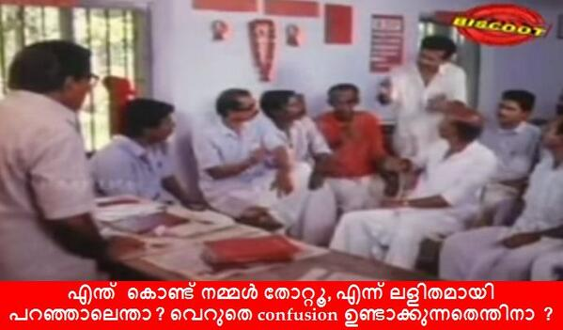
I will try to make it Simple!
Prathikriya vaadhigalum bhoorshvasigalum pradhama drishtya agalchayyil aayirunenkilum avar thammillulla andhardhara kuravayyirunnu ennu venam karudhan. adhannu nammal thottathu.
"MANASILLAYILLA“
Athayyathu vargadhipathyavum colonialist chinthasaranigalum radicalayya matamalla, ippol manasillayyo.

Slide 4
Some Uses of Philosophy
A source to broaden our Intellectual horizon
Every man has a Philosophy. Studying it, makes us to align our beliefs with some kind of standard. Helps communicate ideas better
A Grammar for Thought (If we are looking for one)
A great Emotional Shock Absorber
Character Transformation through deliberate study of Philosophy
Ability to articulate complicated and deep topics succinctly
Study of Philosophy will make you a universal citizen.
Ability to Study vast amount of topics
“Unusual effectiveness” of Philosophy in Professional Life

Slide 5
Some Key ideas of Western Philosophy
Epochs
Greek, Medieval, Renaissance (Modern), Post-Modern
Branches
Metaphysics, Epistemology, Ethics, Aesthetics, Politics, Logic
Fundamental Questions
Who am I?, What Can I Know?, What Should I do?
Primary Methodology
Analytical, Reductionist
Humanistic Traditions
Existentalism,, Phenomenology ,Nihilism , Dialectical Materialism (Marxian)
Philosophy of Science Methods
Induction, Deduction ,Abduction,Falsificationism

Slide 6
Some Key ideas of Indian Philosophy
Vedas and Upanishads
Rig, Yajur, Sama, Atharva
Various Upanishads
Main Schools
Heterodox (Veda not as a Testimony ) , Orthodox (Veda as Testimony)
Three Hetrodox Schools
Carvaka , Jaina , Budhist Traditions
Six Orthodox Schools (Darshana)
{Nyaya, Vaisesika} , {Samkhya, Yoga}, {Mimamsa, Vedanta}
Philosophical Methods
Holism and Intuitionistic,Experiential in nature
Method of Philosophical Arguments ( a form of Dialectic)
Purva Paksha (apriori ) , Khantana (Refutations), Uttara Paksha (Conclusion)

Slide 7
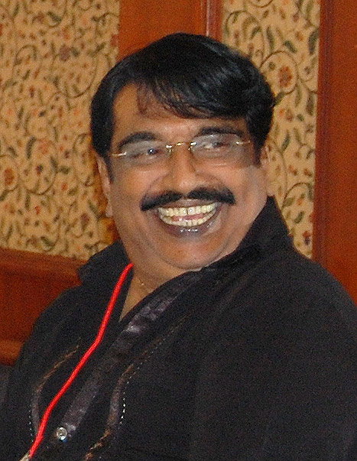
Indian vs Western Philosophy ? Ala Car or a Boat?
In India, it is like this, I do not know how it is in Punjab?
- Punjabi House

Slide 8
Some Tools
Reductionism vs Holism
Materialism vs Idealism, Empiricism vs Rationalism, Induction/Deduction/Abduction
Logic vs Dialectic,Reductio Ad Absurdum
Analysis/Synthesis vs Systems Thinking
Occam’s Razor ( Induce less, Deduce more )
Vale Neutrality and Social Sciences (Its problem)
Ontology, Predicates and DSLs
Jungian Archetypes
SAPIR/WHORF Hypothesis
Pitching Your Idea (Aristotle/Dev Dutt Patnaik way)
Content Centric West vs Context Centric East
Plato’s Cave or Sankara’s Maya

Slide 9
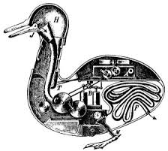
TOOL #1 (Understand the Gist of the world and also see the Big Picture)
REDUCTIONISM and HOLISM

Slide 10
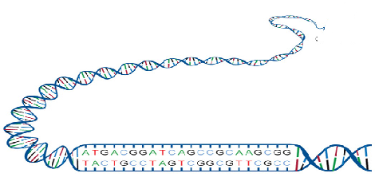
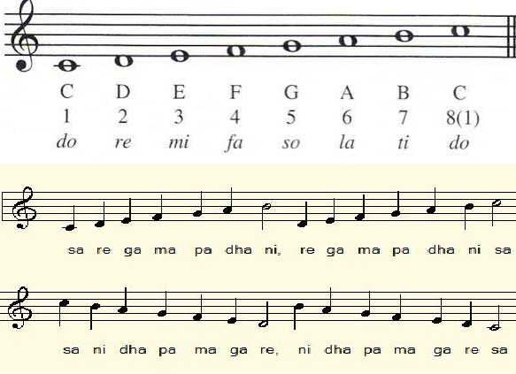
Reductionism in Life & Music
Notes:
Mera joota hai japani yeh patloon englishtani Sar pe laal topi roosi phir bhi dil hai hindustani Mera joota...

Slide 11
What has Regular Expression,SQL Query and Functional Composition has in common?
Notes:
Mera joota hai japani yeh patloon englishtani Sar pe laal topi roosi phir bhi dil hai hindustani Mera joota...

Slide 12
CLOSURE

Slide 13
Closure in RE
Re( NULL) => NULL
Re(“”) => “”
Re([a-z]) => [a-z]
Re.Re => Re
(Re | Re ) => Re
Re* => Re
The above stuff defines Re ( Recursive definition)
What about R+?
Re+ = Re.Re*

Slide 14
Closure in SQL
Data is stored in a data structure called Relation
Relations can be combined using Rel Ops
CartesianProduct(Rel1,Rel2..Reln) => Rel
Restrict(Rel,Predicate) => Rel
Project(Rel,fieldlist) => Rel
Rename(Rel)=> Rel
SetOperators(Rel1..Reln) => Rel
Group(Rel,Pred) => Rel
And so on….

Slide 15
Closure in FP
A = F(G(H(x)))
Functional Composition works because of Closure of Operations

Slide 16
Other instances of Reductionism
Dance Forms
Photo Plotters
LISP interpreter
Digital Gates and Computer Construction
Programming Languages ( SEQuence,Branching,Iteration,Recursion)
Gesture based UX ( A set of primitive Gestures)
The List Goes on
Notes:
Mera joota hai japani yeh patloon englishtani Sar pe laal topi roosi phir bhi dil hai hindustani Mera joota...

Slide 17
Limits of Reductionism
Assumes Sum of Parts is Equivalent to the whole
Cannot Model Emergent Behavior due to the Inter-dependence of parts
Limits of Machine Learning – A case study

Slide 18
Holism
Whole is more than sum of parts
Models Emergent Behavior
Successful in Evolutionary Biology, Social Sciences and Systems Modelling
Software Requirement Analysis
Design of UX
Mental Model of the Users
Considering the User Value System (Culture)

Slide 19
TOOL #2 (Organize your thought with greater Discretion)
Materialism vs Idealism ( Metaphysics)
Empiricism vs Rationalism (Epistemology)
Induction, deduction and abduction (Method of Science and Thinking in General)

Slide 20
TOOL #3 (Understand the Contextual truth )
Dialectics , Logic & Reductio Ad Absurdum

Slide 21
Dialectics vs Logic
Laws of Logic
Law of Identity ( A = A or A <> something else)
Principle of Non Contradiction ( A and not A => false)
Law of Excluded Middle ( Things should be True or False, not in between)
Laws of Dialectics
Process of Change
Reality is modelled as a process of change. What is true can become false in the future
Principle of Contradiction
- Since change is constant , Contradiction being the dynamic underlying change is also constant
Principle of Relationship
- Parts are Meaningful only in the relationship to the whole (context)

Slide 22
Reductio Ad Absurdum
Also known as Proof by Contradiction
Useful when a constructive proof is time consuming and economically not viable
Rather than trying to prove something as correct, we assume what we are trying to prove is correct and find contradictions, if it were true
Successfully used in Mathematics,Arguments and in Courts

Slide 23
TOOL #4 (Think Comprehensively! )
Analysis/Synthesis vs Systems Thinking

Slide 24
Analytical vs Systems Thinking
The Art, Craft and Science of Analysis
Analysis/Synthesis Model of Problem Solving
A Top Decomposition of the Problem into Parts to a granular level , until we have reached a state where we cannot decompose parts further or it has become fine-grained to be amenable for studying it.
A Bottom up process of Synthesis
In Western Philosophy and Science, Rene Descartes is regarded as the father of modern Analysis
Reductionism vs Holism – Analytic Thinking vs System Thinking
Assumption of Independence of Variables and Interdependence of Variables
Additive factors (Linear) vs Non Linear Factors
Systems are Simulated as it cannot be mathematically modelled correctly, if not non-linear

Slide 25
TOOL #5 (What Exists in a world and how entities,relationship,processes can be enumerated and associated computation be done?)
Ontology

Slide 26
Ontology
The Study of What Exists out there
Entities, Relationships, processes, context information are captured
Logic is applied in the context of an Ontology

Slide 27
TOOL #6 (Keep Things Simple to make it easy!)
Occam's Razor

Slide 28
Occam’s Razor
Also called “Law of Parsimony”
Do not Add Entities Unnecessarily
The Idiom behind “Keep it Simple Stupid”
Minimizes Error from Inductive Reasoning

Slide 29
Tool #7 ( More Languages you know, the Better)
SAPIR WHORF HYPOTHESIS

Slide 30
SAPIR WHORF HYPOTHESIS
Also called “Linguistic Determinism”
Formulated by Ed Sapir & Benjamin Whorf
It is not yet a theory (in strict scientific sense)
Statistically significant confirmation is there
Seems to work in the case of Programming languages
Learn Each language which is based on Turing Machine,Lambda Calculus and Predicate Logic

Slide 31

Be a Polyglot!
Notes:
Mera joota hai japani yeh patloon englishtani Sar pe laal topi roosi phir bhi dil hai hindustani Mera joota...

Slide 32
Tool #8 (Pitch Your Idea better)
LOGOS,ETHOS,PATHOS and MYTHOS

Slide 33
LOGOS,ETHOS,PATHOS and MYTHOS
Aristotle's Rhetoric strategies
“MYTHOS” from Dev Dutt Patnaik

Slide 34
Tool #9 (Archetypes as a structuring mechanism for SE )
CARL GUSTAV JUNG’s notion of Archetypes
Business Archetypes by Arlow/Neustadt
“Enterprise Patterns and the MDA” book by Arlow/Neustadt

Slide 35
LOGOS,ETHOS,PATHOS and MYTHOS
Aristotle's Rhetoric strategies
“MYTHOS” from Dev Dutt Patnaik

Slide 36

Tool #10 => Reality is always distorted
Plato’s Cave
Sankara’s Maya

Slide 37
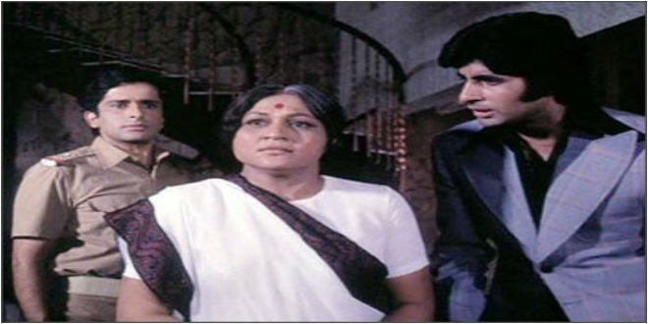
Which Tool is more important? – something which I did not mention here
Aaj mere paas building(C++) hai, property(C#) hai ,
bank balance (Java) hai, bungla(Python) hai,gaadi hai(Ruby)
Kya hai, Kya hai tumhare paas?
....Mere Paas Maa (JavaScript) hai

Slide 38
Philosophy in My Professional Life (Software Engineering)
Reductionism as a Tool for Learning Vast Amount of Subjects
Regular Expressions, SQL Query, Functional Programming are variants of Closure (Reductionism)
Design of Primitives while writing Software Engines
Turing Machine , Lambda Calculus and Predicate Logic as foundations for Paradigms
KISS Principle is a solution for “Problem of Induction”
Party Idiom in Entity Management (Customer, Vendor, Government body, NGOs)
Define a Core, Rest should be Deduction from the Core
Functional Core of a Functional Programming language
Philosophical Ontology
Ontology is study of what exists out there. Useful for defining Vocabulary for Systems and Implementation of Domain Specific Languages
Wrote a Paper titled, “An Ontology and Its Realization on Mobile Devices – a HealthCare Case Study)
Software Design and Enterprise Ontology
Entity Archetypes as a structuring mechanism ( Arlow/Nuestadt)
Holism for Designing UX
Limitations of Analytics ( Analytic Reduction vs Systems Thinking)

Slide 39
Q&A
Any Questions ?

Slide 40
Appendix

Slide 41
Nyaya Philosophy
Analysis of Logic and Epistemology
Detailed work on Anumana (“Inference”)
Right knowledge for “Liberation” ( from suffering)
perception (pratyaksha), inference (anumana), comparison (upamana), and sound/testimony (shabda) are source of valid knowledge
Invalid knowledge involves memory, doubt, error, and hypothetical argument.
Algined with Vaisesika (Merged with it)
Cause as an invariable and un-conditional precedence for effect. ( an effect does not pre-exist in it’s cause)
Three kinds of causes
Material (Inherent) cause - The substance out of which an effect is produced
Non-Inherent cause - helps in the production of a cause,
Efficient cause - the power that helps the material cause produce the effect
God is not the material cause of the universe.

Slide 42
Samkhya System
A Dualistic Philosophy – Matter (Prakriti) and Eternal Spirit (Purusha)
Right knowledge comes from separation of Purusha and Prakriti
Four higher level functions of Purusha are
Buddhi (“consciousness”)
Ahamkara(“I-consciousness”)
Manas (“Mind”)
Prana (“Breath”)
Infinite Purusha and Prakriti is enough (No God). Prakriti springs to action when Purusha gets connected to it.
Purusha impinges on Prakriti to form Consciousness (Budhi) and next to evolve is Ahamkara, which deludes Purusha to think, Ego is the center of its Objective Existence.
Ahmkara can be divided into
Five Gross Elements (Water, Air, Space, Earth , Fire) - Tanmatra
Five Fine Elements (Touch, Sound , Sight, Taste, Smell) - Mahabuthas
Five Organs of Perception ( Skin,Ear,Eyes, Tongue, Nose) - Janendriya
Five Organs of Activity (Speak, Grasp, Move, Procreate,Evacuate) - Karmendriyas
Mind ( Controller of Senses)
Three Primal Qualities of Matter (Gunas) make up prakirti
Tamas (Obscurity, Ignorance,Inertia) – Darkness (InAction)
Rajas ( Activity, Passion, Intensivity) - passion (Action – but, fails often)
Satvik ( , Purity, Dispassion, Light ) – Goodness (Equanimity)

Slide 43
Carvaka System (Materialist)
Also called Lokayata (Earthly Philosophy)
Rejects Vedas, Karma, Moksha , Immortality of Self
Direct Perception as Source of Knowledge ( Anubhava or Experience). Rejects Anumana, Upamana and Shabd as source of knowledge
Everything in this world is some kind of Accident ( Akasmika Vada or Accidentalism)
A Materialist School of Thought
Make merry in this world. Tomorrow, Does it Exist?
Some Believe, Kautilya’s Arthasastra could be written in a Carvaka context

