Slide 1
Data Oriented Programming using Modern C#
Praseed Pai K.T. (praseedp@gmail.com)
Author of “.NET Design Patterns” (Packt Publishing,2018)
Author of “C++ Reactive Programming”(Packt Publishing, 2018)
Author of SLANG Compiler Infrastructure

Slide 2
Four Principles of Data Oriented Programming
Principle #1: Separate Code from Data
Principle #2: Represent Data with Generic Data Structures
Principle #3: Data is Immutable
Principle #4: Separate Data Schema from Data Representation

Slide 3
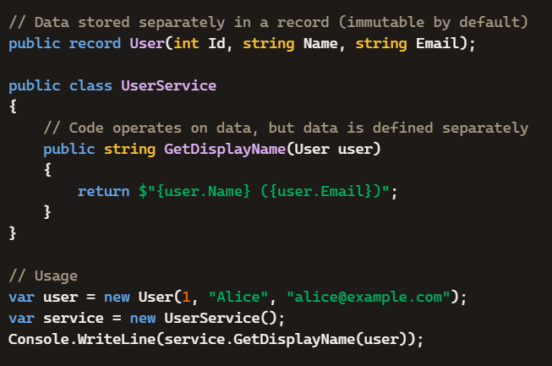
Principle #1: Separate Code from Data (First\Program.cs)

Slide 4
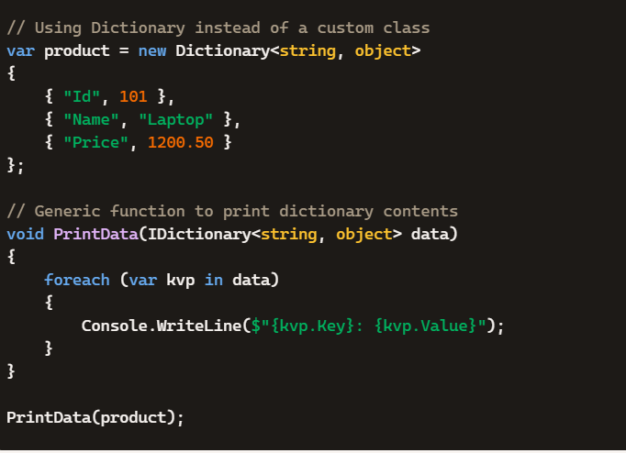
Principle #2: Represent Data with Generic Data Structures (First\Program.cs)

Slide 5
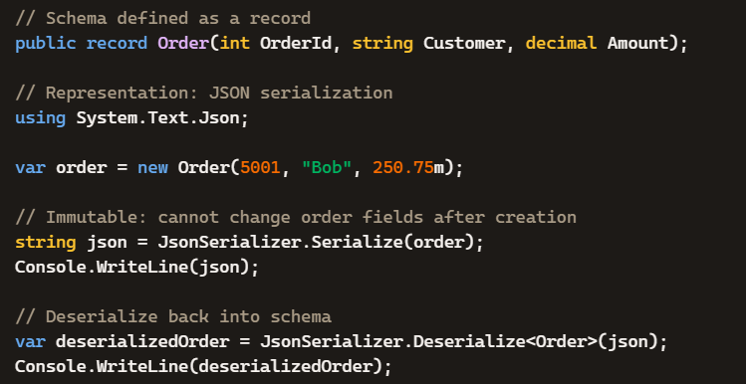
Principle #3: Data is Immutable (First\Program.cs)

Slide 6
Principle #4: Separate Data Schema from Data Representation (First\Program.cs)

Slide 7
Three Pillars of OOP and Four types of Polymorphism
Encapsulation
Abstraction
Polymorphism
  Polymorphism through Inheritance (extension and implementation)
  Parametric Polymorphism ( Generics classes/methods/lambdas)
  Ad hoc Polymorphism with method overloading
  Ad hoc Polymorphism with Algebraic Data Types

Slide 8
Algebraic Data Types (Some theory!)
Product Types ( aka Records )
Sum Types ( aka Union types )
Exponential Types ( aka Function Types )
Ad-hoc Polymorphism using Sum , Product & Exponential Types
Switch Expressions
Pattern Matching

Slide 9
Sum Types
Represent a value that can be one of several types.
Common in functional languages like F#, Rust, and Haskell.
In C# 10, you emulate this using abstract records and pattern matching.
public abstract record Expr;
public record Constant(double Value) : Expr;
public record Add(Expr Left, Expr Right) : Expr;
Evaluated using switch expressions and type patterns.

Slide 10
Product Types
Represent a value that combines multiple fields.
like a tuple or struct — each instance holds multiple values.
public record Person(string Name, int Age);

Slide 11
Exponential Types (aka Function Types )
Represent a mapping from one type to another: A → B.
In category theory, this is analogous to exponentiation: B^A.
In C#, this is expressed via delegates or lambdas:
Func<int, string> describe = age => $"Age: {age}";

Slide 12
How these are combined together?
C# 14 brings these concepts closer to functional programming:
Sum types via abstract records + pattern matching
Product types via concise record syntax
Exponential types via lambdas, delegates, and Func<>
Switch expressions unify control flow with pattern matching

Slide 13
Goodbye Composite/Visitor
Algebraic data types help you to model Types
Processing is done through Recursive function, Functional switch
No complicated manouever like Double Dispatch etc
Enables Adhoc polymorphism

Slide 14
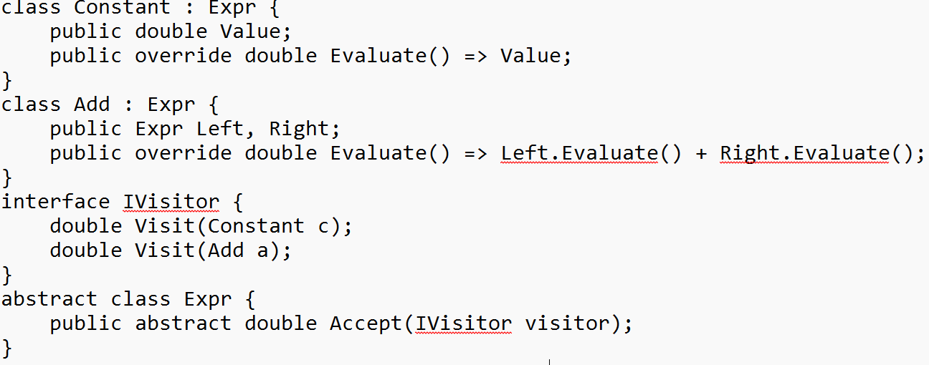
Composite/Visitor version of Evaluator

Slide 15
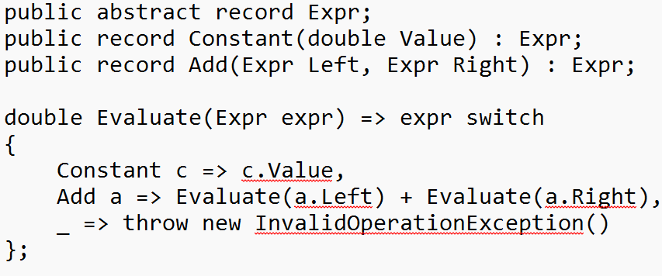
Algebraic data type version of Evaluator

Slide 16
Examples of ADT and DOP
Expression Evaluator
Shape Hierarchy
Org Hierarchy
Tree Data Structure

Slide 17
Example One
Expression Evaluator using Composite
  ExprComposite\Program.cs
Expression Evaluator using Visitor
  ExpressionVisitor\Program.cs
Expression Evaluator using ADT
  Expr\Program.cs

Slide 18
Example Two
Shapes Hierarchy using Composite/Visitor
  ShapeVisitor\*.* (Code)
Shapes Hierarchy using ADT
  ShapeADT\*.* (Code)

Slide 19
Example Three
Org Hierarchy using Composite
  OrgComposite\Program.cs
Org Hierarchy using Visitor
  OrgVisitor\Program.cs
Org Hierarchy using ADT
  OrgADT\Program.cs

Slide 20
Example Four
Tree using ADT
  Tree\Program.cs

Slide 21
Questions?
If any!

